Slide 1
NODE EXE
V8 Engine
Node JS API’s
Application
(JavaScript + other API’s)
NATIVE CODE

Slide 2
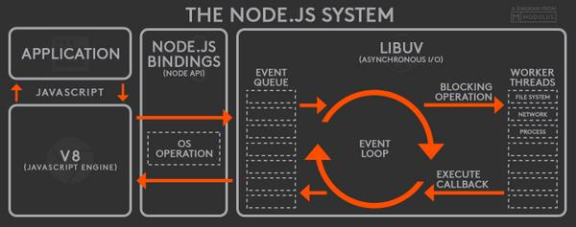

Slide 3
NODE SERVER
BROWSER
HTTP + URL
EXPRESS JS
Web App
HTML + CSS + JS
MONGO DB
HTTP + URL
ID
1
PARTIAL HTML
<table>
<thead>
<tr>
<th>ID</th>
</tr>
</thead>
<tbody>
<tr>
<td>1</td>
</tr>
</tbody>
</table>

Slide 4
NODE SERVER
EXPRESS JS
Web App
BROWSER
HTTP + URL
HTML + CSS + JS
MONGO DB
HTTP + URL
ID
1
EXPRESS JS
Web API
JSON
{“id”:1}
JSON to HTML Convert.
<table>
<thead>
<tr>
<th>ID</th>
</tr>
</thead>
<tbody>
<tr>
<td>1</td>
</tr>
</tbody>
</table>
Vanilla JS
jQuery
Backbone, Knockout
Angular, React, Vue

Slide 5
require(Path)
Module Loader will search for a file on the path specified
Y
N
Load and cache the file on the memory
Module Loader will search for a folder on the path specified
Y
N
Search inside folder, file with the name ‘package.json’
Error Loading Module
Y
N
N
In ‘package.json’, read ‘main’ key
Search inside folder, file with the name ‘index.js’
N
Y
Y
Search file mentioned in ‘main’
N
Load and cache the file on the memory
Y
Load and cache the file on the memory
NODE JS Module Resolution

Slide 6
ReadStream
HTTP responses, on the client
HTTP requests, on the server
fs read streams
zlib streams
crypto streams
TCP sockets
child process stdout and stderr
process.stdin

Slide 7
WriteStream
HTTP requests, on the client
HTTP responses, on the server
fs write streams
zlib streams
crypto streams
TCP sockets
child process stdin
process.stdout, process.stderr

Slide 8
N
Module Loader will search inside node_modules folder of your application
N
require(ModuleName)
Module Loader will search in built in modules
Y
Y
Module Loader will search for a file inside node_modules
Error Loading Module
Load the module on the memory
Y
N
Load and cache the file on the memory
Module Loader will search for a folder inside node_modules
Y
N
Search inside folder, file with the name ‘package.json’
Error Loading Module
Y
N
N
In ‘package.json’, read ‘main’ key
Search inside folder, file with the name ‘index.js’
N
Y
Y
Search file mentioned in ‘main’
N
Load and cache the file on the memory
Y
NODE JS Module Resolution
Load and cache the file on the memory

Slide 9
BankAccount Class
withdraw(amount)
deposit(amount)
Create BankAccount class with withdraw, deposit and other methods if needed.
Withdraw should show error if amount is greater than balance in account
Show message after withdraw and deposit call, showing current balance
Send a SMS after withdraw or deposit is called
Send an Email after withdraw or deposit is called
Follow SOLID principal’s of writing code
SMS Class
send(msg)
EMAIL Class
send(msg)
WhatsApp Class
send(msg)

Slide 10
Multithreaded Network App
request ──> spawn thread
└──> wait for file request
└──> answer request
request ──> spawn thread
└──> wait for file request
└──> answer request
request ──> spawn thread
└──> wait for file request
└──> answer request
The thread spend most of their time using 0% CPU waiting for the file to return data.

Slide 11
Node event loop
request ──> make file request
request ──> make file request
request ──> make file request
file request complete ──> send response
file request complete ──> send response
file request complete ──> send response

Slide 12
DAL
1. REQUEST
2
3
M1
M2
M3
ROUTER
6 . HTML
4
5
VIEWS

Slide 13
DAL
3
1. REQUEST
4
M1
M2
M3
ROUTER
2
CONTROLLER
7
8 . HTML
5
6
VIEWS

