Slide 1
BROWSER
SERVER
HTTP + URL
NAVIGATION
HTML PAGES
CSS
HTML + CSS
HTTP + URL
HTML + CSS
Page
Reload!

Slide 2
BROWSER
SERVER
HTTP + URL
NAVIGATION
Server PAGES
CSS
HTML + CSS + JS
AJAX - HTTP + URL
JS
Partial
Page
Reload!
PARTIAL HTML
<table>
<thead>
<tr>
<th>ID</th>
</tr>
</thead>
<tbody>
<tr>
<td>1</td>
</tr>
</tbody>
</table>
ASP
ASP .Net
JSP
PHP
Ruby
ASP .Net MVC
Spring MVC
Ruby On Rails
DB

Slide 3
SERVER
Single Page Application (SPA)
SERVER PAGES
CSS
BROWSER
HTTP + URL
NAVIGATION
JS
HTML + CSS + JS
(Angular FW & Application)
ASP
ASP .Net
JSP
PHP
Ruby
ASP .Net MVC
Spring MVC
Ruby On Rails
<table>
<thead>
<tr>
<th>ID</th>
</tr>
</thead>
<tbody>
<tr>
<td>1</td>
</tr>
</tbody>
</table>
SERVER
AJAX - HTTP + URL
RESTful API
ASP .Net Web API
JWS
Express JS
Python
DB
JSON to HTML on Client Side
JSON
{
“id”:1
}
Vanilla JS, jQuery, KO, BB, ng1,
Ng2 and Above, React JS, Vue JS

Slide 4
SERVER
Single Page Application (SPA)
SERVER PAGES
CSS
BROWSER
HTTP + URL
NAVIGATION
JS
HTML + CSS + JS
(Angular FW & Application)
ASP
ASP .Net
JSP
PHP
Ruby
ASP .Net MVC
Spring MVC
Ruby On Rails
<table>
<thead>
<tr>
<th>ID</th>
</tr>
</thead>
<tbody>
<tr>
<td>1</td>
</tr>
</tbody>
</table>
Account
Service
AJAX - HTTP + URL
API GATEWAY
JSON
{
“id”:1
}
Inventory
Service
JSON to HTML on Client Side
Vanilla JS, jQuery, KO, BB, ng1,
Ng2 and Above, React JS, Vue JS
Shipping
Service

Slide 5
JavaScript Full Stack Application
 | Database | Application FW API FW | Client Side | Runtime
MEAN | MongoDB | Express JS | Angular | Node
MERN | MongoDB | Express JS | React JS | Node
MEVN | MongoDB | Express JS | Vue JS | Node

Slide 6
Library vs Framework
Library | Framework
Collection of API’s, targeted to do one specific task. | Collection of API’s, targeted for application creation. FW is a piece of code that dictates the architecture of your project.
You are in full control when you call a method from a library and the control is then returned. | The code never calls into a FW, instead the FW uses you code. We can only follow a FW.
It can be integrated seamlessly into an existing project. | FW cannot be integrated, we have to re-write the code.
jQuery – DOM Manipulation & Ajax Moment JS – Date and Time D3 JS – Data Visualization | Angular

Slide 7
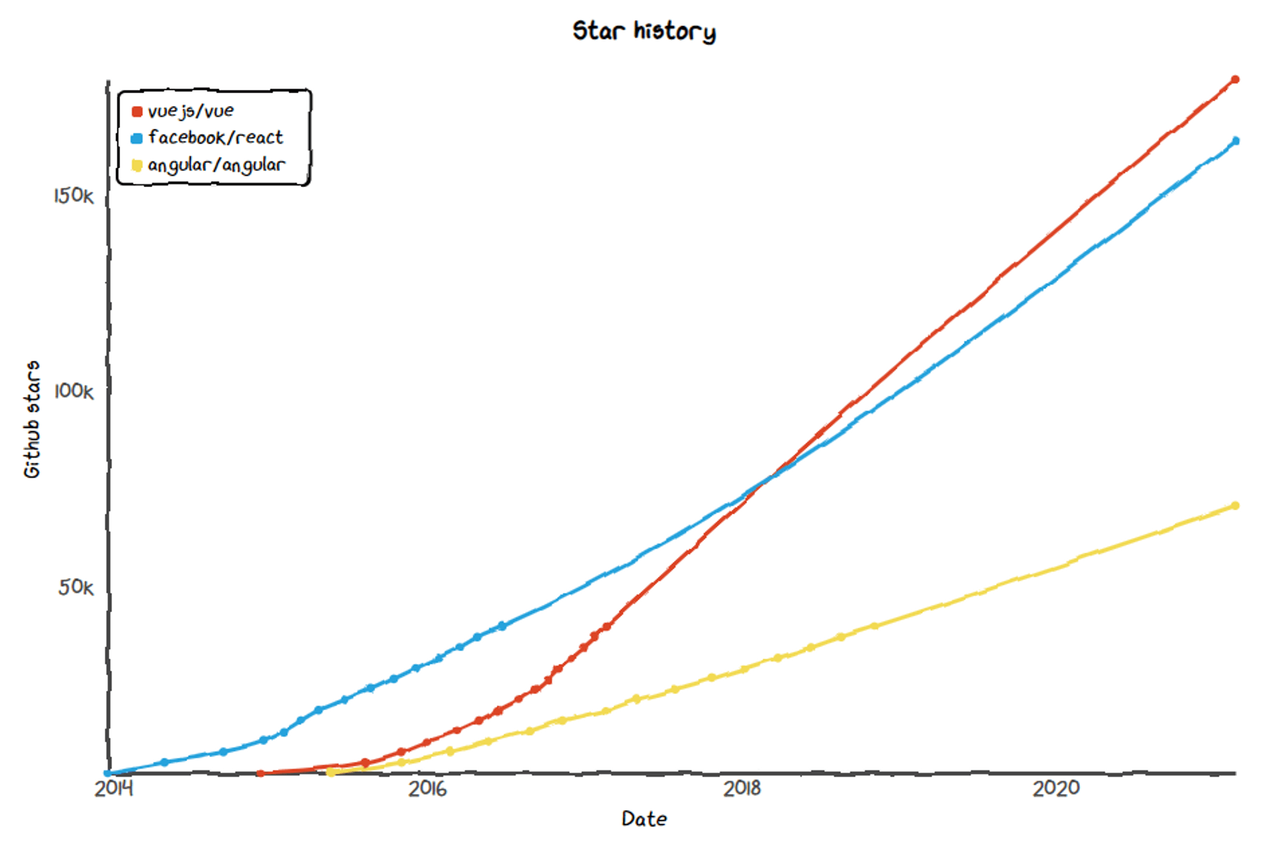

Slide 8
Manual Configuration
Node JS
Webpack
TypeScript Config.
Test Config.
Jasmine
Karma
Protractor
TypeScript (s)
.ts
TSC
Webpack
Dev Server
Webpack
CLI
JavaScript Files
.js (ES5 & ES2015)
Auto Configuration
Angular CLI
Bundle
BROWSER
WEBPACK
JavaScript
.js
HTTP Server
HTML Page
Deploy
Inject Bundles

Slide 9
Installation
Latest Version of Node JS (LTS) - https://nodejs.org/en/
npm install -g @angular/cli@11 (Only Once)
Latest version of Visual Studio Code - https://code.visualstudio.com/
Visual Studio Code Extensions
AutoFileName
vscode-icons
Angular Snippets
Angular Language Service
IntelliSense for CSS class names in HTML
CSS Formatter
Install Chrome Extension
Angular DevTools – Offered by Angular Team

Slide 10
Creating an Angular Application
Single and Separate Application (Workspace)
ng new app-name
Multiple Projects in Single Workspace
ng new multi-apps --createApplication="false"
cd multi-apps
ng generate application app1
ng generate application app2

Slide 11
Angular Packages
@angular/core: Critical runtime parts of the framework needed by every application. Includes all metadata decorators, Component, Directive, dependency injection, and the component lifecycle hooks.
@angular/common: The commonly needed services, pipes, and directives provided by the Angular team.
@angular/compiler: Angular Template Compiler. It understands templates and can convert them to code that makes the application run and render. Typically, you don’t interact with the compiler directly; rather, you use it indirectly via platform-browser-dynamic when JIT compiling in the browser.
@angular/platform-browser: Everything DOM and browser related, especially the pieces that help render into the DOM. This package also includes the bootstrapModuleFactory() method for bootstrapping applications for production builds that pre-compile with AOT.
@angular/platform-browser-dynamic: Includes Providers and methods to compile and run the app on the client using the JIT compiler.
@angular/forms: Support for both template-driven and reactive forms.
@angular/http: Angular old, deprecated, HTTP client.
@angular/animations: Angular animations library makes it easy to define and apply animation effects such as page and list transitions. Read about it in the Animations guide.
@angular/router: The router module navigates among your app pages when the browser URL changes.
@angular/upgrade: Set of utilities for upgrading Angular applications to new Angular Version.

Slide 12
ng generate
Generates and/or modifies files based on a schematic.
ng generate <schematic> [options]
ng g <schematic> [options]
Schematic
app-shell | directive | interface | resolver
application | enum | library | service
class | guard | module | service-worker
component | interceptor | pipe | web-worker

Slide 13
Zone.js (NgZone)
Rxjs, Angular Packages
Runtime
MODULE
COMPONENT

Slide 14
0
+
-
0
+
-
DOM HANDLING LOGIC
DOM HANDLING LOGIC
{
count: 0,
next: function() {
this.count+=1;
},
prev: function() {
this.count-=1;
}
}
{
count: 0,
next: function() {
this.count+=1;
},
prev: function() {
this.count-=1;
}
}
<counter />
<counter />

Slide 15
Angular applications are modular and Angular has its own modularity system called NgModules.
NgModules are containers for a cohesive block of code dedicated to an application domain, a workflow, or a closely related set of capabilities.
They can contain components, service providers, and other code files whose scope is defined by the containing NgModule.
They can import functionality that is exported from other NgModules, and export selected functionality for use by other NgModules.

Slide 16
<counter interval=“10” />
MODULE
COMPONENT
VIEW (UI)
STYLE (Inline, Inside, CSS)
DATA
State (Inside)
Properties (Outside)
BEHAVIOR (Methods)

Slide 17
Composite UI
NAV COMPONENT + CSS
SIDE NAV COMPONENT
+ CSS
LIST COMPONENT
+ CSS
DETAILS COMPONENT
+ CSS
STATUS COMPONENT + CSS

Slide 18
Commands
ng g c components/root -s --skipTests=true
ng g m mone
ng g c mone/components/cone -t -s --skipTests=true
ng g m mtwo
ng g c mtwo /components/ctwo -t -s --skipTests=true

Slide 19
In Angular, component CSS styles are encapsulated into the component's view and don't affect the rest of the application.
Angular comes with view encapsulation built in, which enables us to use Shadow DOM or even emulate it.
What is Shadow DOM?
Shadow DOM is part of the Web Components standard and enables DOM tree and style encapsulation.
It basically means that Shadow DOM allows us to hide DOM logic behind other elements.
It enables us to apply scoped styles to elements without them bleeding out to the outer world.

Slide 20
Data Binding
SOURCE
Component Class
Data Members
Properties
TARGET
Component Template
Element Properties
Element Attributes
Interpolation {{dName}}
One Way Binding
Property and Attribute Binding
[propertyName] or [attr.AttributeName]
One Way To Source Binding
Event Binding
(eventName)
Two Way
[(ngModel)]

Slide 21
Zone
Application state change can be caused by:
Events – User events click, change, input, submit
XMLHttpRequests – When fetching data from a remote service
Timers – setTimeout(), setInterval()
Angular takes advantage of Zones (NgZone)
Zones monkey-patches global asynchronous operations such as setTimeout() and addEventListener(), which is why Angular can easily find out, when to update the DOM.

Slide 22
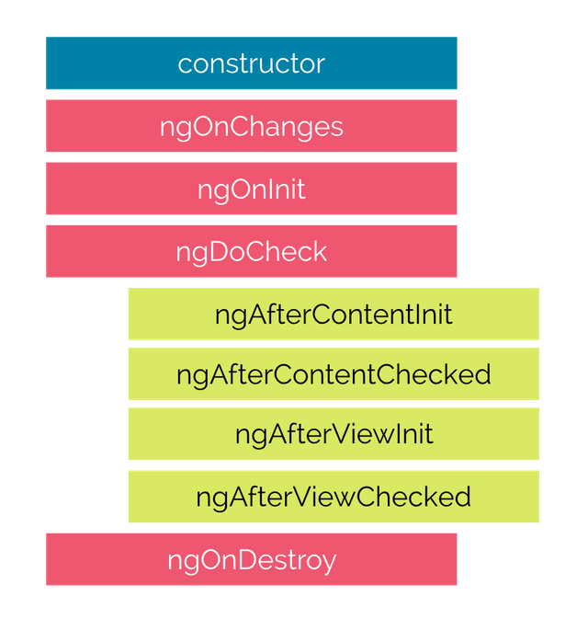
Life Cycle Hooks

Slide 23

Hooks for the Component
constructor : This is invoked when Angular creates a component or directive by calling new on the class.
ngOnChanges : Invoked every time there is a change in one of the input properties of the component.
ngOnInit : Invoked when given component has been initialized. This hook is only called once after the first ngOnChanges
ngDoCheck : Invoked when the change detector of the given component is invoked. It allows us to implement our own change detection algorithm for the given component.
ngAfterContentInit : Invoked after Angular performs any content projection into the component’s
ngAfterContentChecked : Invoked each time the content of the given component has been checked by the change detection mechanism of Angular.
ngAfterViewInit : Invoked when the component’s view has been fully initialized.
ngAfterViewChecked : Invoked each time the view of the given component has been checked by the change detection mechanism of Angular
ngOnDestroy : This method will be invoked just before Angular destroys the component. Use this hook to unsubscribe observables and detach event handlers to avoid memory leaks.

Slide 24
Directives
Directives are classes that add additional behavior to elements in your Angular applications.
The different types of Angular directives are as follows:
Components—directives with a template. This type of directive is the most common directive type.
Attribute directives—directives that change the appearance or behavior of an element, component, or another directive. E.g., NgClass, NgStyle, NgModel
Structural directives—directives that change the DOM layout by adding and removing DOM elements. E.g., NgIf, NgFor, NgSwitch

Slide 25
Parent Child Communication
Parent
Parent
@Output()
Event Emitter
@Input()
Property
@Input()
Property
@Output()
Event Emitter
Child
Child One
Child Two

Slide 26
Pipes
Angular provides built-in pipes for typical data transformations, including transformations for internationalization (i18n), which use locale information to format data.
The following are commonly used built-in pipes for data formatting:
DatePipe: Formats a date value according to locale rules.
UpperCasePipe: Transforms text to all upper case.
LowerCasePipe: Transforms text to all lower case.
CurrencyPipe: Transforms a number to a currency string, formatted according to locale rules.
DecimalPipe: Transforms a number into a string with a decimal point, formatted according to locale rules.
PercentPipe: Transforms a number to a percentage string, formatted according to locale rules.

Slide 27
Forms
Reactive forms provide direct, explicit access to the underlying forms object model. Compared to template-driven forms, they are more robust: they're more scalable, reusable, and testable. If forms are a key part of your application, or you're already using reactive patterns for building your application, use reactive forms.
Template-driven forms rely on directives in the template to create and manipulate the underlying object model. They are useful for adding a simple form to an app, such as an email list signup form. They're easy to add to an app, but they don't scale as well as reactive forms. If you have very basic form requirements and logic that can be managed solely in the template, template-driven forms could be a good fit.

Slide 28
Key Differences
 | REACTIVE | TEMPLATE-DRIVEN
Setup of form model | Explicit, created in component class | Implicit, created by directives
Data model | Structured and immutable | Unstructured and mutable
Predictability | Synchronous | Asynchronous
Form validation | Functions | Directives

Slide 29
Built in Validators
min
max
required
requiredTrue
email
minLength
maxLength
pattern
nullValidator
compose
composeAsync

Slide 30
Promise Vs Observable
Promise | Observables
Emit Single Value | Emit Multiple Values, over a period of time (Stream of Data)
Not Lazy | Lazy, observables will not execute unless we subscribe to it
Cannot be cancelled | Can be cancelled by using unsubscribe
Does not provide any operators | Observables provide a lot of built in operators i.e. map, forEach, filter, reduce, retry

Slide 31
Services
Components shouldn't fetch or save data directly and they certainly shouldn't knowingly present fake data.
They should focus on presenting data and delegate data access to a service.
Instead of creating the service with the new keyword, you'll rely on Angular dependency injection to inject it into the Component’s constructor.
Services are a great way to share information among classes that don't know each other.

Slide 32
@Injectable Services
A service imports the Angular Injectable symbol and annotates the class with the @Injectable() decorator.
This marks the class as one that participates in the dependency injection system.
The @Injectable() decorator accepts a metadata object for the service
providedIn - Determines which injectors will provide the injectable, by either associating it with an @NgModule or other InjectorType
root' : The application-level injector in most apps.
'platform' : A special singleton platform injector shared by all applications on the page.
'any' : Provides a unique instance in each lazy loaded module while all eagerly loaded modules share one instance.

Slide 33
Dependency injection (DI)
DI is wired into the Angular framework and used everywhere to provide new components with the services or other things they need.
Components consume services; that is, you can inject a service into a component, giving the component access to that service class.
The injector is the main mechanism. Angular creates an application-wide injector for you during the bootstrap process, and additional injectors as needed. You don't have to create injectors.
An injector creates dependencies and maintains a container of dependency instances that it reuses if possible.
A provider is an object that tells an injector how to obtain or create a dependency.
For any dependency that you need in your app, you must register a provider with the application's injector, so that the injector can use the provider to create new instances.

Slide 34
Find the provider for the service to be injected in the component itself
If provider is available , it will take the instance from it.
If provider is not available , it will search the provider in the parent.
If provider is available , it will take the instance from it.
If provider is not available on the parent, it will search the provider in the module.
If provider is available , it will take the instance from it.
If provider is not available , it will throw error.
Root
Injector will inject the dependency, taking the dependency instance from the provider
Author List
Author Quote

Slide 35
Assignment
Create a component which can show Navigation Bar in your application, use bootstrap classes to make it responsive.
Create a clock component with current time (hh:mm:ss), to be used across your application

Slide 36
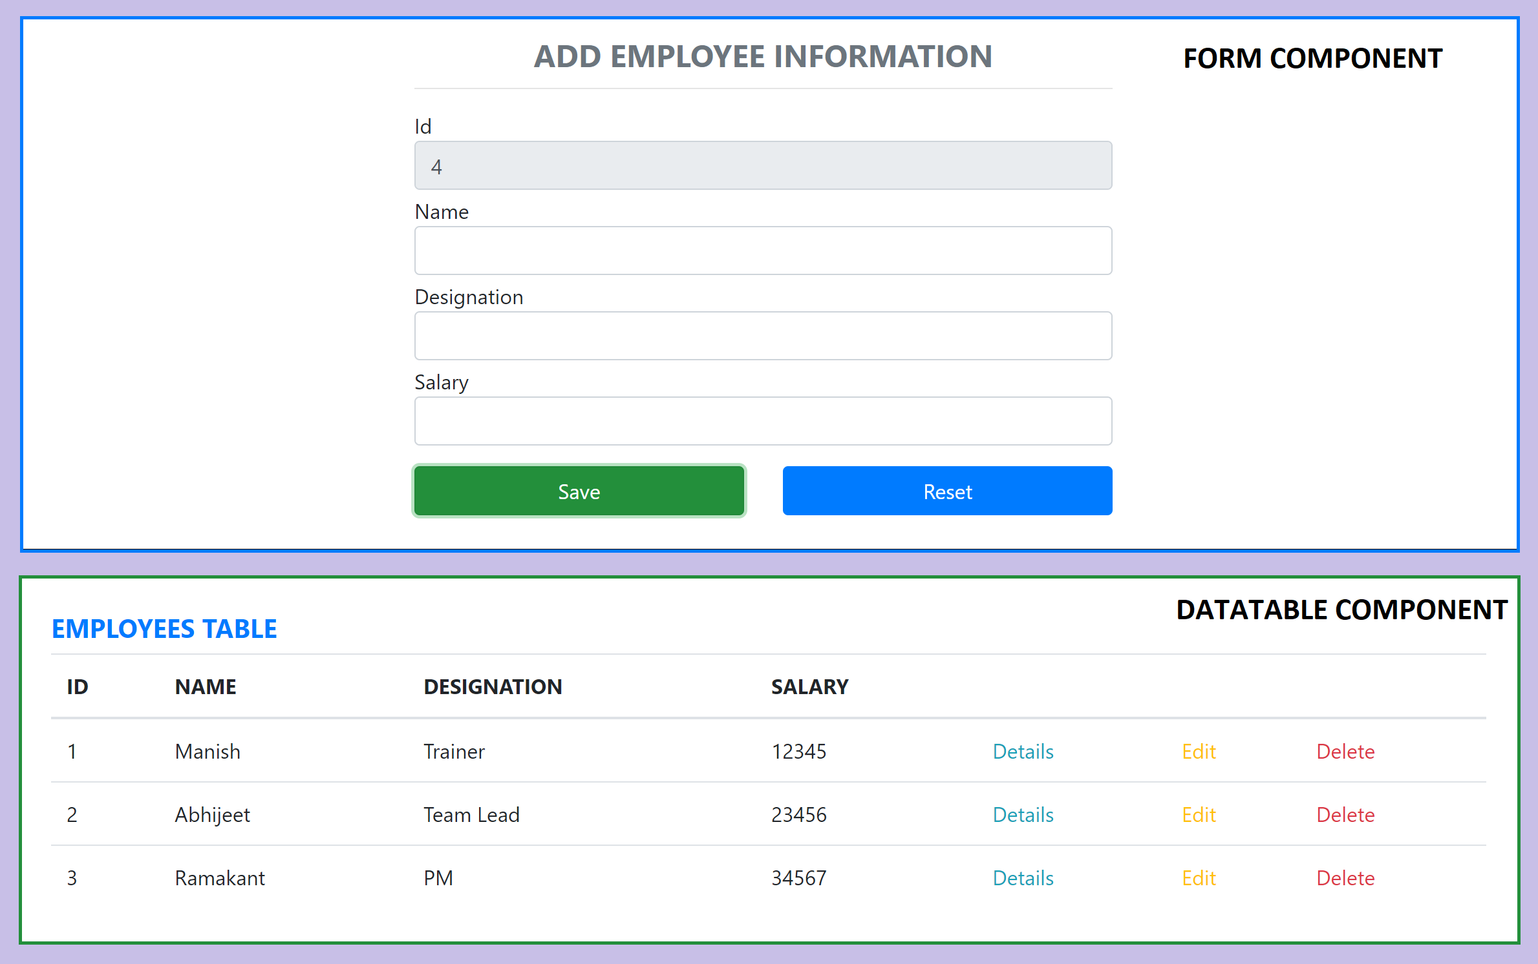
Assignment

Slide 37
Angular Route Guards
CanActivate
Checks to see if a user can visit a route.
CanActivateChild
Checks to see if a user can visit a routes children.
CanDeactivate
Checks to see if a user can exit a route.
CanLoad
Checks to see if a user can route to a module that is lazy loaded.
Resolve
Persforms route data retrieval before route activation.

Slide 38
Secure Application using Route Guards
When user clicks the Admin Link, we need to verify that we have a token in session storage, and if the token in not there in the session storage, redirect the request to login component. (CanActivateAdminGuard)
CanActivateAdminGuard uses Authenticator Service, getToken() to get the token.
If token is undefined, the request is redirected to Login Component
If token is available, the request is allowed for Admin Component.
Logging and Token Management (Authenticator Service)
On Login Component, user must give username and password, which will be sent to Node API Server
If the username & password is correct, in the response token will come from the Server
Received token will be stored in the session storage of the browser.
Reading and Attaching Token (TokenInterceptor Service)
Whenever the AJAX request is made for api, tokenInterceptor, intercepts and attaches token in the request header.
It uses authenticator service to read the token from session storage.

Slide 39
NODE SERVER
EXPRESS JS
Web API
AJAX – account/getToken + U&P
BROWSER
(Stores the Token in Session Storage)
JSON with Token
AJAX – api/users + Read and attach Token
MONGO DB
JSON

Slide 40
Angular Animations
Animation provides the illusion of motion: HTML elements change styling over time.
Well-designed animations can make your application more fun and easier to use.
Animations can improve your application and user experience in several ways:
Without animations, web page transitions can seem abrupt and jarring.
Motion greatly enhances the user experience, so animations give users a chance to detect the application's response to their actions.
Good animations intuitively call the user's attention to where it is needed.
An HTML element can move, change color, grow or shrink, fade, or slide off the page.
These changes can occur simultaneously or sequentially.
You can control the timing of each transformation.

Slide 41
Angular Animations
Angular's animation system is built on CSS functionality
You can animate any property that the browser considers animatable.
This includes positions, sizes, transforms, colors, borders, and more.
To Enable Animations:
Import BrowserAnimationsModule, which introduces the animation capabilities into your Angular root application module.
Importing animation functions
Add the animation metadata property to the Component
Apply animation using HostBinding or Use it on specific area using @

Slide 42
Animation Methods
The following list shows some of the methods used to build Angular animations.
The trigger(...) method encapsulates a single element of animation inside the animations array.
The state(...) method declares an animation state within a trigger attached to an element.
style(…) method declares a key/value object containing CSS properties/styles that can then be used for an animation state, within an animation sequence, or as styling data for calls to animate() and keyframes().
animate(…) method produces a reusable animation that can be invoked in another animation or sequence
transition(…) method declares an animation transition as a sequence of animation steps to run when a given condition is satisfied.

Slide 43
Contact Me
Manish Sharma | Gmail
Manish Sharma | WhatsApp
Manish Sharma | Facebook
Manish Sharma | LinkedIn

