Slide 1
BROWSER
SERVER
HTTP + URL
NAVIGATION
HTML PAGES
CSS
HTML + CSS
HTTP + URL
HTML + CSS

Slide 2
BROWSER
SERVER
HTTP + URL
NAVIGATION
Server PAGES
CSS
HTML + CSS + JS
AJAX - HTTP + URL
JS
PARTIAL HTML
<table>
<thead>
<tr>
<th>ID</th>
</tr>
</thead>
<tbody>
<tr>
<td>1</td>
</tr>
</tbody>
</table>
ASP
ASP .Net
JSP
PHP
Ruby
Express JS
ASP .Net MVC
Spring MVC
Ruby On Rails
Laravel
DB

Slide 3
SPA – Single Page Application
SERVER
SERVER PAGES
CSS
BROWSER
HTTP + URL
NAVIGATION
JS
HTML + CSS + JS
(Client Side Code)
ASP
ASP .Net
JSP
PHP
Ruby
ASP .Net MVC
Spring MVC
Ruby On Rails
Express JS
Sails JS
<table>
<thead>
<tr>
<th>ID</th>
</tr>
</thead>
<tbody>
<tr>
<td>1</td>
</tr>
</tbody>
</table>
SERVER
AJAX - HTTP + URL
RESTful API
ASP .Net Web API
JWS
Express JS
Loopback
Python
DB
JSON to HTML on Client Side
JSON
{
“id”:1
}
Vanilla JS, jQuery, KO, BB, Angular 1
Angular 2 and above, React JS, Vue JS

Slide 4

FullStack Application
 | Database | Application FW | API FW | Client Side | Hosting
MEAN | MongoDB | Express JS | Express JS | Angular | Node
MERN | MongoDB | Express JS | Express JS | React JS | Node
MEVN | MongoDB | Express JS | Express JS | Vue JS | Node

Slide 5
NODE EXE (NODE PROCESS)
V8 Engine
Node JS API’s
Application
(JavaScript)
NATIVE CODE
O. S.

Slide 6
require(Path)
Module Loader will search for a file on the path specified
Y
N
Load and cache the file on the memory
Module Loader will search for a folder on the path specified
Y
N
Search inside folder, file with the name ‘package.json’
Error Loading Module
Y
N
N
In ‘package.json’, read ‘main’ key
Search inside folder, file with the name ‘index.js’
N
Y
Y
Search file mentioned in ‘main’
N
Load and cache the file on the memory
Y
Load and cache the file on the memory
NODE JS Module Resolution

Slide 7
Built In Modules
Module | Description
assert | Provides a set of assertion tests
buffer | To handle binary data
child_process | To run a child process
cluster | To split a single Node process into multiple processes
crypto | To handle OpenSSL cryptographic functions
dgram | Provides implementation of UDP datagram sockets
dns | To do DNS lookups and name resolution functions
events | To handle events
fs | To handle the file system
http | To make Node.js act as an HTTP server
https | To make Node.js act as an HTTPS server.

Slide 8
Built In Modules Continued
Module | Description
net | To create servers and clients
os | Provides information about the operation system
path | To handle file paths
querystring | To handle URL query strings
readline | To handle readable streams one line at the time
stream | To handle streaming data
string_decoder | To decode buffer objects into strings
timers | To execute a function after a given number of milliseconds
tls | To implement TLS and SSL protocols
tty | Provides classes used by a text terminal
url | To parse URL strings

Slide 9
Built In Modules Continued
Module | Description
util | To access utility functions
v8 | To access information about V8 (the JavaScript engine)
vm | To compile JavaScript code in a virtual machine
zlib | To compress or decompress files

Slide 10
util To access utility functions
v8 To access information about V8 (the JavaScript engine)
vm To compile JavaScript code in a virtual machine
zlib To compress or decompress files

Slide 11
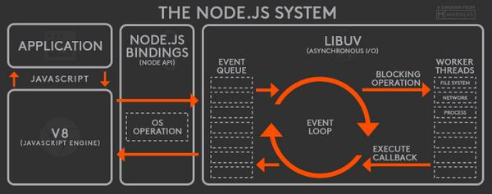

Slide 12
ReadStream
HTTP responses, on the client
HTTP requests, on the server
fs read streams
zlib streams
crypto streams
TCP sockets
child process stdout and stderr
process.stdin

Slide 13
WriteStream
HTTP requests, on the client
HTTP responses, on the server
fs write streams
zlib streams
crypto streams
TCP sockets
child process stdin
process.stdout, process.stderr

Slide 14
fs Module Methods
fs.access(): check if the file exists and Node.js can access it with its permissions
fs.appendFile(): append data to a file. If the file does not exist, it's created
fs.chmod(): change the permissions of a file specified by the filename passed. Related: fs.lchmod(), fs.fchmod()
fs.chown(): change the owner and group of a file specified by the filename passed. Related: fs.fchown(), fs.lchown()
fs.close(): close a file descriptor
fs.copyFile(): copies a file
fs.createReadStream(): create a readable file stream
fs.createWriteStream(): create a writable file stream
fs.link(): create a new hard link to a file
fs.mkdir(): create a new folder

Slide 15
fs.mkdtemp(): create a temporary directory
fs.open(): set the file mode
fs.readdir(): read the contents of a directory
fs.readFile(): read the content of a file. Related: fs.read()
fs.readlink(): read the value of a symbolic link
fs.realpath(): resolve relative file path pointers (., ..) to the full path
fs.rename(): rename a file or folder
fs.rmdir(): remove a folder
fs.stat(): returns the status of the file identified by the filename passed. Related: fs.fstat(), fs.lstat()
fs.symlink(): create a new symbolic link to a file

Slide 16
fs.truncate(): truncate to the specified length the file identified by the filename passed. Related: fs.ftruncate()
fs.unlink(): remove a file or a symbolic link
fs.unwatchFile(): stop watching for changes on a file
fs.utimes(): change the timestamp of the file identified by the filename passed. Related: fs.futimes()
fs.watchFile(): start watching for changes on a file. Related: fs.watch()
fs.writeFile(): write data to a file. Related: fs.write()

Slide 17
N
Module Loader will search inside node_modules folder of your application
N
require(ModuleName)
Module Loader will search in built in modules
Y
Y
Module Loader will search for a file inside node_modules
Error Loading Module
Load the module on the memory
Y
N
Load and cache the file on the memory
Module Loader will search for a folder inside node_modules
Y
N
Search inside folder, file with the name ‘package.json’
Error Loading Module
Y
N
N
In ‘package.json’, read ‘main’ key
Search inside folder, file with the name ‘index.js’
N
Y
Y
Search file mentioned in ‘main’
N
Load and cache the file on the memory
Y
NODE JS Module Resolution
Load and cache the file on the memory

Slide 18
BankAccount Class
withdraw(amount)
deposit(amount)
Create BankAccount class with withdraw, deposit and other methods if needed.
Withdraw should show error if amount is greater than balance in account
Show message after withdraw and deposit call, showing current balance
Send a SMS after withdraw or deposit is called
Send an Email after withdraw or deposit is called
Follow SOLID principal’s of writing code
SMS Class
send(msg)
EMAIL Class
send(msg)
Whatsapp Class
send(msg)

Slide 19
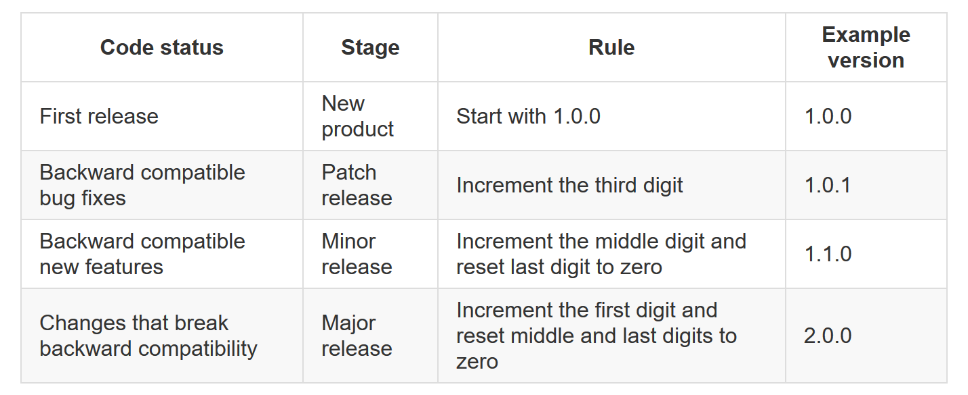

Slide 20
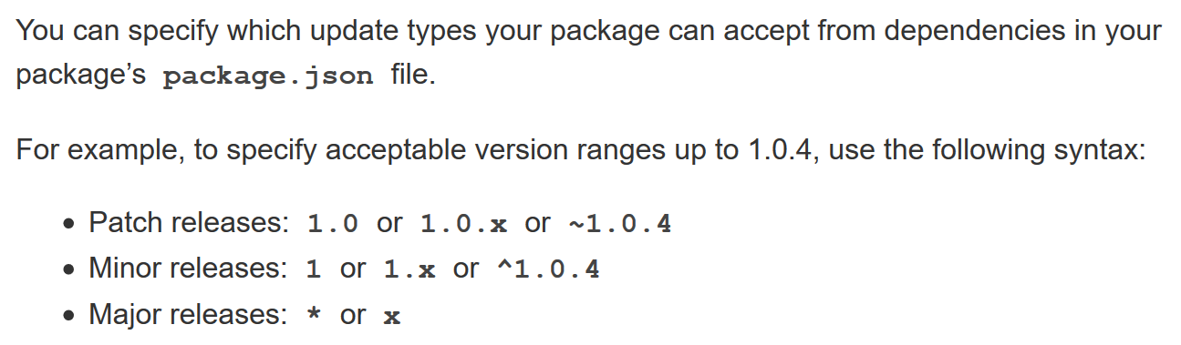

Slide 21
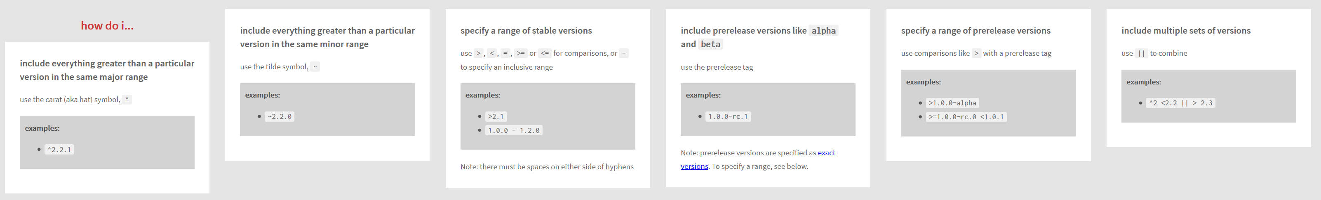

Slide 22
WebSocket
WebSocket is a computer communications protocol, providing full-duplex communication channels over a single TCP connection.
The WebSocket protocol was standardized by the IETF as RFC 6455 in 2011
The WebSocket API in Web IDL is being standardized by the W3C.
WebSocket uses HTTP as the initial transport mechanism but keeps the TCP connection alive after the HTTP response is received so that it can be used for sending messages between client and server.

Slide 23
WebSocket
NODE SERVER
BROWSER
HTTP + URL
HTML + JS
I want WebSocket Communication (WS Request)
WebSocket Handshake
Accept the WS request
Acknowledgement

Slide 24
Express JS
Fast, unopinionated, minimalist web framework for Node.js
Express is a minimal and flexible Node.js web application framework that provides a robust set of features for web and mobile applications.
With a myriad of HTTP utility methods and middleware at your disposal, creating a robust API is quick and easy.

Slide 25
Template Engines
A template engine enables you to use static template files in your application.
At runtime, the template engine replaces variables in a template file with actual values and transforms the template into an HTML file sent to the client.
This approach makes it easier to design dynamic HTML pages.

Slide 26
Template Engines
There are multiple template engines that work “out-of-the-box” with Express, some examples are:
Pug: Haml-inspired template engine (formerly Jade).
Haml.js: Haml implementation.
EJS: Embedded JavaScript template engine.
hbs: Adapter for Handlebars.js, an extension of Mustache.js template engine.
All out-of-the-box Template Engines

Slide 27
Express and Middleware
Express is a routing and middleware web framework that has minimal functionality of its own.
An Express application is essentially a series of middleware function calls.
Middleware is a subset of chained function called by the Express app before the user-defined handler is invoked.
Middleware functions have full access to the request and response objects and the next middleware function in the application’s request-response cycle.
Middleware functions can perform the following tasks:
Execute any code.
Make changes to the request and the response objects.
End the request-response cycle.
Call the next middleware function in the stack.

Slide 28
Request Processing Pipeline
REQUEST
RESPONSE
Middleware (Logging, Authentication, Authorization e.t.c.)

Slide 29
Types of middleware
An Express application can use the following types of middleware:
Application-level middleware
Router-level middleware
Error-handling middleware
Built-in middleware
Third-party middleware

Slide 30
DAL
2
3
1. REQUEST
ROUTER
6 . RESPONSE
4
5
VIEWS

Slide 31
DAL
3
4
1. REQUEST
ROUTER
2
CONTROLLER
8 . RESPONSE
7
5
6
VIEWS

Slide 32
Assignment
Create a CRUD application to work with employee data and store the data in JSON file.
Employee Schema
id – number
name – string
designation – string
salary – number

Slide 33
NODE SERVER
BROWSER
Localhost:3000
EXPRESS JS
Web App
NAVIGATION
Home Index View
Users View Request
Login View
Login POST
Users View
MONGO DB

Slide 34
Localhost:3000
NODE SERVER
BROWSER
Home Index View
EXPRESS JS
Web App
Users View Request
Login View
Login POST
Users View + Client Side App
(jQuery)
EXPRESS JS
Web API
AJAX – api/users
JSON
MONGO DB

Slide 35
NODE SERVER
BROWSER
HTTP + URL (localhost:3000)
React Application
HTML Page + JS (React App)
NODE SERVER
EXPRESS JS
Web API
AJAX – localhost:8000/api/products
DataStore
JSON

Slide 36
Localhost:3000
NODE SERVER
BROWSER
(Store the Token in Session Storage)
Home Index View
EXPRESS JS
Web App
Users View Request
Login View
Login POST
Users View + Client Side App
(jQuery)
On document ready -
AJAX – account/getToken + U&P
EXPRESS JS
Web API
JSON with Token
AJAX – api/users + token
JSON
MONGO DB

