Slide 1
TypeScript

Slide 2
Agenda
Introduction
Installation
Why TypeScript?
Features
Who Uses TypeScript?
Conclusion

Slide 3
1. Introduction
JavaScript that scales

Slide 4
“
TypeScript lets you write JavaScript the way you really want to.
TypeScript is a typed superset of JavaScript that compiles to plain JavaScript.

Slide 5

Overview
Syntax based on ECMAScript proposals
TypeScript is first and foremost a superset of JavaScript
Any regular JavaScript is valid TypeScript Code

Slide 6

“Microsoft's TypeScript may be the best of the many JavaScript front ends. It seems to generate the most attractive code.” - Douglas Crockford
“CoffeeScript is to Ruby as TypeScript is to Java/C#/C++.” - Luke Hoban

Slide 7
2. Installation
How to get it setup?

Slide 8
How to install?
Global Installation
npm install -g typescript
tsc -v
Local Installation
npm install --save-dev typescript
npm i -D typescript

Slide 9
3. Why TypeScript?
Why everyone is using it more and more?

Slide 10
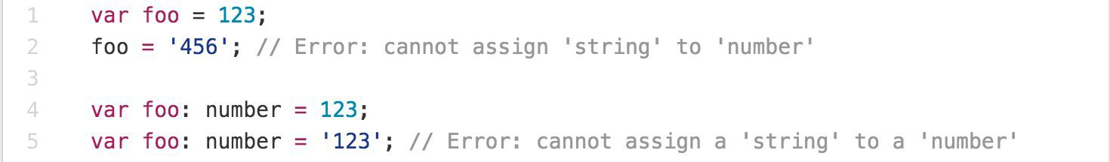
Main Goals of TypeScript
Provide an optional type system for JavaScript.
Provide planned features from future JavaScript editions to current JavaScript engines
Modular Development

Slide 11
4. Features?
What makes TypeScript super awesome?

Slide 12
TypeScript Features
Data Types Supported
Optional Static Type Annotation
Classes
Interface
Modules
Arrow Expressions
Type Assertions
Ambient Declarations
Source File Dependencies

Slide 13
Type Assertion
TypeScript's type assertion are purely you telling the compiler that you know about the types better than it does, and that it should not second guess you.

Slide 14
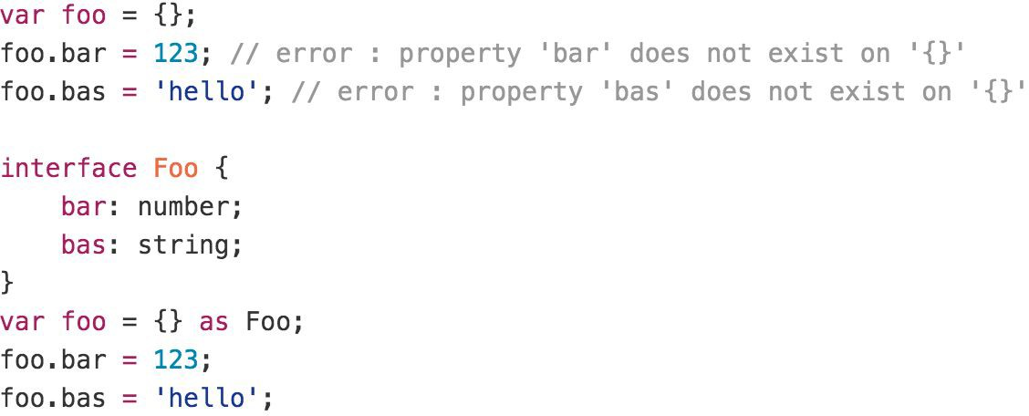
Type Assertion Example

Slide 15
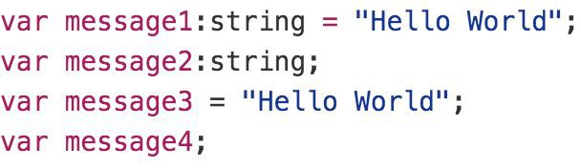
Type Inference
TypeScript tries to infer types
Four ways to variable declaration -
Type and Value in one statement
Type but no Value then Value will be undefined
Value but on Type then the it will be of Any type but maybe be inferred based on its value.
Neither Value nor Type then Type will be Any and Value will be undefined.

Slide 16
Data Types
Any
Never
Unknown
Primitive
Number
Boolean
String
Void
Null
Undefined
Array
Tuple
Enum

Slide 17
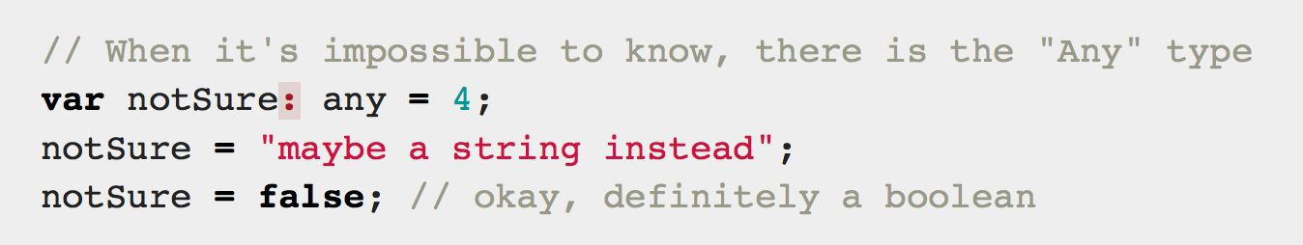
Any
Any is used when it’s impossible to determine the type

Slide 18
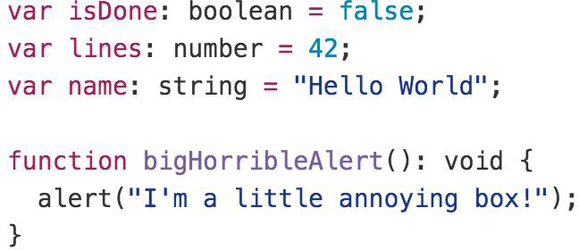
Primitive
Doesn’t have separate integers and float/double type. These all are floating point values and get the type ‘number’
boolean - true/false value
string - both single/double quote can be used
No separate char type
void - is used in function type returning nothing
null and undefined - functions as usual

Slide 19
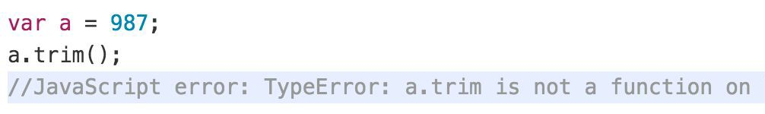
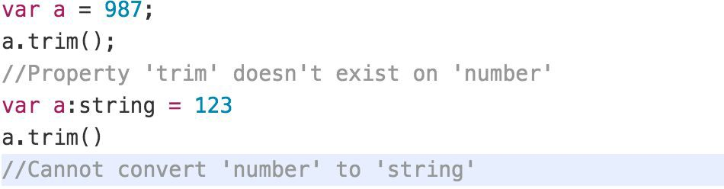
Type Annotations/Checking
JavaScript
TypeScript

Slide 20
Lambda Expression
Implicit return
No braces for single expression
Part of ES6 termed as Arrow Functions
Lexically scoped this
You don't need to keep typing function
It lexically captures the meaning of arguments

Slide 21
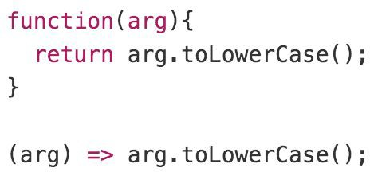
Lambda Example

Slide 22
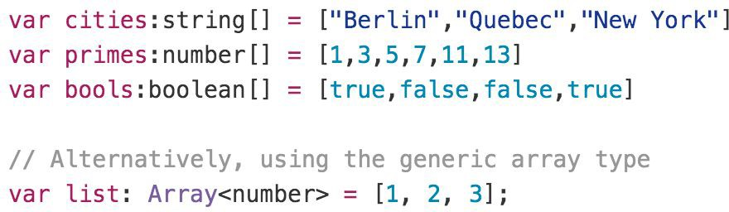
Array

Slide 23
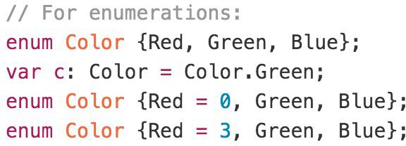
Enum
By default, enums begin numbering their members starting at 0. You can change this by manually setting the value of one its members.

Slide 24
TypeScript Interface
Declared using interface keyword
Like other TS features its design time features i.e., no extra code would be emitted to resultant JS file
Errors being shown when interface signature and implementation doesn’t match.

Slide 25
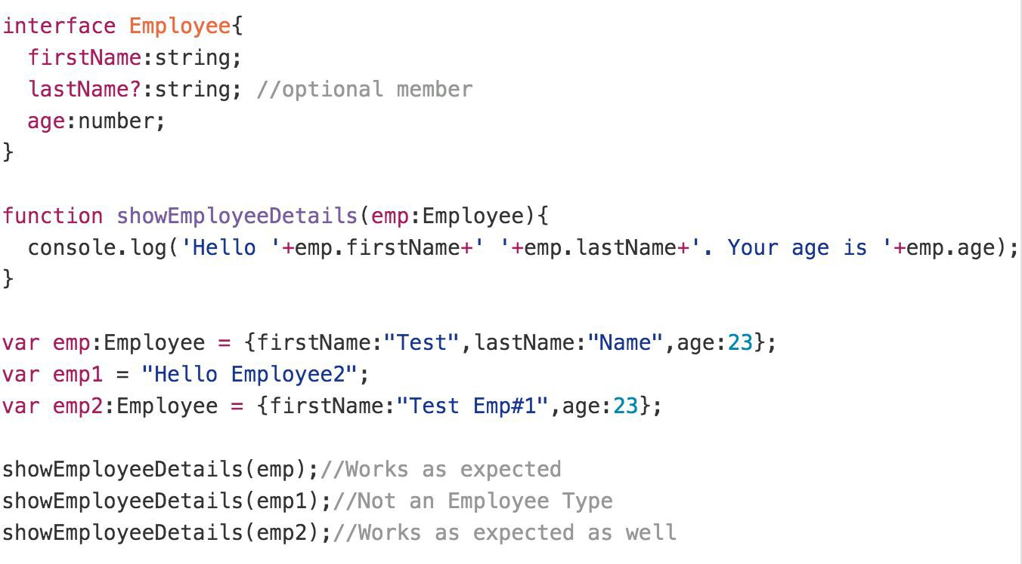
Interface Example

Slide 26
TypeScript Class
Can implement interfaces
Inheritance
Instance methods/members
Static methods/members
Single constructor
Default/Optional parameter
Parameter Members
ES6 class syntax
Optional and Required Members in Strict Mode

Slide 27
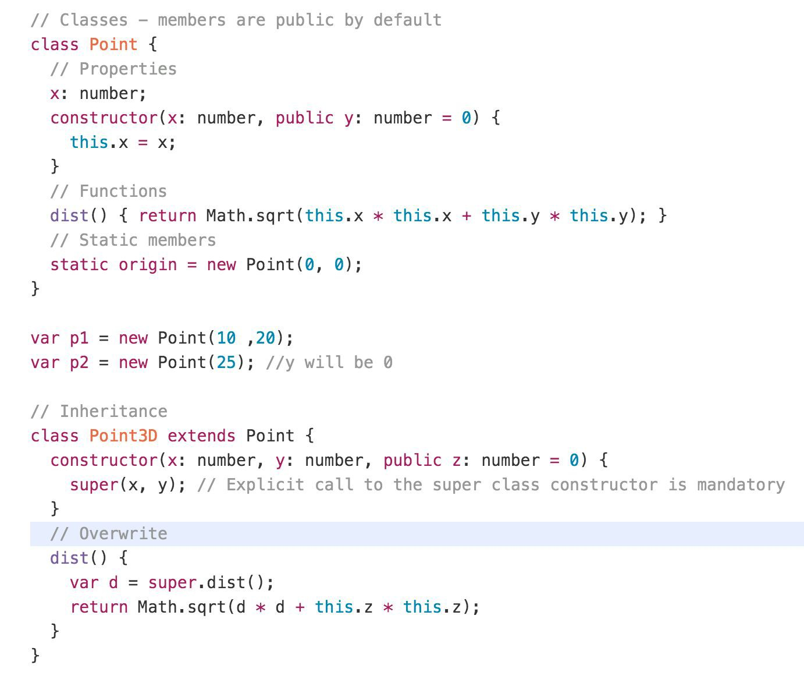
Class Example

Slide 28
TypeScript Modules
Modules can be defined using module keyword
A module can contain Function, Class, Enums or Interfaces.
A file with export or import keyword is termed as module.
Classes and Interfaces can be exposed using export keyword.

Slide 29
Type Definition/Declaration Files
A major design goal of TypeScript was to make it possible for you to safely and easily use existing JavaScript libraries in TypeScript.
TypeScript does this by means of type declaration files.
All type declaration files have *.d.ts as extension.
You can download the type definition files from npm repository as and when needed.

Slide 30
5. Who Uses TypeScript?

Slide 31

Companies use TypeScript
3449 companies reportedly use TypeScript in their tech stacks, including Slack, Stack, and Vox Media.

Slide 32
6. Conclusion

Slide 33
Conclusion
Pros:
High value, low-cost improvement over JavaScript
Safer and more modular
Solid path to ECMAScript 6 and above
Cons:
Still need to know some JS quirks

Slide 34
Webpack

Slide 35
TypeScript (s)
.ts
Manual Configuration
Node JS
Webpack
TypeScript Config.
TSC
Webpack
Dev Server
JavaScript Files
.js (ES5)
Webpack
CLI
Bundle
BROWSER
WEBPACK
JavaScript
.js
HTTP Server
HTML Page
Deploy
Inject Bundles

Slide 36
Webpack Configuration Steps
Entry Point
Resolve Extensions
Loaders
Plugins
Optimization
Output

Slide 37
References
https://www.typescriptlang.org

