Slide 1
BROWSER
SERVER
HTTP + URL
NAVIGATION
HTML PAGES
CSS
HTML + CSS
HTTP + URL
HTML + CSS
Page
Reload!

Slide 2
BROWSER
SERVER
HTTP + URL
NAVIGATION
Server PAGES
CSS
HTML + CSS + JS
AJAX - HTTP + URL
JS
Partial
Page
Reload!
PARTIAL HTML
ID
<table>
<thead>
<tr>
<th>ID</th>
</tr>
</thead>
<tbody>
<tr>
<td>1</td>
</tr>
</tbody>
</table>
ASP
ASP .Net
JSP
PHP
Ruby
ASP .Net MVC
Spring MVC
Ruby On Rails
1
DB

Slide 3
SPA – Single Page Application
SERVER
SERVER PAGES
CSS
BROWSER
HTTP + URL
NAVIGATION
JS
HTML + CSS + JS
(Angular FW & Application)
ASP
ASP .Net
JSP
PHP
Ruby
ASP .Net MVC
Spring MVC
Ruby On Rails
<table>
<thead>
<tr>
<th>ID</th>
</tr>
</thead>
<tbody>
<tr>
<td>1</td>
</tr>
</tbody>
</table>
SERVER
AJAX - HTTP + URL
RESTful API
ASP .Net Web API
JWS
Express JS
Python
DB
JSON to HTML on Client Side
JSON
{
“id”:1
}
Vanilla JS, jQuery, KO, BB, Ng 1,
Ng 2 and above, React JS, Vue JS

Slide 4
SPA – Single Page Application
SERVER
SERVER PAGES
CSS
BROWSER
HTTP + URL
NAVIGATION
JS
HTML + CSS + JS
(Angular FW & Application)
ASP
ASP .Net
JSP
PHP
Ruby
ASP .Net MVC
Spring MVC
Ruby On Rails
<table>
<thead>
<tr>
<th>ID</th>
</tr>
</thead>
<tbody>
<tr>
<td>1</td>
</tr>
</tbody>
</table>
Account
Service
AJAX - HTTP + URL
API GATEWAY
JSON
{
“id”:1
}
Inventory
Service
JSON to HTML on Client Side
Vanilla JS, jQuery, KO, BB, Ng 1,
Ng 2 and above, React JS, Vue JS
Shipping
Service

Slide 5

JavaScript Full Stack Application
 | Database | Application FW API FW | Client Side | Runtime
MEAN | MongoDB | Express JS | Angular | Node
MERN | MongoDB | Express JS | React JS | Node
MEVN | MongoDB | Express JS | Vue JS | Node

Slide 6
Installation
Latest Version of Node JS (LTS) - https://nodejs.org/en/
Latest version of Visual Studio Code - https://code.visualstudio.com/
Visual Studio Code Extensions
AutoFileName
vscode-icons
Angular Snippets
Angular Language Service
IntelliSense for CSS class names in HTML
CSS Formatter

Slide 7
Manual Configuration
Node JS
Webpack
TypeScript Config.
TypeScript (s)
.ts
TSC
Webpack
Dev Server
Webpack
CLI
JavaScript Files
.js (ES5)
Bundle
BROWSER
WEBPACK
JavaScript
.js
HTTP Server
HTML Page
Deploy
Inject Bundles

Slide 8
Webpack Configuration Steps
Entry Point
Resolve Extensions
Loaders
Plugins
Optimization
Output

Slide 9
Manual Configuration
Node JS
Webpack
TypeScript Config.
Test Config.
Jasmine
Karma
Protractor
TypeScript (s)
.ts
TSC
Webpack
Dev Server
Webpack
CLI
JavaScript Files
.js (ES5)
Auto Configuration
Angular CLI
Bundle
BROWSER
WEBPACK
JavaScript
.js
HTTP Server
HTML Page
Deploy
Inject Bundles

Slide 10
Library vs Framework
Library | Framework
Collection of API’s, targeted to do one specific task | Collection of API’s, targeted for application creation. FW is a piece of code that dictates the architecture of your project.
You are in Full control when you call a method from a library and the control is then returned. | The code never calls into a FW, instead the FW uses your code. We can only follow a FW.
It can be integrated seamlessly into an existing project. | FW cannot be integrated, we have to re-write the code.
jQuery – DOM Manipulation & Ajax Date – Moment JS Data Visualization – D3 JS | Angular

Slide 11
Creating an Angular Application
npm install -g @angular/cli (Only Once)
Single Project Application (Workspace)
ng new first-ng-app
Multiple Projects in Single Workspace
ng new multi-apps --createApplication=false
cd multi-apps
ng generate application app-one
ng generate application app-two
ng generate library app-two

Slide 12
0
+
-
0
+
-
DOM HANDLING LOGIC
DOM HANDLING LOGIC
{
count: 0,
next: function() {
this.count+=1;
},
prev: function() {
this.count-=1;
}
}
{
count: 0,
next: function() {
this.count+=1;
},
prev: function() {
this.count-=1;
}
}
<counter />
<counter />

Slide 13
Composite UI
NAV COMPONENT + CSS
SIDE NAV COMPONENT
+ CSS
LIST COMPONENT
+ CSS
DETAILS COMPONENT
+ CSS
STATUS COMPONENT + CSS

Slide 14
<counter interval=“10”/>
MODULE
COMPONENT
VIEW / UI
STYLE (Inside, Outside – CSS)
DATA (State / Properties)
BEHAVIOR (Methods)

Slide 15
Angular Packages
@angular/core: Critical runtime parts of the framework needed by every application. Includes all metadata decorators, Component, Directive, dependency injection, and the component lifecycle hooks.
@angular/common: The commonly needed services, pipes, and directives provided by the Angular team.
@angular/compiler: Angular Template Compiler. It understands templates and can convert them to code that makes the application run and render. Typically, you don’t interact with the compiler directly; rather, you use it indirectly via platform-browser-dynamic when JIT compiling in the browser.
@angular/platform-browser: Everything DOM and browser related, especially the pieces that help render into the DOM. This package also includes the bootstrapModuleFactory() method for bootstrapping applications for production builds that pre-compile with AOT.
@angular/platform-browser-dynamic: Includes Providers and methods to compile and run the app on the client using the JIT compiler.
@angular/forms: Support for both template-driven and reactive forms.
@angular/http: Angular old, deprecated, HTTP client.
@angular/animations: Angular animations library makes it easy to define and apply animation effects such as page and list transitions. Read about it in the Animations guide.
@angular/router: The router module navigates among your app pages when the browser URL changes.
@angular/upgrade: Set of utilities for upgrading Angular applications to new Angular Version.

Slide 16
Zone.js (NgZone)
Rxjs, Angular Packages
MODULE
COMPONENT

Slide 17
Multi Module
AppModule
RootComponent
MoneModule
CompOneComponent
HelloComponent
MtwoModule
CompTwoComponent
HelloComponent
SharedModule
ScompComponent

Slide 18
Data Binding
SOURCE
Component Class
Data Members
Properties
TARGET
Component Template
Element Properties
Element Attributes
One Way Binding
Property and Attribute Binding
[propertyName] or [attr.AttributeName]
One Way To Source Binding
Event Binding
(eventName)
Two Way Binding
[(ngModel)]

Slide 19
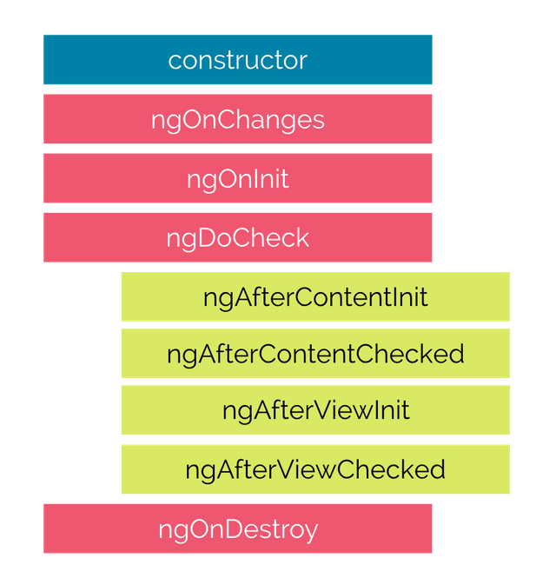
Life Cycle Hooks

Slide 20

Hooks for the Component
constructor : This is invoked when Angular creates a component or directive by calling new on the class.
ngOnChanges : Invoked every time there is a change in one of the input properties of the component.
ngOnInit : Invoked when given component has been initialized. This hook is only called once after the first ngOnChanges
ngDoCheck : Invoked when the change detector of the given component is invoked. It allows us to implement our own change detection algorithm for the given component.
ngAfterContentInit : Invoked after Angular performs any content projection into the component’s
ngAfterContentChecked : Invoked each time the content of the given component has been checked by the change detection mechanism of Angular.
ngAfterViewInit : Invoked when the component’s view has been fully initialized.
ngAfterViewChecked : Invoked each time the view of the given component has been checked by the change detection mechanism of Angular
ngOnDestroy : This method will be invoked just before Angular destroys the component. Use this hook to unsubscribe observables and detach event handlers to avoid memory leaks.

Slide 21
Directives
Directives are classes that add additional behavior to elements in your Angular applications.
The different types of Angular directives are as follows:
Components—directives with a template. This type of directive is the most common directive type.
Attribute directives—directives that change the appearance or behavior of an element, component, or another directive. E.g., NgClass, NgStyle, NgModel
Structural directives—directives that change the DOM layout by adding and removing DOM elements. E.g., NgIf, NgFor, NgSwitch

Slide 22
Assignment
Create a clock (hh:mm:ss) component with time display, to be used across your application.
Create a component which can show Navigation Bar in your application, use bootstrap classes to make it responsive.

Slide 23
Communication
Parent
Parent
@Output()
Event Emitter
@Input()
Property
@Input()
Property
@Output()
Event Emitter
Child
Child One
Child Two

Slide 24
Pipes
Angular provides built-in pipes for typical data transformations, including transformations for internationalization (i18n), which use locale information to format data.
The following are commonly used built-in pipes for data formatting:
DatePipe: Formats a date value according to locale rules.
UpperCasePipe: Transforms text to all upper case.
LowerCasePipe: Transforms text to all lower case.
CurrencyPipe: Transforms a number to a currency string, formatted according to locale rules.
DecimalPipe: Transforms a number into a string with a decimal point, formatted according to locale rules.
PercentPipe: Transforms a number to a percentage string, formatted according to locale rules.

Slide 25
Promise
The Promise object represents the eventual completion (or failure) of an asynchronous operation, and its resulting value.
It allows you to associate handlers with an asynchronous action's eventual success value or failure reason.
This lets asynchronous methods return values like synchronous methods: instead of immediately returning the final value, the asynchronous method returns a promise to supply the value at some point in the future.

Slide 26
Promise Vs Observable
Promise | Observables
Emit Single Value | Emit Multiple Values, over a period of time (Stream of Data)
Not Lazy | Lazy, observables will not execute unless we subscribe to it
Cannot be cancelled | Can be cancelled by using unsubscribe
Does not provide any operators | Observables provide a lot of built in operators i.e. map, forEach, filter, reduce, retry

Slide 27
Forms
Reactive forms provide direct, explicit access to the underlying forms object model. Compared to template-driven forms, they are more robust: they're more scalable, reusable, and testable. If forms are a key part of your application, or you're already using reactive patterns for building your application, use reactive forms.
Template-driven forms rely on directives in the template to create and manipulate the underlying object model. They are useful for adding a simple form to an app, such as an email list signup form. They're easy to add to an app, but they don't scale as well as reactive forms. If you have very basic form requirements and logic that can be managed solely in the template, template-driven forms could be a good fit.

Slide 28
Key Differences
 | REACTIVE | TEMPLATE-DRIVEN
Setup of form model | Explicit, created in component class | Implicit, created by directives
Data model | Structured and immutable | Unstructured and mutable
Predictability | Synchronous | Asynchronous
Form validation | Functions | Directives

Slide 29
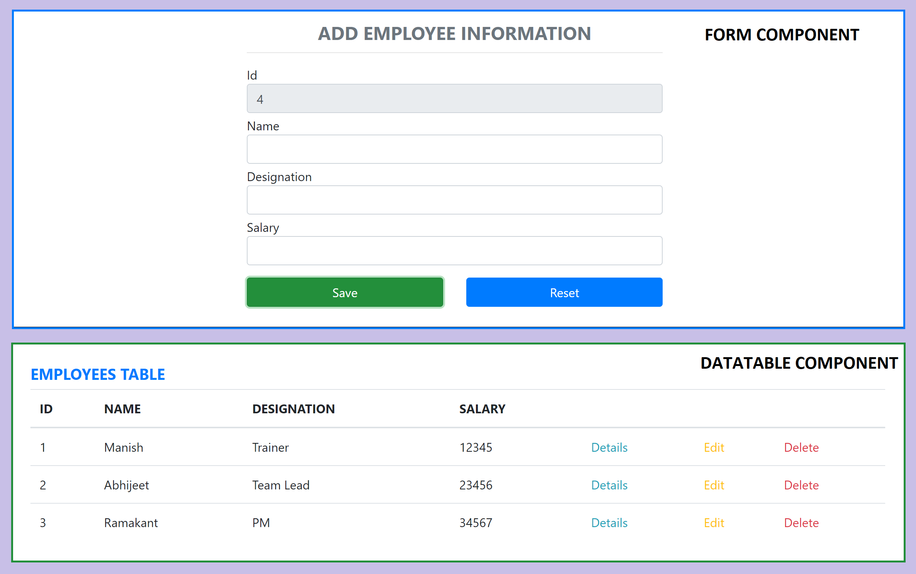
Assignment

Slide 30
NODE SERVER
EXPRESS JS
SPRING BOOT
Web API
AJAX – account/getToken + U&P
BROWSER
(Stores the Token in Session Storage)
JSON with Token
AJAX – api/users + Read and attach Token
MONGO DB
MySQL
JSON

Slide 31
Angular Route Guards
CanActivate
Checks to see if a user can visit a route.
CanActivateChild
Checks to see if a user can visit a routes children.
CanDeactivate
Checks to see if a user can exit a route.
CanLoad
Checks to see if a user can route to a module that is lazy loaded.
Resolve
Persforms route data retrieval before route activation.

Slide 32
Secure Application using Route Guards
When user clicks the Admin Link, we need to verify that we have a token in session storage, and if the token in not there in the session storage, redirect the request to login component. (AuthGuard Custom RouteGuard)
AuthGuard uses AuthenticatorService, getToken() to get the token.
If token is undefined, the request is redirected to Login Component
If token is available, the request is allowed for Admin Component.
Logging and Token Management (Authenticator Service)
On Login Component, user must give username and password, which will be sent to API Server
If the username & password is correct, in the response, token will come from the Server
Received token will be stored in the session storage of the browser.
Reading and Attaching Token (TokenInterceptor Service)
Whenever the AJAX request is made for api/users, tokenInterceptor, intercepts and attaches token in the request header.
It uses authenticator service to read the token from session storage.

Slide 33
Contact Me
Manish Sharma | Gmail
Manish Sharma | WhatsApp
Manish Sharma | Facebook
Manish Sharma | LinkedIn

