Slide 1
BROWSER
SERVER
HTTP + URL
NAVIGATION
HTML PAGES
CSS
HTML + CSS
HTTP + URL
HTML + CSS

Slide 2
BROWSER
SERVER
HTTP + URL
NAVIGATION
Server PAGES
CSS
HTML + CSS + JS
AJAX - HTTP + URL
JS
PARTIAL HTML
ID
<table>
<thead>
<tr>
<th>ID</th>
</tr>
</thead>
<tbody>
<tr>
<td>1</td>
</tr>
</tbody>
</table>
ASP
ASP .Net
JSP
PHP
Ruby
ASP .Net MVC
Spring MVC
Ruby On Rails
Laravel
1
DB

Slide 3
BROWSER
SERVER
HTTP + URL
NAVIGATION
WEB APPLICATION
HTML + CSS + JS
(Vue JS FW & App)
<table>
<thead>
<tr>
<th>ID</th>
</tr>
</thead>
<tbody>
<tr>
<td>1</td>
</tr>
</tbody>
</table>
AJAX - HTTP + URL
WEB API
DB
JSON to HTML on Client Side
JSON
{
“id”:1
}
Vanilla JS, jQuery, KO, BB, Ng1, Ng2
And Above, React JS, Vue JS

Slide 4
Single Page Application
SERVER
SERVER PAGES
CSS
BROWSER
HTTP + URL
NAVIGATION
JS
HTML + CSS + JS
(Vue JS FW & App)
ASP
ASP .Net
JSP
PHP
Ruby
ASP .Net MVC
Spring MVC
Ruby On Rails
Express JS
<table>
<thead>
<tr>
<th>ID</th>
</tr>
</thead>
<tbody>
<tr>
<td>1</td>
</tr>
</tbody>
</table>
SERVER
AJAX - HTTP + URL
RESTful API
ASP .Net Web API
JWS
Express JS
Python
DB
JSON to HTML on Client Side
JSON
{
“id”:1
}
Vanilla JS, jQuery, KO, BB, Ng1, Ng2
And Above, React JS, Vue JS

Slide 5

JavaScript Full Stack Application
 | Database | Application FW / API FW | Client Side | Hosting / Server
MEAN | MongoDB | Express JS | Angular | Node
MERN | MongoDB | Express JS | React JS | Node
MEVN | MongoDB | Express JS | Vue JS | Node

Slide 6
Library vs Framework
Library | Framework
Collection of API’s, targeted to do one specific task. | Collection of API’s, targeted for application creation. FW is a piece of code that dictates the architecture of your project.
You are in Full control when you call a method from a library and the control is then returned. | The code never calls into a FW, instead the FW uses your code. We can only follow a FW.
It can be integrated seamlessly into an existing project. | FW cannot be integrated, we have to re-write the code.
jQuery – DOM Manipulation & AJAX Moment JS – Working with Date & Time D3 JS – Data Visualization React – UI Library | Angular Vue

Slide 7
Vue JS
VueJS is a progressive framework for building user interfaces.
Vue is designed from the ground up to be incrementally adoptable.
Vue is easy to pick up and integrate with other libraries or existing projects.
Vue is also perfectly capable of powering sophisticated Single-Page Applications when used in combination with modern tooling and supporting libraries.
Like Vue Router and Vuex

Slide 8
Installation
Install latest LTS version of Node JS - https://nodejs.org/en/
Install Visual Studio Code - https://code.visualstudio.com/download
Extensions of VS Code
AutoFileName
vscode-icons
JavaScript (ES6) code snippets
CSS Formatter
IntelliSense for CSS class names in HTML
Vetur
Vue VSCode Snippets

Slide 9
Refer Vue FW on HTML Page
and compile everything on
Client Side
CLIENT SIDE BUILD
ES 2015 +
(Multiple Files)
Babel + Vue +
Preset (Env) +
Polyfill (core-js)
Manual Configuration
Node JS
Webpack
Babel
WEBPACK-DEV-
SERVER
ES5
(Multiple Files)
WEBPACK
CLI
Auto Configuration
Vue CLI
Bundling
(Webpack)
BROWSER
WEBPACK
ES5 (Single File)
Local
HTTP Server
HTML PAGE
Deploy
Inject Bundles

Slide 10
Installing and using Vue CLI
npm install -g @vue/cli
To Create an application
vue create vue-core -d
cd vue-core
npm run serve

Slide 11
Components of Vue CLI
The CLI (@vue/cli) is a globally installed npm package and provides the vue command in your terminal. It provides the ability to quickly scaffold a new project via vue create, or instantly prototype new ideas via vue serve
The CLI Service (@vue/cli-service) is a development dependency. It's a npm package installed locally into every project created by @vue/cli.
CLI Plugins are npm packages that provide optional features to your Vue CLI projects, such as Babel/TypeScript transpilation, ESLint integration, unit testing, and end-to-end testing.

Slide 12
 | UMD | CommonJS | ES Module (for bundlers) | ES Module (for browsers)
Full | vue.js | vue.common.js | vue.esm.js | vue.esm.browser.js
Runtime-only | vue.runtime.js | vue.runtime.common.js | vue.runtime.esm.js | -
Full (production) | vue.min.js | - | - | vue.esm.browser.min.js
Runtime-only (production) | vue.runtime.min.js | - | - | -

Slide 13
Vue Configuration Object
Data
data
props
propsData
computed
methods
watch
DOM
el
template
render
renderError

Slide 14
Vue Configuration Object
Lifecycle Hooks
beforeCreate
created
beforeMount
mounted
beforeUpdate
updated
activated
deactivated
beforeDestroy
destroyed
errorCaptured
Assets
directives
filters
components

Slide 15
Vue Configuration Object
Composition
parent
mixins
extends
provide / inject
Misc
name
delimiters
functional
model
inheritAttrs
comments

Slide 16
Component Registration and Usage Rules
Created Using
PascalCase
Use
PascalCase
camelCase
kebab-case
Created Using
camelCase
Use
camelCase
kebab-case
Created Using
kebab-case
Use
kebab-case

Slide 17
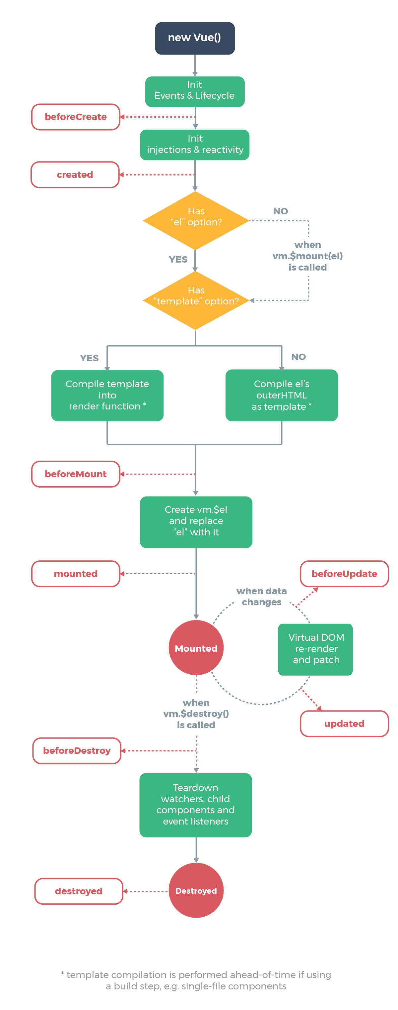
Lifecycle Methods

Slide 18
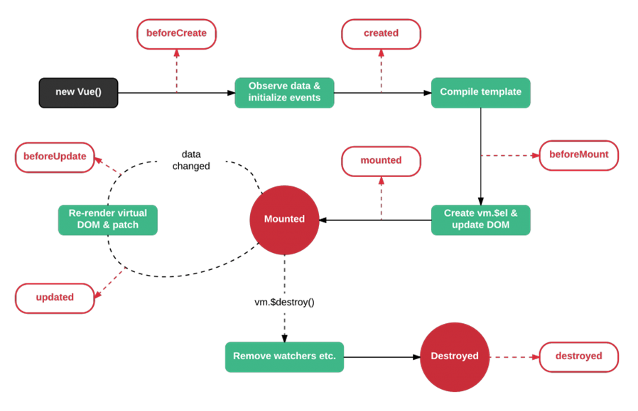
Vue Lifecycle methods

Slide 19
NAVIGATION
SIDE NAVIGATION
LIST AREA
DETAILS AREA
STATUS

Slide 20
0
+
-
<counter /> - Custom Tag (Component)
VUE COMPONENT
UI
Template – HTML / JSX / PUG
STYLE - CSS / JSX
BEHAVIOR – Methods – Interaction
DATA (Inside) – data()
DATA (Outside) - props

Slide 21
Built In Directives
A directive is some special token in the markup that tells Vue to do something to a DOM element.
Built in Directives in Vue
v-text
v-html
v-show
v-if
v-else
v-else-if
v-for
v-on
v-bind
v-model
v-slot
v-pre
v-cloak
v-once

Slide 22
Prop Type Checks
String
Number
Boolean
Array
Object
Date
Function
Symbol

Slide 23
Event Modifiers
.stop - stopPropagation
.prevent - preventDefault
.capture - for event capturing
.self - only when the element is used
.once - Fire Only Once
.passive - don't want to prevent the default behavior of the event

Slide 24
Key Modifiers
.enter
.tab
.delete (captures both “Delete” and “Backspace” keys)
.esc
.space
.up
.down
.left
.right

Slide 25
v-model – Two Way Binding
v-model
Create a two-way binding on a form input element or a component.
Limited to:
<input>
<select>
<textarea>
components
Modifiers
.lazy
.number
.trim

Slide 26
Parent Child Communication
PARENT
PARENT
PARENT
Props
$refs
Parent
Method
Reference
$emit
CHILD
CHILD
CHILD
Anti Pattern

Slide 27
Sibling Communication
Parent Component
CHILD Component
CHILD Component

Slide 28
Sibling Communication
CHILD Component
1
Parent Component
CHILD Component
2
GRANDCHILD Component
1.1
GRANDCHILD Component
2.1

Slide 29
Sibling Communication – via Root
Root Component
CHILD Component
1
Parent Component
CHILD Component
2
GRANDCHILD Component
1.1
$root.$emit()
$root.$on()
GRANDCHILD Component
2.1

Slide 30
Sibling Communication – via EventBus
CHILD Component
1
Parent Component
CHILD Component
2
GRANDCHILD Component
1.1
GRANDCHILD Component
2.1
EVENT BUS

Slide 31
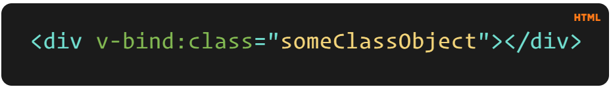
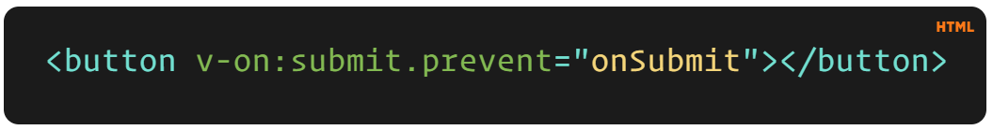
v-example="value" – this will pass a value into the directive, and the directive figures out what to do based off of that value.
v-example="'string'" – this will let you use a string as an expression.
v-example:arg="value" – this allows us to pass in an argument to the directive.
v-example:arg.modifier="value" – this allows us to use a modifier.

Slide 32
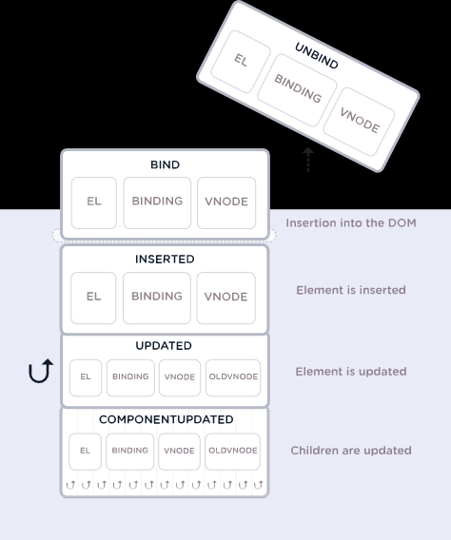

Slide 33
Directive Hooks
There are a few hooks available to us, and each one has the option of a few arguments. The hooks are as follows:
bind – This occurs once the directive is attached to the element.
inserted – This hook occurs once the element is inserted into the parent DOM.
update – This hook is called when the element updates, but children haven’t been updated yet.
componentUpdated – This hook is called once the component and the children have been updated.
unbind – This hook is called once the directive is removed.

Slide 34
Filters
Vue.js allows you to define filters that can be used to apply common text formatting.
Filters are usable in two places: mustache interpolations and v-bind expressions.
Filters should be appended to the end of the JavaScript expression, denoted by the “pipe” symbol

Slide 35
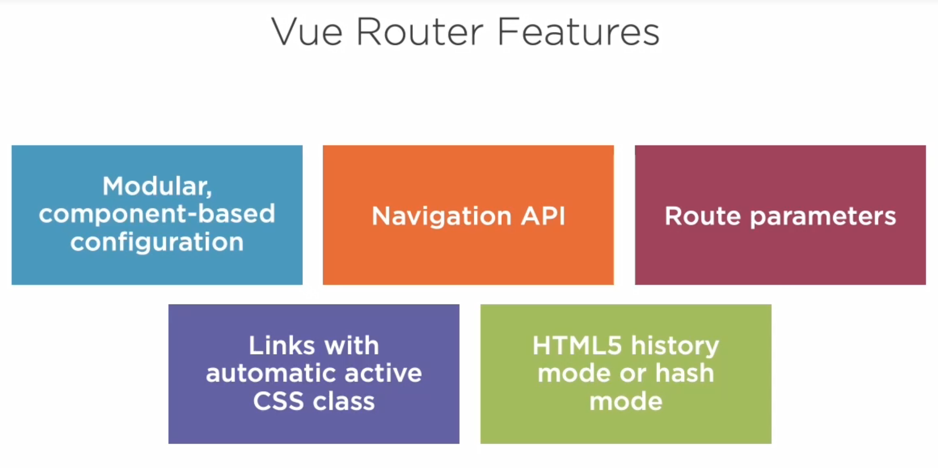

Slide 36
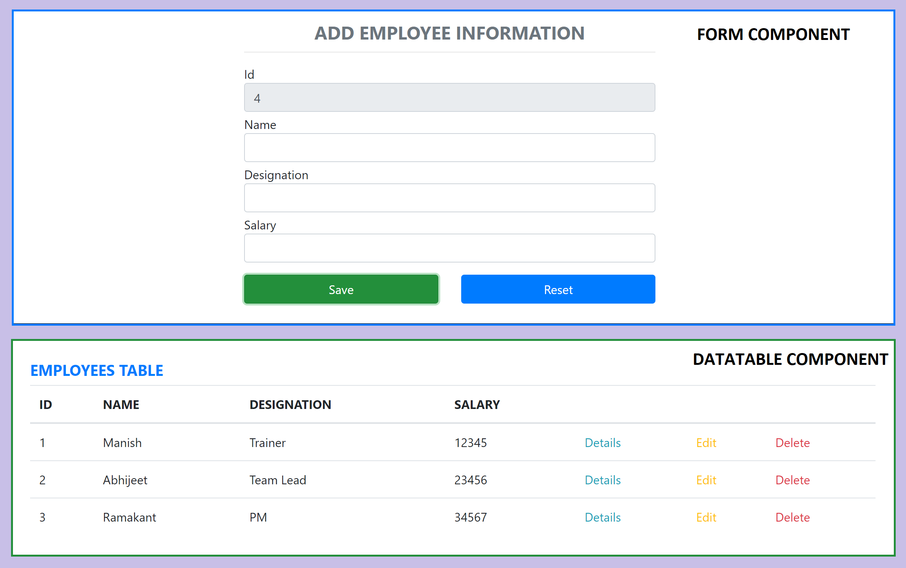
Assignment

Slide 37
Contact Me
Manish Sharma | Gmail
Manish Sharma | WhatsApp
Manish Sharma | Facebook
Manish Sharma | LinkedIn

