Slide 1

TypeScript & Angular

Slide 2
BROWSER
SERVER
HTTP + URL
NAVIGATION
HTML PAGES
CSS
HTML + CSS
HTTP + URL
HTML + CSS
Page
Reload!

Slide 3
BROWSER
SERVER
HTTP + URL
NAVIGATION
HTML + CSS
Server PAGES
CSS
HTTP + URL
ASP
ASP .NET
JSP
PHP
Ruby
HTML + CSS
Page
Reload!
DB

Slide 4
BROWSER
SERVER
HTTP + URL
NAVIGATION
Server PAGES
CSS
HTML + CSS + JS
AJAX - HTTP + URL
JS
Partial
Page
Reload!
PARTIAL HTML
<table>
<thead>
<tr>
<th>ID</th>
</tr>
</thead>
<tbody>
<tr>
<td>1</td>
</tr>
</tbody>
</table>
ASP
ASP.NET
JSP
PHP
Ruby
ASP .NET MVC
Spring MVC
Ruby On Rails
Laravel
DB

Slide 5
SINGLE PAGE APPLICATION
SERVER
SERVER PAGES
CSS
BROWSER
HTTP + URL
NAVIGATION
JS
HTML + CSS + JS
(Client Side JS App)
ASP
ASP .NET
JSP
PHP
Ruby
ASP .NET MVC
Spring MVC
Ruby On Rails
Laravel
<table>
<thead>
<tr>
<th>ID</th>
</tr>
</thead>
<tbody>
<tr>
<td>1</td>
</tr>
</tbody>
</table>
SERVER
AJAX - HTTP + URL
RESTful API
ASP .NET Web API
JWS
Express JS
Python
DB
JSON to HTML on Client Side
JSON
{
“id”:1
}
Vanilla JS, jQuery, KO, BB, NG1,
NG2 and above, React, Vue

Slide 6
SINGLE PAGE APPLICATION
SERVER
SERVER PAGES
CSS
BROWSER
HTTP + URL
NAVIGATION
JS
HTML + CSS + JS
(Client Side JS App)
ASP
ASP .NET
JSP
PHP
Ruby
ASP .NET MVC
Spring MVC
Ruby On Rails
Laravel
<table>
<thead>
<tr>
<th>ID</th>
</tr>
</thead>
<tbody>
<tr>
<td>1</td>
</tr>
</tbody>
</table>
Account
Service
AJAX - HTTP + URL
API GATEWAY
JSON
{
“id”:1
}
Inventory
Service
JSON to HTML on Client Side
Vanilla JS, jQuery, KO, BB, NG1,
NG2 and above, React, Vue
Shipping
Service

Slide 7
Library vs Framework
Library | Framework
Collection of API’s, targeted to do one specific task. | Collection of API’s, targeted for application creation. FW is a piece of code that dictates the architecture of your project.
You are in full control when you call a method from a library and the control is then returned. | The code never calls into a FW, instead the FW uses you code. We can only follow a FW.
It can be integrated seamlessly into an existing project. | FW cannot be integrated, we have to re-write the code.
jQuery – DOM Manipulation & Ajax Moment JS – Date and Time D3 JS – Data Visualization | Angular

Slide 8
Installation
Latest Version (v14) of Node JS (LTS) - https://nodejs.org/en/
Latest version of Visual Studio Code - https://code.visualstudio.com/
Visual Studio Code Extensions
AutoFileName
vscode-icons
Angular Snippets
Angular Language Service
IntelliSense for CSS class names in HTML
CSS Formatter
After Installing the extensions, select the following in VS Code
File Menu -> Preferences -> File Icon Theme -> VSCode Icons
Chrome Extension
Angular DevTools – Offered by Angular Team - https://chrome.google.com/webstore/detail/angular-devtools/ienfalfjdbdpebioblfackkekamfmbnh?hl=en

Slide 9
“
TypeScript lets you write JavaScript the way you really want to.
TypeScript is a typed superset of JavaScript that compiles to plain JavaScript.

Slide 10
Language | C# | TypeScript (.ts)
Compiler | CSC | TSC
IL | MSIL | JavaScript (.js)
Runtime | CLR (JIT) | JavaScript Runtime
 | Native | Native
 | O.S. | O.S.

Slide 11

Overview
Syntax based on ECMAScript proposals
TypeScript is first and foremost a superset of JavaScript
Any regular JavaScript is valid TypeScript Code

Slide 12

“Microsoft's TypeScript may be the best of the many JavaScript front ends. It seems to generate the most attractive code.” - Douglas Crockford
“CoffeeScript is to Ruby as TypeScript is to Java/C#/C++.” - Luke Hoban

Slide 13
How to install?
Global Installation
npm install -g typescript
tsc -v
Local Installation
npm install --save-dev typescript@4.2
npm i -D typescript@4.2

Slide 14
.ts files
.ts files
Will be compiled by
Will be compiled by
Automate .ts
to .js file
Creation
Run tsc in
Watch mode
tsc
tsc
Convert to
Convert to
.js files
.js files
Refer in
Refer in
.html page
.html page
Open in
Open in
BROWSER
BROWSER

Slide 15
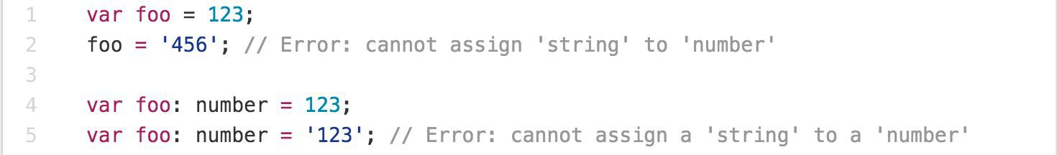
Main Goals of TypeScript
Provide an optional type system for JavaScript.
Provide planned features from future JavaScript editions to current JavaScript engines
Modular Development

Slide 16
TypeScript Features
Data Types Supported
Optional Static Type Annotation
Classes
Interface
Modules
Arrow Expressions
Type Assertions
Ambient Declarations
Source File Dependencies

Slide 17
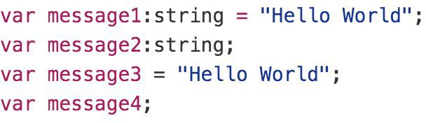
Type Inference
TypeScript tries to infer types
Four ways to variable declaration -
Type and Value in one statement
Type but no Value then Value will be undefined
Value but on Type then the it will be of Any type but maybe be inferred based on its value.
Neither Value nor Type then Type will be Any and Value will be undefined.

Slide 18
Data Types
Any
Never
Unknown
Primitive
Number
Boolean
String
Void
Null
Undefined
Array
Tuple
Enum

Slide 19
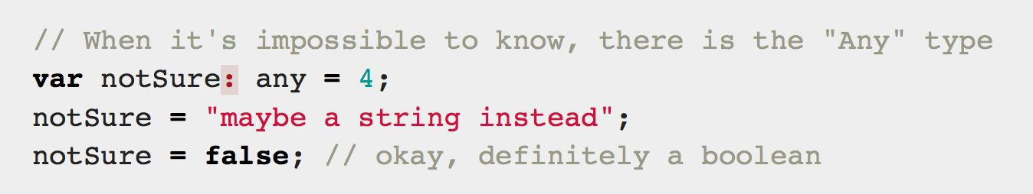
Any
Any is used when it’s impossible to determine the type

Slide 20
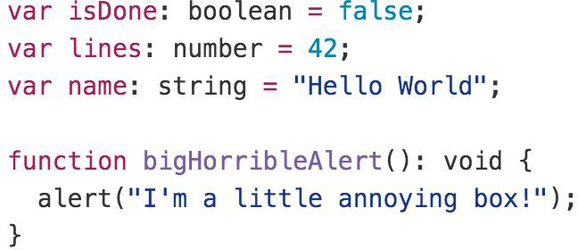
Primitive
Doesn’t have separate integers and float/double type. These all are floating point values and get the type ‘number’
boolean - true/false value
string - both single/double quote can be used
No separate char type
void - is used in function type returning nothing
null and undefined - functions as usual

Slide 21
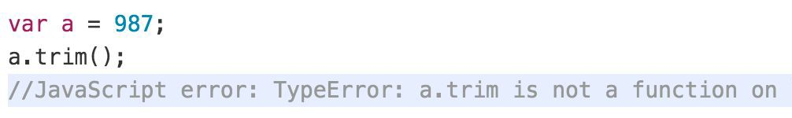
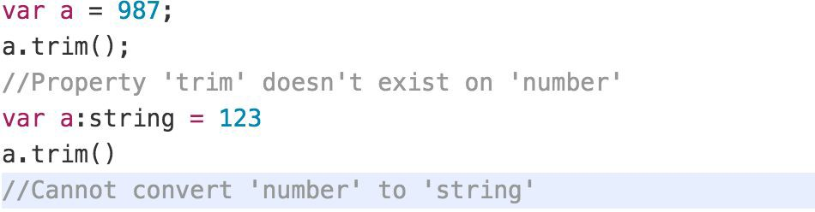
Type Annotations/Checking
JavaScript
TypeScript

Slide 22
Type Assertion
TypeScript's type assertion are purely, you telling the compiler that you know about the types better than it does, and that it should not second guess you.
Type assertion is a mechanism which tells the compiler about the type of a variable.
Type assertion is explicitly telling the compiler that we want to treat the entity as a different type.

Slide 23
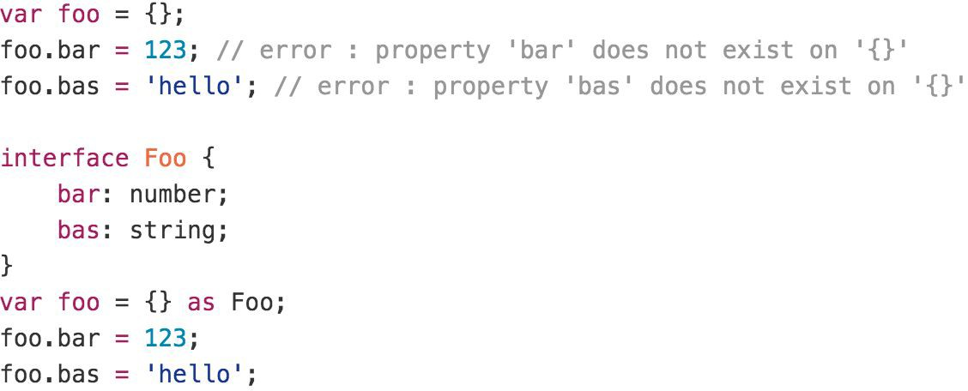
Type Assertion Example

Slide 24
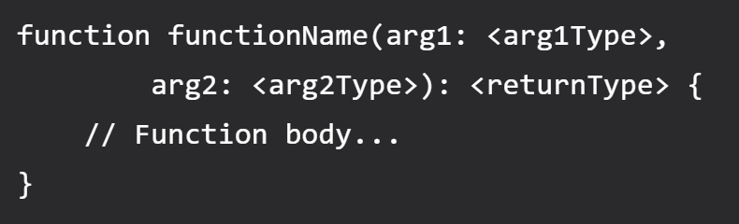
Functions
Writing a function in TypeScript is similar to writing them in JavaScript but with added parameters and return type. Note that any JavaScript function is a perfectly valid TypeScript function. However, we can do better by adding type.
TypeScript function syntax (with two arguments)

Slide 25
Function Parameters
Function Parameters are required, and you cannot pass extra arguments to a function
Function Parameters are also type safe, if you don't use any type explicitly
Adding an optional parameter is super simple, just add ? to the end of the argument name.
For default argument suffix it with an equal sign and default value (TS compiler will automatically deduce the type for default argument based on provided value).

Slide 26
Rest Parameter (…args)
A rest parameter allows you a function to accept zero or more arguments of the specified type.
In TypeScript, rest parameters follow these rules:
A function has only one rest parameter.
The rest parameter appears last in the parameter list.
The type of the rest parameter is an array type.
To declare a rest parameter, you prefix the parameter name with three dots and use the array type as the type annotation:

Slide 27
Lambda Expression
Implicit return
No braces for single expression
Part of ES6 termed as Arrow Functions
Lexically scoped this
You don't need to keep typing function
It lexically captures the meaning of arguments

Slide 28
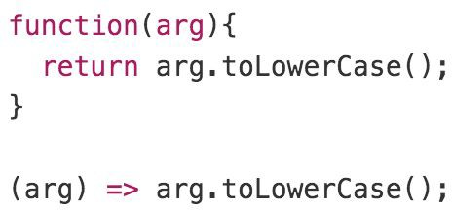
Lambda Example

Slide 29
Arrays
The use of variables to store values poses the following limitations −
Variables are scalar in nature. In other words, a variable declaration can only contain a single at a time. This means that to store n values in a program n variable declarations will be needed. Hence, the use of variables is not feasible when one needs to store a larger collection of values.
Variables in a program are allocated memory in random order, thereby making it difficult to retrieve/read the values in the order of their declaration.
TypeScript introduces the concept of arrays to tackle the same.
An array is a homogenous collection of values.
An array is a collection of values of the same data type.
It is a user defined type.

Slide 30
Features of an Array
An array declaration allocates sequential memory blocks.
Arrays are static. This means that an array once initialized cannot be resized.
Each memory block represents an array element.
Array elements are identified by a unique integer called as the subscript / index of the element.
Like variables, arrays too, should be declared before they are used. Use the var keyword to declare an array.
Array initialization refers to populating the array elements.
Array element values can be updated or modified but cannot be deleted.

Slide 31
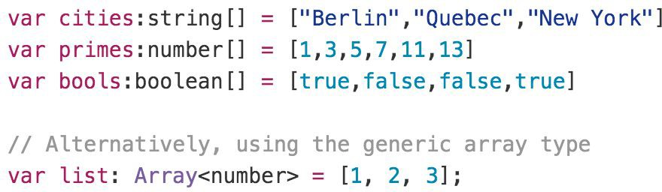
Array

Slide 32
Type Guards & Union Types
Type Guards allow you to narrow down the type of a variable within a conditional block.
Union types are a powerful way to express a value that can be one of the several types.
Two or more data types are combined using the pipe symbol (|) to denote a Union Type. In other words, a union type is written as a sequence of types separated by vertical bars.

Slide 33
Tuple
As we know array consists value of Homogeneous types but sometimes, we need to store a collection of a different type value in a single variable. Then we will go with Tuples.
Tuples are just like structure in C programming and can also be passed as parameters in a function call.
To denote a multi-dimensional coordinate system the term used is tuple in abstract mathematics.
In JavaScript we doesn’t have tuples as data types, but in typescript Tuple's facility is available.
Tuple values are individually called items. Tuples are index based. This means that items in a tuple can be accessed using their corresponding numeric index.

Slide 34
Enum
Enums or enumerations are a new data type supported in TypeScript. Most object-oriented languages like Java and C# use Enums. This is now available in TypeScript too.
In simple words, Enums allow us to declare a set of named constants i.e., a collection of related values that can be numeric or string values.
Using Enum, we can make it easier to document intent, or create a set of distinct cases.
There are three types of Enums:
Numeric Enum
String Enum
Heterogeneous Enum

Slide 35
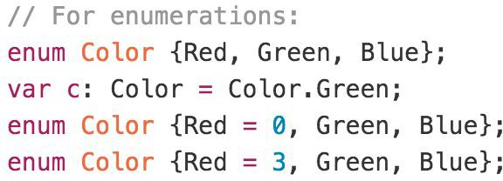
Enum
By default, Enums begin numbering their members starting at 0. You can change this by manually setting the value of one its members.

Slide 36
TypeScript Interface
Interface is a structure that defines the contract in your application.
Declared using interface keyword
Like other TypeScript features its design time features i.e., no extra code would be emitted to resultant JavaScript file
TypeScript compiler uses interface for type checking. This is also known as "duck typing" or "structural subtyping".
Errors being shown when interface signature and implementation doesn’t match.

Slide 37
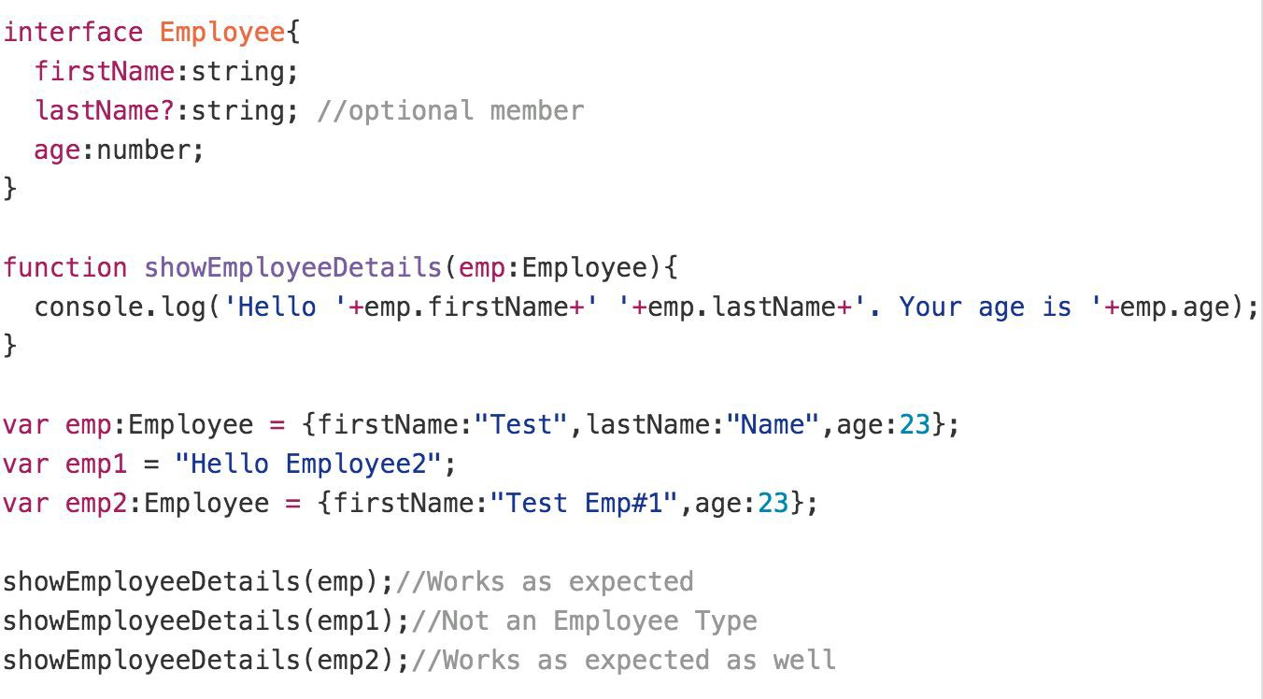
Interface Example

Slide 38
TypeScript Class
In object-oriented programming languages like Java and C#, classes are the fundamental entities used to create reusable components.
TypeScript introduced classes to avail the benefit of object-oriented techniques like encapsulation and abstraction.
The class in TypeScript is compiled to plain JavaScript functions by the TypeScript compiler to work across platforms and browsers.
The concept of 'Encapsulation' is used to make class members public or private i.e., a class can control the visibility of its members. This is done using access modifiers.
There are three types of access modifiers in TypeScript:
public (Default)
private
protected.

Slide 39
TypeScript Class
A class can have the following features
Instance methods/members
Single constructor with Default/Optional parameter
Optional and Required Members in Strict Mode
Parameter Members
Static methods/members
Readonly Members
Can implement interfaces
Inheritance

Slide 40
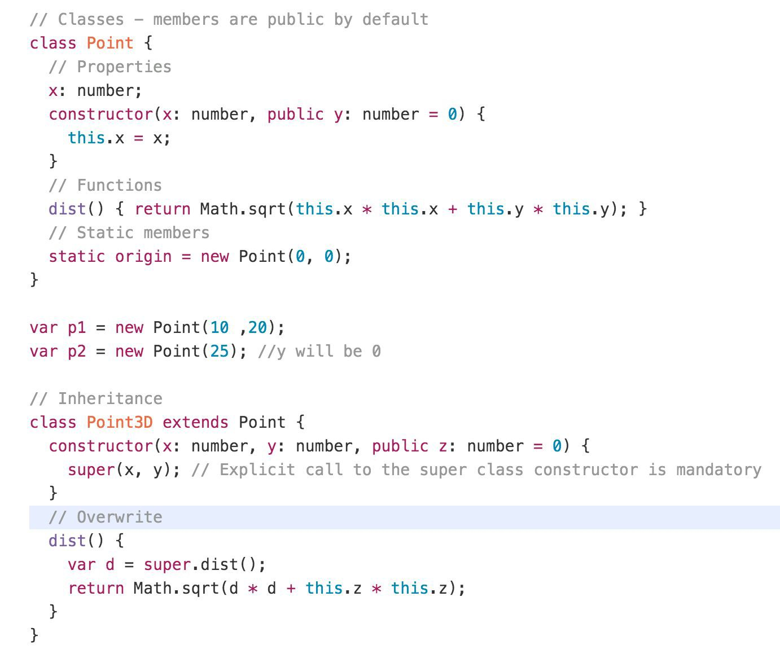
Class Example

Slide 41
Generics
When writing programs, one of the most important aspects is to build reusable components. This ensures that the program is flexible as well as scalable in the long-term.
Generics offer a way to create reusable components. Generics provide a way to make components work with any data type and not restrict to one data type.
So, components can be called or used with a variety of data types, without loosing type safety and intellisense.
Generic Type can be used with
Functions
Class
Interface

Slide 42
Generic Constraints
As mentioned earlier, the generic type allows any data type. However, we can restrict it to certain types using constraints.
A constraint is specified after the generic type in the angle brackets.
Constraints can be applied using:
extends
Type Parameters
Class Types
keyof

Slide 43
Generators
In TypeScript, generators provide a new way to work with functions and iterators. Generators provide an easier way to implement iterators.
Using a generator,
you can stop the execution of a function from anywhere inside the function
and continue executing code from a halted position
To create a generator, you need to first define a generator function with function* symbol.
You can pause the execution of a generator function without executing the whole function body by using yield keyword.
The yield expression returns a value. However, unlike the return statement, it doesn't terminate the program. That's why you can continue executing code from the last yielded position.

Slide 44
Generator Methods
Method | Description
next() | Returns a value of yield
return() | Returns a value and terminates the generator
throw() | Throws an error and terminates the generator

Slide 45
Uses of Generators
Generators let us write cleaner code while writing asynchronous tasks.
Generators provide an easier way to implement iterators.
Generators execute its code only when required.
Generators are memory efficient.

Slide 46
Decorators
Decorators provide a way to add both annotations and a meta-programming syntax.
A Decorator is a special kind of declaration that can be attached to a class declaration, method, accessor, property, or parameter.
Decorators use the form @expression, where expression must evaluate to a function that will be called at runtime with information about the decorated declaration.
Decorators are just a clean syntax for wrapping a piece of code with a function

Slide 47
Namespaces
The namespace is used for logical grouping of functionalities. A namespace can include interfaces, classes, functions and variables to support a single or a group of related functionalities.
A namespace can be created using the namespace keyword followed by the namespace name.
By default, namespace components cannot be used in other modules or namespaces.
You must export each component to make it accessible outside, using the export keyword
The generated JavaScript code for the namespace uses the IIFE pattern to stop polluting the global scope.

Slide 48
Modules
As our application grows bigger, we want to split it into multiple files, so called “modules”.
Until ES6, JavaScript existed without a language-level module syntax.
JavaScript community invented a variety of ways to organize code into modules, special libraries to load modules on demand.
AMD – one of the most ancient module systems, initially implemented by the library require.js.
CommonJS – the module system created for Node.js server.
UMD – one more module system, suggested as a universal one, compatible with AMD and CommonJS.
The language-level module system appeared in the standard in ECMASCRIPT 2015

Slide 49
Modules
A module is just a file. One typescript file is one module. As simple as that.
A module may contain a class or a library of functions for a specific purpose.
Modules can load each other and use special directives export and import to interchange functionality, call functions of one module from another one:
export keyword labels variables and functions that should be accessible from outside the current module.
import allows the import of functionality from other modules.

Slide 50
Namespace vs Module
Namespace | Module
Must use the namespace keyword and the export keyword to expose namespace components. | Uses the export keyword to expose module functionalities.
Used for logical grouping of functionalities with local scoping. | Used to organize the code in separate files and not pollute the global scope.
To use it, it must be included using triple slash reference syntax e.g., ///<reference path="path to namespace file" />. | Must import it first in order to use it elsewhere.
Compile using the --outFile command. | Compile using the --module command.
Must export functions and classes to be able to access it outside the namespace. | All the exports in a module are accessible outside the module.
Namespaces cannot declare their dependencies. | Modules can declare their dependencies.
No need of module loader. Include the .js file of a namespace using the <script> tag in the HTML page. | Must include the module loader API which was specified at the time of compilation e.g., CommonJS, require.js etc.

Slide 51
Build Tools
Build Tools are utilities that help automate the transformation and bundling of your code into a single file. Most JavaScript projects use these build tools to automate the build process.
There are several common build tools available that can be integrated with TypeScript.
Some of the tools are:
Browserify
Grunt
Gulp
Webpack

Slide 52
CLIENT SIDE BUILD
TypeScript (s)
.ts
Manual Configuration
Node JS
Webpack
TypeScript Config.
Test Config.
Jasmine
Karma
Protractor
TSC
Build & Deploy your
Project on Local Server
Build your project
Browser Compatible Files
(Multiple Files)
WEBPACK-DEV-
SERVER
WEBPACK
CLI
Bundling
BROWSER
WEBPACK
Single File / Set of Files
Local
HTTP Server
HTML PAGE
Deploy
Inject

Slide 53
Webpack Configuration Steps
Entry
Extensions
Loaders
Plugins
Optimization
Output

Slide 54
Steps to run the webpack application
Download and Extract the zip file.
Open the extracted folder in Visual Studio Code
Open the terminal window on the folder path and execute the following command
npm install
After the installation completes, execute the following command
npm run serve – To start the development server
npm run build – To create the dist folder with production build

Slide 55
Angular
An application design framework and development platform for creating efficient and sophisticated single-page apps.

Slide 56
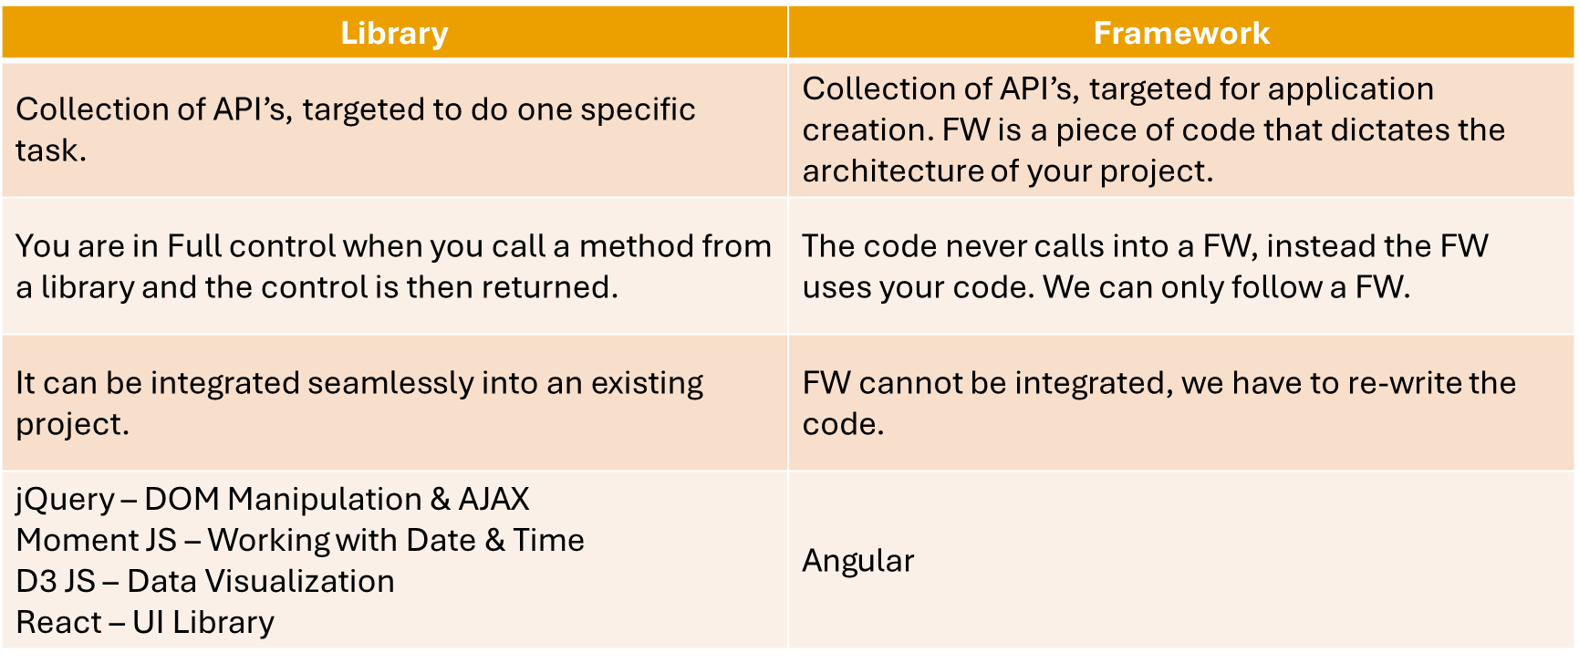
Library vs Framework

Slide 57
Angular CLI
The Angular CLI is a command-line interface tool that you use to initialize, develop, scaffold, and maintain Angular applications directly from a command shell.
Installing Angular CLI
Open terminal window on any path and execute the following command
npm install -g @angular/cli

Slide 58
Angular CLI (Commands)
ng add | ng help
ng analytics | ng lint
ng build | ng new
ng config | ng run
ng deploy | ng serve
ng doc | ng test
ng e2e | ng update
ng extract-i18n | ng version
ng generate

Slide 59
ANGULAR CLIENT SIDE BUILD
TypeScript (s)
.ts
Auto Configuration
Angular CLI
TSC
Build & Deploy your
Project on Local Server
Build your project
Browser Compatible Files
(Multiple Files)
WEBPACK-DEV-
SERVER
WEBPACK
CLI
Bundling
BROWSER
WEBPACK
Single File / Set of Files
Local
HTTP Server
HTML PAGE
Deploy
Inject

Slide 60
OUR APPLICATION ARCHITECTURE
NODE SERVER
localhost:3000
BROWSER
HTTP + URL
HTML PAGE
CSS
NAVIGATION
HTML + CSS + JS
(Client Side JS App - Angular)
JS
<table>
<thead>
<tr>
<th>ID</th>
</tr>
</thead>
<tbody>
<tr>
<td>1</td>
</tr>
</tbody>
</table>
SERVER
AJAX - HTTP + URL
RESTful API
ASP .NET Web API
Express JS
DB
JSON to HTML on Client Side
JSON
{
“id”:1
}
Angular 12

Slide 61
Creating Application
Multiple Projects in Single Workspace
ng new multi-apps --createApplication="false"
cd multi-apps
ng generate application app-one
ng generate application app-two
Run the Application
ng serve – This command will run the default project configured in angular.json file
ng serve --project=app-two – This command will run the project specified

Slide 62
Creating Application
Single Project in Single Workspace
ng new app-name
Run the Application
ng serve – This command will run the project

Slide 63
Composite UI
NAV COMPONENT + CSS
SIDE NAV COMPONENT
+ CSS
LIST COMPONENT
+ CSS
DETAILS COMPONENT
+ CSS
STATUS COMPONENT + CSS

Slide 64
Angular Packages
@angular/core: Critical runtime parts of the framework needed by every application. Includes all metadata decorators, Component, Directive, dependency injection, and the component lifecycle hooks.
@angular/common: The commonly needed services, pipes, and directives provided by the Angular team.
@angular/compiler: Angular Template Compiler. It understands templates and can convert them to code that makes the application run and render. Typically, you don’t interact with the compiler directly; rather, you use it indirectly via platform-browser-dynamic when JIT compiling in the browser.
@angular/platform-browser: Everything DOM and browser related, especially the pieces that help render into the DOM. This package also includes the bootstrapModuleFactory() method for bootstrapping applications for production builds that pre-compile with AOT.
@angular/platform-browser-dynamic: Includes Providers and methods to compile and run the app on the client using the JIT compiler.
@angular/forms: Support for both template-driven and reactive forms.
@angular/http: Angular old, deprecated, HTTP client.
@angular/animations: Angular animations library makes it easy to define and apply animation effects such as page and list transitions. Read about it in the Animations guide.
@angular/router: The router module navigates among your app pages when the browser URL changes.
@angular/upgrade: Set of utilities for upgrading Angular applications to new Angular Version.

Slide 65
Zone.js (NgZone)
Rxjs, Angular Packages
Runtime
MODULE
COMPONENT

Slide 66
Modules
Angular applications are modular and Angular has its own modularity system called NgModules.
NgModules are containers for a cohesive block of code dedicated to an application domain, a workflow, or a closely related set of capabilities.
They can contain components, service providers, and other code files whose scope is defined by the containing NgModule.
They can import functionality that is exported from other NgModules, and export selected functionality for use by other NgModules.

Slide 67
Component
Components are the most basic UI building block of an Angular app. An Angular app contains a tree of Angular components.
Angular components are a subset of directives, always associated with a template.
A component must belong to an NgModule in order for it to be available to another component or application.

Slide 68
MODULE
COMPONENT
VIEW (UI) *
STYLE (Inline, Inside, CSS)
DATA
State (Inside)
Properties (Outside)
BEHAVIOR (Methods) - Interaction

Slide 69
0
+
-
0
+
-
DOM Handler
DOM Handler
Counter
{
count: 0,
next: function() { this.count+= 1; }
prev: function() { this.count-= 1; }
}
Counter
{
count: 0,
next: function() { this.count+= 10; }
prev: function() { this.count-= 10; }
}
<Counter />
<Counter interval=10 />

Slide 70
ng generate
Generates and/or modifies files based on a schematic.
ng generate <schematic> [options]
ng g <schematic> [options]
Schematic
app-shell | directive | interface | resolver
application | enum | library | service
class | guard | module | service-worker
component | interceptor | pipe | web-worker

Slide 71
Multiple Tree of Components
NAV COMPONENT + CSS
ADVERTISEMENT
COMPONENT
SIDE NAV COMPONENT
+ CSS
LIST COMPONENT
+ CSS
DETAILS COMPONENT
+ CSS
STATUS COMPONENT + CSS

Slide 72
Angular Providers
The Angular Provider is an instruction (or recipe) that describes how an object for a certain token is created.
The Angular Providers is an array of such instructions (Provider). Each provider is uniquely identified by a token (or DI Token ) in the Providers Array.

Slide 73
View Encapsulation
In Angular, component CSS styles are encapsulated into the component's view and don't affect the rest of the application.
Angular comes with view encapsulation built in, which enables us to use Shadow DOM or even emulate it.
What is Shadow DOM?
Shadow DOM is part of the Web Components standard and enables DOM tree and style encapsulation.
It basically means that Shadow DOM allows us to hide DOM logic behind other elements.
It enables us to apply scoped styles to elements without them bleeding out to the outer world.

Slide 74
View Encapsulation
Emulated
No Shadow DOM
Style Encapsulation
ShadowDom
Enable Shadow DOM
Style Encapsulation
None
No Shadow DOM
No Style Encapsulation
Value: 0
Value: 1
Value: 2

Slide 75
Data Binding
Data binding is the core concept of Angular and used to define the communication between a component and the DOM.
It is a technique to link your data to your view layer.
In simple words, you can say that data binding is a communication between your typescript code of your component and your template which user sees.
Data binding automatically keeps your page up-to-date based on your application's state.

Slide 76
Types of Data binding
Angular provides three categories of data binding according to the direction of data flow:
From the source to view
From view to source
In a two-way sequence of view to source to view

Slide 77
Data Binding (Flow of Data)
SOURCE
Component Class
Data Members
Properties
TARGET
Component Template
Element Properties
Element Attributes
Interpolation {{dName}}
One Way Binding
Property and Attribute Binding
[propertyName] or bind-propertyName
[attr.AttributeName]
One Way To Source Binding
Event Binding
(eventName)

Slide 78
Zone
Application state change can be caused by:
Events – User events click, change, input, submit
XMLHttpRequests – When fetching data from a remote service
Timers – setTimeout(), setInterval()
Angular takes advantage of Zones (NgZone)
Zone monkey-patches global asynchronous operations such as setTimeout() and addEventListener(), which is why Angular can easily find out, when to update the DOM.

Slide 79
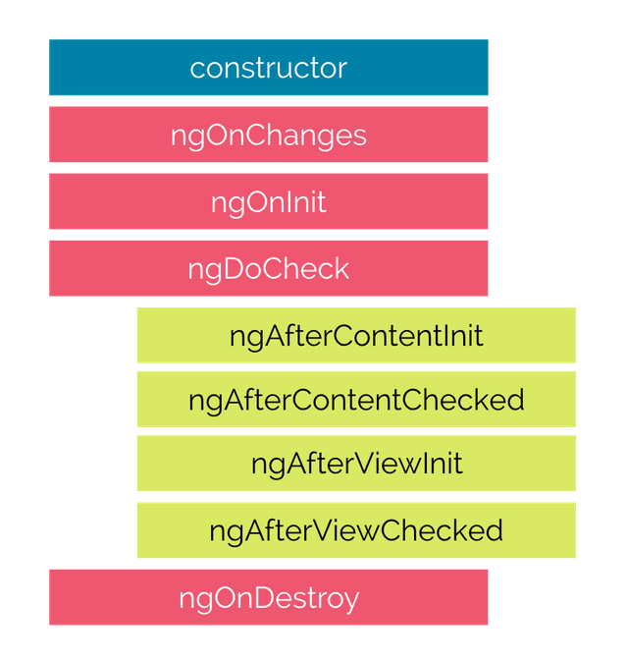
Life Cycle Hooks

Slide 80

Hooks for the Component
constructor : This is invoked when Angular creates a component or directive by calling new on the class.
ngOnChanges : Invoked every time, there is a change in one of the input properties of the component.
ngOnInit : Invoked when given component has been initialized. This hook is only called once after the first ngOnChanges
ngDoCheck : Invoked when the change detector of the given component is invoked. It allows us to implement our own change detection algorithm for the given component.
ngAfterContentInit : Invoked after Angular performs any content projection into the component’s
ngAfterContentChecked : Invoked each time the content of the given component has been checked by the change detection mechanism of Angular.
ngAfterViewInit : Invoked when the component’s view has been fully initialized.
ngAfterViewChecked : Invoked each time the view of the given component has been checked by the change detection mechanism of Angular
ngOnDestroy : This method will be invoked just before Angular destroys the component. Use this hook to unsubscribe observables and detach event handlers to avoid memory leaks.

Slide 81
Directives
Directives are classes that add additional behavior to elements in your Angular applications.
The different types of Angular directives are as follows:
Components—directives with a template. This type of directive is the most common directive type.
Attribute directives—directives that change the appearance or behavior of an element, component, or another directive. E.g., NgClass, NgStyle, NgModel
Structural directives—directives that change the DOM layout by adding and removing DOM elements. E.g., NgIf, NgFor, NgSwitch

Slide 82
Parent Child Communication
Parent
Parent
@Input()
Property
@Output()
Event Emitter
@Input()
Property
@Output()
Event Emitter
Template Ref (#c1)
@ViewChild
@ViewChildren
Child
Child One
Child Two

Slide 83
Parent
Child Two
Child One
Child Three
SERVICE

Slide 84
Pipes
Angular provides built-in pipes for typical data transformations, including transformations for internationalization (i18n), which use locale information to format data.
The following are commonly used built-in pipes for data formatting:
DatePipe: Formats a date value according to locale rules.
UpperCasePipe: Transforms text to all upper case.
LowerCasePipe: Transforms text to all lower case.
CurrencyPipe: Transforms a number to a currency string, formatted according to locale rules.
DecimalPipe: Transforms a number into a string with a decimal point, formatted according to locale rules.
PercentPipe: Transforms a number to a percentage string, formatted according to locale rules.

Slide 85
Forms
Reactive forms provide direct, explicit access to the underlying forms object model. Compared to template-driven forms, they are more robust: they're more scalable, reusable, and testable. If forms are a key part of your application, or you're already using reactive patterns for building your application, use reactive forms.
Template-driven forms rely on directives in the template to create and manipulate the underlying object model. They are useful for adding a simple form to an app, such as an email list signup form. They're easy to add to an app, but they don't scale as well as reactive forms. If you have very basic form requirements and logic that can be managed solely in the template, template-driven forms could be a good fit.

Slide 86
Key Differences
 | REACTIVE | TEMPLATE-DRIVEN
Setup of form model | Explicit, created in component class | Implicit, created by directives
Data model | Structured and immutable | Unstructured and mutable
Predictability | Synchronous | Asynchronous
Form validation | Functions | Directives

Slide 87
Built in Validators
min
max
required
requiredTrue
email
minLength
maxLength
pattern
nullValidator
compose
composeAsync

Slide 88
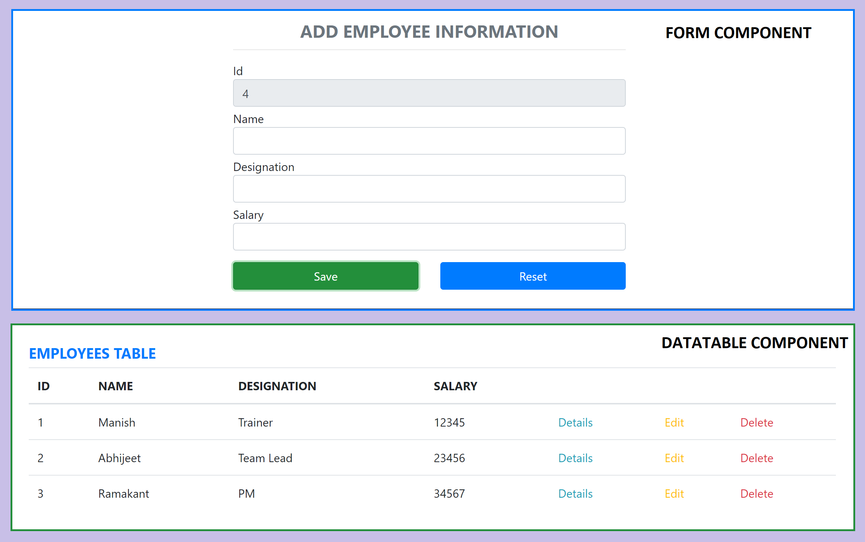
Assignment

Slide 89
Promise Vs Observable
Promise | Observables
Emit Single Value | Emit Multiple Values, over a period of time (Stream of Data)
Not Lazy | Lazy, observables will not execute unless we subscribe to it
Cannot be cancelled | Can be cancelled by using unsubscribe
Does not provide any operators | Observables provide a lot of built in operators i.e. map, forEach, filter, reduce, retry

Slide 90
RxJS
Reactive Extensions Library for JavaScript
RxJS is a library for reactive programming using Observables, to make it easier to compose asynchronous or callback-based code.
RxJS is a library for composing asynchronous and event-based programs by using observable sequences.
It provides one core type, the Observable, satellite types (Observer, Schedulers, Subjects) and operators inspired by Array#extras (map, filter, reduce, every, etc) to allow handling asynchronous events as collections.

Slide 91
Concepts in RxJS
Observable: represents the idea of an invokable collection of future values or events.
Observer: is a collection of callbacks that knows how to listen to values delivered by the Observable.
Subscription: represents the execution of an Observable, is primarily useful for cancelling the execution.
Operators: are pure functions that enable a functional programming style of dealing with collections with operations like map, filter, concat, reduce, etc.
Subject: is equivalent to an EventEmitter, and the only way of multicasting a value or event to multiple Observers.
Schedulers: are centralized dispatchers to control concurrency, allowing us to coordinate when computation happens on e.g. setTimeout or requestAnimationFrame or others.

Slide 92
Subject
A Subject is a special type of Observable that allows values to be multi-casted to many Observers.
A Subject is like an Observable but can multicast to many Observers.
Subjects are like EventEmitters: they maintain a registry of many listeners. Every Subject is an Observable and an Observer.
You can subscribe to a Subject and you can call next to feed values as well as error and complete.

Slide 93
Subject Type Variations to consider
Subject - a subscriber will only get published values that were emitted after the subscription.
BehaviorSubject - the last value is cached. A subscriber will get the latest value upon initial subscription. The semantics for this subject is to represent a value that changes over time.
ReplaySubject - it can cache up to a specified number of emissions if buffer Size is provided / else it is Infinity (Cache all published values). Any subscribers will get all the cached values upon subscription.

Slide 94
Services
Components shouldn't fetch or save data directly and they certainly shouldn't knowingly present fake data.
They should focus on presenting data and delegate data access to a service.
Instead of creating the service with the new keyword, you'll rely on Angular dependency injection to inject it into the Component’s constructor.
Services are a great way to share information among classes that don't know each other.

Slide 95
Dependency Injection (DI)
DI is wired into the Angular framework and used everywhere to provide new components with the services or other things they need.
Components consume services; that is, you can inject a service into a component, giving the component access to that service class.
The injector is the main mechanism. Angular creates an application-wide injector for you during the bootstrap process, and additional injectors as needed. You don't have to create injectors.
An injector creates dependencies and maintains a container of dependency instances that it reuses if possible.
A provider is an object that tells an injector how to obtain or create a dependency.
For any dependency that you need in your app, you must register a provider with the application's injector, so that the injector can use the provider to create new instances.

Slide 96
What is a Provider?
A provider in Angular acts like an instruction for the Dependency Injection system, which directs on how to get a value for a particular dependency.
These Dependencies are the services that we create and provide to Angular application module(s).
It helps the injector in, How to create/find the Dependency for a token.

Slide 97
Angular Providers
Providers are used to registering classes, functions, or values as dependencies using Angular’s Dependency Injection (DI) system.
Each Provider is located using a token.
Three types of token registration are available:
Type Token
String Token
Injection Token
Four ways can be used to create the dependency:
useClass : Class Provider
useValue: Value Provider
useFactory: Factory Provider
useExisting: Class as Alias Provider

Slide 98
Dependency Injection (DI)
Angular creates a hierarchical dependency injection system. It creates a hierarchical tree of Injectors.
Each Injector gets their own copy of Angular Providers.
Together these two form the core of the Angular dependency injection framework.
Angular Creates not one but two injector trees. Module Injector tree & Element Injector tree.
Module Injector tree is for Modules (@NgModule). For Root Module & for every Lazy Loaded Module.
Element Injector tree is for DOM Elements like Components & Directives.

Slide 99
Module Injector Tree
Angular creates the ModuleInjector for the services to be provided at Module Levels.
We register the Module level services in two ways
Using The Providers Metadata of the @NgModule()
Using the @Injectable() Decorator with providedIn : root in the service itself
Angular Creates the Module Injector tree when the Application starts.
At the top of the Module Injector tree, Angular creates an instance of Null Injector.
Under Null Injector Angular creates an instance of PlatformInjector.

Slide 100
Module Injector Tree
Null Injector
Platform Injector
RootModule Injector
Eager Module 1
Eager Module 2
Eager Module 3

Slide 101
Null Injector
The Null Injector always throws an error unless we decorate the dependency with the Optional decorator.
Optional Decorators
@Self
@SkipSelf
@Optional

Slide 102
Platform injector
The platformBrowserDynamic() method creates an injector configured by a PlatformModule, which contains platform-specific dependencies.
This allows multiple applications to share a platform configuration.
Platform Injector usually includes built-in providers like DomSanitize etc.

Slide 103
Element Injector
Angular creates the Element Injector tree for the services to be provided at the element level like Components & Directives.
Angular creates the Element Injector tree when the application starts.
The Injector instance of the Root Component becomes the root Injector for the Element Injector tree. It gets the Providers from the provider’s property of the Root Component.
The Root Component acts as a parent to every element we create. Each of those elements can contain child elements creating a tree of elements. The Angular creates an Injector for each of these elements creating a tree of Injectors.
Each Injector gets the list of Providers from the @Directive() or @Component(). If the Providers array is empty, then Angular creates an empty Injector.
The Angular will destroy the Injector when Angular destroys the element.

Slide 104
Element Injector Tree
Root Component
Parent Component A
Child Component C
Parent Component B
Child Component A
Child Component B
Grand Child Component

Slide 105
Dependency Resolution
When a component asks for Dependency, the DI Framework resolves it in two phases.
First phase
It starts to look for the Dependency in the current component’s ElementInjector.
If it does not provide the Dependency, it will look in the Parent Components ElementInjector.
The Request bubbles up until it finds an injector that provides the service or reaches the root ElementInjector.
Second phase - If ElementInjector does not satisfy the request
Angular looks for the Dependency in the ModuleInjector hierarchy.
If Angular still doesn’t find the provider, it throws an error.

Slide 106
Content Projection
Content projection is the ability to put HTML elements (or other Angular components) between the opening and closing tag of a component selector, and have that content displayed.
It allows for components to be even more reusable, as the user can determine what content to project.
The <ng-content> tag in an Angular component is what enables us to project content into our components.
You can also select certain parts of the projected content by class, attribute, id, or tag and place it in a certain location inside the component if needed.

Slide 107
@Injectable Services
A service imports the Angular Injectable symbol and annotates the class with the @Injectable() decorator.
This marks the class as one that participates in the dependency injection system.
The @Injectable() decorator accepts a metadata object for the service
providedIn - Determines which injectors will provide the injectable, by either associating it with an @NgModule or other InjectorType
root' : The application-level injector in most apps.
'platform' : A special singleton platform injector shared by all applications on the page.
'any' : Provides a unique instance in each lazy loaded module while all eagerly loaded modules share one instance.

Slide 108
Communicating with backend services using HTTP
Most front-end applications need to communicate with a server over the HTTP protocol, to download or upload data and access other back-end services.
Angular provides a client HTTP API for Angular applications, the HttpClient service class in @angular/common/http.
The HTTP client service offers the following major features.
The ability to request typed response objects.
Streamlined error handling.
Testability features.
Request and response interception.

Slide 109
NODE SERVER
BROWSER
HTTP + URL (localhost:3000)
NAVIGATION
React Application
User clicks on Admin Link, component calls the API in ngOnInit(), modifies the state and displays the data
HTML Page + JS (Angular App)
NODE SERVER
EXPRESS JS
Web API
AJAX – localhost:8000/api/users
Database
JSON

Slide 110
NODE SERVER
BROWSER
HTTP + URL (localhost:3000)
NAVIGATION
React Application
User clicks on Admin Link, code to verify token in sessionStorage, if not, redirect to Login Component
HTML Page + JS (Angular App)
HTTP + URL (AJAX) + Username & Password
NODE SERVER
EXPRESS JS
Web API
JSON with Token
{“token”:”___”}
Store Token in Session
Storage of the browser
Send the same token to
Access data from the
server
AJAX – localhost:8000/api/users + Token
Database
JSON

Slide 111
Angular Route Guards
CanActivate
Checks to see if a user can visit a route.
CanActivateChild
Checks to see if a user can visit a routes children.
CanDeactivate
Checks to see if a user can exit a route.
CanLoad
Checks to see if a user can route to a module that is lazy loaded.
Resolve
Performs route data retrieval before route activation.

Slide 112
Secure Application using Route Guards
When user clicks the Admin Link, we need to verify that we have a token in session storage, and if the token in not there in the session storage, redirect the request to login component. (CanActivateAdminGuard)
CanActivateAdminGuard uses Authenticator Service, getToken() to get the token.
If token is undefined, the request is redirected to Login Component
If token is available, the request is allowed for Admin Component.
Logging and Token Management (Authenticator Service)
On Login Component, user must give username and password, which will be sent to Node API Server
If the username & password is correct, in the response token will come from the Server
Received token will be stored in the session storage of the browser.
Reading and Attaching Token (TokenInterceptor Service)
Whenever the AJAX request is made for api, tokenInterceptor, intercepts and attaches token in the request header.
It uses authenticator service to read the token from session storage.

Slide 113
Angular Animations
Animation provides the illusion of motion: HTML elements change styling over time.
Well-designed animations can make your application more fun and easier to use.
Animations can improve your application and user experience in several ways:
Without animations, web page transitions can seem abrupt and jarring.
Motion greatly enhances the user experience, so animations give users a chance to detect the application's response to their actions.
Good animations intuitively call the user's attention to where it is needed.
An HTML element can move, change color, grow or shrink, fade, or slide off the page.
These changes can occur simultaneously or sequentially.
You can control the timing of each transformation.

Slide 114
Angular Animations
Angular's animation system is built on CSS functionality
You can animate any property that the browser considers animatable.
This includes positions, sizes, transforms, colors, borders, and more.
To Enable Animations:
Import BrowserAnimationsModule, which introduces the animation capabilities into your Angular root application module.
Importing animation functions
Add the animation metadata property to the Component
Apply animation using HostBinding or Use it on specific area using @

Slide 115
Animation Methods
The following list shows some of the methods used to build Angular animations.
The trigger(...) method encapsulates a single element of animation inside the animations array.
The state(...) method declares an animation state within a trigger attached to an element.
style(…) method declares a key/value object containing CSS properties/styles that can then be used for an animation state, within an animation sequence, or as styling data for calls to animate() and keyframes().
animate(…) method produces a reusable animation that can be invoked in another animation or sequence
transition(…) method declares an animation transition as a sequence of animation steps to run when a given condition is satisfied.

Slide 116
What to learn next?
How to use Component Library with Angular
ng-bootstrap | Angular UI Component Library
ngx-bootstrap | Angular UI Component Library (Valor Software)
Material | Angular UI Component Library
PrimeNG | Angular UI Component Library (primefaces.org)
Kendo UI for Angular | Angular UI Component Library (Telerik)
NgRx
Angular - Testing

Slide 117

Contact Me
Manish Sharma | Gmail
Manish Sharma | WhatsApp
Manish Sharma | Facebook
Manish Sharma | LinkedIn

