Slide 1

NODE JS
Node.js® is a JavaScript runtime built on Chrome's V8 JavaScript engine.

Slide 2
Installation
Install Node 14 LTS version - https://nodejs.org/en/
Install / Update Visual Studio Code to Latest Release - https://code.visualstudio.com/
Extensions of VS Code
AutoFileName
vscode-icons
JavaScript (ES6) code snippets
Node.js Modules Intellisense

Slide 3
BROWSER
SERVER
HTTP + URL
NAVIGATION
Server PAGES
CSS
HTML + CSS + JS
AJAX - HTTP + URL
JS
Partial
Page
Reload!
PARTIAL HTML
<table>
<thead>
<tr>
<th>ID</th>
</tr>
</thead>
<tbody>
<tr>
<td>1</td>
</tr>
</tbody>
</table>
ASP
ASP .NET
JSP
Express JS
ASP .NET MVC
Spring MVC
Ruby On Rails
Sails JS
DB

Slide 4
SERVER
Single Page Application (SPA)
SERVER PAGES
CSS
BROWSER
HTTP + URL
NAVIGATION
JS
HTML + CSS + JS
(Client Side JS App)
ASP
ASP .NET
JSP
Express JS
ASP .NET MVC
Spring MVC
Ruby On Rails
Sails JS
<table>
<thead>
<tr>
<th>ID</th>
</tr>
</thead>
<tbody>
<tr>
<td>1</td>
</tr>
</tbody>
</table>
SERVER
AJAX - HTTP + URL
RESTful API
ASP .NET Web API
JWS
Express JS
Python
DB
JSON to HTML on Client Side
JSON
{
“id”:1
}
Vanilla JS, jQuery, KO, BB, NG1,
NG2 or above, React, Vue

Slide 5
SERVER
Single Page Application (SPA)
SERVER PAGES
CSS
BROWSER
HTTP + URL
NAVIGATION
JS
HTML + CSS + JS
(Client Side JS App)
ASP
ASP .NET
JSP
Express JS
ASP .NET MVC
Spring MVC
Ruby On Rails
Sails JS
<table>
<thead>
<tr>
<th>ID</th>
</tr>
</thead>
<tbody>
<tr>
<td>1</td>
</tr>
</tbody>
</table>
Account
Service
AJAX - HTTP + URL
API GATEWAY
JSON
{
“id”:1
}
Inventory
Service
JSON to HTML on Client Side
Vanilla JS, jQuery, KO, BB, NG1,
NG2 or above, React, Vue
Shipping
Service

Slide 6
JavaScript Full Stack Application
 | Database | Application FW API FW | Client Side | Runtime
MEAN | MongoDB | Express JS | Angular | Node
MERN | MongoDB | Express JS | React JS | Node
MEVN | MongoDB | Express JS | Vue JS | Node

Slide 7
Supported | ES 3 | ES 3
 | ES 5 | ES 5
 | ECMASCRIPT 2015 | ES 6
 | ECMASCRIPT 2016 | ES 7
 | ECMASCRIPT 2017 | ES 8
 | ECMASCRIPT 2018 | ES 9
 | ECMASCRIPT 2019 | ES 10
 | ECMASCRIPT 2020 | ES 11
Not Supported | ECMASCRIPT 2021 | ES 12
 | ECMASCRIPT 2022 | ES 13

Slide 8
process
(Node Process)
NODE EXE (NODE PROCESS)
V8 Engine
Node JS API’s
Application
(JavaScript)
+
Third Party Modules
NATIVE CODE
O. S.

Slide 9
Modules
Module in Node.js is a simple or complex functionality organized in single or multiple JavaScript files which can be reused throughout the Node.js application.
Each module in Node.js has its own context, so it cannot interfere with other modules or pollute global scope. Also, each module can be placed in a separate .js file under a separate folder.
Node.js implements CommonJS modules standard.
CommonJS is a group of volunteers who define JavaScript standards for web server, desktop, and console application.

Slide 10
Types of Module
Core Modules (Built in Modules)
Global Objects
User Defined Modules (Developer Created Modules)
External Modules (Third Party Developers)
Are available on the NPM Repository

Slide 11
Node Global Objects
Node.js Global Objects are those objects which are present in all modules.
Global Objects can be used directly in the application which is available without importing any module.
Global objects have been added keeping in mind that these are some basic requirements and one can require these anytime, so it is better to keep them global rather than to add specific modules for these objects.
Some of the Node.js Global Objects:
Buffer Class
console
process
setImmediate
setTimeout

Slide 12
User Defined Modules / Local Modules
Local modules are created by us locally in our Node.js application.
These modules are included in our program using require() function.
In the require() function to load the local module, you must provide full qualified path of the file (module) or the folder containing the index.js file.

Slide 13
require(Path)
User-defined / Local Modules
Module Loader will search for a file on the path specified
Y
N
Load and cache the file on the memory
Module Loader will search for a folder on the path specified
Y
N
Search inside folder, file with the name ‘package.json’
Error Loading Module
Y
N
N
In ‘package.json’, read ‘main’ key
Search inside folder, file with the name ‘index.js’
N
Y
Y
Search file mentioned in ‘main’
N
Load and cache the file on the memory
Y
Load and cache the file on the memory
NODE JS Module Resolution
NOTE: Module Loader will search files, only with .js extension

Slide 14
Built-in Modules / Core Modules
Built-in modules are part of NodeJS and come with the Node.js installation process and are also known as core modules.
To load/include this module in our program, we use the require() function, with the ModuleName
The return type of require() function depends on what the particular module returns.

Slide 15
Built In Modules
Module | Description
assert | Provides a set of assertion tests
buffer | To handle binary data
child_process | To run a child process
cluster | To split a single Node process into multiple processes
crypto | To handle OpenSSL cryptographic functions
dgram | Provides implementation of UDP datagram sockets
dns | To do DNS lookups and name resolution functions
events | To create and handle events
fs | To handle the file system
http | To make Node.js act as an HTTP server
https | To make Node.js act as an HTTPS server.

Slide 16
Built In Modules Continued
Module | Description
net | To create servers and clients
os | Provides information about the operation system
path | To handle file paths
querystring | To handle URL query strings
readline | To handle readable streams one line at the time
stream | To handle streaming data
string_decoder | To decode buffer objects into strings
timers | To execute a function after a given number of milliseconds
tls | To implement TLS and SSL protocols
tty | Provides classes used by a text terminal
url | To parse URL strings

Slide 17
Built In Modules Continued
Module | Description
util | To access utility functions
v8 | To access information about V8 (the JavaScript engine)
vm | To compile JavaScript code in a virtual machine
zlib | To compress or decompress files

Slide 18
ReadStream
HTTP responses, on the client
HTTP requests, on the server
fs read streams
zlib streams
crypto streams
TCP sockets
Child process stdout and stderr
process.stdin

Slide 19
WriteStream
HTTP requests, on the client
HTTP responses, on the server
fs read streams
zlib streams
crypto streams
TCP sockets
Child process stdin
process.stdout and process.stderr

Slide 20
N
Module Loader will search inside node_modules folder of your application
N
require(ModuleName)
Module Loader will search in built-in modules
Y
Y
Module Loader will search for a file inside node_modules
Error Loading Module
Load the module on the memory
Y
N
Load and cache the file on the memory
Module Loader will search for a folder inside node_modules
Y
N
Built-in / Third Party Modules
Search inside folder, file with the name ‘package.json’
Error Loading Module
Y
N
N
In ‘package.json’, read ‘main’ key
Search inside folder, file with the name ‘index.js’
N
Y
Y
Search file mentioned in ‘main’
N
Load and cache the file on the memory
Y
NODE JS Module Resolution
NOTE: Module Loader will search files, only with .js extension
Load and cache the file on the memory

Slide 21
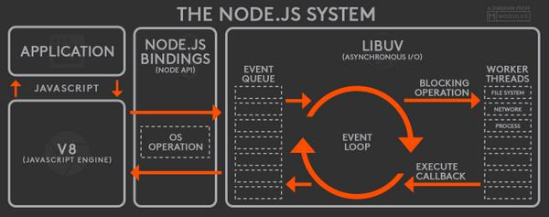

Slide 22
Node FS Module
The Node.js file system module allows you to work with the file system on your computer.

Slide 23
fs Module Methods
fs.access(): check if the file exists and Node.js can access it with its permissions
fs.appendFile(): append data to a file. If the file does not exist, it's created
fs.chmod(): change the permissions of a file specified by the filename passed. Related: fs.lchmod(), fs.fchmod()
fs.chown(): change the owner and group of a file specified by the filename passed. Related: fs.fchown(), fs.lchown()
fs.close(): close a file descriptor
fs.copyFile(): copies a file
fs.createReadStream(): create a readable file stream
fs.createWriteStream(): create a writable file stream
fs.link(): create a new hard link to a file
fs.mkdir(): create a new folder

Slide 24
fs Module Methods
fs.mkdtemp(): create a temporary directory
fs.open(): set the file mode
fs.readdir(): read the contents of a directory
fs.readFile(): read the content of a file. Related: fs.read()
fs.readlink(): read the value of a symbolic link
fs.realpath(): resolve relative file path pointers (., ..) to the full path
fs.rename(): rename a file or folder
fs.rmdir(): remove a folder
fs.stat(): returns the status of the file identified by the filename passed. Related: fs.fstat(), fs.lstat()
fs.symlink(): create a new symbolic link to a file

Slide 25
fs Module Methods
fs.truncate(): truncate to the specified length the file identified by the filename passed. Related: fs.ftruncate()
fs.unlink(): remove a file or a symbolic link
fs.unwatchFile(): stop watching for changes on a file
fs.utimes(): change the timestamp of the file identified by the filename passed. Related: fs.futimes()
fs.watchFile(): start watching for changes on a file. Related: fs.watch()
fs.writeFile(): write data to a file. Related: fs.write()

Slide 26
Events
Node.js core API is built around an idiomatic asynchronous event-driven architecture in which objects called "emitters" emit named events that cause Function objects "listeners" to be called.
All objects that emit events are instances of the EventEmitter class.
These objects expose an eventEmitter.on() function that allows one or more functions to be attached to named events.
When the EventEmitter object emits an event, all the functions attached to that specific event are called synchronously.

Slide 27
BankAccount Class
withdraw(amount)
deposit(amount)
Create BankAccount class with withdraw, deposit and other methods if needed.
Withdraw should show error if amount is greater than balance in account
Show message after withdraw and deposit call, showing current balance
Send a SMS after withdraw or deposit is called
Send an Email after withdraw or deposit is called
Follow SOLID principal’s of writing code
SMS Class
send(msg)
EMAIL Class
send(msg)
Whatsapp Class
send(msg)

Slide 28
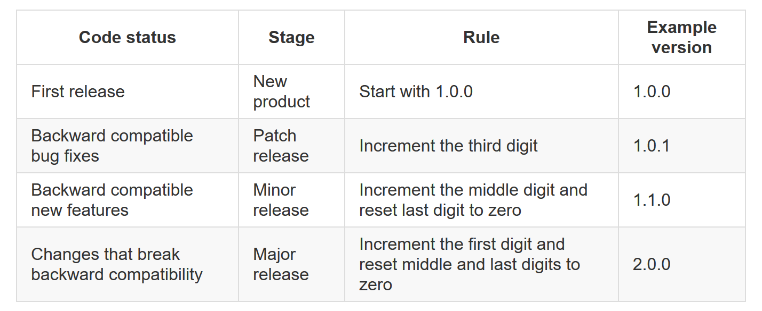

Slide 29
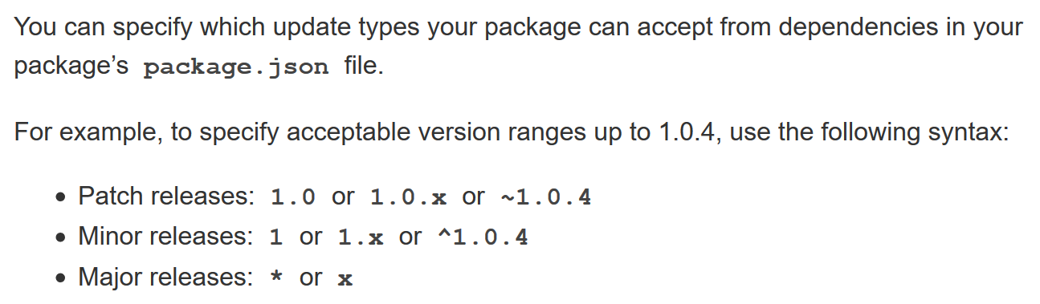

Slide 30
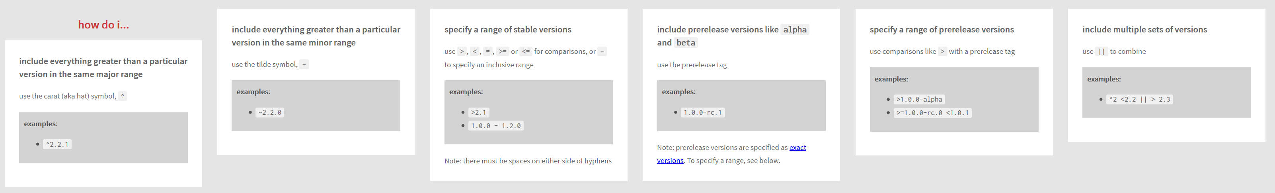

Slide 31
npm
Global Installation
npm install -g <package_name>
Local Installation
Production Packages
npm install --save <package_name>
npm install <package_name>
npm i <package_name>
Developement Packages
npm install --save-dev <package_name>
npm install --dev <package_name>
npm i -D <package_name>
npm un <package_name>
npm un -g <package_name>

Slide 32
Steps to run the application
Download and Extract the zip file.
Open the extracted folder in Visual Studio Code
Open the terminal window on the folder path and run
npm install
After the installation completes, run
node app.js

Slide 33
Express JS
Fast, unopinionated, minimalist web framework for Node.js
Express is a minimal and flexible Node.js web application framework that provides a robust set of features for web and mobile applications.
With a myriad of HTTP utility methods and middleware at your disposal, creating a robust API is quick and easy.

Slide 34
Template Engines
A template engine enables you to use static template files in your application.
At runtime, the template engine replaces variables in a template file with actual values and transforms the template into an HTML file sent to the client.
This approach makes it easier to design dynamic HTML pages.

Slide 35
Template Engines
There are multiple template engines that work “out-of-the-box” with Express, some examples are:
Pug: Haml-inspired template engine (formerly Jade).
Haml.js: Haml implementation.
EJS: Embedded JavaScript template engine.
hbs: Adapter for Handlebars.js, an extension of Mustache.js template engine.
All out-of-the-box Template Engines

Slide 36
Express and Middleware
Express is a routing and middleware web framework that has minimal functionality of its own.
An Express application is essentially a series of middleware function calls.
Middleware is a subset of chained function called by the Express app before the user-defined handler is invoked.
Middleware functions have full access to the request and response objects and the next middleware function in the application’s request-response cycle.
Middleware functions can perform the following tasks:
Execute any code.
Make changes to the request and the response objects.
End the request-response cycle.
Call the next middleware function in the stack.

Slide 37
Request Processing Pipeline
REQUEST
RESPONSE
Middleware (Logging, Authentication, Authorization e.t.c.)

Slide 38
Types of middleware
An Express application can use the following types of middleware:
Application-level middleware
Router-level middleware
Error-handling middleware
Built-in middleware
Third-party middleware

Slide 39
Process managers for Express apps
When you run Express apps for production, it is helpful to use a process manager to:
Restart the app automatically if it crashes.
Gain insights into runtime performance and resource consumption.
Modify settings dynamically to improve performance.
Control clustering.
A process manager is somewhat like an application server: it’s a “container” for applications that facilitates deployment, provides high availability, and enables you to manage the application at runtime.

Slide 40
Process managers for Express apps
Most popular process managers for Express and other Node.js applications are:
Forever
PM2
StrongLoop Process Manager (Strong-PM)
SystemD

Slide 41
DAL
2
3
1. REQUEST
ROUTER
6 . RESPONSE
4
5
VIEWS

Slide 42
DAL
3
4
1. REQUEST
ROUTER
2
CONTROLLER
8 . RESPONSE
7
5
6
VIEWS

Slide 43
Express-generator
npm i -g express-generator (Once)
npm i -g npm-check-updates (Once)
Create a new application
express --view=pug 7_express-app
cd 7_express-app
ncu
ncu -u
npm install
npm i -D nodemon
Change start script to use nodemon (package.json file)
npm start

Slide 44
Assignment
Create a CRUD application to work with employee data.
Persist the data in JSON file (employees.json)
Employee Schema
id – number
name – string
designation – string
salary – number

Slide 45

Contact Me
Manish Sharma | Gmail
Manish Sharma | WhatsApp
Manish Sharma | Facebook
Manish Sharma | LinkedIn

