Slide 1

Vue JS

Slide 2
BROWSER
SERVER
HTTP + URL
NAVIGATION
HTML PAGES
CSS
HTML + CSS
HTTP + URL
HTML + CSS
Page
Reload!

Slide 3
BROWSER
SERVER
HTTP + URL
NAVIGATION
HTML + CSS
Server PAGES
CSS
HTTP + URL
ASP
ASP .NET
JSP
PHP
Ruby
HTML + CSS
Page
Reload!
DB

Slide 4
BROWSER
SERVER
HTTP + URL
NAVIGATION
Server PAGES
CSS
HTML + CSS + JS
AJAX - HTTP + URL
JS
Partial
Page
Reload!
PARTIAL HTML
<table>
<thead>
<tr>
<th>ID</th>
</tr>
</thead>
<tbody>
<tr>
<td>1</td>
</tr>
</tbody>
</table>
ASP
ASP .NET
JSP
PHP
Ruby
ASP .NET MVC
Spring MVC
Ruby On Rails
DB

Slide 5
Single Page Application (SPA)
SERVER
SERVER PAGES
CSS
BROWSER
HTTP + URL
NAVIGATION
JS
HTML + CSS + JS
(Client Side JS App)
ASP
ASP .NET
JSP
PHP
Ruby
ASP .NET MVC
Spring MVC
Ruby On Rails
<table>
<thead>
<tr>
<th>ID</th>
</tr>
</thead>
<tbody>
<tr>
<td>1</td>
</tr>
</tbody>
</table>
SERVER
AJAX - HTTP + URL
RESTful API
ASP .NET Web API
JWS
Express JS
Python
DB
JSON to HTML on Client Side
JSON
{
“id”:1
}
Vanilla JS, jQuery, KO, BB, NG1,
NG 2 and Above, React, Vue

Slide 6
Single Page Application (SPA)
SERVER
SERVER PAGES
CSS
BROWSER
HTTP + URL
NAVIGATION
JS
HTML + CSS + JS
(Client Side JS App)
ASP
ASP .NET
JSP
PHP
Ruby
ASP .NET MVC
Spring MVC
Ruby On Rails
<table>
<thead>
<tr>
<th>ID</th>
</tr>
</thead>
<tbody>
<tr>
<td>1</td>
</tr>
</tbody>
</table>
Account
Service
AJAX - HTTP + URL
API GATEWAY
JSON
{
“id”:1
}
Inventory
Service
JSON to HTML on Client Side
Vanilla JS, jQuery, KO, BB, NG1,
NG 2 and Above, React, Vue
Shipping
Service

Slide 7
JavaScript Full Stack Application
 | Database | Application FW API FW | Client Side | Runtime
MEAN | MongoDB | Express JS | Angular | Node
MERN | MongoDB | Express JS | React JS | Node
MEVN | MongoDB | Express JS | Vue JS | Node

Slide 8
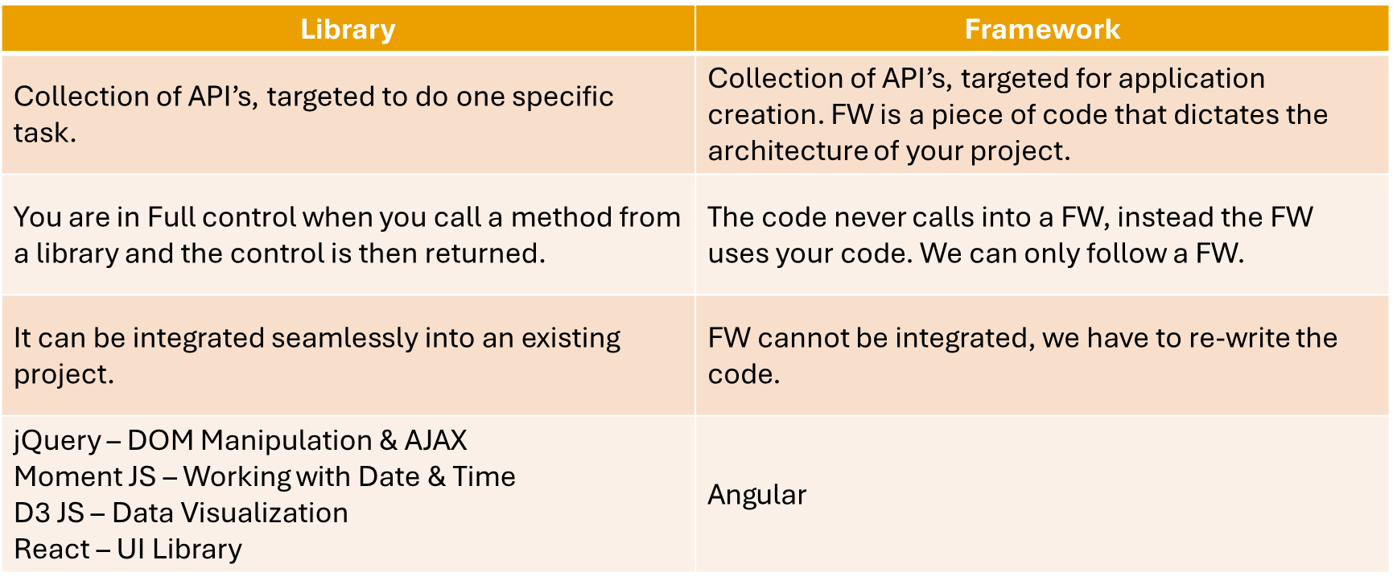
Library vs Framework

Slide 9
Vue JS
Vue is a progressive framework for building user interfaces.
Vue is designed from the ground up to be incrementally adoptable.
Vue is easy to pick up and integrate with other libraries or existing projects.
Vue is also perfectly capable of powering sophisticated Single-Page Applications when used in combination with modern tooling and supporting libraries.
Like Vue Router and Vuex

Slide 10
Installation
Install Node 14 LTS version - https://nodejs.org/en/
Install / Update Visual Studio Code to Latest Release - https://code.visualstudio.com/
Extensions of VS Code
AutoFileName
vscode-icons
JavaScript (ES6) code snippets
CSS Formatter
IntelliSense for CSS class names in HTML
Vetur
Vue VSCode Snippets
Extension for Chrome
Vue.js DevTools - https://chrome.google.com/webstore/detail/vuejs-devtools/nhdogjmejiglipccpnnnanhbledajbpd

Slide 11
Create Application
Refer Vue Framework JS file, on HTML Page and compile everything on the Client Side
If we want to create SPA, with multiple source files, we will need a Build environment
Manual Configuration
Webpack + Babel
Auto Configuration
Vue CLI
Note: Vue 2 CLI use Webpack as build tool and Vue 3 CLI uses Vite as build tool

Slide 12
ES 2015 +
(Multiple Files)
CLIENT-SIDE BUILD USING WEBPACK
Babel + Vue +
Preset (Env) +
Polyfill (core-js)
Build & Deploy your
Project on Local Server
Build your project
Browser Based Compatible Files
(Multiple Files)
WEBPACK-DEV-
SERVER
WEBPACK
CLI
Bundling
(Webpack)
BROWSER
WEBPACK
Single File / Set of Files
Local
HTTP Server
HTML PAGE
Inject Bundles

Slide 13
Vue CLI
Vue CLI is a full system for rapid Vue.js development, providing:
Interactive project scaffolding via @vue/cli.
Zero config rapid prototyping via @vue/cli + @vue/cli-service-global.
A runtime dependency (@vue/cli-service) that is:
Upgradeable;
Built on top of webpack, with sensible defaults;
Configurable via in-project config file;
Extensible via plugins
A rich collection of official plugins integrating the best tools in the frontend ecosystem.
A full graphical user interface to create and manage Vue.js projects

Slide 14
Components of Vue CLI
The CLI (@vue/cli) is a globally installed npm package and provides the vue command in your terminal. It provides the ability to quickly scaffold a new project via vue create, or instantly prototype new ideas via vue serve
The CLI Service (@vue/cli-service) is a development dependency. It's a npm package installed locally into every project created by @vue/cli.
CLI Plugins are npm packages that provide optional features to your Vue CLI projects, such as Babel/TypeScript transpilation, ESLint integration, unit testing, and end-to-end testing.

Slide 15
Install and Use Vue CLI (For Our Session)
npm install -g @vue/cli
Check the installation using
vue --version
To Create a Vue Project
vue create vue-core (Will prompt for options – Select v2)
cd vue-core
npm run serve

Slide 16
To Create Vue 3 Application (Webpack)
npm install -g @vue/cli
Check the installation using
vue --version
To Create a Vue Project
vue create vue-core -d (With default options automatically picked as Vue 3)
or
vue create vue-core (Will prompt for options – Select v3)
cd vue-core
npm run serve

Slide 17
To Create Vue 3 Application (Vite)
npm init vue@latest
Will prompt for options, configure the options as needed and enjoy Vue 3 application using Vite Build

Slide 18
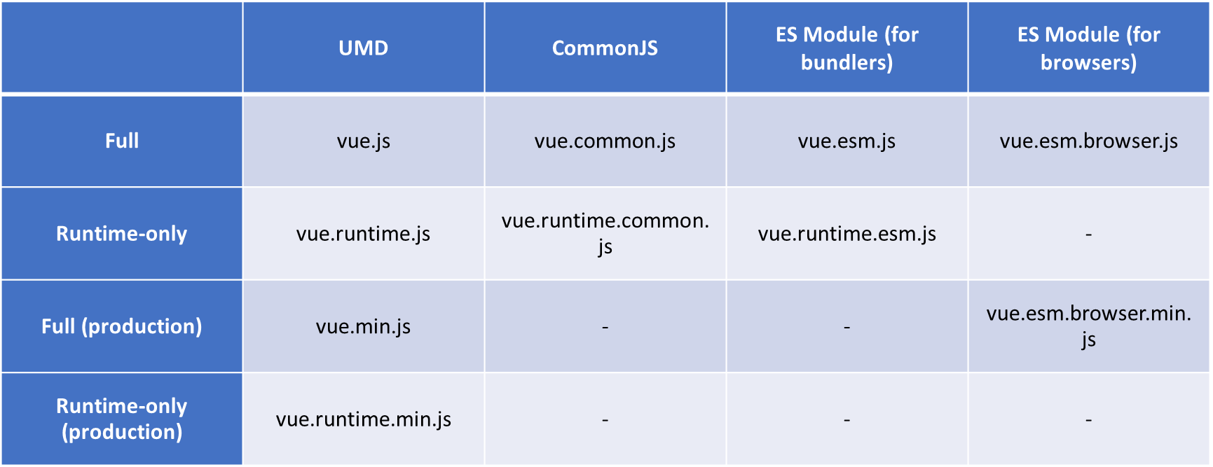
Vue Builds
In the dist/ directory of the NPM package you will find many different builds of Vue.js. Here’s an overview of the difference between them:

Slide 19
Vue JS App Builds
Compiler
code that is responsible for compiling template strings into JavaScript render functions.
Builds of Vue JS
Full Build
builds that contain both the compiler and the runtime.
Runtime Only (Pre-Compiled Templates)
code that is responsible for creating Vue instances, rendering and patching virtual DOM, etc. Basically everything minus the compiler.
UMD
UMD builds can be used directly in the browser via a <script> tag.
CommonJS:
CommonJS builds are intended for use with older bundlers like browserify or webpack 1.
ES Module: starting in 2.6 Vue provides two ES Modules (ESM) builds:
ESM for bundlers: intended for use with modern bundlers like webpack 2 and above or Rollup.
ESM for browsers (2.6+ only): intended for direct imports in modern browsers via <script type="module">.

Slide 20
Component Components are reusable Vue instances with a name
VUE COMPONENT
UI*
Template – HTML / JSX / PUG
STYLE
CSS / JSX
DATA (State)
Inside – data(), computed
Outside – props
BEHAVIOR
Methods (Interaction)

Slide 21
Composite UI
NAV COMPONENT + CSS
SIDE NAV COMPONENT
+ CSS
LIST COMPONENT
+ CSS
DETAILS COMPONENT
+ CSS
STATUS COMPONENT + CSS

Slide 22
Styling Vue components with CSS
Vue has following approaches to styling apps:
Global styles in Single File Components (.vue files).
There are some styles that we will want to apply across components in our app. To do so efficiently, we will use global styling, rather than styling them in a scoped or external file
Component-scoped styles in Single File Components.
The scoped attribute attached to the style tag below means that any CSS style defined here is only going to be applied to this template and not outside the component/template.
External CSS files.
As our application grows bigger with lots of CSS, it is recommend separating the CSS styles into an external CSS file and linking it to the component. This is just one of many ways to clean up your code.
Use inline styling
An inline CSS is used to apply a unique style to a particular HTML element using the style attribute.
We can also add an inline style to our element by binding the style attribute in the HTML tag.

Slide 23
Scoped vs Module CSS
They're both ways of handling scoped CSS and do pretty much the same thing. The way they handle it is a bit different though.
Scoped styles in Vue is just normal CSS but with some additional classes added scoping. It's similar to the shadow DOM in that it will scope things out to a component. The benefit of this approach is you carry on writing CSS how you usually do but you get some additional scoping if that's what you want.
CSS Modules is different in that it uses Webpack to compile unique class names based on the block and class. It's kind of automatically creating unique BEM classes. It has a lot of additional functionality above CSS.
CSS Modules is not a Vue specific thing so if you learnt that you could apply it to any build where you can import CSS Modules. CSS Modules uses JavaScript a bit more to manage styles.
CSS Modules classes will be built by webpack as .{component}__{className}__{randomHash}.
Scoped Vue CSS will be built by postcss as .{className}[data-v-{componentHash}]. The componentHash is applied to every element in that component. Scoped CSS is also adding additional data attributes to the HTML for it's scoping.
Both methods are compiling CSS based on hashes and class names.

Slide 24
Vue Configuration Object
Data
data
props
propsData
computed
methods
watch
DOM
el
template
render
renderError

Slide 25
Vue Configuration Object
Lifecycle Hooks
beforeCreate
created
beforeMount
mounted
beforeUpdate
updated
activated
deactivated
beforeDestroy
destroyed
errorCaptured
Assets
directives
filters
components

Slide 26
Vue Configuration Object
Composition
parent
mixins
extends
provide / inject
Misc
name
delimiters
functional
model
inheritAttrs
comments

Slide 27
Directives
Vue.js Directives are special HTML attributes that allow us to manipulate the DOM elements based on the multiple parameter or conditions.
Directives are very powerful, and they can be used for day-to-day development activities like hiding/show elements, adding/removing elements, and so on.
Common directives are v-if, v-for and v-model.

Slide 28
Built In Directives
A directive is some special token in the markup that tells Vue to do something to a DOM element.
Built in Directives in Vue
v-text
v-html
v-show
v-if
v-else
v-else-if
v-for
v-on
v-bind
v-model
v-slot
v-pre
v-cloak
v-once

Slide 29
What are Props in Vue.js?
“Props” is a special keyword which stands for properties. It can be registered on a component to pass data from a parent component to one of its children components.
Data in props can only flow one way – from the top, or parent component, to the bottom, or child components. This simply means you cannot pass data from a child to a parent.
Another thing to keep in mind is that Props are read-only and cannot be modified by the child component because the parent component "owns" that value.

Slide 30
Props Declaration
Vue components require explicit props declaration so that Vue knows what external props passed to the component should be treated as fallthrough attributes.
Props are declared using the props option.
In addition to declaring props using an array of strings, we can also use the object syntax.
For each property in the object declaration syntax, the key is the name of the prop, while the value should be the constructor function of the expected type.
This not only documents your component but will also warn other developers using your component in the browser console if they pass the wrong type.

Slide 31
Prop Type props: { propName: { type: ?, default: ?, required: ?, validator: ? } }
String
Number
Boolean
Array
Object
Date
Function
Symbol

Slide 32
Event Handling
We can use the v-on directive to listen to DOM events and run some JavaScript when they’re triggered.
v-on can accept the name of a method you’d like to call.
Sometimes we also need to access the original DOM event in an inline statement handler. You can pass it into a method using the special $event variable
It is a very common need to call event.preventDefault() or event.stopPropagation() inside event handlers. Although we can do this easily inside methods, it would be better if the methods can be purely about data logic rather than having to deal with DOM event details.
To address this problem, Vue provides event modifiers for v-on

Slide 33
Event Modifiers
.stop - stopPropagation
.prevent - preventDefault
.capture - for event capturing
.self - only when the element is used
.once - Fire Only Once
.passive - don't want to prevent the default behavior of the event

Slide 34
Key Modifiers
.enter
.tab
.ctrl
.alt
.shift
.meta
.delete (captures both “Delete” and “Backspace” keys)
.esc
.space
.up
.down
.left
.right
.exact

Slide 35
Mouse Button Modifiers
.left
.right
.middle

Slide 36
Data Binding
Data Binding is a automatic process of Synchronizing Data between two parties (Source and Target)
Source
State (data)
Props
Computed
Target
Template
Elements
{{Interpolation}} or directives (v-bind) – One Way
(v-on) Event Arguments – One Way to Source
v-model – Two Way

Slide 37
v-model – Two Way Binding
v-model
Create a two-way binding on a form input element or a component.
Limited to:
<input>
<select>
<textarea>
components
Modifiers
.lazy
.number
.trim

Slide 38
Parent Child Communication
PARENT
PARENT
PARENT
props
$refs
Parent
Method
Reference
$emit
CHILD
CHILD
CHILD
Anti Pattern
Via Events

Slide 39
Sibling Communication
Parent Component
$emit
props
CHILD Component
1
CHILD Component
2

Slide 40
Sibling Communication
$emit
props
CHILD Component
1
Parent Component
CHILD Component
2
$emit
props
GRANDCHILD Component
1.1
GRANDCHILD Component
2.1

Slide 41
Sibling Communication – via Root
Root Component
CHILD Component
1
Parent Component
CHILD Component
2
GRANDCHILD Component
1.1
$root.$emit()
$root.$on()
GRANDCHILD Component
2.1

Slide 42
Sibling Communication – via EventBus
CHILD Component
1
Parent Component
CHILD Component
2
GRANDCHILD Component
1.1
GRANDCHILD Component
2.1
$emit
$on
EVENT BUS
Vue()

Slide 43
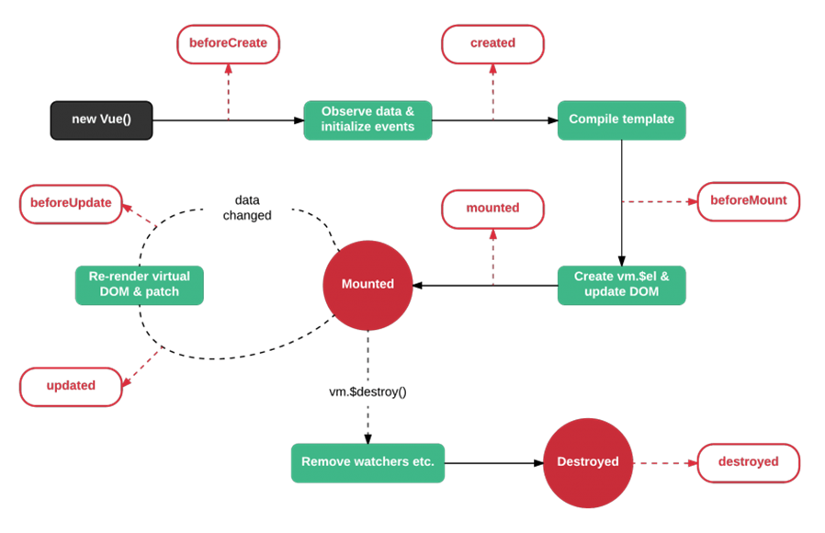
Vue Lifecycle methods

Slide 44
Slots
Oftentimes you will need to allow your parent Vue components to embed arbitrary content inside of child components. Vue provides a way to accomplish this with slots.
Vue implements a content distribution API inspired by the Web Components spec draft, using the <slot> element to serve as distribution outlets for content.
If you are coming from an Angular background, this is a similar concept to transclusion or content projection.

Slide 45
Filters
Vue.js allows you to define filters that can be used to apply common text formatting.
Filters are usable in two places: mustache interpolations and v-bind expressions.
Filters should be appended to the end of the JavaScript expression, denoted by the “pipe” symbol

Slide 46
Custom Directives
In addition to the default set of directives shipped in core (v-model and v-show), Vue also allows you to register your own custom directives.
Note that in Vue 2.0, the primary form of code reuse and abstraction is components
However, there may be cases where you need some low-level DOM access on plain elements, and this is where custom directives would still be useful.

Slide 47
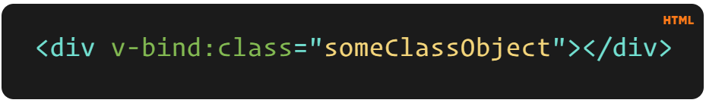
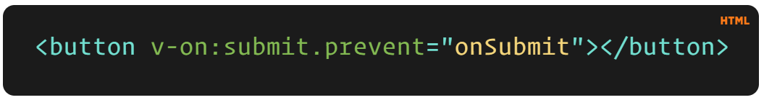
v-example="value" – this will pass a value into the directive, and the directive figures out what to do based off of that value.
v-example="'string'" – this will let you use a string as an expression.
v-example:arg="value" – this allows us to pass in an argument to the directive.
v-example:arg.modifier="value" – this allows us to use a modifier.

Slide 48
Directive Hooks
There are a few hooks available to us, and each one has the option of a few arguments. The hooks are as follows:
bind – This occurs once the directive is attached to the element.
inserted – This hook occurs once the element is inserted into the parent DOM.
update – This hook is called when the element updates, but children haven’t been updated yet.
componentUpdated – This hook is called once the component and the children have been updated.
unbind – This hook is called once the directive is removed.

Slide 49
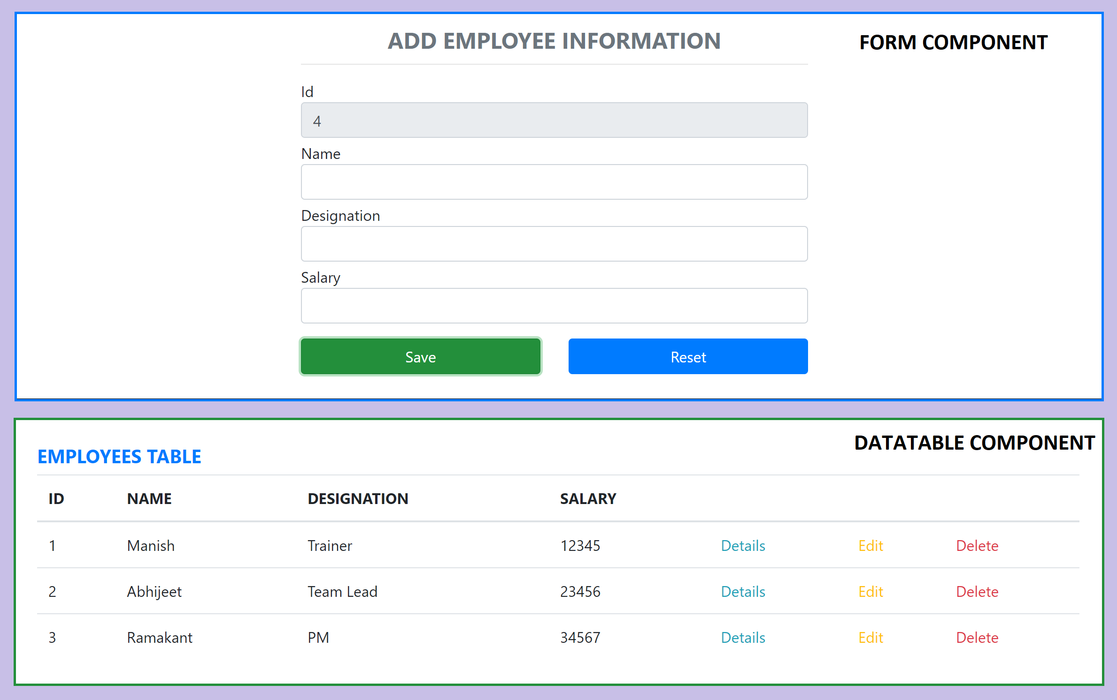
Assignment

Slide 50
Form validation
Form validation is one of the most difficult subjects in frontend, not only do you have to deal with ensuring correct values are submitted, you must also make sure to provide a suitable UX for your users.
We also have to deal with accessibility and making sure our forms are inclusive and usable for all types of our users.
Doing form validation by hand is painful, a lot of work, and fairly time consuming!

Slide 51
Form Validation (vee-validate)
VeeValidate is a validation framework built specifically for Vue.js and as such it makes some assumptions and enforces "best-practices" for your forms while being versatile and customizable.
VeeValidate is a collection of function-based APIs and Vue components, the main things that will be covered is how to add rules and use them on your fields and error messages.
vee-validate tackles the major pain points of form validation and addresses them in the most flexible way possible:
Ability to craft complicated UX for your users.
Most common validations are built-in.
Cross Field validation.
Utilities to enhance your forms accessability and styling.
Localization is built-in the core.

Slide 52
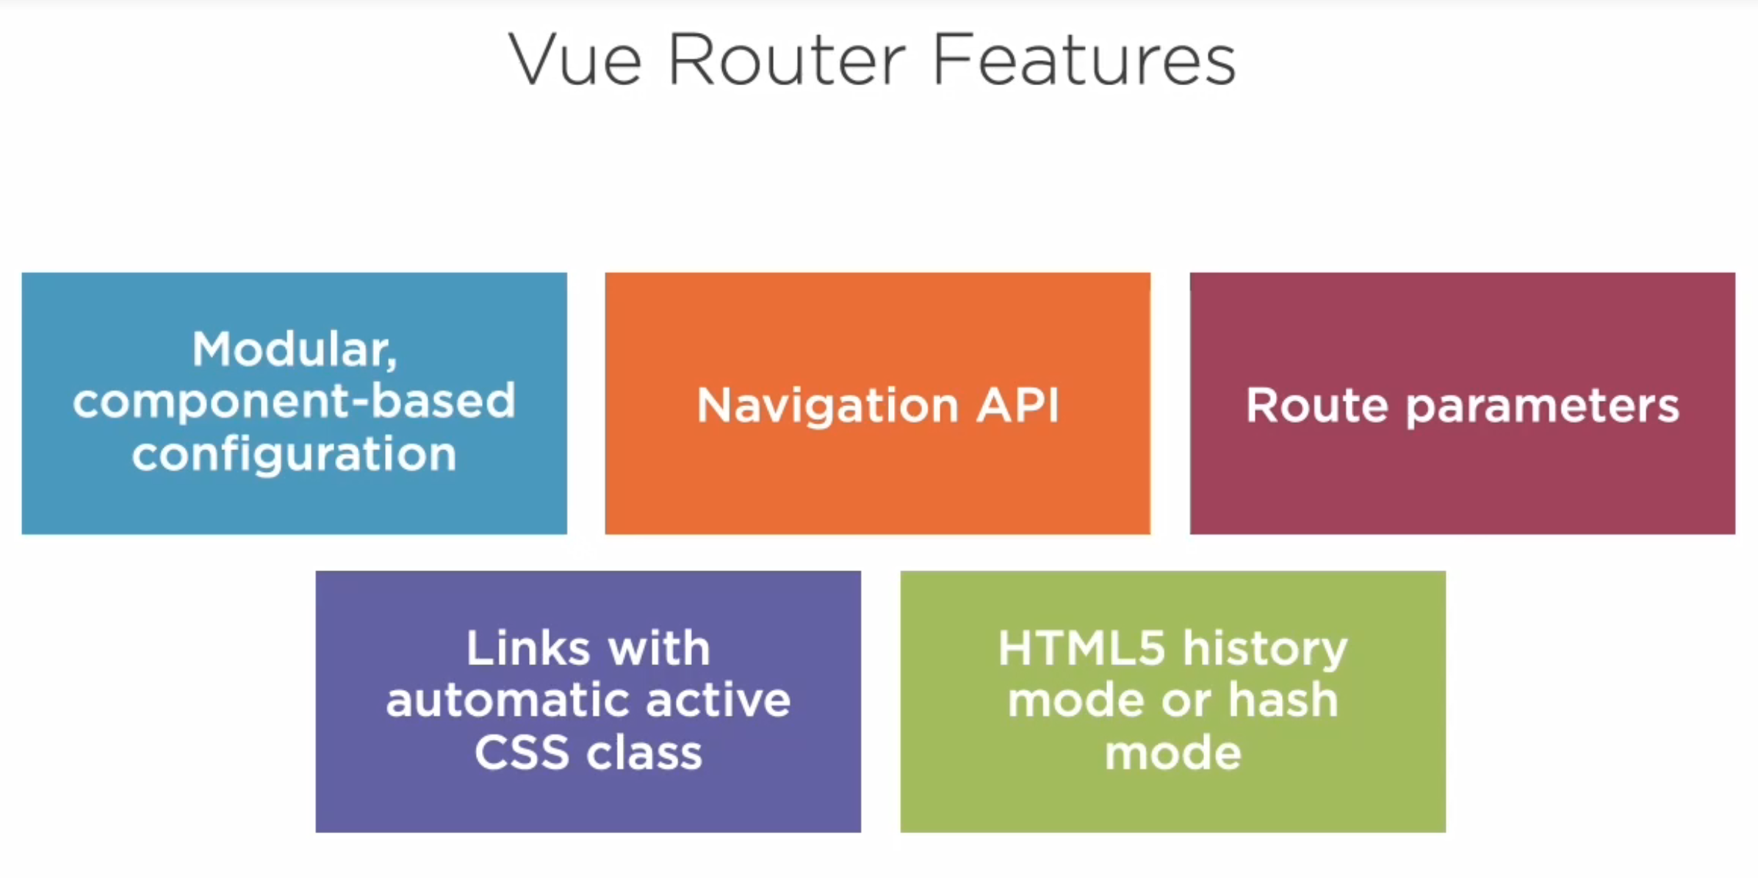

Slide 53
Install Router
Manually
npm i vue-router@3
Create a router folder with route configuration file
Add the router to your application (main.js)
Using Vue CLI plugin
vue add router

Slide 54
NODE SERVER
BROWSER
HTTP + URL (localhost:3000)
NAVIGATION
Vue Application
Click on Admin link, load the
Admin Component, which
Sends AJAX req. to the server in
beforeMount lifecycle hook,
Gets the result and stores it into
Products state
HTML Page + JS (Vue App)
NODE SERVER
EXPRESS JS
Web API
AJAX – localhost:8000/api/products
Database
JSON

Slide 55
NODE SERVER
BROWSER
HTTP + URL (localhost:3000)
NAVIGATION
Vue Application
Click on Admin link, Will Verify token in sessionStorage. If not, you will be redirected
to Login
HTML Page + JS (Vue App)
HTTP + URL (AJAX) + Username & Password
NODE SERVER
Login Submit
EXPRESS JS
Web API
JSON with Token
{“token”:”___”}
Store Token in Session
Storage of the browser
Send the same token to
Access data from the
Server using interceptor
AJAX – localhost:8000/api/products + Token
Database
JSON

Slide 56
Vue Router Guards
Global guards – These are called each time the URL changes
beforeEach, beforeResolve, afterEach
Route guards – These are only called when the associated ROUTE is matched
beforeEnter
Route Component guards – These are only called when a ROUTE COMPONENT is used/unused
beforeRouteEnter, beforeRouteUpdate, beforeRouteLeave

Slide 57
VueX How can you access data of Component One in Component Two? What if Component Two wants to modify the data in Component One?
Methods
State
View
Methods
State
View
Component One
Component Two

Slide 58
Vuex
Vuex is a state management pattern + library for Vue.js applications.
It serves as a centralized store for all the components in an application, with rules ensuring that the state can only be mutated in a predictable fashion.
It also integrates with Vue's official devtools extension to provide advanced features such as zero-config time-travel debugging.
By defining and separating the concepts involved in state management and enforcing rules that maintain independence between views and states, we give our code more structure and maintainability.
This is the basic idea behind Vuex, inspired by Flux, Redux and The Elm Architecture.

Slide 59
Vuex Core Concepts
State
Getters
Mutations
Actions
Modules

Slide 60
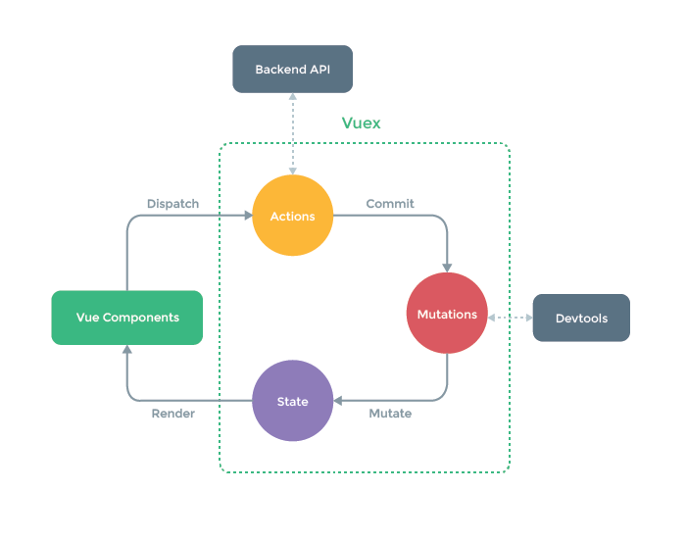
Vuex

Slide 61
Contact Me
Manish Sharma | Gmail
Manish Sharma | WhatsApp
Manish Sharma | Facebook
Manish Sharma | LinkedIn

