Slide 1

Ext JS

Slide 2
BROWSER
SERVER
HTTP + URL
NAVIGATION
HTML PAGES
CSS
HTML + CSS
HTTP + URL
HTML + CSS
Page
Reload!

Slide 3
BROWSER
SERVER
HTTP + URL
NAVIGATION
HTML + CSS
Server PAGES
CSS
HTTP + URL
ASP
ASP .NET
JSP
PHP
Ruby
Express JS
HTML + CSS
Page
Reload!
DB

Slide 4
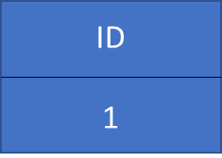
BROWSER
SERVER
HTTP + URL
NAVIGATION
Server PAGES
CSS
HTML + CSS + JS
AJAX - HTTP + URL
JS
Partial
Page
Reload!
PARTIAL HTML
<table>
<thead>
<tr>
<th>ID</th>
</tr>
</thead>
<tbody>
<tr>
<td>1</td>
</tr>
</tbody>
</table>
ASP
ASP .NET
JSP
PHP
Ruby
Express JS
ASP .NET MVC
Spring MVC
Ruby On Rails
Laravel
Sails JS
DB

Slide 5
Single Page Application (SPA)
Client Side Rendering (CSR)
SERVER
SERVER PAGES
CSS
BROWSER
HTTP + URL
NAVIGATION
JS
HTML + CSS + JS
ASP
ASP .NET
JSP
PHP
Ruby
ASP .NET MVC
Spring MVC
Ruby On Rails
Laravel
<table>
<thead>
<tr>
<th>ID</th>
</tr>
</thead>
<tbody>
<tr>
<td>1</td>
</tr>
</tbody>
</table>
SERVER
AJAX - HTTP + URL
RESTful API
ASP .NET Web API
JWS
Express JS
Python
DB
JSON to HTML on Client Side
JSON
{
“id”:1
}
Vanilla JS, jQuery, KO, BB, NG,
ExtJS, Vue JS, React JS

Slide 6
Single Page Application (SPA)
Client Side Rendering (CSR)
SERVER
SERVER PAGES
CSS
BROWSER
HTTP + URL
NAVIGATION
JS
HTML + CSS + JS
ASP
ASP .NET
JSP
PHP
Ruby
ASP .NET MVC
Spring MVC
Ruby On Rails
Laravel
<table>
<thead>
<tr>
<th>ID</th>
</tr>
</thead>
<tbody>
<tr>
<td>1</td>
</tr>
</tbody>
</table>
Account
Service
AJAX - HTTP + URL
API GATEWAY
Inventory
Service
JSON to HTML on Client Side
JSON
{
“id”:1
}
Vanilla JS, jQuery, KO, BB, NG,
ExtJS, Vue JS, React JS
Shipping
Service

Slide 7


Slide 8
Single Page Application Pros
Quick Loading Time
Seamless User Experience
Ease in Building Feature-rich Apps
Uses Less Bandwidth

Slide 9
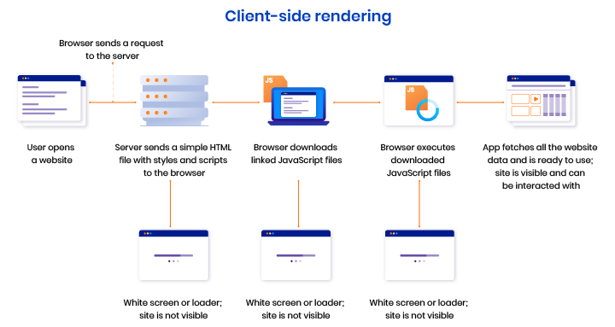

Slide 10
What is a JavaScript Library?
JavaScript libraries are collections of prewritten code snippets that can be used and reused to perform common JavaScript functions.
A particular JavaScript library code can be plugged into the rest of your project’s code on an as-needed basis.
This led to faster development and fewer vulnerabilities to have errors.

Slide 11
Library vs Framework
Library | Framework
Collection of API’s, targeted to do one specific task | Collection of API’s, targeted for application creation. FW is a piece of code that dictates the architecture of your project.
You are in Full control when you call a method from a library and the control is then returned. | The code never calls into a FW, instead the FW uses your code. We can only follow a FW.
It can be integrated seamlessly into an existing project. | FW cannot be integrated, we have to re-write the code.
jQuery – DOM Manipulation & Ajax Moment.js – Date & Time D3.js – Data Visualization React JS – UI Component | Angular, EXT JS

Slide 12
Variables
Variables are containers for storing data (storing data values).
There are 4 Ways to Declare a JavaScript Variable:
Using var
Using let (ES6)
Using const (ES6)
Using nothing (Not Recommended)
Always declare JavaScript variables with var, let, or const.
The var keyword is used in all JavaScript code from 1995 to 2015.
The let and const keywords were added to JavaScript in 2015.
If you want your code to run in older browser, you must use var.

Slide 13
Datatypes
The set of types in the JavaScript language consists of primitive values and objects.
Primitive Values - Immutable datum represented directly at the lowest level of the language
Null – null
Undefined – undefined
Boolean() – boolean
Number() – number
String() – string
Symbol (ECMAScript 2015) – symbol – We cannot use new keyword with Symbol()
Objects - An object is a mutable value in memory which is possibly referenced by an identifier.
Object() - object

Slide 14
Mutable vs Immutable
JavaScript Engine handles mutable and immutable objects differently.
Immutable are quicker to access than mutable objects.
Mutable objects are great to use when you need to change the size of the object, example array, set etc..
Immutable are used when you need to ensure that the object you made will always stay the same.
Immutable objects are fundamentally expensive to “change”, because doing so involves creating a copy.
Changing mutable objects is cheap.

Slide 15
JavaScript types
All types except objects define immutable values (that is, values which can't be changed)
Boolean type: Boolean represents a logical entity and can have two values: true and false. See Boolean and Boolean for more details.
Null type: The Null type has exactly one value: null. See null and Null for more details.
Undefined type: A variable that has not been assigned a value has the value undefined. See undefined and Undefined for more details.
Number type: The Number type is a double-precision 64-bit binary format value (numbers between -(2^53 − 1) and 2^53 − 1). In addition to representing floating-point numbers, the number type has three symbolic values: +Infinity, -Infinity, and NaN ("Not a Number").
String type: JavaScript's String type is used to represent textual data. It is a set of "elements" of 16-bit unsigned integer values. Each element in the String occupies a position in the String.
Symbol type: A Symbol is a unique and immutable primitive value and may be used as the key to an Object property.
Objects: An object is a value in memory which is possibly referenced by an identifier. objects can be seen as a collection of properties. Properties are identified using key values. A key value is either a String value or a Symbol value.

Slide 16
JAVA / CS
TS
JAVAC / CSC
TSC
Byte Code / MSIL
JavaScript
JavaScript
JIT Compiler (JVM / CLR)
JavaScript Runtime
JavaScript Runtime
Native
Native
Native

Slide 17
Standard built-in objects
Value properties
Infinity
NaN
undefined
globalThis
Function properties
eval()
uneval()
isFinite()
isNaN()
parseFloat()
parseInt()
encodeURI()
encodeURIComponent()
decodeURI()
decodeURIComponent()
Fundamental objects
Object
Function
Boolean
Symbol
Error objects
Error
AggregateError
EvalError
InternalError
RangeError
ReferenceError
SyntaxError
TypeError
URIError

Slide 18
Standard built-in objects
Numbers and dates
Number
Math
Date
Text processing
String
RegExp
Indexed collections
Array
Int8Array
Uint8Array
Uint8ClampedArray
Int16Array
Uint16Array
Int32Array
Uint32Array
Float32Array
Float64Array

Slide 19
Standard built-in objects
Keyed collections
Map
Set
WeakMap
WeakSet
Structured data
ArrayBuffer
DataView
JSON
Control abstraction objects
Promise
Generator
GeneratorFunction
AsyncFunction
AsyncGenerator
AsyncGeneratorFunction
Reflection
Reflect
Proxy

Slide 20
Statements & Loops
Control Flow
Block { }
break
continue
Empty
if…else
switch
throw
try…catch
Iterations
for
for...in
for…of (es6)
while
do…while

Slide 21
Functions
Functions are one of the fundamental building blocks in JavaScript.
A function in JavaScript is like a procedure—a set of statements that performs a task or calculates a value, but for a procedure to qualify as a function, it should take some input and return an output.
To use a function, you must define it somewhere in the scope from which you wish to call it.
In JavaScript, functions are first-class objects, because they can have properties and methods just like any other object.
What distinguishes them from other objects is that functions can be called.
Every JavaScript function is a Function object.

Slide 22
Functions
function
Declares a function with the specified parameters.
function* (ES6)
Generator Functions, enable writing iterators more easily
async function (ES7)
Declares an async function with the specified parameters.

Slide 23
Function Parameters & Arguments
Function Parameters are the names that are define in the function definition and real values passed to the function in function definition are known as arguments.
Parameter Rules:
There is no need to specify the data type for parameters in JavaScript function definitions.
It does not perform type checking based on passed in JavaScript function.
It does not check the number of received arguments.
If a function is called with missing arguments (less than declared), the missing values are set to undefined.

Slide 24
The Arguments Object
JavaScript functions have a built-in object called the arguments object.
The argument object contains an array of the arguments used when the function was called (invoked).
If a function is called with too many arguments (more than declared), these arguments can be reached using the arguments object.

Slide 25
Pure and Impure Functions
A side-effect is any operation your function performs that is not related to computing the final output, including but not limited to:
Modifying a global variable
Modifying an argument
Making HTTP requests
DOM manipulation
Reading/writing files
A pure function must both be predictable and without side-effects. If either of these criteria is not met, we're dealing with an impure function.
A pure function, returns same result if same arguments are passed in, no matter how many times it runs.
An impure function, may return different result if same arguments are passed in, on multiple runs

Slide 26
Function Overloading
JavaScript does not support function overloading.
If we create two function with same name, the second function will overwrite the first function.
To handle same function names in JavaScript
The first recommendation is to use a different and self-explanatory name for functions.
Using default values for the parameters.
Checking the number of arguments and type of arguments.
Passing the last parameter to describe the kind of option the function should perform. We can use switch or if...else to perform the required operation.

Slide 27
Function Currying
Currying is a way of constructing functions that allows partial application of a function’s arguments.
What this means is that you can pass all the arguments a function is expecting and get the result or pass a subset of those arguments and get a function back that’s waiting for the rest of the arguments.

Slide 28
Closure
A closure is a function or reference to a function together with a referencing environment — a table storing a reference to each of the non-local variables of that function.
Closures are functions that refer to independent (free) variables. In other words, the function defined in the closure 'remembers' the environment in which it was created.
A closure is a special kind of object that combines two things: a function, and the environment in which that function was created. The environment consists of any local variables that were in-scope at the time that the closure was created.

Slide 29
Callback
A callback is a function that is passed as an argument to another function, which is expected to invoke it either immediately or at some point in the future.
Callbacks can be seen as a form of the continuation-passing style (CPS), in which control is passed explicitly in the form of a continuation; in this case the callback passed as an argument represents a continuation.
There are two types of callbacks.
A callback passed to a function can be invoked synchronously before return
Or it can be deferred to execute asynchronously some time after return.

Slide 30
Higher Order Functions
Functions that operate on other functions, by taking them as arguments and by returning them, are called higher-order functions.
Higher-order functions allow us to abstract over actions, not just values.

Slide 31
JavaScript ‘this’ keyword
In JavaScript, “context” refers to an object.
Within an object, the keyword “this” refers to that object, and provides an interface to the properties and methods that are members of that object.
When a function is executed, the keyword “this” refers to the object that the function is executed in.
Scenarios
When a function executes in the global context, “this” refers to the global, or “window” object
When a function is a method of an Object, “this” refers to that object (unless it is manually executed in the context of a different object)
When a function executes inside of another function (no matter how deeply nested), “this” refers to the object whose context within which it is executed
When you instantiate a constructor function, inside of the instance object, “this” refers to the instance object

Slide 32
Objects
A JavaScript object is an entity having state and behavior (properties and method). For example: car, pen, bike, chair, glass, keyboard, monitor etc.
JavaScript is an object-based language. Everything is an object in JavaScript.
We can create objects directly.
By object literal
By creating instance of Object directly (using new keyword)
By using an object constructor (using new keyword)

Slide 33
var toy1 = new Object();
console.log(toy1.constructor)
toy1
Object.prototype
constructor
hasOwnProperty()
toString()
.
.
.
.
__proto__

Slide 34
toy1
color
shape
Object.prototype
constructor
hasOwnProperty()
toString()
.
.
.
.
__proto__
__proto__
toy2
color
shape

Slide 35
toy1
__proto__
Object.prototype
constructor
hasOwnProperty()
toString()
color=“red”
shape=“circle”
.
toy2
__proto__
toy1
__proto__
Object.prototype
constructor
hasOwnProperty()
toString()
color=“red”
shape=“circle”
.
toy2.color = “blue”;
toy2.shape = “square”
toy2
color
shape
__proto__

Slide 36
Constructor Function
In JavaScript, a constructor function is used to create objects.
To create an object from a constructor function, we use the new keyword.
It is considered a good practice to capitalize the first letter of your constructor function.
When this keyword is used in a constructor function, this refers to the object when the object is created.

Slide 37
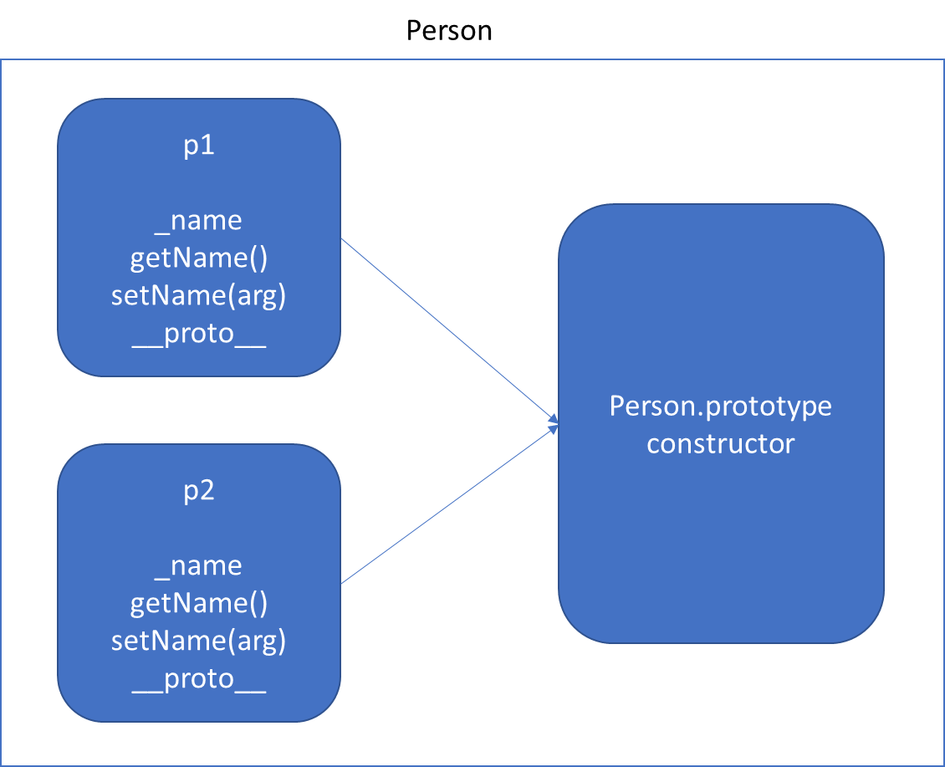
Function Using this keyword *Will increase memory Usage

Slide 38
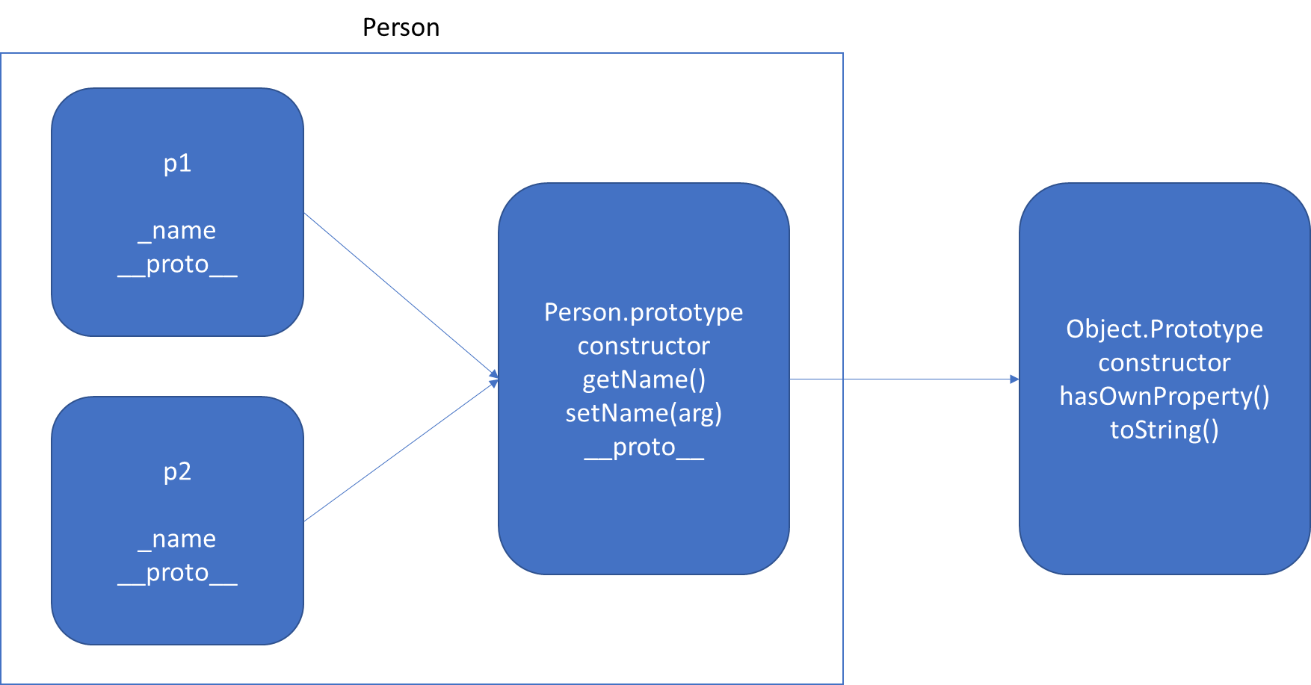
Function Using prototype

Slide 39
v.start()
Vehicle.prototype
start()
__proto__
Object.prototype
constructor
hasOwnProperty()
toString()
.
.
v
__proto__
FourWheeler.prototype
__proto__
Object.prototype
constructor
hasOwnProperty()
toString()
.
.
v.start() - Error
v
__proto__

Slide 40
FourWheeler.prototype
move()
__proto__
Vehicle.prototype
start()
__proto__
Object.prototype
constructor
hasOwnProperty()
toString()
.
v
__proto__
FourWheeler.prototype
move()
start()
__proto__
Vehicle.prototype
start()
__proto__
Object.prototype
constructor
hasOwnProperty()
toString()
.
v
__proto__

Slide 41
Indexed collections
Array
Int8Array
Uint8Array
Uint8ClampedArray
Int16Array
Uint16Array
Int32Array
Uint32Array
Float32Array
Float64Array

Slide 42
Arrays
Arrays are an ordered collection that can hold data of any type. In JavaScript, arrays are created with square brackets [...] or using Array constructor and allow duplicate elements.
JavaScript objects and arrays were the most important data structures to handle collections of data.
The combination of objects and arrays was able to handle data in many scenarios, however, there were a few shortcomings as follows
Object keys can only be of type string.
Objects don't maintain the order of the elements inserted into them.
Objects lack some useful methods, which makes them difficult to use in some situations. For example, you can't compute the size (length) of an object easily. Also, enumerating an object is not that straightforward.
Arrays are collections of elements that allow duplicates. Supporting arrays that only have distinct elements requires extra logic and code.

Slide 43
Ext JS
Ext JS 4 is a pure JavaScript application framework that works everywhere from IE6 to Chrome 11.
It enables you to create the best cross-platform applications using nothing but a browser, and has a phenomenal API.

Slide 44
EXT JS Version History
Ext JS 2.0 - 4 December 2007
Ext JS 3.0 - 6 July 2009
Ext JS 4.0 - 26 April 2011
Ext JS 5.0 - 2 June 2014
Ext JS 6.0 - 1 July 2015
Ext JS 7.0 - 29 August 2019

Slide 45
Ext JS 4.0
Ext JS 4.0 SDK – Ext JS Core API’s
Ext JS 4.0 SDK Tools (Todays World this is Sencha Cmd)
Ext JS 4.0 IDE Plugins
Eclipse
Visual Studio
Visual Studio Code

Slide 46
Ext JS 4's class system
Ext JS 4 introduces an entirely new way of defining classes
When developing with Ext JS 4 your JavaScript's structure will be more closely in line with that of other object oriented languages.
The Ext.define method is used to define new classes. It uses a string-based definition, leaving the framework to take care of the namespacing and concrete defining of the class.
Internally every class that is defined is turned into an instance of the Ext.Class class by the Ext.ClassManager.
The manager runs through a series of pre and post processing steps.

Slide 47
Pre-Processors
Loader: Loads any other required classes if they don't already exist, recursing through this process for each class loaded
Extend: Now that all the required classes have been loaded, we can extend from them as required by our extend config option
Mixins: Any Mixins that have been defined are now handled and merged into our class
Config: Any properties in the config configuration option are processed and their get/set/apply/reset methods are created
Statics: If the class has any static properties or methods these are handled at this stage.
Once all of these pre-processors have completed their work, our new class is ready to be instantiated.

Slide 48
Post-Processors
The class manager, will continue to work through its post-processors that perform the following actions:
Aliases: It creates the necessary structure to allow the class to be created through an xtype
Singleton: If the class has been defined as a singleton its single instance is created here
Legacy: To help with backward compatibility a class can have alternate names that are mapped to the class
After post processors our class is fully created, and all that is left to do is to execute the callback function

Slide 49
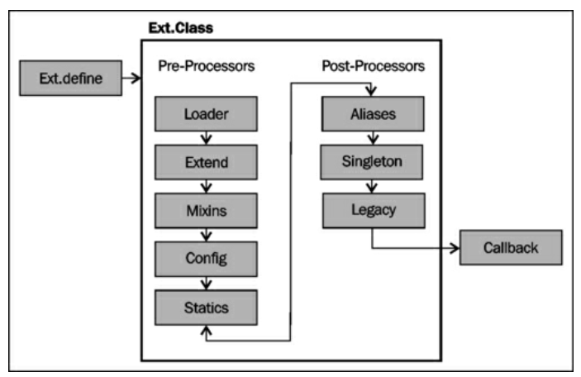

Slide 50
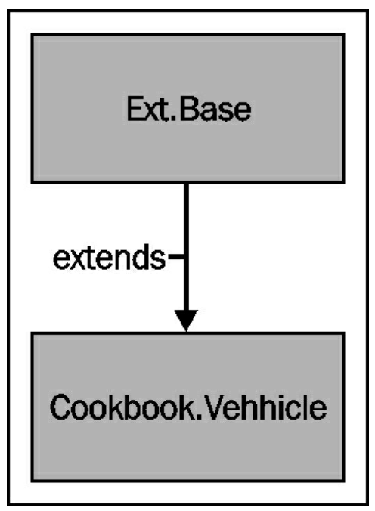
EXT Class System
This model is extremely flexible and allows you to include your own pre or post processor at any stage in the sequence by using the registerPreProcessor and registerPostProcessor methods.
All Ext JS 4 classes inherit from a common base class, named Ext.Base.
Ext.Base class contains several methods that provide basic functionality to all created subclasses
The new Ext JS class system also takes care of a lot of the heavy lifting for you when it comes to defining your properties, configuration options, and their associated getter and setter methods.

Slide 51
When to explicitly defining our own methods
If we will want to perform some extra actions when calling these generated methods.
We can do this by explicitly defining our own version of the method that will override the generated one.
For example, when calling the apply method, we want to update a DOM element that contains the Vehicle's name, so the change is reflected on the screen.

Slide 52
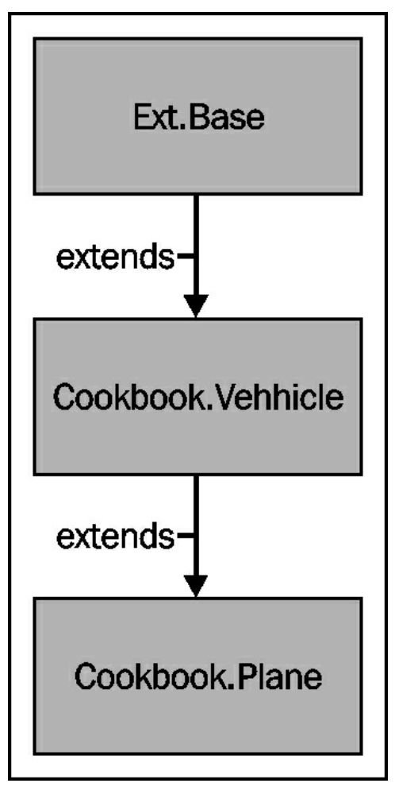
Ext Class Inheritance
More often than not when defining a new class, we want to extend an existing Ext JS class or component so that we inherit its current behavior and add our own new functionality.
The extend configuration option, used when defining your new subclass, tells the Ext.Class' Extend preprocessor, what class your new one should be inherited from.
The preprocessor then merges all of the parent class' members into the new class' definition, giving us our extended class.
The callParent method is a very quick way of executing the parent class' version of the method. This is important to ensure that the parent class is constructed correctly and will still function as we expect.

Slide 53
Adding Mixins to your class
Mixins are classes that can be included in another class, merging its members (methods and properties) into it.
This technique provides us with a form of multiple inheritance where the mixin class' methods and properties can be accessed as if they were part of the parent class.
By making use of mixins we can package small and reusable bits of functionality into an encapsulated class, and merge it into classes which require that functionality.
This reduces repetition and removes the need for the class to be extended directly.

Slide 54
How Mixins Work?
By using the mixins configuration option we tell the class defining process to use the mixins preprocessor to merge all of the mixin class' members into the main class.
This now means that all of the methods and properties defined as part of the HasCamera class can be accessed directly from the parent class' instance.
To override the functionality provided by our mixins class, recipes, we declare a method called with same name that will override the one added by the Mixin.

Slide 55
Ext JS Context Switching
The Ext.bind method creates a wrapper function for the speak method that will force it to have its scope set to the object that is passed in, overriding the default scope value.
This new function can be executed immediately or stored in a variable to be executed at a later point.
By using it we redefine the “this” keyword used within the function to refer to what was passed in as the second parameter.
Getting the scope of a function correct is especially important within event handlers.
Ext JS provides a scope config option that can be used to explicitly set the scope an event handler is executed in.
scope object is effectively a short hand way of using Ext.bind and gives us the same outcome with less code.

Slide 56
Dynamically loading Ext JS classes
Ext JS 4 gives us the ability to only load the parts of the framework we need, as and when we need them.
The initial configuration of the Ext.Loader class is vital for our classes to be loaded correctly, as it defines how class names are mapped to file locations so the Loader class knows where to find each class it is required to load.
It also highlights the need for strict naming conventions when it comes to creating your files.
The paths configuration tells the Loader that any required classes within the given namespace should be loaded from the which directory.
We then call the Ext.require method, which takes the class name specified and resolves its URL based on the paths configuration, and if it hasn't already been loaded previously, injects a script tag into the HTML page to load it.
The Ext.require method accepts either a single or array of string values that will all be loaded prior to the callback being executed.

Slide 57
Aliasing your components
Aliasing allows you to define a shorthand name for a component class.
Additionally, aliasing allows you to define an xtype for your component.

Slide 58
How Aliasing Works?
When the application is first loaded, the class definitions are parsed, and a dictionary of class aliases is created.
This is contained within the framework's component manager (Ext.ComponentManager).
We're required to name our aliases with a prefix, "widget." However, when using the alias, the prefix is not required.
Calling the alias is done using the xtype config option, which is where you provide the alias name.

Slide 59
Accessing components with component query
Ext JS 4 introduces a new helper class called Ext.ComponentQuery , which allows us to get references to Ext JS Components using CSS/XPath style selector syntax.
The component query class also allows us to evaluate a component reference we already have to find out if it matches a certain criteria.
Ext.container.AbstractContainer ComponentQuery methods
Ext.container.AbstractContainer class, which all container classes extend from, which utilizes the component query engine and allow us to query using that component as the root.
There are four methods available as query, child, up & down.
The up and down methods retrieve the first component, at any level, either above or below the current component in the component hierarchy that matches the selector passed in.
The child method retrieves the first direct child of the current instance that matches the selector.

Slide 60
Pseudo-Selectors
Pseudo-selectors allow us to filter the retrieved result array based on some criteria that may be too complex to represent in a plain selector.
There are two built-in pseudo-selectors: not and last.

Slide 61
Extending Ext JS components
It is regarded as best practice to create each of your components as extensions of Ext JS' own components and store them in separate files.
This approach aids code reuse, helps organize your code and makes maintenance a much easier task.

Slide 62
COMPONENT
UI (VIEW)
CSS (STYLE)
DATA
BEHAVIOR

Slide 63
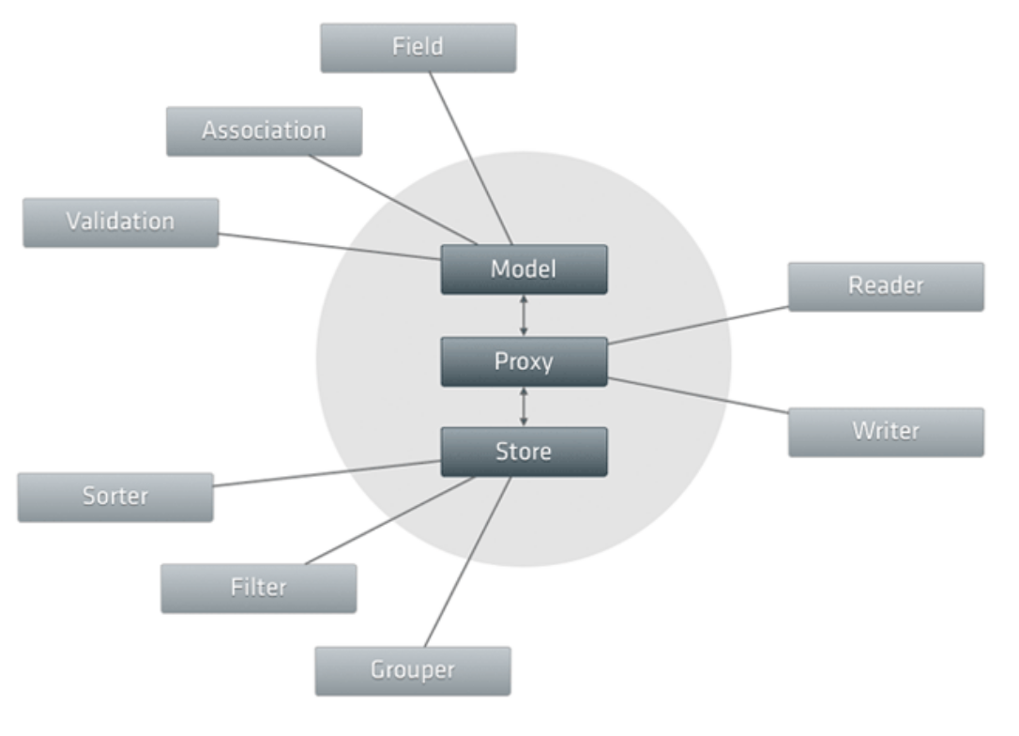

Slide 64
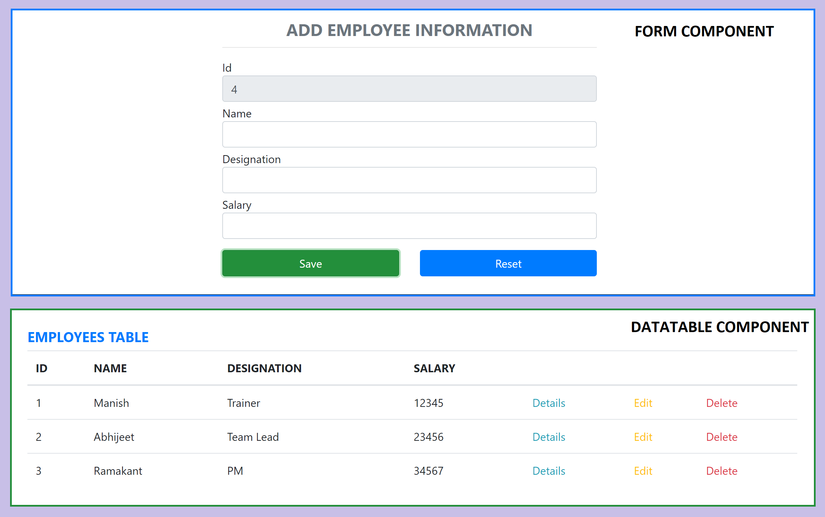
Assignment

Slide 65
Contact Me
Manish Sharma | Gmail
Manish Sharma | WhatsApp
Manish Sharma | Facebook
Manish Sharma | LinkedIn

