Slide 1

Node JS

Slide 2
What is Node.js?
Node.js® is a JavaScript runtime built on Chrome's V8 JavaScript engine.
As an asynchronous event-driven JavaScript runtime
Node.js is designed to build scalable network applications.

Slide 3
What is Node.js?
Node.js is
open-source
cross-platform
back-end JavaScript runtime environment
runs on the V8 engine
executes JavaScript code outside a web browser.
Node.js lets developers use JavaScript for server-side scripting.
Node.js represents a "JavaScript everywhere" paradigm
Unifying web-application development around a single programming language.

Slide 4
BROWSER
SERVER
HTTP + URL
NAVIGATION
Server PAGES
CSS
HTML + CSS + JS
AJAX - HTTP + URL
JS
Partial
Page
Reload!
PARTIAL HTML
<table>
<thead>
<tr>
<th>ID</th>
</tr>
</thead>
<tbody>
<tr>
<td>1</td>
</tr>
</tbody>
</table>
ASP
ASP .NET
JSP
Express JS
ASP .NET MVC
Spring MVC
Ruby On Rails
Sails JS
DB

Slide 5
SERVER
Single Page Application (SPA)
SERVER PAGES
CSS
BROWSER
HTTP + URL
NAVIGATION
JS
HTML + CSS + JS
(Client Side JS App)
ASP
ASP .NET
JSP
Express JS
ASP .NET MVC
Spring MVC
Ruby On Rails
Sails JS
<table>
<thead>
<tr>
<th>ID</th>
</tr>
</thead>
<tbody>
<tr>
<td>1</td>
</tr>
</tbody>
</table>
SERVER
AJAX - HTTP + URL
RESTful API
ASP .NET Web API
JWS
Express JS
Python
DB
JSON to HTML on Client Side
JSON
{
“id”:1
}
Vanilla JS, jQuery, KO, BB, NG1,
NG2 or above, React, Vue

Slide 6
SERVER
Single Page Application (SPA)
SERVER PAGES
CSS
BROWSER
HTTP + URL
NAVIGATION
JS
HTML + CSS + JS
(Client Side JS App)
ASP
ASP .NET
JSP
Express JS
ASP .NET MVC
Spring MVC
Ruby On Rails
Sails JS
<table>
<thead>
<tr>
<th>ID</th>
</tr>
</thead>
<tbody>
<tr>
<td>1</td>
</tr>
</tbody>
</table>
Account
Service
AJAX - HTTP + URL
API GATEWAY
JSON
{
“id”:1
}
Inventory
Service
JSON to HTML on Client Side
Vanilla JS, jQuery, KO, BB, NG1,
NG2 or above, React, Vue
Shipping
Service

Slide 7
JavaScript Full Stack Application
 | Database | Application FW API FW | Client Side | Runtime
MEAN | MongoDB | Express JS | Angular | Node
MERN | MongoDB | Express JS | React JS | Node
MEVN | MongoDB | Express JS | Vue JS | Node

Slide 8
Installation
Install Node LTS version - https://nodejs.org/en/
Install / Update Visual Studio Code to Latest Release - https://code.visualstudio.com/
Extensions of VS Code
AutoFileName
vscode-icons
JavaScript (ES6) code snippets
Node.js Modules Intellisense
After all Extensions are installed
File Menu -> Preferences -> File Icon Theme -> Select VScode Icons

Slide 9
Node Global Objects
Node.js Global Objects are those objects which are present in all modules.
Global Objects can be used directly in the application which is available without importing any module.
Global objects have been added keeping in mind that these are some basic requirements and one can require these anytime, so it is better to keep them global rather than to add specific modules for these objects.
Some of the Node.js Global Objects:
Buffer Class
console
process
setImmediate
setTimeout

Slide 10
NODE EXE (NODE PROCESS)
V8 Engine
Node JS API’s
Application
(JavaScript)
NATIVE CODE
O. S.

Slide 11
NODE APIs
V8 Engine
Libuv
(Asynchronous I/O)
Developer Uses the NODE API’s in JavaScript Language

Slide 12
Modules
Module in Node.js is a simple or complex functionality organized in single or multiple JavaScript files which can be reused throughout the Node.js application.
Each module in Node.js has its own context, so it cannot interfere with other modules or pollute global scope. Also, each module can be placed in a separate .js file under a separate folder.
Node.js implements CommonJS modules standard.
CommonJS is a group of volunteers who define JavaScript standards for web server, desktop, and console application.

Slide 13
Types of Modules
Core Modules (Built-in Modules)
Global Modules
Local Modules (User Defined Modules)
External Modules (Third Party Modules)

Slide 14
Steps to run TypeScript Project Folder
Download and Extract the zip file.
Open the extracted folder in Visual Studio Code
Open the terminal window on the folder path and run
npm install
Once the installation completes, run
npm run compile – Run the TypeScript Compiler in Watch mode and will compile and generate dist folder
Open the terminal window on the dist folder path and run
node app.js

Slide 15
require(Path)
Module Loader will search for a file on the path specified
Y
N
Load and cache the file on the memory
Module Loader will search for a folder on the path specified
Y
N
Search inside folder, file with the name ‘package.json’
Error Loading Module
Y
N
N
In ‘package.json’, read ‘main’ key
Search inside folder, file with the name ‘index.js’
N
Y
Y
Search file mentioned in ‘main’
N
Load and cache the file on the memory
Y
Load and cache the file on the memory
NODE JS Module Resolution

Slide 16
Built-in Modules / Core Modules
Built-in modules of node.js that are part of NodeJS and come with the Node.js installation process are known as core modules.
To load/include this module in our program, we use the require() function.
The return type of require() function depends on what the particular module returns.

Slide 17
Built In Modules
Module | Description
assert | Provides a set of assertion tests
buffer | To handle binary data
child_process | To run a child process
cluster | To split a single Node process into multiple processes
crypto | To handle OpenSSL cryptographic functions
dgram | Provides implementation of UDP datagram sockets
dns | To do DNS lookups and name resolution functions
events | To create and handle events
fs | To handle the file system
http | To make Node.js act as an HTTP server
https | To make Node.js act as an HTTPS server.

Slide 18
Built In Modules Continued
Module | Description
net | To create servers and clients
os | Provides information about the operation system
path | To handle file paths
querystring | To handle URL query strings
readline | To handle readable streams one line at the time
stream | To handle streaming data
string_decoder | To decode buffer objects into strings
timers | To execute a function after a given number of milliseconds
tls | To implement TLS and SSL protocols
tty | Provides classes used by a text terminal
url | To parse URL strings

Slide 19
Built In Modules Continued
Module | Description
util | To access utility functions
v8 | To access information about V8 (the JavaScript engine)
vm | To compile JavaScript code in a virtual machine
zlib | To compress or decompress files

Slide 20
Readline Module
The readline module provides an interface for reading data from a Readable stream (such as process.stdin) one line at a time.

Slide 21
ReadStream
HTTP responses, on the client
HTTP requests, on the server
fs read streams
zlib streams
crypto streams
TCP sockets
child process stdout and stderr
process.stdin

Slide 22
WriteStream
HTTP requests, on the client
HTTP responses, on the server
fs write streams
zlib streams
crypto streams
TCP sockets
child process stdin
process.stdout and process.stderr

Slide 23
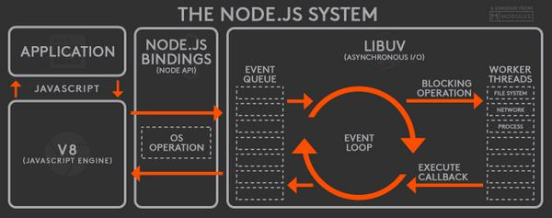

Slide 24
fs Module Methods
fs.access(): check if the file exists and Node.js can access it with its permissions
fs.appendFile(): append data to a file. If the file does not exist, it's created
fs.chmod(): change the permissions of a file specified by the filename passed. Related: fs.lchmod(), fs.fchmod()
fs.chown(): change the owner and group of a file specified by the filename passed. Related: fs.fchown(), fs.lchown()
fs.close(): close a file descriptor
fs.copyFile(): copies a file
fs.createReadStream(): create a readable file stream
fs.createWriteStream(): create a writable file stream
fs.link(): create a new hard link to a file
fs.mkdir(): create a new folder

Slide 25
fs Module Methods
fs.mkdtemp(): create a temporary directory
fs.open(): set the file mode
fs.readdir(): read the contents of a directory
fs.readFile(): read the content of a file. Related: fs.read()
fs.readlink(): read the value of a symbolic link
fs.realpath(): resolve relative file path pointers (., ..) to the full path
fs.rename(): rename a file or folder
fs.rmdir(): remove a folder
fs.stat(): returns the status of the file identified by the filename passed. Related: fs.fstat(), fs.lstat()
fs.symlink(): create a new symbolic link to a file

Slide 26
fs Module Methods
fs.truncate(): truncate to the specified length the file identified by the filename passed. Related: fs.ftruncate()
fs.unlink(): remove a file or a symbolic link
fs.unwatchFile(): stop watching for changes on a file
fs.utimes(): change the timestamp of the file identified by the filename passed. Related: fs.futimes()
fs.watchFile(): start watching for changes on a file. Related: fs.watch()
fs.writeFile(): write data to a file. Related: fs.write()

Slide 27
Events
Node.js core API is built around an idiomatic asynchronous event-driven architecture in which objects called "emitters" emit named events that cause Function objects "listeners" to be called.
All objects that emit events are instances of the EventEmitter class.
These objects expose an eventEmitter.on() function that allows one or more functions to be attached to named events.
When the EventEmitter object emits an event, all the functions attached to that specific event are called synchronously.

Slide 28
BankAccount Class
withdraw(amount)
deposit(amount)
Create BankAccount class with withdraw, deposit and other methods if needed.
Withdraw should show error if amount is greater than balance in account
Show message after withdraw and deposit call, showing current balance
Send a SMS after withdraw or deposit is called
Send an Email after withdraw or deposit is called
Follow SOLID principal’s of writing code
SMS Class
send(msg)
EMAIL Class
send(msg)
Whatsapp Class
send(msg)

Slide 29
CLIENT BROWSER
NODE SERVER
localhost:3000
JSON PLACEHOLDER
SERVER
Client Will send request to Node Server on URL : http://localhost:3000/posts
Node Server will check, in cache data related to URL requested,
if available send the data to Browser
if not available send request to https://jsonplaceholder.typicode.com/posts,
get the data and cache it for next calls
send the cached data back to client

Slide 30
What is npm?
npm is the world's largest Software Registry.
The registry contains over 800,000 code packages.
Open-source developers use npm to share software.
Many organizations also use npm to manage private development.
You can download all npm public software packages without any registration or logon.
npm consists of three distinct components:
the website: Use the website to discover packages, set up profiles, and manage other aspects of your npm experience.
the Command Line Interface (CLI): The CLI runs from a terminal, and is how most developers interact with npm
the registry: The registry is a large public database of JavaScript software and the meta-information surrounding it.

Slide 31
npm cli
Local Installation
Production Packages
npm install --save <package_name>
npm install <package_name>
npm i <package_name>
Developement Packages
npm install --save-dev <package_name>
npm install --dev <package_name>
npm i -D <package_name>
Local Un-installation
Production Packages
npm un <package_name>
Developement Packages
npm un -D <package_name>

Slide 32
Steps to run the application
Download and Extract the zip file.
Open the extracted folder in Visual Studio Code
Open the terminal window on the folder path and run
npm install
After the installation completes, run
node app.js

Slide 33
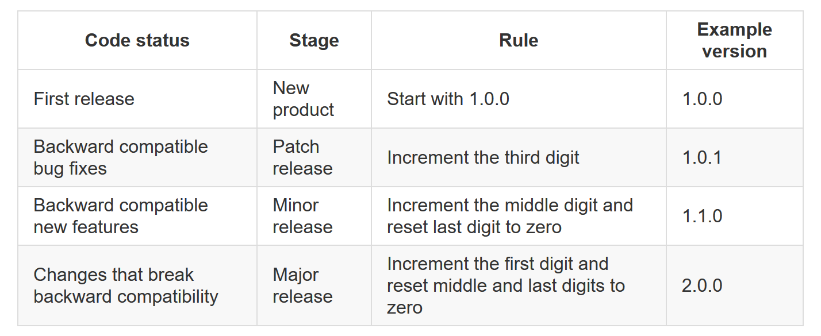

Slide 34
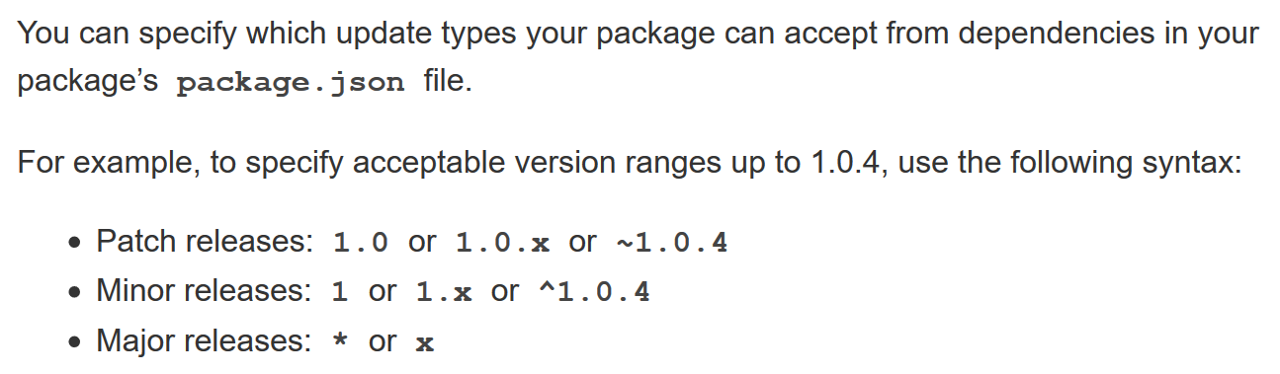

Slide 35
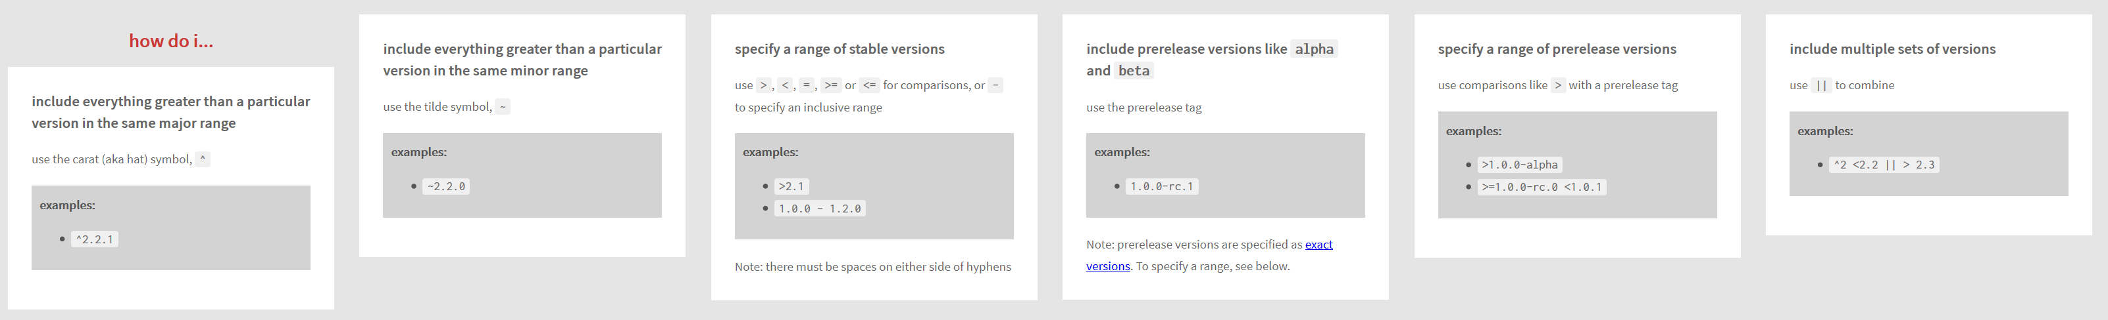

Slide 36
npm cli
Global Installation
npm install -g <package_name>
npm i -g <package_name>
Global Un-installation
npm uninstall -g <package_name>
npm un -g <package_name>
List all Global Packages installed
npm list -g --depth=0

Slide 37
Update Package Versions
npm-check-updates - npm (npmjs.com)

Slide 38
N
Module Loader will search inside node_modules folder of your application
N
require(ModuleName)
Module Loader will search in built-in modules
Y
Y
Module Loader will search for a file inside node_modules
Error Loading Module
Load the module on the memory
Y
N
Load and cache the file on the memory
Module Loader will search for a folder inside node_modules
Y
N
Search inside folder, file with the name ‘package.json’
Error Loading Module
Y
N
N
In ‘package.json’, read ‘main’ key
Search inside folder, file with the name ‘index.js’
N
Y
Y
Search file mentioned in ‘main’
N
Load and cache the file on the memory
Y
NODE JS Module Resolution
Load and cache the file on the memory

Slide 39
WebSocket
WebSocket is a computer communications protocol, providing full-duplex communication channels over a single TCP connection.
The WebSocket protocol was standardized by the IETF as RFC 6455 in 2011
The WebSocket API in Web IDL is being standardized by the W3C.
WebSocket uses HTTP as the initial transport mechanism but keeps the TCP connection alive after the HTTP response is received so that it can be used for sending messages between client and server.

Slide 40
NODE SERVER
BROWSER
HTTP + URL
HTML + JS
I want WebSocket Communication (WS Request)
Should have a code to accept and acknowledge the WebSocket Request
WebSocket Handshake
Acknowledgement

Slide 41
Express JS
Fast, unopinionated, minimalist web framework for Node.js
Express is a minimal and flexible Node.js web application framework that provides a robust set of features for web and mobile applications.
With a myriad of HTTP utility methods and middleware at your disposal, creating a robust API is quick and easy.

Slide 42
Template Engines
A template engine enables you to use static template files in your application.
At runtime, the template engine replaces variables in a template file with actual values and transforms the template into an HTML file sent to the client.
This approach makes it easier to design dynamic HTML pages.

Slide 43
Template Engines
There are multiple template engines that work “out-of-the-box” with Express, some examples are:
Pug: Haml-inspired template engine (formerly Jade).
Haml.js: Haml implementation.
EJS: Embedded JavaScript template engine.
hbs: Adapter for Handlebars.js, an extension of Mustache.js template engine.
All out-of-the-box Template Engines

Slide 44
Express and Middleware
Express is a routing and middleware web framework that has minimal functionality of its own.
An Express application is essentially a series of middleware function calls.
Middleware is a subset of chained function called by the Express app before the user-defined handler is invoked.
Middleware functions have full access to the request and response objects and the next middleware function in the application’s request-response cycle.
Middleware functions can perform the following tasks:
Execute any code.
Make changes to the request and the response objects.
End the request-response cycle.
Call the next middleware function in the stack.

Slide 45
Request Processing Pipeline
REQUEST
RESPONSE
Middleware (Logging, Authentication, Authorization e.t.c.)

Slide 46
Types of middleware
An Express application can use the following types of middleware:
Application-level middleware
Router-level middleware
Error-handling middleware
Built-in middleware
Third-party middleware

Slide 47
DAL
2
3
1. REQUEST
ROUTER
6 . RESPONSE
4
5
VIEWS

Slide 48
DAL
3
4
1. REQUEST
ROUTER
2
CONTROLLER
8 . RESPONSE
7
5
6
VIEWS

Slide 49
Express-generator
npm install -g express-generator (Once)
Create a new application
express --view=pug express-app
cd express-app
ncu
ncu -u
npm install
npm i -D nodemon
Change the start script to use nodemon (in package.json file)
npm start

Slide 50
Assignment
Create a CRUD application to work with employee data using express generator.
Write code to persist the data in JSON file (employees.json)
Use Promise based implementation.
Employee Schema
id – number
name – string
designation – string
salary – number

Slide 51
CRUD Application
NODE SERVER
BROWSER
localhost:3000
EXPRESS JS
Web App
NAVIGATION
Home Index View
monk
Users View Request
Users View
MONGO DB

Slide 52
CRUD Application Secured
NODE SERVER
BROWSER
localhost:3000
EXPRESS JS
Web App
NAVIGATION
Home Index View
monk
Users View Request
Login View
Login POST
Users View
MONGO DB

Slide 53
BROWSER
SERVER
HTTP + URL
NAVIGATION
Server PAGES
CSS
HTML + CSS + JS
HTTP + URL
JS
Full
Page
Reload!
HTML + CSS + JS
Express JS
DB

Slide 54
In Domain Communication
NODE SERVER (localhost:3000)
BROWSER
localhost:3000
Home Index View
EXPRESS JS
Web App
Users View Request
Login View
Login POST
Users View + Client Side App
(jQuery)
EXPRESS JS
Web API
AJAX – api/users
Converted JSON to HTML
JSON
MONGO DB

Slide 55
Cross Domain Communication
NODE SERVER
BROWSER
HTTP + URL (localhost:4000)
React Application
HTML Page + JS (React App)
NODE SERVER
EXPRESS JS
Web API
Enable CORS()
AJAX – localhost:3000/api/users
MongoDB
JSON

Slide 56
localhost:3000
NODE SERVER
BROWSER
(Store the Token in Session Storage)
Home Index View
EXPRESS JS
Web App
Users View Request
Login View
Login POST
Users View + Client Side App
(jQuery)
On document ready -
AJAX – account/getToken + U&P
EXPRESS JS
Web API
JSON with Token
AJAX – api/users + token
JSON
MONGO DB

Slide 57
Links
https://kangax.github.io/compat-table/es6/
https://nodejs.org/dist/latest-v16.x/docs/api/
https://pugjs.org/api/getting-started.html
https://automattic.github.io/monk/docs/GETTING_STARTED.html
https://expressjs.com/en/resources/frameworks.html

Slide 58
Contact Me
Manish Sharma | Gmail
Manish Sharma | WhatsApp
Manish Sharma | Facebook
Manish Sharma | LinkedIn

