Slide 1

Next JS

Slide 2
BROWSER
SERVER
HTTP + URL
NAVIGATION
HTML PAGES
CSS
HTML + CSS
HTTP + URL
HTML + CSS
Page
Reload!

Slide 3
BROWSER
SERVER
HTTP + URL
NAVIGATION
HTML + CSS
Server PAGES
CSS
HTTP + URL
ASP
ASP .NET
JSP
PHP
Ruby
Express JS
HTML + CSS
Page
Reload!
DB

Slide 4
BROWSER
SERVER
HTTP + URL
NAVIGATION
Server PAGES
CSS
HTML + CSS + JS
AJAX - HTTP + URL
JS
Partial
Page
Reload!
PARTIAL HTML
ID
1
<table>
<thead>
<tr>
<th>ID</th>
</tr>
</thead>
<tbody>
<tr>
<td>1</td>
</tr>
</tbody>
</table>
ASP
ASP .NET
JSP
PHP
Ruby
Express JS
ASP .NET MVC
Spring MVC
Ruby On Rails
Laravel
Sails JS
DB

Slide 5
SERVER
Single Page Application (SPA)
SERVER PAGES
CSS
BROWSER
HTTP + URL
NAVIGATION
JS
HTML + CSS + JS
(Client Side JS App)
ASP
ASP .NET
JSP
PHP
Ruby
ASP .NET MVC
Spring MVC
Ruby On Rails
Laravel
<table>
<thead>
<tr>
<th>ID</th>
</tr>
</thead>
<tbody>
<tr>
<td>1</td>
</tr>
</tbody>
</table>
SERVER
AJAX - HTTP + URL
RESTful API
ASP .NET Web API
JWS
Express JS
Python
DB
JSON to HTML on Client Side
JSON
{
“id”:1
}
Vanilla JS, jQuery, KO, BB, NG 1,
NG 2 & Above, Vue JS, React JS

Slide 6
Client-Side Rendering
Client Browser send request to the server using URL
Server responds back based on the URL requested with an HTML
Browser download the JS files referred on the page.
Once the JS files are downloaded, Browser executes React App.
Page now is Viewable and is enabled with interactions.

Slide 7
Pros and Cons of Client-Side
Pros of Client-Side Rendering:
Rich site interactions
Fast website rendering after the initial load.
Great for web applications.
Robust selection of JavaScript libraries.
Cons of Client-Side Rendering:
Low SEO if not implemented correctly.
Initial load might require more time.
In most cases, requires an external library.

Slide 8
Server-Side Rendering
Client Browser send request to the server using URL
Server responds back based on the URL requested, with an rendered HTML.
Browser renders the page which viewable and download the JS files referred on the page.
Once the JS files are downloaded, Browser executes React Code.
Page now is enabled with interactions.

Slide 9
Pros and Cons of Server-Side
Pros of Server-Side Rendering :
Search engines can crawl the site for better SEO.
The initial page load is faster.
Great for static sites.
Cons of Server-Side Rendering:
Frequent server requests.
An overall slow page rendering.
Full page reloads.
Non-rich site interactions

Slide 10
Building Blocks of a Web Application
User Interface
Routing
Data Fetching
Rendering
Integrations
Infrastructure
Performance
Scalability
Developer Experience

Slide 11
React JS - A JavaScript library for building user interfaces
BROWSER (Client Side)
REACTDOM
REACT COMPONENT
View* (UI) – JSX
Style (CSS) – JSX / CSS
Data (Inside) – State
Data (Outside) – Props
Behaviour – Methods
Node JS App (Server Side)
REACTDOMSERVER

Slide 12
Types of Rendering – Web Application
Static Page Rendering - Static Site Generation (SSG)
Static Server Rendering – Server-Side Rendering (SSR)
Client-Side Rendering (CSR)

Slide 13
Steps to Run for ssr application
api-server
Follow the steps given in json_server.txt file
ssr-app
1. Open the terminal on application path
2. Execute 'npm install'
3. Execute 'npm run dev' to start the express server
4. Navigate to localhost:4000, to check the output
If you want to run ssr-app (as client-side app)
1. Open the terminal on application path
2. Execute 'npm install'
3. Execute 'npm run react-start'
4. Chrome Browser will automatically open on localhost:3000

Slide 14
React
Components
ES 2015 +
(Multiple Files)
Manual Configuration
Installed next
Installed react
Installed react-dom
Configure the “npm run dev” command to run next in dev mode
Build & Deploy your
Project on Local Server
Next JS Compiler
(SWC – Speedy Web Compiler)
Only Build & create
Distributable output
npm run dev
Browser Compatible Files
(Multiple Files)
Bundling
BROWSER
Single File / Set of Files
Local
HTTP Server
HTML PAGE
Deploy
Inject Bundles

Slide 15
React
Components
ES 2015 +
(Multiple Files)
Auto Configuration
CLI (create-next-app)
Build & Deploy your
Project on Local Server
Next JS Compiler
(SWC – Speedy Web Compiler)
Only Build & create
Distributable output
npm run dev
Browser Compatible Files
(Multiple Files)
npm run build
Bundling
BROWSER
Single File / Set of Files
Local
HTTP Server
HTML PAGE
Deploy
Inject Bundles

Slide 16
Using Next CLI
To Create a new application
npx create-next-app
cd <app-name>
Commands available in the application
npm run dev
Starts the development server.
npm run build
Bundles the app into static files for production.
npm run start
Build and run, in production.
npm run lint
Check errors and warnings as per es lint

Slide 17
What is Next.js?
Next.js is a React framework.
Next.js gives you all the building blocks to create a web application.
Next.js handles the tooling and configuration needed for React, and provides additional structure, features, and optimizations for your application.
Some core features of Next.js are:
Server rendering React Apps.
Automatic code splitting and lazy loading.
Built in CSS support.
Hot Reloading support.

Slide 18
Adding Bootstrap
Install
yarn add bootstrap bootstrap-icons
yarn add @popperjs/core
Add the Css files to _app.js
Add the bootstrap js using useEffectHook and dynamic import
If we directly import the Bootstrap-bundled JavaScript file, we will get a 'document is not defined' error.
The useEffect() Hook in React is used to instruct our React components that they need to do something after rendering, and in this scenario, we’d use it to import the Bootstrap JavaScript file.

Slide 19
Routing
Next.js has a file-system based router built on the concept of pages.
When a file is added to the pages directory, it's automatically available as a route.
Client-side transitions between routes can be enabled via the Link component exported by next/link.
For an example, consider a pages directory with the following files:
pages/index.js
pages/about.js
We can have a link to each of these pages

Slide 20
Custom App (pages/_app.js)
Next.js uses the App component to initialize pages. You can override it and control the page initialization.
Which allows you to do amazing things like:
Persisting layout between page changes
Keeping state when navigating pages
Custom error handling using componentDidCatch
Inject additional data into pages
Add global CSS
To override the default App, create the file ./pages/_app.js

Slide 21
Custom Document
A custom Document can update the <html> and <body> tags used to render a Page.
This file is only rendered on the server, so event handlers like onClick cannot be used in _document.
To override the default Document, create the file pages/_document.js

Slide 22
Web Performance & Core Web Vitals
Web Vitals is an initiative created by Google to provide unified guidance and metrics to measure end-user page experience on the web.
Core Web Vitals is a subset of Web Vitals, and currently consists of three metrics that measure loading, interactivity, and visual stability.
These metrics are
Largest Contentful Paint (LCP)
First Input Delay (FID)
Cumulative Layout Shift (CLS).
Achieving a great score in these three metrics will create a smoother website experience for your users.
Websites scoring poorly in each of the Core Web Vitals metrics will impact its search engine ranking.

Slide 23
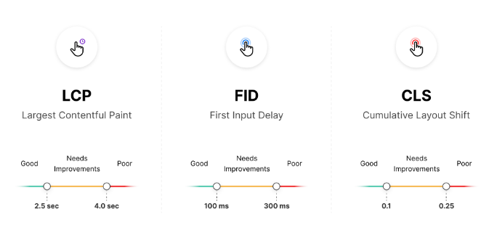
Core Web Vitals
There are three different values when measuring Core Web Vitals: "Good", "Needs Improvement", and "Poor".

Slide 24
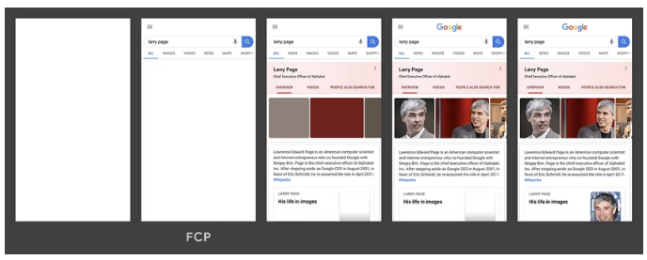
First Contentful Paint
The First Contentful Paint (FCP) metric measures the time from when the page starts loading to when any part of the page's content is rendered on the screen.
For this metric, "content" refers to text, images (including background images), <svg> elements, or non-white <canvas> elements.

Slide 25
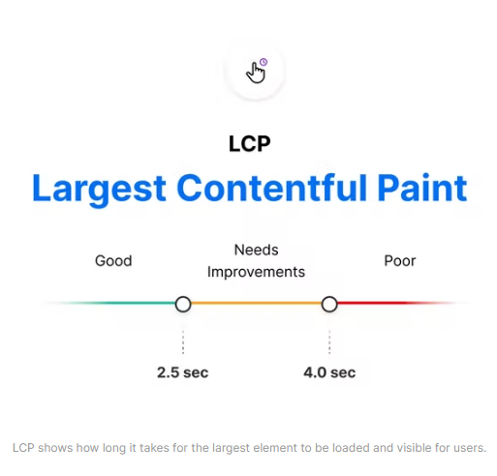
Largest Contentful Paint (LCP)
The Largest Contentful Paint (LCP) metric looks at the loading performance of your page.
LCP measures the time it takes to get the largest element on the page visible within the viewport.
This could be a large text block, video, or image that takes up the primary real estate on the page.

Slide 26
FCP vs LCP
The First Contentful Paint (FCP) metric measures the time from when the page starts loading to when any part of the page's content is rendered on the screen.
The Largest Contentful Paint (LCP) metric reports the render time of the largest image or text block visible within the viewport, relative to when the page first started loading.

Slide 27
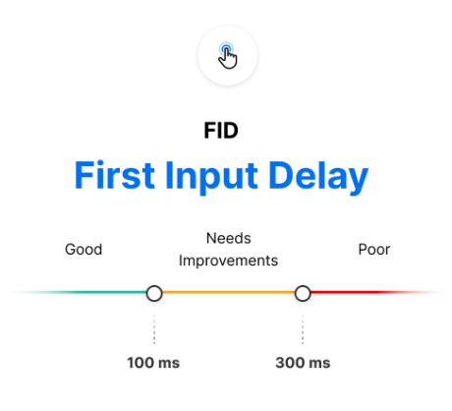
First Input Delay (FID)
The First Input Delay (FID) metric is the perception of an end user’s experience while interacting with a web page.
Imagine clicking inside an input box only for nothing to happen – this frustration with the interactivity and responsiveness of a site is caused by large input delays.
FID requires real user data and cannot be measured in the lab

Slide 28
Total Blocking Time (TBT)
The Total Blocking Time (TBT) metric measures the total amount of time between First Contentful Paint (FCP) and Time to Interactive (TTI) where the main thread was blocked for long enough to prevent input responsiveness.
Total Blocking Time (TBT) is an important lab metric for measuring load responsiveness because it helps quantify the severity of how non-interactive a page is prior to it becoming reliably interactive.

Slide 29
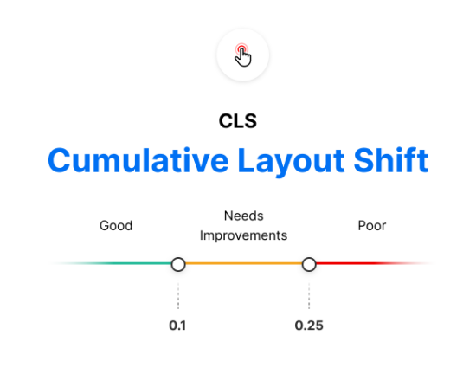
Cumulative Layout Shift (CLS)
The Cumulative Layout Shift (CLS) metric is a measure of your site’s overall layout stability.
A site that unexpectedly shifts layout as the page loads can lead to accidental user error and distraction.
Cumulative Layout Shift (CLS) occurs when elements have been shifted after initially being rendered by the DOM.

Slide 30
next/image
Next.js 10 introduced a built-in image component with automatic optimization capabilities, and this has been one of the most important features ever added to Next.js.
This was developed with the Core Web Vitals scores in mind, which are an important measurement of user experience and are factored into the Google search rankings.
Optimizations the <Image /> component include:
Faster page load: Next.js images will only be loaded when entering the viewport, being lazy-loaded by default.
Responsiveness: images will be resized according to the device used.
Visual stability: the cumulative layout shift problem is automatically avoided.
Improved performance: Next.js images can be resized and encoded on-demand, even when they are stored on remote servers or an external data source, such as CMS. This prevents you from having to create images with different sizes at build time, making it faster.

Slide 31
Next/image Layouts
intrinsic:
This is the behavior adopted by default.
The image will be adjusted visually on smaller viewports and maintain the original dimensions for larger viewports.
The height and width provided as props will act as the maximum dimensions for the image.
fixed:
The image dimensions will not change as the viewport changes.
There is no resizing or responsiveness, just as happens with the HTML <img> tag.
responsive:
The image will be scaled down for smaller viewports and scaled up for larger viewports.
fill:
The image will scale both width and height to the dimensions of the parent element, provided that the latter has position: relative in its stylesheet.
When using this layout width and height do not have to match image dimensions.

Slide 32
Font Optimization
Next.js helps you optimize loading web fonts by inlining font CSS during next build.
This optimization eliminates an extra network round trip to fetch font declaration files.
This results in improvements to First Contentful Paint (FCP) and Largest Contentful Paint (LCP).
Adding fonts to _document is preferred over individual pages. When adding fonts to a single page with next/head, font optimizations included by Next.js will not work on navigations between pages client-side.
Next.js currently supports optimizing Google Fonts and Typekit

Slide 33
Environment Variables
Next.js comes with built-in support for environment variables, which allows you to do the following:
Use .env.local to load environment variables
Expose environment variables to the browser by prefixing with NEXT_PUBLIC_
Default Environment Variables
If you want to add some defaults for the development (next dev) or production (next start) environment.
Next.js allows you to set defaults in .env (all environments), .env.development (development environment), and .env.production (production environment).
.env.local always overrides the defaults set.

Slide 34
Data Fetching
Data fetching in Next.js allows you to render your content in different ways, depending on your application's use case.
SSR: Server-side rendering - On each request
getServerSideProps()
SSG: Static-site generation - On Build
getStaticProps()
ISR: Incremental Static Regeneration – On Build or after the revalidate time
getStaticProps() with revalidate
CSR: Client-side rendering
useEffect() and other hooks

Slide 35
useSWR() - React Hooks for Data Fetching
The team behind Next.js has created a React hook library for data fetching called SWR.
It is highly recommended if you are fetching data on the client-side.
It handles
Caching
Revalidation
Focus tracking
Refetching on intervals and more.
The name “SWR” is derived from stale-while-revalidate, a HTTP cache invalidation strategy popularized by HTTP RFC 5861.
SWR is a strategy to first return the data from cache (stale), then send the fetch request (revalidate), and finally come with the up-to-date data.

Slide 36
Routing Imperatively
next/link should be able to cover most of your routing needs, but you can also do client-side navigations without it by using
useRouter hook from “next/router” package

Slide 37
Shallow Routing
Shallow routing allows you to change the URL without running data fetching methods again, that includes getServerSideProps, getStaticProps, and getInitialProps.
You'll receive the updated pathname and the query via the router object (added by useRouter or withRouter), without losing state.
To enable shallow routing, set the shallow option to true.
Shallow routing only works for URL changes in the current page.

Slide 38
Dynamic Routes
When you don't know the exact segment names ahead of time and want to create routes from dynamic data, you can use Dynamic Segments that are filled in at request time
In Next.js you can add brackets to a page ([params]) to create a dynamic route.
Dynamic routes can be extended to catch all paths by adding three dots (...) inside the brackets. Ex. […params]
Note:
Predefined routes take precedence over dynamic routes
And dynamic routes over catch all routes.

Slide 39
API Routes
As part of our Next.js application folder structure, API routes allow us to establish RESTful endpoints.
We need to establish a folder named ‘api’ within the page folder, and within that folder, we can define all APIs for our application and add business logic without having to write any additional custom server code or set up any API routes.

Slide 40
NEXT JS Application
Data Source
Database
API
http://localhost:3000/api/users
user.service.js
JSON
File System
user-repository
HTTP RESPONSE (JSON)

Slide 41
Dynamic Imports
Next.js supports lazy loading external libraries with import() and React components with next/dynamic.
Deferred loading helps improve the initial loading performance by decreasing the amount of JavaScript necessary to render the page.
Components or libraries are only imported and included in the JavaScript bundle when they're used.
next/dynamic is an extension of React.lazy. When used in combination with Suspense

Slide 42
Authentication
Authentication verifies who a user is, while authorization controls what a user can access.
Next.js supports following authentication patterns, each designed for different use cases.
Authentication Patterns
Server-Side Authentication
Client-Side Authentication

Slide 43
Server-Side Authentication
The request is sent from the browser to a server-side page on our Next.js App.
The SSR page calls a backend API to authenticate the user session
If the session is valid the server pre-renders the requested page on the backend and sends it to the browser
If the session is invalid, the server redirects to the Sign In page.

Slide 44
Iron-session
Node.js stateless session utility using signed and encrypted cookies to store data. Works with Next.js, Express, NestJs, Fastify, and any Node.js HTTP framework.
The session data is stored in encrypted cookies ("seals"). And only your server can decode the session data. There are no session ids, making iron sessions "stateless" from the server point of view.
npm i iron-session

Slide 45
Client Side Authentication
Use static generation to server-render a loading state, followed by fetching user data client-side.
In this pattern, the request is sent from the browser to a static page on our Next.js App, our Next app immediately renders a static-loader/loading-skeleton.
After that, on the client-side (i.e., the browser), we fetch the user data by calling our Backend API.
Depending on the response from the API, we either populate the data or redirect the user to the Sign In page.

Slide 46
Deployment
Next.js Build API
‘next build’ generates an optimized version of your application for production.
Next.js application can be deployed using the following options
Self Hosting
Next.js can be deployed to any hosting provider that supports Node.js
Deploy with Vercel
Docker Image
Static HTML Export

Slide 47
NextAuth.js
NextAuth.js is an open-source authentication library for Next.js.
NextAuth.js provides a simple and customizable solution for adding authentication, authorization, and identity management to Next.js projects.
NextAuth.js simplifies the process of implementing authentication in Next.js applications by abstracting away the complexities and providing a unified interface to work with different authentication providers.

Slide 48
NextAuth
NextAuth.js can be considered as an identity integrator.
It provides a convenient way to integrate various authentication providers and identity systems into your Next.js application.
It acts as a middleware between your application and the identity providers, abstracting away the complexities of authentication integration.

Slide 49
Key Features
Authentication Providers:
NextAuth.js supports various authentication providers out of the box, such as OAuth, JWT, email/password, and more.
Session Management:
NextAuth.js manages user sessions and provides a session object that can be accessed server-side and client-side.
Token-Based Authentication:
NextAuth.js supports token-based authentication, allowing you to issue and validate tokens for authentication purposes.
Customization and Extensibility:
NextAuth.js offers a flexible and extensible architecture, allowing you to customize and extend its functionality to meet your application's specific requirements.
SSR and API Routes Integration:
NextAuth.js seamlessly integrates with Next.js server-side rendering (SSR) and API routes, providing an API route for handling authentication-related requests and supporting server-rendered pages that require authentication.

Slide 50
Contact Me
Manish Sharma | Gmail
Manish Sharma | WhatsApp
Manish Sharma | Facebook
Manish Sharma | LinkedIn

