Slide 1

ECMAScript 2015+

Slide 2
Installation
Install Node Latest LTS version - https://nodejs.org/en/
Install / Update Visual Studio Code to Latest Release - https://code.visualstudio.com/
Extensions of Visual Studio Code
AutoFileName
vscode-icons
JavaScript (ES6) code snippets
File Menu -> Preferences -> File Icon Theme -> Select VScode Icons

Slide 3
Babel
Babel is a JavaScript compiler.
Babel is a toolchain that is mainly used to convert ECMAScript 2015+ code into a backwards compatible version of JavaScript in current and older browsers or environments.
Here are the main things Babel can do for you:
Transform syntax
Polyfill features that are missing in your target environment (through a third-party polyfill such as core-js)
Source code transformations (codemods)

Slide 4
Polyfill
A polyfill is a piece of code (usually JavaScript on the Web) used to provide modern functionality on older browsers that do not natively support it.
core-js
Modular standard library for JavaScript.
Includes polyfills for ECMAScript up to 2021: promises, symbols, collections, iterators, typed arrays, many other features, ECMAScript proposals, some cross-platform WHATWG / W3C features and proposals like URL.

Slide 5
Create and Compile
Create a new project folder
Open the project folder path in terminal window & run the following commands
npm init -y
npm i -D @babel/core @babel/preset-env @babel/cli
npm i core-js
Create babel.config.json file with configuration inside the project folder
To Compile
npx babel --version
npx babel src --out-dir dist

Slide 6
Steps to run the application
Download and Extract the zip file.
Open the extracted folder in Visual Studio Code
Open the terminal window on the folder path and run
npm install
Compile the code
npx babel src --out-dir dist
Once the compilation completes, run from terminal window
node dist/main.js

Slide 7
Modular JavaScript
Module loaders and Module bundlers both make it more actionable to write modular JavaScript applications.
Module loaders
A module loader is typically some library that can load, interpret and execute JavaScript modules you defined using a certain module format/syntax, such as AMD or CommonJS.
Module bundlers
Module bundlers are an alternative to module loaders.
They do the same thing (manage and load interdependent modules) but do it as part of the application build rather than at runtime.
The primary advantage of a bundler is that it leaves you with far fewer files that the browser must download.
This can give your application a performance advantage, as it may decrease the amount of time it takes to load.

Slide 8
Build Tools
Build Tools are utilities that help automate the transformation and bundling of your code into a single file. Most JavaScript projects use these build tools to automate the build process.
There are several common build tools available that can be integrated with Babel.
Some of the tools are:
Browserify
Grunt
Gulp
Webpack

Slide 9
Webpack
We need a module bundler like Webpack to resolve dependencies.
Webpack can understand the relationships between multiple files and "resolve" them in a process called dependency resolution.
Dependency resolution doesn't just which files are needed but the order they are required in since any dependency can rely on another.
Webpack Dev Server:
A NodeJS server and its purpose is to propagate changes from your webpack bundle to your browser during the development of your app
Hot Module Reloading:
This feature allows the app to continue running in its current state whilst the parts you are changing can be swapped out live.

Slide 10
Client Side Build
ES 2015 +
(Multiple Files)
Manual Configuration
Learn Node JS
Learn Webpack
Learn Babel & Config.
Babel +
Preset (Env) +
Polyfill (core-js)
npm start
Build & Deploy your
Project on Local Server
npm run build
Build your project
Browser Compatible Files
(Multiple Files)
WEBPACK-DEV-
SERVER
WEBPACK
CLI
Bundling
BROWSER
WEBPACK
Single File / Set of Files
Local
HTTP Server
HTML PAGE
Deploy
Inject Bundles

Slide 11
Webpack Configuration
Entry Point
Extensions
Loaders (Used to pre-process files)
Plugins
Optimization
Output

Slide 12
Steps to run the application
Download and Extract the zip file.
Open the extracted folder in Visual Studio Code
Open the terminal window on the folder path and run
npm install
Once the installation completes, run
npm start – Starts the Development Server on localhost:3000
npm run build – To create a production build in dist folder
npm run build-serve – To create a production build in dist folder and serve it locally

Slide 13
Datatypes
Primitive Types – Immutable
Primitive Values
undefined
null
Primitive Datatypes
string String()
number Number()
boolean Boolean()
symbol Symbol() – ES6 – You cannot use new keyword with Symbol()
Object Types – Mutable
object Object()

Slide 14
JavaScript types
All types except objects define immutable values (that is, values which can't be changed)
Boolean type: Boolean represents a logical entity and can have two values: true and false. See Boolean and Boolean for more details.
Null type: The Null type has exactly one value: null. See null and Null for more details.
Undefined type: A variable that has not been assigned a value has the value undefined. See undefined and Undefined for more details.
Number type: The Number type is a double-precision 64-bit binary format value (numbers between -(2^53 − 1) and 2^53 − 1). In addition to representing floating-point numbers, the number type has three symbolic values: +Infinity, -Infinity, and NaN ("Not a Number").
String type: JavaScript's String type is used to represent textual data. It is a set of "elements" of 16-bit unsigned integer values. Each element in the String occupies a position in the String.
Symbol type: A Symbol is a unique and immutable primitive value and may be used as the key to an Object property.
Objects: An object is a value in memory which is possibly referenced by an identifier. objects can be seen as a collection of properties. Properties are identified using key values. A key value is either a String value or a Symbol value.

Slide 15
Mutable vs Immutable
JavaScript Engine handles mutable and immutable objects differently.
Immutable are quicker to access than mutable objects.
Mutable objects are great to use when you need to change the size of the object, example array, set etc..
Immutable are used when you need to ensure that the object you made will always stay the same.
Immutable objects are fundamentally expensive to “change”, because doing so involves creating a copy.
Changing mutable objects is cheap.

Slide 16
Standard built-in objects
Value properties
Infinity
NaN
undefined
globalThis
Function properties
eval()
uneval()
isFinite()
isNaN()
parseFloat()
parseInt()
encodeURI()
encodeURIComponent()
decodeURI()
decodeURIComponent()
Fundamental objects
Object
Function
Boolean
Symbol
Error objects
Error
AggregateError
EvalError
InternalError
RangeError
ReferenceError
SyntaxError
TypeError
URIError

Slide 17
Standard built-in objects
Numbers and dates
Number
Math
Date
Text processing
String
RegExp
Indexed collections
Array
Int8Array
Uint8Array
Uint8ClampedArray
Int16Array
Uint16Array
Int32Array
Uint32Array
Float32Array
Float64Array

Slide 18
Standard built-in objects
Keyed collections
Map
Set
WeakMap
WeakSet
Structured data
ArrayBuffer
DataView
JSON
Control abstraction objects
Promise
Generator
GeneratorFunction
AsyncFunction
AsyncGenerator
AsyncGeneratorFunction
Reflection
Reflect
Proxy

Slide 19
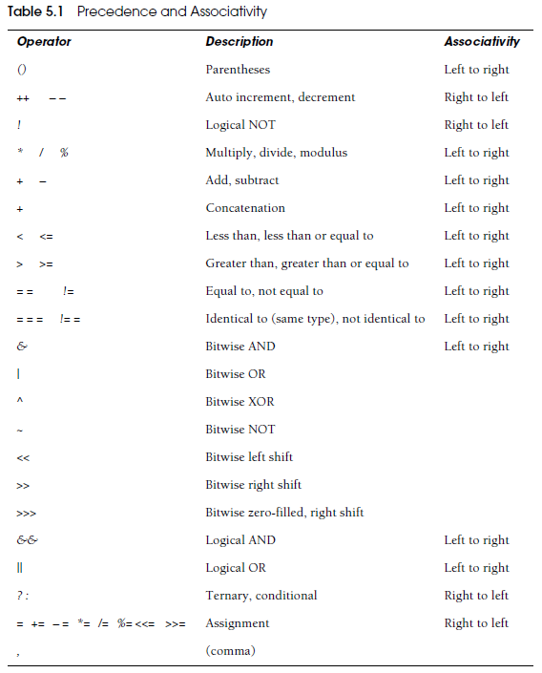
Operators

Slide 20
Symbol
In JavaScript, a Symbol is a primitive data type that represents a unique identifier.
One important thing to note about Symbol is that each Symbol value is unique, even if it has the same description. This makes it useful for creating object keys that won't clash with other keys.

Slide 21
Statements
Control Flow
Block { }
break
continue
Empty
if…else
switch
throw
try…catch
Iterations
for
for...in
for…of
while
do…while

Slide 22
Functions
Functions are one of the fundamental building blocks in JavaScript.
A function in JavaScript is like a procedure—a set of statements that performs a task or calculates a value, but for a procedure to qualify as a function, it should take some input and return an output.
To use a function, you must define it somewhere in the scope from which you wish to call it.
In JavaScript, functions are first-class objects, because they can have properties and methods just like any other object.
What distinguishes them from other objects is that functions can be called.
Every JavaScript function is a Function object.

Slide 23
Functions
function
Declares a function with the specified parameters.
function*
Generator Functions, enable writing iterators more easily
async function
Declares an async function with the specified parameters.

Slide 24
Function Parameters & Arguments
Function Parameters are the names that are define in the function definition and real values passed to the function in function definition are known as arguments.
Parameter Rules:
There is no need to specify the data type for parameters in JavaScript function definitions.
It does not perform type checking based on passed in JavaScript function.
It does not check the number of received arguments.
If a function is called with missing arguments (less than declared), the missing values are set to undefined.

Slide 25
The Arguments Object
JavaScript functions have a built-in object called the arguments object.
The argument object contains an array of the arguments used when the function was called (invoked).
If a function is called with too many arguments (more than declared), these arguments can be reached using the arguments object.

Slide 26
Rest & Spread
REST
The rest operator (also represented by three dots, "...") allows you to represent an indefinite number of arguments as an array.
This operator is used when defining a function that takes a variable number of arguments.
The rest operator also allows us in de-structuring array or objects.
SPREAD
The spread operator (represented by three dots, "...") allows you to spread an array or object into another array or object.
This operator can be used to create a new array or object with the properties of the existing array or object, or to concatenate arrays.

Slide 27
IIFE
Immediately Invoked Function Expression (IIFE) is one of the most popular design patterns in JavaScript.
It is pronounced as, iify.
As name suggest, IIFE is a function expression that automatically invokes after completion of the definition.
IEFE solves this problem by having its own scope and restricting functions and variables to become global.
The functions and variables declare inside IIFE will not pollute global scope even they have same name as global variables & functions.

Slide 28
Pure and Impure Functions
A side-effect is any operation your function performs that is not related to computing the final output, including but not limited to:
Modifying a global variable
Modifying an argument
Making HTTP requests
DOM manipulation
Reading/writing files
A pure function must both be predictable and without side-effects. If either of these criteria is not met, we're dealing with an impure function.
A pure function, returns same result if same arguments are passed in, no matter how many times it runs.
An impure function, may return different result if same arguments are passed in, on multiple runs

Slide 29
Function Overloading
JavaScript does not support function overloading.
If we create two function with same name, the second function will overwrite the first function.
To handle same function names in JavaScript
The first recommendation is to use a different and self-explanatory name for functions.
Using default values for the parameters.
Checking the number of arguments and type of arguments.
Passing the last parameter to describe the kind of option the function should perform. We can use switch or if...else to perform the required operation.

Slide 30
Callback
A callback is a function that is passed as an argument to another function, which is expected to invoke it either immediately or at some point in the future.
Callbacks can be seen as a form of the continuation-passing style (CPS), in which control is passed explicitly in the form of a continuation; in this case the callback passed as an argument represents a continuation.
There are two types of callbacks.
A callback passed to a function can be invoked synchronously before return
Or it can be deferred to execute asynchronously some time after return.

Slide 31
Closure
A closure is a function or reference to a function together with a referencing environment — a table storing a reference to each of the non-local variables of that function.
Closures are functions that refer to independent (free) variables. In other words, the function defined in the closure 'remembers' the environment in which it was created.
A closure is a special kind of object that combines two things: a function, and the environment in which that function was created. The environment consists of any local variables that were in-scope at the time that the closure was created.

Slide 32
Closure
A closure is a function that “encloses” variables from its surrounding scope, allowing it to access those variable even after the surrounding scope has exited.
A closure retains access to variables that were present in its surrounding scope when it was created, even if those variables are no longer in scope.
Closures are often used in JavaScript to create private variables or to preserve the state of a function across multiple invocations.
They can also be used to create callback functions or to create functions that are passed as arguments to other functions.

Slide 33
JavaScript ‘this’ keyword
In JavaScript, “context” refers to an object.
Within an object, the keyword “this” refers to that object, and provides an interface to the properties and methods that are members of that object.
When a function is executed, the keyword “this” refers to the object that the function is executed in.
Scenarios
When a function executes in the global context, “this” refers to the global, or “window” object
When a function is a method of an Object, “this” refers to that object (unless it is manually executed in the context of a different object)
When a function executes inside of another function (no matter how deeply nested), “this” refers to the object whose context within which it is executed
When you instantiate a constructor function, inside of the instance object, “this” refers to the instance object

Slide 34
Function Currying
Currying is a way of constructing functions that allows partial application of a function’s arguments.
What this means is that you can pass all the arguments a function is expecting and get the result or pass a subset of those arguments and get a function back that’s waiting for the rest of the arguments.

Slide 35
Higher Order Functions
Functions that operate on other functions, by taking them as arguments and by returning them, are called higher-order functions.
Higher-order functions allow us to abstract over actions, not just values.
Higher-order functions are functions that take one or more functions as arguments or return a function as a result.
These functions are a fundamental concept of functional programming and allow developers to create more modular and reusable code.

Slide 36
Objects
A JavaScript object is an entity having state and behavior (properties and method). For example: car, pen, bike, chair, glass, keyboard, monitor etc.
JavaScript is an object-based language. Everything is an object in JavaScript.
We can create objects directly.
By object literal
By creating instance of Object directly (using new keyword)
By using an object constructor (using new keyword)

Slide 37
JSON
JSON is a format for storing and transporting data.
JSON is often used when data is sent from a server to a web page.
What is JSON?
JSON stands for JavaScript Object Notation
JSON is a lightweight data interchange format
JSON is language independent *
JSON is "self-describing" and easy to understand
The JSON syntax is derived from JavaScript object notation syntax, but the JSON format is text only.
Code for reading and generating JSON data can be written in any programming language.

Slide 38
toy1
color
shape
__proto__
Object.prototype
constructor
hasOwnProperty()
toString()
.
toy2
color
shape
__proto__

Slide 39
toy1
__proto__
Object.prototype
constructor
hasOwnProperty()
toString()
color=“red”
shape=“circle”
.
toy2
__proto__
toy1
__proto__
Object.prototype
constructor
hasOwnProperty()
toString()
color=“red”
shape=“circle”
.
toy2.color = “blue”;
toy2.shape = “square”
toy2
color
shape
__proto__

Slide 40
Constructor Function
In JavaScript, a constructor function is used to create objects.
To create an object from a constructor function, we use the new keyword.
It is considered a good practice to capitalize the first letter of your constructor function.
When this keyword is used in a constructor function, this refers to the object when the object is created.

Slide 41
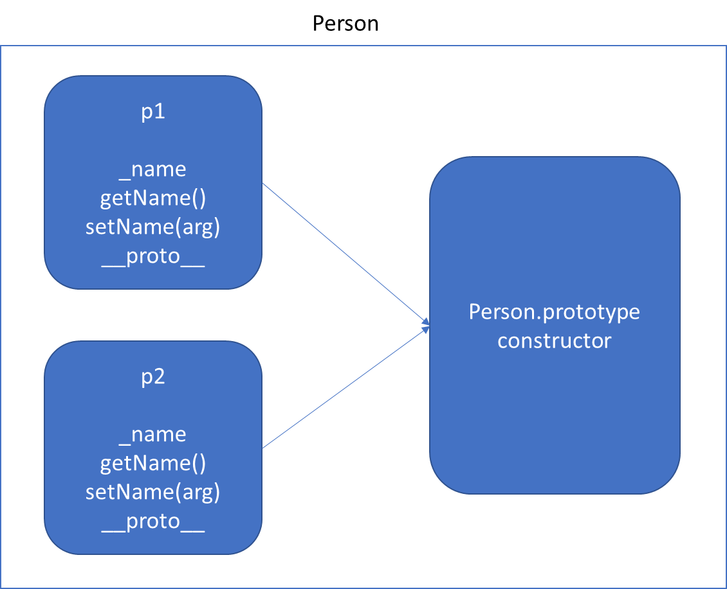
Function Using this keyword *Will increase memory Usage
Object.Prototype
constructor
hasOwnProperty()
toString()

Slide 42
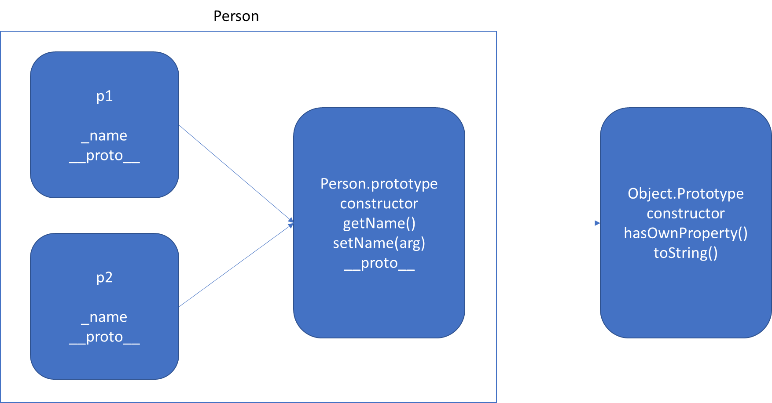
Function Using prototype

Slide 43
Accessor Property
In JavaScript, accessor properties are methods that get or set the value of an object.
Accessor properties are represented by “getter” and “setter” methods.
We use these two keywords:
get - to define a getter method to get the property value
set - to define a setter method to set the property value

Slide 44
static
The static keyword defines a static method or property for a class, or a class static initialization block.
Neither static methods nor static properties can be called on instances of the class. Instead, they're called on the class itself.
Static methods are often utility functions, such as functions to create or clone objects, whereas static properties are useful for caches, fixed-configuration, or any other data you don't need to be replicated across instances.

Slide 45
v.start()
Vehicle.prototype
start()
__proto__
Object.prototype
constructor
hasOwnProperty()
toString()
.
.
v
__proto__
FourWheeler.prototype
__proto__
Object.prototype
constructor
hasOwnProperty()
toString()
.
.
v.start() - Error
v
__proto__

Slide 46
FourWheeler.prototype
move()
__proto__
Vehicle.prototype
start()
__proto__
Object.prototype
constructor
hasOwnProperty()
toString()
.
.
v
__proto__
FourWheeler.prototype
start()
move()
__proto__
Vehicle.prototype
start()
__proto__
Object.prototype
constructor
hasOwnProperty()
toString()
.
.
v
__proto__

Slide 47
Mixins
In JavaScript we can only inherit from a single object. There can be only one [[Prototype]] for an object. And a class may extend only one other class.
A mixin is a class containing methods that can be used by other classes without a need to inherit from it.
In other words, a mixin provides methods that implement a certain behavior, but we do not use it directly, we use it to add the behavior to other classes.
The easiest way of implementing a mixin is to create an object with efficient methods, so that one could merge them to a prototype of any class.

Slide 48
Indexed collections
Array
Int8Array
Uint8Array
Uint8ClampedArray
Int16Array
Uint16Array
Int32Array
Uint32Array
Float32Array
Float64Array

Slide 49
Arrays
Arrays are an ordered collection that can hold data of any type. In JavaScript, arrays are created with square brackets [...] or using Array constructor and allow duplicate elements.
JavaScript objects and arrays were the most important data structures to handle collections of data.
The combination of objects and arrays was able to handle data in many scenarios, however, there were a few shortcomings as follows
Object keys can only be of type string.
Objects don't maintain the order of the elements inserted into them.
Objects lack some useful methods, which makes them difficult to use in some situations. For example, you can't compute the size (length) of an object easily. Also, enumerating an object is not that straightforward.
Arrays are collections of elements that allow duplicates. Supporting arrays that only have distinct elements requires extra logic and code.

Slide 50
Keyed collections
Map
Set
WeakMap
WeakSet

Slide 51
Map
Map is a collection of key-value pairs where the key can be of any type. Map remembers the original order in which the elements were added to it, which means data can be retrieved in the same order it was inserted in.
In other words, Map has characteristics of both Object and Array:
Like an object, it supports the key-value pair structure.
Like an array, it remembers the insertion order.
A new Map can be created using Map Constructor.
Use Map when:
You may want to create keys that are non-strings. Storing an object as a key is a very powerful approach. Map gives you this ability by default.
You need a data structure where elements can be ordered. Regular objects do not maintain the order of their entries.
You are looking for flexibility without relying on an external library like lodash.

Slide 52
Set
A Set is a collection of unique elements that can be of any type.
Set is also an ordered collection of elements, which means that elements will be retrieved in the same order that they were inserted in.
A Set in JavaScript behaves the same way as a mathematical set.
Use Set when
You need to maintain a distinct set of data to perform set operations like union, intersection, difference, and so on.

Slide 53
Weak Map
The WeakMap object is a collection of key/value pairs in which the keys are objects only and the values can be arbitrary values.
The object references in the keys are held weakly, meaning that they are a target of garbage collection (GC) if there is no other reference to the object anymore.
One difference to Map objects is that WeakMap keys are not enumerable.
One use case of WeakMap objects is to store private data for an object, or to hide implementation details.

Slide 54
Weak Set
WeakSet objects are collections of objects.
An object in the WeakSet may only occur once.
It is unique in the WeakSet's collection, and objects are not enumerable.
The main differences to the Set object are:
In contrast to Sets, WeakSets are collections of objects only, and not of arbitrary values of any type.
The WeakSet is weak: References to objects in the collection are held weakly. If there is no other reference to an object stored in the WeakSet, they can be garbage collected. That also means that there is no list of current objects stored in the collection.
WeakSets are not enumerable.
The use cases of WeakSet objects are limited.
They will not leak memory, so it can be safe to use DOM elements as a key and mark them for tracking purposes.

Slide 55
Well-Known symbols
A list of symbols that JavaScript treats specially is published as well-known symbols.
Well-known symbols are used by built-in JavaScript algorithms. For example Symbol.iterator (@@iterator) is utilized to iterate over items in arrays, strings, or even to define your own iterator function.

Slide 56
Well-known symbol
Specification Name | [[Description]] | Value and Purpose
@@hasInstance | "Symbol.hasInstance" | A method that determines if a constructor object recognizes an object as one of the constructor’s instances. Called by the semantics of the instanceof operator.
@@isConcatSpreadable | "Symbol.isConcatSpreadable" | A Boolean valued property that if true indicates that an object should be flattened to its array elements by Array.prototype.concat.
@@iterator | "Symbol.iterator" | A method that returns the default Iterator for an object. Called by the semantics of the for-of statement.
@@match | "Symbol.match" | A regular expression method that matches the regular expression against a string. Called by the String.prototype.match method.
@@replace | "Symbol.replace" | A regular expression method that replaces matched substrings of a string. Called by the String.prototype.replace method.
@@search | "Symbol.search" | A regular expression method that returns the index within a string that matches the regular expression. Called by the String.prototype.search method.
@@species | "Symbol.species" | A function valued property that is the constructor function that is used to create derived objects.
@@split | "Symbol.split" | A regular expression method that splits a string at the indices that match the regular expression. Called by the String.prototype.split method.
@@toPrimitive | "Symbol.toPrimitive" | A method that converts an object to a corresponding primitive value. Called by the ToPrimitive abstract operation.
@@toStringTag | "Symbol.toStringTag" | A String valued property that is used in the creation of the default string description of an object. Accessed by the built-in method Object.prototype.toString.
@@unscopables | "Symbol.unscopables" | An object valued property whose own property names are property names that are excluded from the with environment bindings of the associated object.

Slide 57
Iterators & Generators
Iterators and Generators bring the concept of iteration directly into the core language and provide a mechanism for customizing the behavior of for...of loops.
In JavaScript an iterator is an object which defines a sequence and potentially a return value upon its termination.
Specifically, an iterator is any object which implements the Iterator protocol by having a next() method that returns an object with two properties:
value
The next value in the iteration sequence.
done
This is true if the last value in the sequence has already been consumed. If value is present alongside done, it is the iterator's return value.
Once created, an iterator object can be iterated explicitly by repeatedly calling next().

Slide 58
Generators
In JavaScript, generators provide a new way to work with functions and iterators. Generators provide an easier way to implement iterators.
Using a generator,
you can stop the execution of a function from anywhere inside the function
and continue executing code from a halted position
To create a generator, you need to first define a generator function with function* symbol.
You can pause the execution of a generator function without executing the whole function body by using yield keyword.
The yield expression returns a value. However, unlike the return statement, it doesn't terminate the program. That's why you can continue executing code from the last yielded position.

Slide 59
Generator Methods
Method | Description
next() | Returns a value of yield
return() | Returns a value and terminates the generator
throw() | Throws an error and terminates the generator

Slide 60
Real-time use cases
Some real-time use cases of generators:
Stream Processing:
Generators can be used for stream processing where we have a potentially infinite stream of data that we want to process in chunks. By using a generator function to produce chunks of data, we can process the stream one chunk at a time, rather than loading the entire stream into memory.
Asynchronous Operations:
Generators can also be used to perform asynchronous operations in a synchronous-looking code. By using the yield keyword inside the generator function, we can pause the execution of the generator and wait for an asynchronous operation to complete before resuming execution.
Memory Optimization:
Generators can help optimize memory usage in scenarios where we only need a small portion of a potentially large data set at any given time. By using a generator function to generate only the required portion of the data on-demand, we can avoid loading the entire data set into memory.
Iterative Algorithms:
Generators can also be used in iterative algorithms where we need to generate a sequence of values that depends on the previous value. By using a generator function to generate the next value in the sequence on-demand, we can create an iterative algorithm that is more efficient and memory-friendly.

Slide 61
Assignment - Generator
Use a generator function to generate random passwords of the specified length.

Slide 62
Modules
As our application grows bigger, we want to split it into multiple files, so called “modules”.
Until ES6, JavaScript existed without a language-level module syntax.
JavaScript community invented a variety of ways to organize code into modules, special libraries to load modules on demand.
AMD – one of the most ancient module systems, initially implemented by the library require.js.
CommonJS – the module system created for Node.js server.
UMD – one more module system, suggested as a universal one, compatible with AMD and CommonJS.
The language-level module system appeared in the standard in ECMASCRIPT 2015

Slide 63
Modules
A module is just a file. One script is one module. As simple as that.
A module may contain a class or a library of functions for a specific purpose.
Modules can load each other and use special directives export and import to interchange functionality, call functions of one module from another one:
export keyword labels variables and functions that should be accessible from outside the current module.
import allows the import of functionality from other modules.

Slide 64
Promise
The Promise object represents the eventual completion (or failure) of an asynchronous operation, and its resulting value.
It allows you to associate handlers with an asynchronous action's eventual success value or failure reason.
This lets asynchronous methods return values like synchronous methods: instead of immediately returning the final value, the asynchronous method returns a promise to supply the value at some point in the future.

Slide 65
Fetch API
The Fetch API provides a JavaScript interface for accessing and manipulating parts of the HTTP pipeline, such as requests and responses.
It also provides a global fetch() method that provides an easy, logical way to fetch resources asynchronously across the network.
This kind of functionality was previously achieved using XMLHttpRequest.
Fetch provides a better alternative that can be easily used by other technologies such as Service Workers.
Fetch also provides a single logical place to define other HTTP-related concepts such as CORS and extensions to HTTP.

Slide 66
Assignment - Promise Chaining
Do Calls to the following URL and get data to display the user details with all the posts
https://jsonplaceholder.typicode.com/users/1
https://jsonplaceholder.typicode.com/users/1/posts

Slide 67
Beyond ES6
ES 7 (ECMAScript 2016) New Features
Exponentiation Operator
Array: includes()
ES 8 (ECMAScript 2017) New Features
Object Static Methods
Object: entries() & values()
Object: getOwnPropertyDescriptors()
String Padding
Trailing commas in Function
Async Functions
Async Await Flow
Async Await
ES 9 (ECMAScript 2018) New Features
Object rest/spread properties
Asynchronous Iteration
Promise: finally()
Template literal Revision

Slide 68
What’s next?
Learn the features in:
ECMAScript 2019
ECMAScript 2020
ECMAScript 2021
ECMAScript 2022
Learn HTML 5 Programming (HTML 5 API’s)
Fetch
Fetch-Interceptor
Web Storage API
Video API
All Other API’s also

Slide 69
React
JavaScript (At least ECMASCRIPT 2018)
HTML 5
CSS 3
Basic Node JS Understanding
TypeScript
SCSS (SASS)
Webpack Knowledge (Advantage)

Slide 70
Angular
JavaScript (At least ECMASCRIPT 2018)
HTML 5
CSS 3
Basic Node JS Understanding
TypeScript
SCSS (SASS)
Webpack Knowledge (Advantage)

Slide 71
Contact Me
Manish Sharma | Gmail
Manish Sharma | WhatsApp
Manish Sharma | Facebook
Manish Sharma | LinkedIn

