Slide 1

ECMAScript 2015+

Slide 2
Installation
Install Node Latest LTS version - https://nodejs.org/en/
Install / Update Visual Studio Code to Latest Release - https://code.visualstudio.com/
Extensions of Visual Studio Code
AutoFileName
vscode-icons
JavaScript (ES6) code snippets
File Menu -> Preferences -> Theme -> File Icon Theme -> Select VScode Icons

Slide 3
Babel
Babel is a JavaScript compiler.
Babel is a toolchain that is mainly used to convert ECMAScript 2015+ code into a backward compatible version of JavaScript in current and older browsers or environments.
Here are the main things Babel can do for you:
Transform syntax
Polyfill features that are missing in your target environment (through a third-party polyfill such as core-js)
Source code transformations (codemods)

Slide 4
Steps to run the application
Download and Extract the zip file / clone it from Gitlab Repo.
Open the folder in Visual Studio Code
Open the terminal window on the folder path and run
npm install
To Compile
npx babel --version
npx babel src --out-dir dist
Once the installation completes, run
node dist/main.js
The output will not run on the browser because it needs module loader or module bundler

Slide 5
Commands
npm init -y
npm i -D @babel/core @babel/preset-env @babel/cli
npm i core-js
To Compile
npx babel --version
npx babel src --out-dir dist

Slide 6
Build Tools
Build Tools are utilities that help automate the transformation and bundling of your code into a single file. Most JavaScript projects use these build tools to automate the build process.
There are several common build tools available that can be integrated with Babel.
Some of the tools are:
Browserify
Rollup
Gulp
Webpack

Slide 7
Client-Side Build
ES 2015 +
(Multiple Files)
Manual Configuration
Learn Node JS
Learn Webpack
Learn Babel & Config.
Learn Polyfill
Babel +
Preset (Env) +
Polyfill (core-js)
Build & Deploy your
Project on Local Server
Build your project
Browser Compatible Files
(Multiple Files)
WEBPACK-DEV-
SERVER
WEBPACK
CLI
Bundling
BROWSER
WEBPACK
Single File / Set of Files
Local
HTTP Server
HTML PAGE
Deploy
Inject Bundles

Slide 8
Webpack Configuration Steps
Entry Point
Mode
Extensions
Loaders (Used to pre-process files)
Plugins
Optimization
Output

Slide 9
Steps to run the application
Download and Extract the zip file.
Open the extracted folder in Visual Studio Code
Open the terminal window on the folder path and run
npm install
Once the installation completes, run
npm start – Starts the Development Server on localhost:3000
npm run build – To create a production build in dist folder
npm run build-serve – To create a production build in dist folder and serve it locally

Slide 10
Variables
Variables are containers for storing data (storing data values).
There are 4 Ways to Declare a JavaScript Variable:
Using var
Using let
Using const
Using nothing (Not Recommended)
Always declare JavaScript variables with var, let, or const.
The var keyword is used in all JavaScript code from 1995 to 2015.
The let and const keywords were added to JavaScript in 2015.
If you want your code to run in older browser, you must use var.

Slide 11
Datatypes
The set of types in the JavaScript language consists of primitive values and objects.
Primitive Values - Immutable datum represented directly at the lowest level of the language
Null – null
Undefined – undefined
Boolean() – boolean
Number() – number
String() – string
Symbol (ECMAScript 2015) – symbol – We cannot use new keyword with Symbol()
Objects - An object is a mutable value in memory which is possibly referenced by an identifier.
Object() - object

Slide 12
Mutable vs Immutable
JavaScript Engine handles mutable and immutable objects differently.
Immutable are quicker to access than mutable objects.
Mutable objects are great to use when you need to change the size of the object, example array, set etc..
Immutable are used when you need to ensure that the object you made will always stay the same.
Immutable objects are fundamentally expensive to “change”, because doing so involves creating a copy.
Changing mutable objects is cheap.

Slide 13
JavaScript types
All types except objects define immutable values (that is, values which can't be changed)
Boolean type: Boolean represents a logical entity and can have two values: true and false. See Boolean and Boolean for more details.
Null type: The Null type has exactly one value: null. See null and Null for more details.
Undefined type: A variable that has not been assigned a value has the value undefined. See undefined and Undefined for more details.
Number type: The Number type is a double-precision 64-bit binary format value (numbers between -(2^53 − 1) and 2^53 − 1). In addition to representing floating-point numbers, the number type has three symbolic values: +Infinity, -Infinity, and NaN ("Not a Number").
String type: JavaScript's String type is used to represent textual data. It is a set of "elements" of 16-bit unsigned integer values. Each element in the String occupies a position in the String.
Symbol type: A Symbol is a unique and immutable primitive value and may be used as the key to an Object property.
Objects: An object is a value in memory which is possibly referenced by an identifier. objects can be seen as a collection of properties. Properties are identified using key values. A key value is either a String value or a Symbol value.

Slide 14
Standard built-in objects
Value properties
Infinity
NaN
undefined
globalThis
Function properties
eval()
uneval()
isFinite()
isNaN()
parseFloat()
parseInt()
encodeURI()
encodeURIComponent()
decodeURI()
decodeURIComponent()
Fundamental objects
Object
Function
Boolean
Symbol
Error objects
Error
AggregateError
EvalError
InternalError
RangeError
ReferenceError
SyntaxError
TypeError
URIError

Slide 15
Standard built-in objects
Numbers and dates
Number
Math
Date
Text processing
String
RegExp
Indexed collections
Array
Int8Array
Uint8Array
Uint8ClampedArray
Int16Array
Uint16Array
Int32Array
Uint32Array
Float32Array
Float64Array

Slide 16
Standard built-in objects
Keyed collections
Map
Set
WeakMap
WeakSet
Structured data
ArrayBuffer
DataView
JSON
Control abstraction objects
Promise
Generator
GeneratorFunction
AsyncFunction
AsyncGenerator
AsyncGeneratorFunction
Reflection
Reflect
Proxy

Slide 17
Statements & Loops
Control Flow
Block { }
break
continue
Empty
if…else
switch
throw
try…catch
Iterations
for
for...in
for…of
while
do…while

Slide 18
Functions
Functions are one of the fundamental building blocks in JavaScript.
A function in JavaScript is like a procedure—a set of statements that performs a task or calculates a value, but for a procedure to qualify as a function, it should take some input and return an output.
To use a function, you must define it somewhere in the scope from which you wish to call it.
In JavaScript, functions are first-class objects, because they can have properties and methods just like any other object.
What distinguishes them from other objects is that functions can be called.
Every JavaScript function is a Function object.

Slide 19
Functions
function
Declares a function with the specified parameters.
function*
Generator Functions, enable writing iterators more easily
async function
Declares an async function with the specified parameters.

Slide 20
Function Parameters & Arguments
Function Parameters are the names that are define in the function definition and real values passed to the function in function definition are known as arguments.
Parameter Rules:
There is no need to specify the data type for parameters in JavaScript function definitions.
It does not perform type checking based on passed in JavaScript function.
It does not check the number of received arguments.
If a function is called with missing arguments (less than declared), the missing values are set to undefined.

Slide 21
The Arguments Object
JavaScript functions have a built-in object called the arguments object.
The argument object contains an array of the arguments used when the function was called (invoked).
If a function is called with too many arguments (more than declared), these arguments can be reached using the arguments object.

Slide 22
Rest & Spread
The rest operator (…) allows us to call a function with any number of arguments and then access those excess arguments as an array. The rest operator also allows us in destructuring array or objects.
The spread operator (…) allows us to expand an iterable like array into its individual elements.

Slide 23
Reference Vs Shallow Vs Deep Copy
var arr2 = arr1;
var arr2 = […arr1];
arr1
arr2
10
20
30
40
10
20
30
40
50
60
var arr2 = JSON.parse(JSON.stringify(arr1));
arr2
10
20
30
40
50
60

Slide 24
Reference Copy Vs Shallow Copy
person1
person2
person1
Id
1
Name
Manish
Address
Id
1
Name
Manish
Address
City
Pune
City
Pune
var person2 = person1;
var person2 = {…person1};
person2
Id
1
Name
Manish
Address

Slide 25
Pure and Impure Functions
A side-effect is any operation your function performs that is not related to computing the final output, including but not limited to:
Modifying a global variable
Modifying an argument
Making HTTP requests
DOM manipulation
Reading/writing files
A pure function must both be predictable and without side-effects. If either of these criteria is not met, we're dealing with an impure function.
A pure function, returns same result if same arguments are passed in, no matter how many times it runs.
An impure function, may return different result if same arguments are passed in, on multiple runs

Slide 26
IIFE
Immediately Invoked Function Expression (IIFE) is one of the most popular design patterns in JavaScript.
It is pronounced as, iify.
As name suggest, IIFE is a function expression that automatically invokes after completion of the definition.
IEFE solves this problem by having its own scope and restricting functions and variables to become global.
The functions and variables declare inside IIFE will not pollute global scope even they have same name as global variables & functions.

Slide 27
Function Overloading
JavaScript does not support function overloading.
If we create two function with same name, the second function will overwrite the first function.
To handle same function names in JavaScript
The first recommendation is to use a different and self-explanatory name for functions.
Using default values for the parameters.
Checking the number of arguments and type of arguments.
Passing the last parameter to describe the kind of option the function should perform. We can use switch or if...else to perform the required operation.

Slide 28
Callback
A callback is a function that is passed as an argument to another function, which is expected to invoke it either immediately or at some point in the future.
Callbacks can be seen as a form of the continuation-passing style (CPS), in which control is passed explicitly in the form of a continuation; in this case the callback passed as an argument represents a continuation.
There are two types of callbacks.
A callback passed to a function can be invoked synchronously before return
Or it can be deferred to execute asynchronously some time after return.

Slide 29
Closure
A closure is a function or reference to a function together with a referencing environment — a table storing a reference to each of the non-local variables of that function.
Closures are functions that refer to independent (free) variables. In other words, the function defined in the closure 'remembers' the environment in which it was created.
A closure is a special kind of object that combines two things: a function, and the environment in which that function was created. The environment consists of any local variables that were in-scope at the time that the closure was created.

Slide 30
JavaScript ‘this’ keyword
In JavaScript, “context” refers to an object.
Within an object, the keyword “this” refers to that object, and provides an interface to the properties and methods that are members of that object.
When a function is executed, the keyword “this” refers to the object that the function is executed in.
Scenarios
When a function executes in the global context, “this” refers to the global, or “window” object
When a function is a method of an Object, “this” refers to that object (unless it is manually executed in the context of a different object)
When a function executes inside of another function (no matter how deeply nested), “this” refers to the object whose context within which it is executed
When you instantiate a constructor function, inside of the instance object, “this” refers to the instance object

Slide 31
Function Currying
Currying is a way of constructing functions that allows partial application of a function’s arguments.
What this means is that you can pass all the arguments a function is expecting and get the result or pass a subset of those arguments and get a function back that’s waiting for the rest of the arguments.

Slide 32
Higher Order Functions
Functions that operate on other functions, by taking them as arguments and by returning them, are called higher-order functions.
Higher-order functions allow us to abstract over actions, not just values.

Slide 33
Objects
A JavaScript object is an entity having state and behavior (properties and method). For example: car, pen, bike, chair, glass, keyboard, monitor etc.
JavaScript is an object-based language. Everything is an object in JavaScript.
We can create objects directly.
By object literal
By creating instance of Object directly (using new keyword)
By using an object constructor (using new keyword)

Slide 34
JSON
JSON is a format for storing and transporting data.
JSON is often used when data is sent from a server to a web page.
What is JSON?
JSON stands for JavaScript Object Notation
JSON is a lightweight data interchange format
JSON is language independent *
JSON is "self-describing" and easy to understand
The JSON syntax is derived from JavaScript object notation syntax, but the JSON format is text only.
Code for reading and generating JSON data can be written in any programming language.

Slide 35
var toy1 = new Object()
toy1
__proto__
Object.prototype
constructor
hasOwnProperty()
toString()
.
.
.

Slide 36
toy1
color
shape
__proto__
Object.prototype
constructor
hasOwnProperty()
toString()
.
toy2
color
shape
__proto__

Slide 37
toy1
__proto__
Object.prototype
constructor
hasOwnProperty()
toString()
color=“red”
shape=“circle”
.
toy2
__proto__
toy1
__proto__
Object.prototype
constructor
hasOwnProperty()
toString()
color=“red”
shape=“circle”
.
toy2.color = “blue”;
toy2.shape = “square”
toy2
color
shape
__proto__

Slide 38
Constructor Function
In JavaScript, a constructor function is used to create objects.
To create an object from a constructor function, we use the new keyword.
It is considered a good practice to capitalize the first letter of your constructor function.
When this keyword is used in a constructor function, this refers to the object when the object is created.

Slide 39
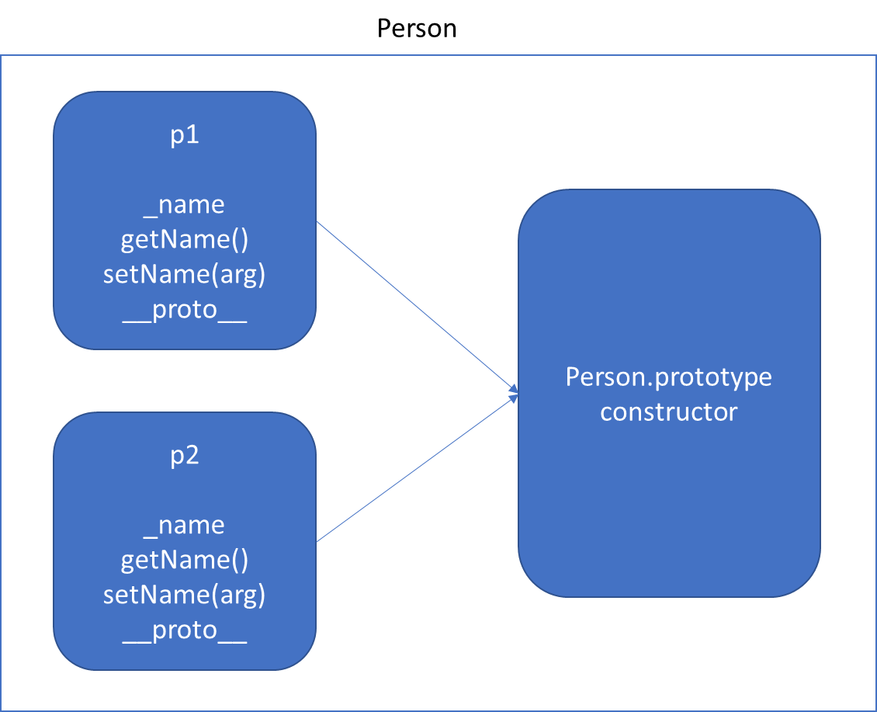
Function Using this keyword *Will increase memory Usage

Slide 40
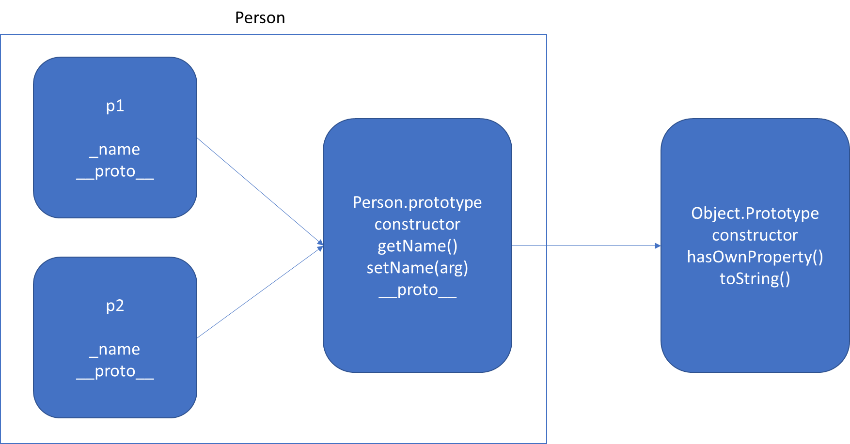
Function Using prototype

Slide 41
static
The static keyword defines a static method or property for a class, or a class static initialization block.
Neither static methods nor static properties can be called on instances of the class. Instead, they're called on the class itself.
Static methods are often utility functions, such as functions to create or clone objects, whereas static properties are useful for caches, fixed-configuration, or any other data you don't need to be replicated across instances.

Slide 42
v.start()
v.toString()
Vehicle.prototype
start()
__proto__
Object.prototype
constructor
hasOwnProperty()
toString()
.
.
v
__proto__
FourWheeler.prototype
__proto__
Object.prototype
constructor
hasOwnProperty()
toString()
.
.
v.start() - Error
v
__proto__

Slide 43
FourWheeler.prototype
move()
__proto__
Vehicle.prototype
start()
__proto__
Object.prototype
constructor
hasOwnProperty()
toString()
.
.
v
__proto__
FourWheeler.prototype
start()
move()
__proto__
Vehicle.prototype
start()
__proto__
Object.prototype
constructor
hasOwnProperty()
toString()
.
.
v
__proto__

Slide 44
Indexed collections
Array
Int8Array
Uint8Array
Uint8ClampedArray
Int16Array
Uint16Array
Int32Array
Uint32Array
Float32Array
Float64Array

Slide 45
Arrays
Arrays are an ordered collection that can hold data of any type. In JavaScript, arrays are created with square brackets [...] or using Array constructor and allow duplicate elements.
JavaScript objects and arrays were the most important data structures to handle collections of data.
The combination of objects and arrays was able to handle data in many scenarios, however, there were a few shortcomings as follows
Object keys can only be of type string.
Objects don't maintain the order of the elements inserted into them.
Objects lack some useful methods, which makes them difficult to use in some situations. For example, you can't compute the size (length) of an object easily. Also, enumerating an object is not that straightforward.
Arrays are collections of elements that allow duplicates. Supporting arrays that only have distinct elements requires extra logic and code.

Slide 46
Keyed collections
Map
Set
WeakMap
WeakSet

Slide 47
Map
Map is a collection of key-value pairs where the key can be of any type. Map remembers the original order in which the elements were added to it, which means data can be retrieved in the same order it was inserted in.
In other words, Map has characteristics of both Object and Array:
Like an object, it supports the key-value pair structure.
Like an array, it remembers the insertion order.
A new Map can be created using Map Constructor.
Use Map when:
You may want to create keys that are non-strings. Storing an object as a key is a very powerful approach. Map gives you this ability by default.
You need a data structure where elements can be ordered. Regular objects do not maintain the order of their entries.
You are looking for flexibility without relying on an external library like lodash.

Slide 48
Set
A Set is a collection of unique elements that can be of any type.
Set is also an ordered collection of elements, which means that elements will be retrieved in the same order that they were inserted in.
A Set in JavaScript behaves the same way as a mathematical set.
Use Set when
You need to maintain a distinct set of data to perform set operations like union, intersection, difference, and so on.

Slide 49
Weak Map
The WeakMap object is a collection of key/value pairs in which the keys are objects only and the values can be arbitrary values.
The object references in the keys are held weakly, meaning that they are a target of garbage collection (GC) if there is no other reference to the object anymore.
One difference to Map objects is that WeakMap keys are not enumerable.
One use case of WeakMap objects is to store private data for an object, or to hide implementation details.

Slide 50
Weak Set
WeakSet objects are collections of objects.
An object in the WeakSet may only occur once.
It is unique in the WeakSet's collection, and objects are not enumerable.
The main differences to the Set object are:
In contrast to Sets, WeakSets are collections of objects only, and not of arbitrary values of any type.
The WeakSet is weak: References to objects in the collection are held weakly. If there is no other reference to an object stored in the WeakSet, they can be garbage collected. That also means that there is no list of current objects stored in the collection.
WeakSets are not enumerable.
The use cases of WeakSet objects are limited.
They will not leak memory, so it can be safe to use DOM elements as a key and mark them for tracking purposes.

Slide 51
Well-Known symbols
A list of symbols that JavaScript treats specially is published as well-known symbols.
Well-known symbols are used by built-in JavaScript algorithms. For example Symbol.iterator (@@iterator) is utilized to iterate over items in arrays, strings, or even to define your own iterator function.

Slide 52
Well-known symbol
Specification Name | [[Description]] | Value and Purpose
@@hasInstance | "Symbol.hasInstance" | A method that determines if a constructor object recognizes an object as one of the constructor’s instances. Called by the semantics of the instanceof operator.
@@isConcatSpreadable | "Symbol.isConcatSpreadable" | A Boolean valued property that if true indicates that an object should be flattened to its array elements by Array.prototype.concat.
@@iterator | "Symbol.iterator" | A method that returns the default Iterator for an object. Called by the semantics of the for-of statement.
@@match | "Symbol.match" | A regular expression method that matches the regular expression against a string. Called by the String.prototype.match method.
@@replace | "Symbol.replace" | A regular expression method that replaces matched substrings of a string. Called by the String.prototype.replace method.
@@search | "Symbol.search" | A regular expression method that returns the index within a string that matches the regular expression. Called by the String.prototype.search method.
@@species | "Symbol.species" | A function valued property that is the constructor function that is used to create derived objects.
@@split | "Symbol.split" | A regular expression method that splits a string at the indices that match the regular expression. Called by the String.prototype.split method.
@@toPrimitive | "Symbol.toPrimitive" | A method that converts an object to a corresponding primitive value. Called by the ToPrimitive abstract operation.
@@toStringTag | "Symbol.toStringTag" | A String valued property that is used in the creation of the default string description of an object. Accessed by the built-in method Object.prototype.toString.
@@unscopables | "Symbol.unscopables" | An object valued property whose own property names are property names that are excluded from the with environment bindings of the associated object.

Slide 53
Iterators & Generators
Iterators and Generators bring the concept of iteration directly into the core language and provide a mechanism for customizing the behavior of for...of loops.
In JavaScript an iterator is an object which defines a sequence and potentially a return value upon its termination.
Specifically, an iterator is any object which implements the Iterator protocol by having a next() method that returns an object with two properties:
value
The next value in the iteration sequence.
done
This is true if the last value in the sequence has already been consumed. If value is present alongside done, it is the iterator's return value.
Once created, an iterator object can be iterated explicitly by repeatedly calling next().

Slide 54
Generators
In JavaScript, generators provide a new way to work with functions and iterators. Generators provide an easier way to implement iterators.
Using a generator,
you can stop the execution of a function from anywhere inside the function
and continue executing code from a halted position
To create a generator, you need to first define a generator function with function* symbol.
You can pause the execution of a generator function without executing the whole function body by using yield keyword.
The yield expression returns a value. However, unlike the return statement, it doesn't terminate the program. That's why you can continue executing code from the last yielded position.

Slide 55
Generator Methods
Method | Description
next() | Returns a value of yield
return() | Returns a value and terminates the generator
throw() | Throws an error and terminates the generator

Slide 56
Uses of Generators
Generators let us write cleaner code while writing asynchronous tasks.
Generators provide an easier way to implement iterators.
Generators execute its code only when required.
Generators are memory efficient.

Slide 57
Modules
As our application grows bigger, we want to split it into multiple files, so called “modules”.
Until ES6, JavaScript existed without a language-level module syntax.
JavaScript community invented a variety of ways to organize code into modules, special libraries to load modules on demand.
AMD – one of the most ancient module systems, initially implemented by the library require.js.
CommonJS – the module system created for Node.js server.
UMD – one more module system, suggested as a universal one, compatible with AMD and CommonJS.
The language-level module system appeared in the standard in ECMASCRIPT 2015

Slide 58
Modules
A module is just a file. One script is one module. As simple as that.
A module may contain a class or a library of functions for a specific purpose.
Modules can load each other and use special directives export and import to interchange functionality, call functions of one module from another one:
export keyword labels variables and functions that should be accessible from outside the current module.
import allows the import of functionality from other modules.

Slide 59
Promise
The Promise object represents the eventual completion (or failure) of an asynchronous operation, and its resulting value.
It allows you to associate handlers with an asynchronous action's eventual success value or failure reason.
This lets asynchronous methods return values like synchronous methods: instead of immediately returning the final value, the asynchronous method returns a promise to supply the value at some point in the future.
Essentially, a promise is a returned object to which you attach callbacks, instead of passing callbacks into a function.

Slide 60
Promise vs Callbacks
There are several advantages of using a promise over a callback in JavaScript. Here are some of the advantages of using a promise:
They are composable, unlike callbacks, therefore we can avoid callback hells
You can easily execute code with Promise.all when multiple responses are returned
You can wait for only one result from concurrent pending promises with the help of Promise.race
You can write asynchronous code in a synchronous manner if you use it in conjunction with async / await.
While they are a perfect choice over callbacks, there are some minor disadvantages we need to cover as well. Here are some:
They can only operate on a single value at a time
They are not available in older browser; they must be polyfilled

Slide 61
Promise Guarantees
Unlike old-fashioned passed-in callbacks, a promise comes with some guarantees:
Callbacks added with then() will never be invoked before the completion of the current run of the JavaScript event loop.
These callbacks will be invoked even if they were added after the success or failure of the asynchronous operation that the promise represents.
Multiple callbacks may be added by calling then() several times. They will be invoked one after another, in the order in which they were inserted.
One of the great things about using promises is chaining.
A common need is to execute two or more asynchronous operations back-to-back, where each subsequent operation starts when the previous operation succeeds, with the result from the previous step. We accomplish this by creating a promise chain.

Slide 62
Fetch API
The Fetch API provides a JavaScript interface for accessing and manipulating parts of the HTTP pipeline, such as requests and responses.
It also provides a global fetch() method that provides an easy, logical way to fetch resources asynchronously across the network.
This kind of functionality was previously achieved using XMLHttpRequest.
Fetch provides a better alternative that can be easily used by other technologies such as Service Workers.
Fetch also provides a single logical place to define other HTTP-related concepts such as CORS and extensions to HTTP.

Slide 63
What’s next?
Learn the features in:
Learn Promise Methods (All, Race)
Learn Promise Chaining
ECMAScript 2016 to ECMAScript 2022
Learn HTML 5 Programming (HTML 5 API’s)
Fetch (get, put, post, delete)
Learn to change request headers in fetch
Fetch-Interceptor
Web Storage API
Video API
All Other API’s

Slide 64
Beyond ES6
ES 7 (ECMAScript 2016) New Features
Exponentiation Operator
Array: includes()
ES 8 (ECMAScript 2017) New Features
Object Static Methods
Object: entries() & values()
Object: getOwnPropertyDescriptors()
String Padding
Trailing commas in Function
Async Functions
Async Await Flow
Async Await
ES 9 (ECMAScript 2018) New Features
Object rest/spread properties
Asynchronous Iteration
Promise: finally()
Template literal Revision

Slide 65
Notes
https://compat-table.github.io/compat-table/es2016plus/
https://developer.mozilla.org/en-US/docs/Web/JavaScript/JavaScript_technologies_overview

Slide 66
Contact Me
Manish Sharma | Gmail
Manish Sharma | WhatsApp
Manish Sharma | Facebook
Manish Sharma | LinkedIn

