Slide 1

Angular 15

Slide 2
BROWSER
SERVER
HTTP + URL
NAVIGATION
HTML PAGES
CSS
HTML + CSS
HTTP + URL
HTML + CSS
Page
Reload!

Slide 3
BROWSER
SERVER
HTTP + URL
NAVIGATION
HTML + CSS
Server PAGES
CSS
HTTP + URL
ASP
ASP .NET
JSP
PHP
Ruby
Express JS
HTML + CSS
Page
Reload!
DB

Slide 4
BROWSER
SERVER
HTTP + URL
NAVIGATION
Server PAGES
CSS
HTML + CSS + JS
AJAX - HTTP + URL
JS
PARTIAL HTML
Partial
Page
Reload!
ASP
ASP .NET
JSP
PHP
Ruby
Express JS
ASP .NET MVC
Spring MVC
Ruby On Rails
Laravel
Sails JS
<table>
<thead>
<tr>
<th>ID</th>
</tr>
</thead>
<tbody>
<tr>
<td>1</td>
</tr>
</tbody>
</table>
ID
1
DB

Slide 5
SERVER
SINGLE PAGE APPLICATION – Cross Domain
SERVER PAGES
CSS
BROWSER
HTTP + URL
NAVIGATION
JS
HTML + CSS + JS
ASP
ASP .NET
JSP
PHP
Ruby
ASP .NET MVC
Spring MVC
Ruby On Rails
Laravel
<table>
<thead>
<tr>
<th>ID</th>
</tr>
</thead>
<tbody>
<tr>
<td>1</td>
</tr>
</tbody>
</table>
ID
1
SERVER
AJAX - HTTP + URL
RESTful API
ASP .NET Web API
JWS
Express JS
Python
DB
JSON to HTML on Client Side
JSON
{
“id”:1
}
Vanilla JS, jQuery, KO, BB, Ext JS,
NG JS, NG 2 & above, React, Vue

Slide 6
Single Page Application Pros - CSR
Quick Loading Time
Seamless User Experience
Ease in Building Feature-rich Apps
Uses Less Bandwidth

Slide 7
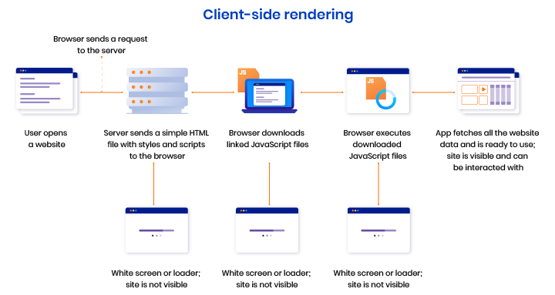

Slide 8
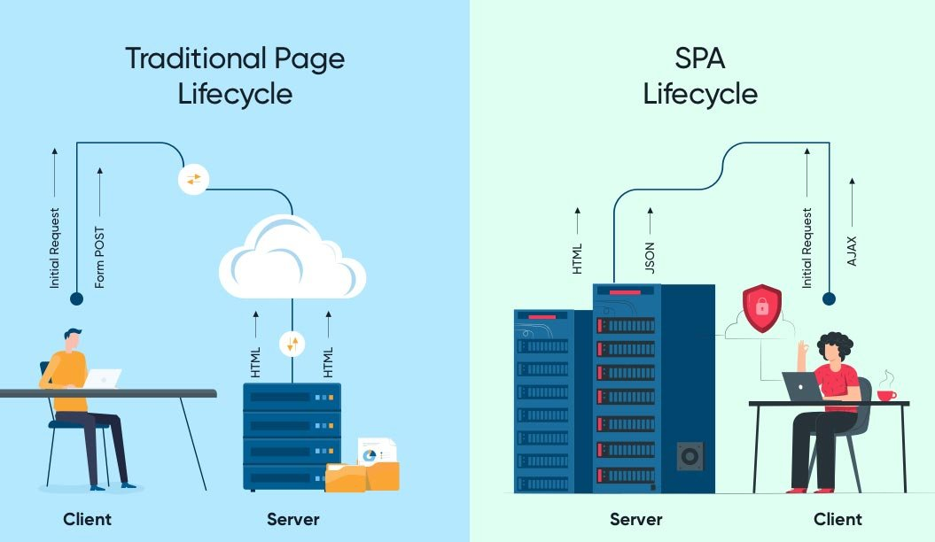

Slide 9
Single Page Application Cons (Purely CSR)
Doesn’t Perform Well With SEO
One of the metrics that search engines use is the number of pages a website has. However, since SPAs only load a single page, it serves as a disadvantage when ranking on search engines
Uses a Lot of Browser Resources
SPAs require many resources from the web browser since the browser is doing most of the tasks for the SPAs.
Security Issues
As compared to multi-page apps, SPAs are more prone to cross-site scripting attacks.

Slide 10
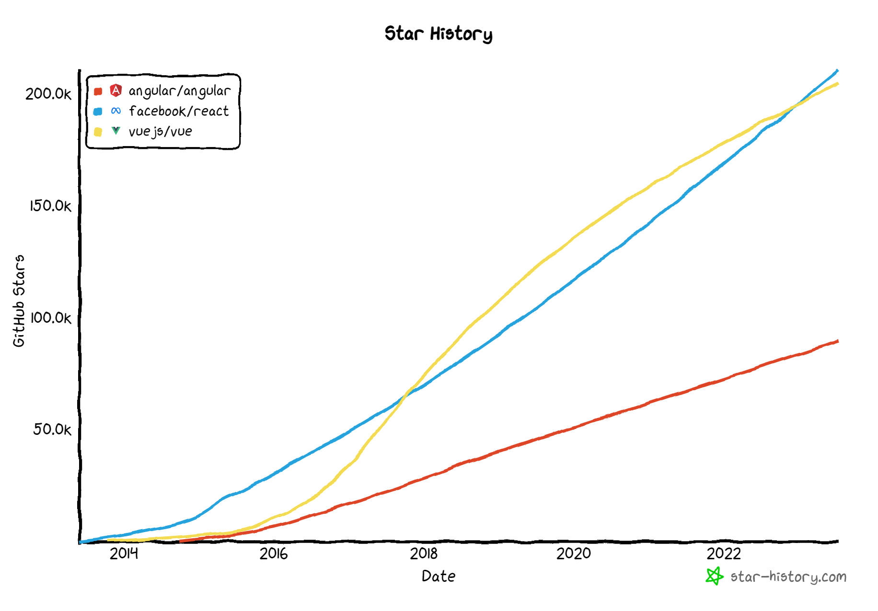

Slide 11
Component vs Traditional Approach
HTML and CSS
HTML and CSS
0
+
-
0
+
-
domHandler
domHandler
Counter
{
count: 0,
next: function() { this.count +=1; } ,
prev: function() { this.count -=1; }
}
Counter
{
count: 0,
next: function() { this.count +=10; } ,
prev: function() { this.count -=10; }
}
<Counter />
<Counter interval=“10”/>

Slide 12
Installation
Latest Version of Node JS (LTS v 16) - https://nodejs.org/en/
Latest version of Visual Studio Code - https://code.visualstudio.com/
Visual Studio Code Extensions
AutoFileName
vscode-icons
Angular Snippets (Version 16)
Angular Language Service
IntelliSense for CSS class names in HTML
CSS Formatter
After Installing the extensions, select the following in VS Code
File Menu -> Preferences -> Theme -> File Icon Theme -> VSCode Icons
Chrome Extension
Angular DevTools – Offered by Angular Team - https://chrome.google.com/webstore/detail/angular-devtools/ienfalfjdbdpebioblfackkekamfmbnh?hl=en

Slide 13
ANGULAR CLIENT-SIDE BUILD
TypeScript (s)
.ts
ng
Auto Configuration
Angular CLI
Build & Deploy your
Project on Local Server
ng serve
TSC
Build your project
ng build
Browser Compatible Files
(Multiple Files)
WEBPACK-DEV-
SERVER
WEBPACK
CLI
Bundling
BROWSER
WEBPACK
Single File / Set of Files
Local
HTTP Server
HTML PAGE
Deploy
Inject

Slide 14
Angular CLI
The Angular CLI is a command-line interface tool that you use to initialize, develop, scaffold, and maintain Angular applications directly from a command shell.
Installing Angular CLI
Open terminal window on any path and execute the following command
npm install --global @angular/cli@15
OR
npm install -g @angular/cli@15
OR
npm i -g @angular/cli@15

Slide 15
Angular CLI (Commands)
ng add | ng help
ng analytics | ng lint
ng build | ng new
ng config | ng run
ng deploy | ng serve
ng doc | ng test
ng e2e | ng update
ng extract-i18n | ng version
ng generate

Slide 16
Terminologies
Angular Workspace
A workspace is a collection of different projects. The ng new command creates a new workspace.
Angular Projects
Angular Library
A library is a collection of components, services, directives etc. that can be shared across different Angular projects.
A library can be packaged and published
Angular Application
An application is a collection of components, services, directives etc. that can be served as an output.
An application can be built and deployed.

Slide 17
Creating Application
Single Project in Single Workspace
ng new <app-name>
Run the Application
ng serve – This command will run the project in development
ng build – This command will create the production build
ng test – This command will run the jasmine tests

Slide 18
Creating Application
Multiple Projects in Single Workspace
ng new multi-apps --create-application=“false”
cd multi-apps
ng generate application app-one
ng generate application app-two
ng generate library my-lib
Run the Application
ng serve --project=app-one – This command will run the application project in development named app-one
Only project of type application will be served

Slide 19
ng generate
Generates and/or modifies files based on a schematic.
ng generate <schematic> [options]
ng g <schematic> [options]
https://angular.io/cli/generate
Schematic
app-shell | directive | interface | resolver
application | enum | library | service
class | guard | module | service-worker
component | interceptor | pipe | web-worker

Slide 20
What is Angular schematic?
A schematic is a command-line tool provided by the Angular CLI (Command Line Interface) that helps developers generate code and modify project files based on predefined templates.
It automates repetitive tasks and provides a consistent way to create components, modules, services, and other Angular artifacts.
The Angular CLI includes a set of built-in schematics that can be used to generate different parts of an Angular application.
Developers can create their own custom schematics to generate code specific to their project requirements.

Slide 21
MODULE
COMPONENT
VIEW (UI) * -
Template / Template URL
STYLE (inline, css)
Style / Style URL
DATA
State (Inside)
Properties (Outside)
BEHAVIOUR (Methods)

Slide 22
Composite UI
APP COMPONENT
ADVERTISEMENT
COMPONENT
NAV COMPONENT + CSS
SIDE NAV COMPONENT
+ CSS
LIST COMPONENT
+ CSS
DETAILS COMPONENT
+ CSS
STATUS COMPONENT + CSS

Slide 23
Steps to run the application
Download and Extract the zip file / Fork the Repo
Open the extracted folder in Visual Studio Code
Open the terminal window on the folder path and run
npm install
Once the installation completes, run
ng serve – Starts the Development Server on port 3000 and opens the default browser on http://localhost:3000

Slide 24
Modules
Angular applications are modular and Angular has its own modularity system called NgModules.
NgModules are containers for a cohesive block of code dedicated to an application domain, a workflow, or a closely related set of capabilities.
They can contain components, service providers, and other code files whose scope is defined by the containing NgModule.
They can import functionality that is exported from other NgModules, and export selected functionality for use by other NgModules.

Slide 25
Component
Components are the most basic UI building block of an Angular app. An Angular app contains a tree of Angular components.
Angular components are a subset of directives, always associated with a template.
A component must belong to an NgModule, for it to be available to another component or application.

Slide 26
Angular Packages
@angular/core: Critical runtime parts of the framework needed by every application. Includes all metadata decorators, Component, Directive, dependency injection, and the component lifecycle hooks.
@angular/common: The commonly needed services, pipes, and directives provided by the Angular team.
@angular/compiler: Angular Template Compiler. It understands templates and can convert them to code that makes the application run and render. Typically, you don’t interact with the compiler directly; rather, you use it indirectly via platform-browser-dynamic when JIT compiling in the browser.
@angular/platform-browser: Everything DOM and browser related, especially the pieces that help render into the DOM. This package also includes the bootstrapModuleFactory() method for bootstrapping applications for production builds that pre-compile with AOT.
@angular/platform-browser-dynamic: Includes Providers and methods to compile and run the app on the client using the JIT compiler.
@angular/forms: Support for both template-driven and reactive forms.
@angular/animations: Angular animations library makes it easy to define and apply animation effects such as page and list transitions. Read about it in the Animations guide.
@angular/router: The router module navigates among your app components/pages when the browser URL changes

Slide 27
RUNTIME
Vendor (Rxjs, Angular Packages)
Polyfills (Zone.js) - NgZone
MODULE
COMPONENT

Slide 28
Adding Bootstrap & Icons
Install Bootstrap and Bootstrap Icons
npm i bootstrap bootstrap-icons
Include the CSS and JS files in angular.json
styles: [
"node_modules/bootstrap/dist/css/bootstrap.css",
"node_modules/bootstrap-icons/font/bootstrap-icons.css",
]
scripts: [
"node_modules/bootstrap/dist/js/bootstrap.js"
]

Slide 29
Assignment
Create and Render the following Components in your application:
Component One
Hello from Component One (text-success)
Component Two
Hello from Component Two (text-primary)

Slide 30
Angular Providers
The Angular Provider is an instruction (or recipe) that describes how an object for a certain token is created.
The Angular Providers is an array of such instructions (Provider). Each provider is uniquely identified by a token (or DI Token ) in the Providers Array.

Slide 31
More on Modules – Multi Modules
Every Angular application has at least one NgModule class, the root module, which is conventionally named AppModule and resides in a file named app.module.ts. You launch your application by bootstrapping the root NgModule.
While a small application might have only one NgModule, most applications have many more feature modules.
Modules in angular are a great way to share and reuse code across your application.

Slide 32
Why use modules in Angular?
Develop a particular piece of functionality independently from the others
Manage teams more easily by enabling each development team to work on a separate feature
Explicitly define the list of modules that the current one requires to function
Deploy features gradually
Build scalable applications
Write tests easily
Enable Lazy Loading

Slide 33
More on Modules – Multi Modules
Components, Directives, Pipes
Services
Declares
Provides
Other Modules
Angular Module
Other Modules
Imports
Exports

Slide 34
Types of Module
We can break our application into following modules:
Root module
The root module is the main module in an Angular application. It is generated by the Angular CLI as AppModule and bootstrapped when the application starts.
Every other Angular module depends either directly or indirectly on the root module. Only one root module can exist in an Angular application.
Core module
The core module usually contains components that are used once in an Angular application, such as a navigation bar, loader, footer, etc.
Shared module
A shared module is made up of directives, pipes, and components that can be reused in feature modules.
Feature modules
Feature modules house the main features of your Angular application.
If you’re building an ecommerce application, for example, you might have specific sets of functionalities, such as orders, products, cart, customers, etc.

Slide 35
Creating Angular Library & NPM publish
Create an Angular workspace for angular library which is not an application.
ng new my-sync-library --create-application=false
Generate Angular Library in the workspace
ng g library manish-sync-pnq-jul23
Build the Library
ng build manish-sync-pnq-jul23
Publish the Library to npm
Register a free account on npmjs.com
On Command Prompt, login to npm
npm adduser
npm login
Navigate to Project Build folder in dist
npm publish

Slide 36
Consume the published npm package
In your application folder path, install the npm package
npm i manish-sync-pnq-jul23
Import the Library Module in AppModule imports array
imports: [ManishSyncPnqJul23Module]
Use the component in the application Root Component
<lib-manish-sync-pnq-jul23></lib-manish-sync-pnq-jul23>

Slide 37
View Encapsulation
In Angular, component CSS styles are encapsulated into the component's view and don't affect the rest of the application.
Angular comes with view encapsulation built in, which enables us to use Shadow DOM or even emulate it.
What is Shadow DOM?
Shadow DOM is part of the Web Components standard and enables DOM tree and style encapsulation.
It basically means that Shadow DOM allows us to hide DOM logic behind other elements.
It enables us to apply scoped styles to elements without them bleeding out to the outer world.

Slide 38
View Encapsulation
Emulated
No Shadow DOM
Style Encapsulation
ShadowDom
Enable Shadow DOM
Style Encapsulation
None
No Shadow DOM
No Style Encapsulation
Value: 0
Value: 1
Value: 2

Slide 39
View Encapsulation
Emulated:
Emulates a native Shadow DOM encapsulation behavior by adding a specific attribute to the component's host element and applying the same attribute to all the CSS selectors provided via Component.
None:
Doesn't provide any sort of CSS style encapsulation, meaning that all the styles provided via Component#styles styles or Component#styleUrls styleUrls are applicable to any HTML element of the application regardless of their host Component.
Shadow DOM:
Uses the browser's native Shadow DOM API to encapsulate CSS styles, meaning that it creates a ShadowRoot for the component's host element which is then used to encapsulate all the Component's styling.

Slide 40
Data Binding
Data binding is the core concept of Angular and used to define the communication between a component and the DOM.
It is a technique to link your data to your view layer.
In simple words, you can say that data binding is a communication between your typescript code of your component and your template which user sees.
Data binding automatically keeps your page up-to-date based on your application's state.

Slide 41
Types of Data binding
Angular provides three categories of data binding according to the direction of data flow:
From the source to view
From view to source
In a two-way sequence of view to source to view

Slide 42
Data Binding (Flow of Data)
SOURCE
Component Class
Data Members
Properties
TARGET
Component Template
Element Properties
Element Attributes
Component Properties
Interpolation {{dName}}
One Way Binding
Property and Attribute Binding
[propertyName] or bind-propertyName
[attr.AttributeName]
One Way To Source Binding
Event Binding
(eventName) or on-eventName
Two Way Binding
[(ngModel)] or bindon-ngModel

Slide 43
$event
$event object is a special variable that is used to capture and access event data in event bindings.
When an event occurs, such as a button click or input change, Angular provides the event data as part of the event binding.
The $event variable allows you to access this event data within the event handler method.
By using the $event object, you can access event-specific data and perform actions based on that data within your event handlers.
The specific properties available in the $event object depend on the type of event being triggered.

Slide 44
ngModel
ngModel is a directive in Angular that facilitates two-way data binding between the model (data) and the view (UI) in forms.
It is primarily used with form controls such as <input>, <select>, and <textarea> elements.
By using ngModel on an input element, you can bind the value of that input to a property in the component's data model.
When the user interacts with the input (e.g., enters text or selects an option), the value is automatically updated in the component's data model.
Similarly, if the value in the data model changes programmatically, the corresponding input element in the UI is automatically updated.
ngModel requires the FormsModule or ReactiveFormsModule to be imported in the Angular module where the component is declared.

Slide 45
How Browser Renders a Web Page?
DOM
HTML Parser
DOM Tree
Layout
HTML
Attachment
Render Tree
Painting
Display
CSS
CSS Parser
Style Rules (CSSOM)

Slide 46
Problems, when we change DOM
The DOM is the representation of the HTML structure of a web page in the browser's memory.
When changes are made to the UI, such as updating text or adding/removing elements, the DOM needs to be updated to reflect those changes.
Traditional approaches involve fully re-rendering the entire DOM tree, even if only a small portion of the UI has changed.
This can be inefficient and lead to performance bottlenecks, especially when dealing with large or complex UIs.

Slide 47
Solution
Angular Ivy is a new Angular renderer, which is radically different from anything we have seen in mainstream frameworks, because it uses incremental DOM.
Incremental DOM takes a different approach. Instead of re-rendering the entire DOM, it performs targeted updates only to the specific parts of the UI that have changed.
The key idea is:
Every component gets compiled into a series of instructions. These instructions create DOM trees and update them in-place when the data changes.

Slide 48
How UI updates?
Angular employs a concept called "change detection"
Change detection in Angular is the process of detecting and updating the user interface (UI) when there are changes to the underlying data or state of an Angular application.
Angular uses a mechanism called Zone.js for enabling change detection.
Angular runs change detection in cycles. During a change detection cycle, Angular checks the component's bindings, including property bindings, event bindings, and child component bindings.
It compares the current values with the previous values and updates the UI accordingly. If any changes are detected, Angular propagates those changes through the component tree.
By triggering change detection, Angular keeps the UI in sync with the underlying data and ensures a responsive and up-to-date user interface.

Slide 49
When does change detection happen?
Initialization: Angular performs an initial change detection when a component is created to set up the component and its associated view.
Event Binding: Change detection is triggered when an event occurs and is bound to a component, such as a button click or input change.
Property Binding: Angular detects changes when the value of a bound property changes within the component.
Input Binding: Change detection is triggered when the value of an input property changes, typically from a parent component to a child component.
Timer-based operations: Angular's change detection is triggered after timer-based operations, such as setTimeout or setInterval, complete their execution.
Asynchronous operations: Angular's change detection is aware of asynchronous operations, like HTTP requests or Promises, and triggers change detection when these operations complete.
Manual triggering: Change detection can be manually triggered using the ChangeDetectorRef service's detectChanges() method. This is useful for updating the UI explicitly in specific cases.

Slide 50
Zone
Application state change can be caused by:
Events – User events click, change, input, submit
XMLHttpRequests – When fetching data from a remote service
Timers – setTimeout(), setInterval()
Angular takes advantage of Zones (NgZone)
Zone monkey-patches global asynchronous operations such as setTimeout() and addEventListener(), which is why Angular can easily find out, when to update the DOM.

Slide 51
When Angular needs to update the HTML?
Typically, updates occur for one of the following reasons:
Component initialization: When bootstrapping an Angular application, Angular loads the bootstrap component and triggers the ApplicationRef.tick() to call change detection and View Rendering
Event listener: The DOM event listener can update the data in an Angular component and trigger change detection.
HTTP Data Request. You can also get data from a server through an HTTP request.
MacroTasks, such as setTimeout() or setInterval(). You can also update the data in the callback function of a macroTask such as setTimeout()
MicroTasks, such as Promise.then(). Other asynchronous APIs return a Promise object (such as fetch), so the then() callback function can also update the data.
Other async operations. In addition to addEventListener(), setTimeout() and Promise.then(), there are other operations that can update the data asynchronously. E.g., WebSocket.onmessage()

Slide 52
Directives
Directives are classes that add additional behavior to elements in your Angular applications.
The different types of Angular directives are as follows:
Components—directives with a template. This type of directive is the most common directive type.
Attribute directives—directives that change the appearance or behavior of an element, component, or another directive. E.g., NgClass, NgStyle, NgModel
Structural directives—directives that change the DOM layout by adding and removing DOM elements. E.g., NgIf, NgFor, NgSwitch

Slide 53
Renderer 2
In Angular, Renderer2 is a utility class provided by the platform browser module (@angular/platform-browser).
It allows you to interact with the browser’s DOM directly
It provids a safe and platform-agnostic way to manipulate elements, attributes, and styles.
The Renderer2 class serves as a wrapper around the browser's native DOM manipulation methods.
It abstracts away the direct access to the DOM and provides a set of methods that ensure compatibility across different platforms.

Slide 54
Lifecycle hooks
Lifecycle hooks in Angular are methods that allow you to tap into various stages of a component’s or directive’s lifecycle.
They provide a way to perform certain actions or execute code at specific points in the component's or directive’s lifecycle, such as before it is created, after it is initialized, or before it is destroyed.
By implementing the lifecycle hooks in your component or directives, allows you to manage initialization, data updates, view changes, and cleanup operations effectively.

Slide 55
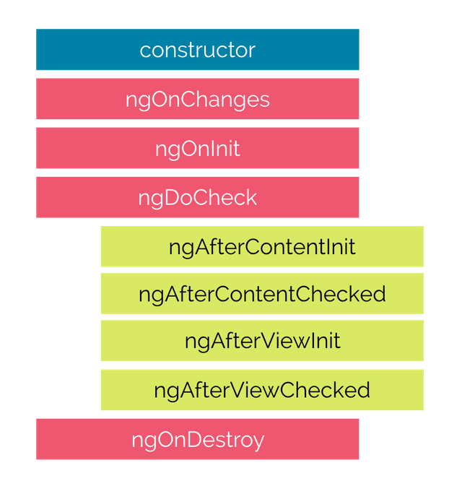
Life Cycle Hooks

Slide 56

Hooks for the Component
constructor : This is invoked when Angular creates a component or directive by calling new on the class.
ngOnChanges : Invoked every time, there is a change in one of the input properties of the component.
ngOnInit : Invoked when given component has been initialized. This hook is only called once after the first ngOnChanges
ngDoCheck : Invoked when the change detector of the given component is invoked. It allows us to implement our own change detection algorithm for the given component.
ngAfterContentInit : Invoked after Angular performs any content projection into the component’s
ngAfterContentChecked : Invoked each time the content of the given component has been checked by the change detection mechanism of Angular.
ngAfterViewInit : Invoked when the component’s view has been fully initialized.
ngAfterViewChecked : Invoked each time the view of the given component has been checked by the change detection mechanism of Angular
ngOnDestroy : This method will be invoked just before Angular destroys the component. Use this hook to unsubscribe observables and detach event handlers to avoid memory leaks.

Slide 57
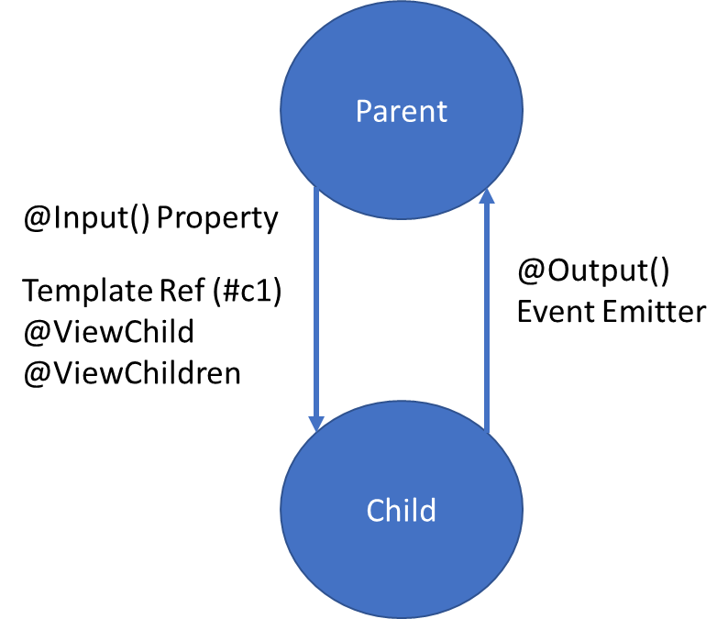
Parent Child Communication
Property Binding:
With property binding, the parent component can bind a property value to an input property of the child component. This allows the parent to pass data to the child component.
Event and Output:
The child component can emit events that the parent component can listen to. This allows the child component to notify the parent about an action or state change.
ViewChild, ViewChildren and Template Reference Variable:
The parent component can access the child component's properties and methods using ViewChild and a template reference variable.

Slide 58
Event Emitter
EventEmitter is a class provided by the @angular/core package that allows components to emit custom events.
It serves as a mechanism for communication between components, enabling the exchange of data or triggering actions based on user interactions or other application events.
It is typically used in conjunction with the @Output decorator to create custom event emitters within Angular components.
It facilitates communication in a unidirectional manner, where the child component emits events that the parent component can listen to and respond to.

Slide 59
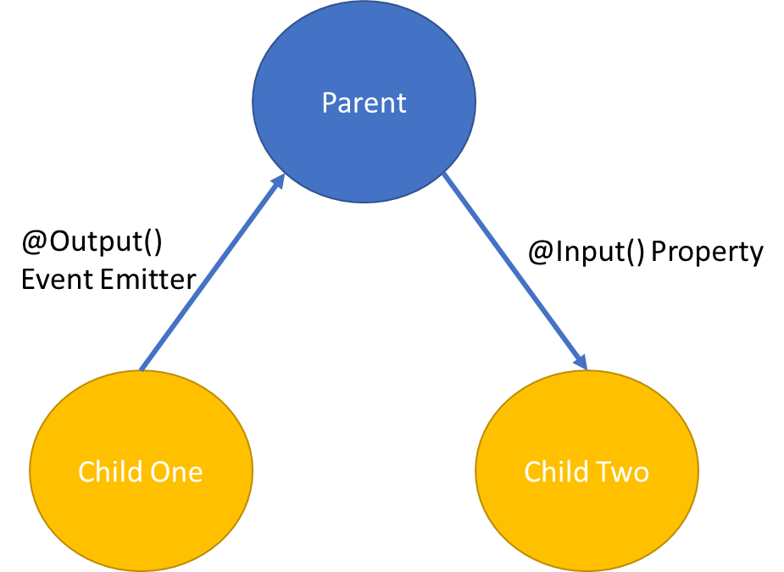
Sibling Communication
Using a Common Parent Component:
Sibling components can communicate with each other indirectly through a shared parent component.
The parent component acts as a mediator and facilitates data exchange between the siblings using property bindings and event bindings.
Using a Shared Service:
Sibling components can communicate directly with each other using a shared service.
The service acts as a central communication hub and allows siblings to share data and trigger actions.
S
E
R
V
I
C
E
Component One
Component Two

Slide 60
Content Projection
Content projection is a pattern in which you insert, or project, the content you want to use inside another component.
For example, you could have a Card component that accepts content provided by another component.
Common implementations of content projection
Single-slot content projection
With this type of content projection, a component accepts content from a single source.
Multi-slot content projection
In this scenario, a component accepts content from multiple sources.
Conditional content projection
Components that use conditional content projection render content only when specific conditions are met.

Slide 61
Pipes
Angular provides built-in pipes for typical data transformations, including transformations for internationalization (i18n), which use locale information to format data.
The following are commonly used built-in pipes for data formatting:
DatePipe: Formats a date value according to locale rules.
UpperCasePipe: Transforms text to all upper case.
LowerCasePipe: Transforms text to all lower case.
CurrencyPipe: Transforms a number to a currency string, formatted according to locale rules.
DecimalPipe: Transforms a number into a string with a decimal point, formatted according to locale rules.
PercentPipe: Transforms a number to a percentage string, formatted according to locale rules.

Slide 62
Using 3rd party Libraries in Angular
Install the package/library
npm i <package-name>
npm i lodash
Install the type definition file of the library
npm i -D @types/<package-name>
npm i -D @types/lodash
If the package supports Angular schematics, we can use
ng add <package-name>

Slide 63
Forms
Reactive forms provide direct, explicit access to the underlying forms object model. Compared to template-driven forms, they are more robust: they're more scalable, reusable, and testable. If forms are a key part of your application, or you're already using reactive patterns for building your application, use reactive forms.
Template-driven forms rely on directives in the template to create and manipulate the underlying object model. They are useful for adding a simple form to an app, such as an email list signup form. They're easy to add to an app, but they don't scale as well as reactive forms. If you have very basic form requirements and logic that can be managed solely in the template, template-driven forms could be a good fit.

Slide 64
Key Differences
 | REACTIVE | TEMPLATE-DRIVEN
Setup of form model | Explicit, created in component class | Implicit, created by directives
Data model | Structured and immutable | Unstructured and mutable
Predictability | Synchronous | Asynchronous
Form validation | Functions | Directives

Slide 65
Form Builder
Creates an AbstractControl from a user-specified configuration.
The FormBuilder provides syntactic sugar that shortens creating instances of a FormControl, FormGroup, or FormArray.
It reduces the amount of boilerplate needed to build complex forms.

Slide 66
Built in Validators
min
max
required
requiredTrue
email
minLength
maxLength
pattern
nullValidator
compose
composeAsync

Slide 67
Promise
The Promise object represents the eventual completion (or failure) of an asynchronous operation, and its resulting value.
It allows you to associate handlers with an asynchronous action's eventual success value or failure reason.
This lets asynchronous methods return values like synchronous methods: instead of immediately returning the final value, the asynchronous method returns a promise to supply the value at some point in the future.

Slide 68
RxJS
Reactive Extensions Library for JavaScript
RxJS is a library for reactive programming using Observables, to make it easier to compose asynchronous or callback-based code.
RxJS is a library for composing asynchronous and event-based programs by using observable sequences.
It provides one core type, the Observable, satellite types (Observer, Schedulers, Subjects) and operators inspired by Array#extras (map, filter, reduce, every, etc) to allow handling asynchronous events as collections.

Slide 69
Promise Vs Observable
Promise | Observables
Emit Single Value | Emit Multiple Values, over a period of time (Stream of Data)
Not Lazy | Lazy, observables will not execute unless we subscribe to it
Cannot be cancelled | Can be cancelled by using unsubscribe
Does not provide any operators | Observables provide a lot of built in operators i.e. map, forEach, filter, reduce, retry

Slide 70
Concepts in RxJS
Observable: represents the idea of an invokable collection of future values or events.
Observer: is a collection of callbacks that knows how to listen to values delivered by the Observable.
Subscription: represents the execution of an Observable, is primarily useful for cancelling the execution.
Operators: are pure functions that enable a functional programming style of dealing with collections with operations like map, filter, concat, reduce, etc.
Subject: is equivalent to an EventEmitter, and the only way of multicasting a value or event to multiple Observers.
Schedulers: are centralized dispatchers to control concurrency, allowing us to coordinate when computation happens on e.g. setTimeout or requestAnimationFrame or others.

Slide 71
Subject
A Subject is a special type of Observable that allows values to be multi-casted to many Observers.
A Subject is like an Observable but can multicast to many Observers.
Subjects are like EventEmitters: they maintain a registry of many listeners. Every Subject is an Observable and an Observer.
You can subscribe to a Subject and you can call next to feed values as well as error and complete.

Slide 72
Subject Type Variations to consider
Subject - a subscriber will only get published values that were emitted after the subscription.
BehaviorSubject - the last value is cached. A subscriber will get the latest value upon initial subscription. The semantics for this subject is to represent a value that changes over time.
ReplaySubject - it can cache up to a specified number of emissions if buffer Size is provided / else it is Infinity (Cache all published values). Any subscribers will get all the cached values upon subscription.

Slide 73
RxJS Operators
An operator is a pure function that takes in observable as input and the output is also an observable.
To work with operators, we need a pipe() method.
There are operators for different purposes, and they may be categorized as: creation, transformation, filtering, joining, multicasting, error handling, utility, etc.

Slide 74
Creation Operators
ajax
bindCallback
bindNodeCallback
defer
empty
from
fromEvent
fromEventPattern
generate
interval
of
range
throwError
timer
iif

Slide 75
Join Creation Operators
combineLatest
concat
forkJoin
merge
partition
race
zip
combineAll
concatAll
exhaust
mergeAll
startWith
withLatestFrom

Slide 76
Transformation Operators
buffer
bufferCount
bufferTime
bufferToggle
bufferWhen
concatMap
concatMapTo
exhaust
exhaustMap
expand
groupBy
map
mapTo
mergeMap
mergeMapTo
mergeScan

Slide 77
Transformation Operators
pairwise
partition
pluck
scan
switchMap
switchMapTo
window
windowCount
windowTime
windowToggle
windowWhen

Slide 78
Filtering Operators
audit
auditTime
debounce
debounceTime
distinct
distinctKey
distinctUntilChanged
distinctUntilKeyChanged
elementAt
filter
first
ignoreElements
last

Slide 79
Filtering Operators
sample
sampleTime
single
skip
skipLast
skipUntil
skipWhile
take
takeLast
takeUntil
takeWhile
throttle
throttleTime

Slide 80
Misc
Multicasting Operators
multicast
publish
publishBehavior
publishLast
publishReplay
share
Error Handling Operators
catchError
retry
retryWhen

Slide 81
Misc
Utility Operators
tap
delay
delayWhen
dematerialize
materialize
observeOn
subscribeOn
timeInterval
timestamp
timeout
timeoutWith
toArray

Slide 82
Misc
Conditional and Boolean Operators
defaultIfEmpty
every
find
findIndex
isEmpty
Mathematical and Aggregate Operators
count
max
min
reduce

Slide 83
RxJS Learning
https://rxjs.dev/
https://rxmarbles.com/

Slide 84
Services
Components shouldn't fetch or save data directly and they certainly shouldn't knowingly present fake data.
They should focus on presenting data and delegate data access to a service.
Instead of creating the service with the new keyword, you'll rely on Angular dependency injection to inject it into the Component’s constructor.
Services are a great way to share information among classes that don't know each other.

Slide 85
Dependency Injection (DI)
DI is wired into the Angular framework and used everywhere to provide new components with the services or other things they need.
Components consume services; that is, you can inject a service into a component, giving the component access to that service class.
The injector is the main mechanism. Angular creates an application-wide injector for you during the bootstrap process, and additional injectors as needed. You don't have to create injectors.
An injector creates dependencies and maintains a container of dependency instances that it reuses if possible.
A provider is an object that tells an injector how to obtain or create a dependency.
For any dependency that you need in your app, you must register a provider with the application's injector, so that the injector can use the provider to create new instances.

Slide 86
What is a Provider?
A provider in Angular acts like an instruction for the Dependency Injection system, which directs on how to get a value for a particular dependency.
These Dependencies are the services that we create and provide to Angular application module(s).
It helps the injector in, How to create/find the Dependency for a token.

Slide 87
Angular Providers
Providers are used to registering classes, functions, or values as dependencies using Angular’s Dependency Injection (DI) system.
Each Provider is located using a token.
Three types of token registration are available:
Type Token
String Token
Injection Token
Four ways can be used to create the dependency:
useClass : Class Provider
useValue: Value Provider
useFactory: Factory Provider
useExisting: Class as Alias Provider

Slide 88
Dependency Injection (DI)
Angular creates a hierarchical dependency injection system. It creates a hierarchical tree of Injectors.
Each Injector gets their own copy of Angular Providers.
Together these two form the core of the Angular dependency injection framework.
Angular Creates not one but two injector trees. Module Injector tree & Element Injector tree.
Module Injector tree is for Modules (@NgModule). For Root Module & for every Lazy Loaded Module.
Element Injector tree is for DOM Elements like Components & Directives.

Slide 89
Module Injector Tree
Angular creates the ModuleInjector for the services to be provided at Module Levels.
We register the Module level services in two ways
Using The Providers Metadata of the @NgModule()
Using the @Injectable() Decorator with providedIn : root in the service itself
Angular Creates the Module Injector tree when the Application starts.
At the top of the Module Injector tree, Angular creates an instance of Null Injector.
Under Null Injector Angular creates an instance of PlatformInjector.

Slide 90
Module Injector Tree
Null Injector
Platform Injector
RootModule Injector
Eager Module 1
Eager Module 2
Eager Module 3

Slide 91
Null Injector
The Null Injector always throws an error unless we decorate the dependency with the Optional decorator.
Optional Decorators
@Self
@SkipSelf
@Optional

Slide 92
Platform injector
The platformBrowserDynamic() method creates an injector configured by a PlatformModule, which contains platform-specific dependencies.
This allows multiple applications to share a platform configuration.
Platform Injector usually includes built-in providers like DomSanitize etc.

Slide 93
Element Injector
Angular creates the Element Injector tree for the services to be provided at the element level like Components & Directives.
Angular creates the Element Injector tree when the application starts.
The Injector instance of the Root Component becomes the root Injector for the Element Injector tree. It gets the Providers from the provider’s property of the Root Component.
The Root Component acts as a parent to every element we create. Each of those elements can contain child elements creating a tree of elements. The Angular creates an Injector for each of these elements creating a tree of Injectors.
Each Injector gets the list of Providers from the @Directive() or @Component(). If the Providers array is empty, then Angular creates an empty Injector.
The Angular will destroy the Injector when Angular destroys the element.

Slide 94
Element Injector Tree
Root Component
Parent Component A
Child Component C
Parent Component B
Child Component A
Child Component B
Grand Child Component

Slide 95
Dependency Resolution
When a component asks for Dependency, the DI Framework resolves it in two phases.
First phase
It starts to look for the Dependency in the current component’s ElementInjector.
If it does not provide the Dependency, it will look in the Parent Components ElementInjector.
The Request bubbles up until it finds an injector that provides the service or reaches the root ElementInjector.
Second phase - If ElementInjector does not satisfy the request
Angular looks for the Dependency in the ModuleInjector hierarchy.
If Angular still doesn’t find the provider, it throws an error.

Slide 96
Assignment (Day 3)
Create a Custom Validator to compare 2 fields in the form
Compare Password and Confirm Password
Compare Start Date and End Date
End Date cannot be a date before the start date
Complete the CRUD assignment as per the screenshot shared in the next slide, use array to keep the data.
Create form-component and data-table-component as sibling components.
Id should be auto generated after every insert, update and delete
When we click details or edit, data will be displayed in Form Component.
In Details, Form should display data but will be disabled for editing.
On delete, ask for confirmation, before delete

Slide 97
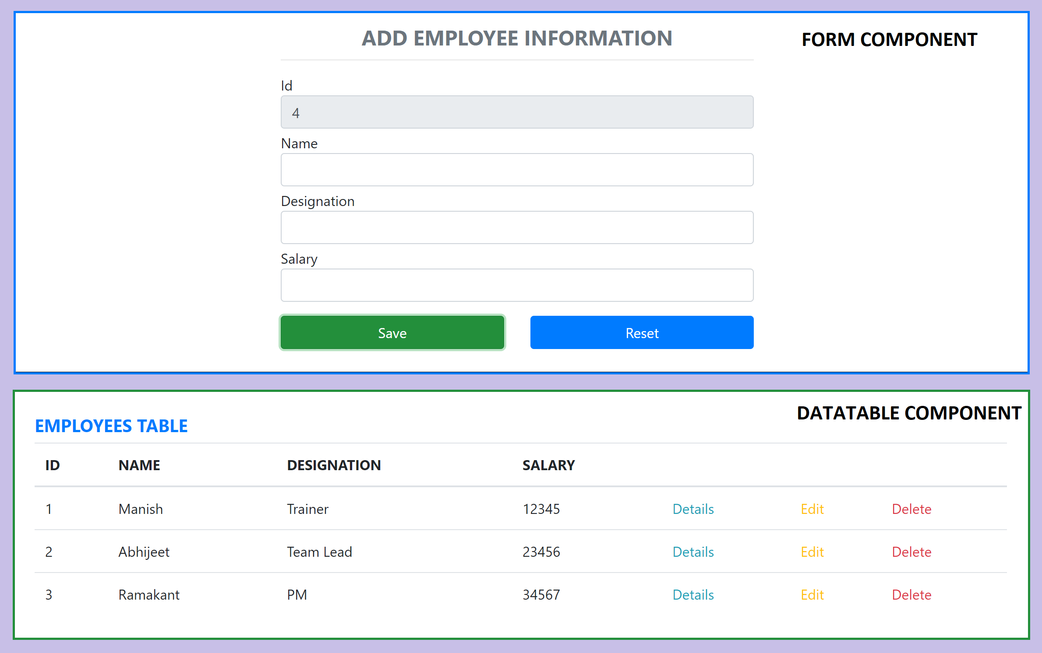
Assignment

Slide 98
Communicating with backend services using HTTP
Most front-end applications need to communicate with a server over the HTTP protocol, to download or upload data and access other back-end services.
Angular provides a client HTTP API for Angular applications, the HttpClient service class in @angular/common/http.
The HTTP client service offers the following major features.
The ability to request typed response objects.
Streamlined error handling.
Testability features.
Request and response interception.

Slide 99
Commonly used HTTP Client Methods
get(url: string, options?: {params?: HttpParams; headers?: HttpHeaders; responseType?: 'json'; withCredentials?: boolean;}): Observable<any>
Sends an HTTP GET request to the specified URL and returns the response as an observable.
post(url: string, body: any, options?: {headers?: HttpHeaders; observe?: 'body'; responseType?: 'json'; withCredentials?: boolean;}): Observable<any>
Sends an HTTP POST request to the specified URL with the provided body and returns the response as an observable.
put(url: string, body: any, options?: {headers?: HttpHeaders; observe?: 'body'; responseType?: 'json'; withCredentials?: boolean;}): Observable<any>
Sends an HTTP PUT request to the specified URL with the provided body and returns the response as an observable.
delete(url: string, options?: {headers?: HttpHeaders; observe?: 'body'; responseType?: 'json'; withCredentials?: boolean;}): Observable<any>
Sends an HTTP DELETE request to the specified URL and returns the response as an observable.
patch(url: string, body: any, options?: {headers?: HttpHeaders; observe?: 'body'; responseType?: 'json'; withCredentials?: boolean;}): Observable<any>
Sends an HTTP PATCH request to the specified URL with the provided body and returns the response as an observable.

Slide 100
NODE SERVER
BROWSER
HTTP + URL (localhost:3000)
NAVIGATION
Angular Application
User clicks on Admin Link, component calls the API in ngOnInit(), modifies the state and displays the data
HTML Page + JS (Angular App)
NODE SERVER
EXPRESS JS
Web API
AJAX – localhost:8000/api/users
Database
JSON

Slide 101
Routing
Routing is the process of determining how an application responds to a specific URL or path requested by the user.
In the context of web development, routing allows for navigation between different views or pages within a single-page application (SPA) without requiring a full page reload.
In Angular, routing is a core feature provided by the Angular Router module.
The Angular Router enables developers to define routes, associate them with specific components, and handle navigation between those components based on the URL.

Slide 102
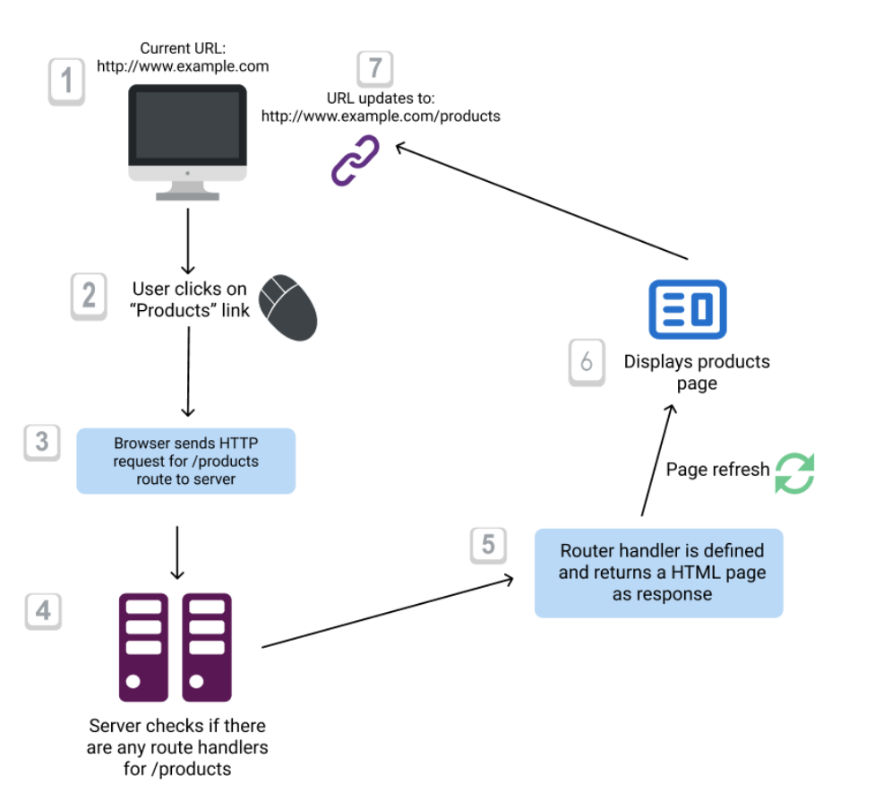
Conventional Routing

Slide 103
Angular Router
Angular Router is a module provided by Angular that enables client-side routing in Angular applications.
It allows you to define routes, associate them with components, and handle navigation between different views or components based on the application's URL.
Angular Router provides a powerful and flexible routing mechanism that helps create dynamic and responsive web applications.

Slide 104
Key Features
Route Configuration:
Angular Router allows you to define routes and associate them with specific components in a route configuration file.
Router Outlet:
The <router-outlet> serves as a placeholder in the application's template where the content of the routed components is rendered.
Links and Navigation:
Angular provides the routerLink directive to create links within templates, enabling navigation to different routes.
Route Parameters:
Route parameters allow you to include dynamic values in the URL paths, making it easy to capture and use dynamic data within components.

Slide 105
Key Features
Guards:
Route guards protect routes and control access based on conditions, such as authentication or authorization.
Lazy Loading:
Angular Router supports lazy loading, enabling modules and their components to be loaded on-demand, improving application performance.
Nested Routes:
Angular Router allows you to define child routes within parent routes, facilitating complex application layouts and component organization.

Slide 106
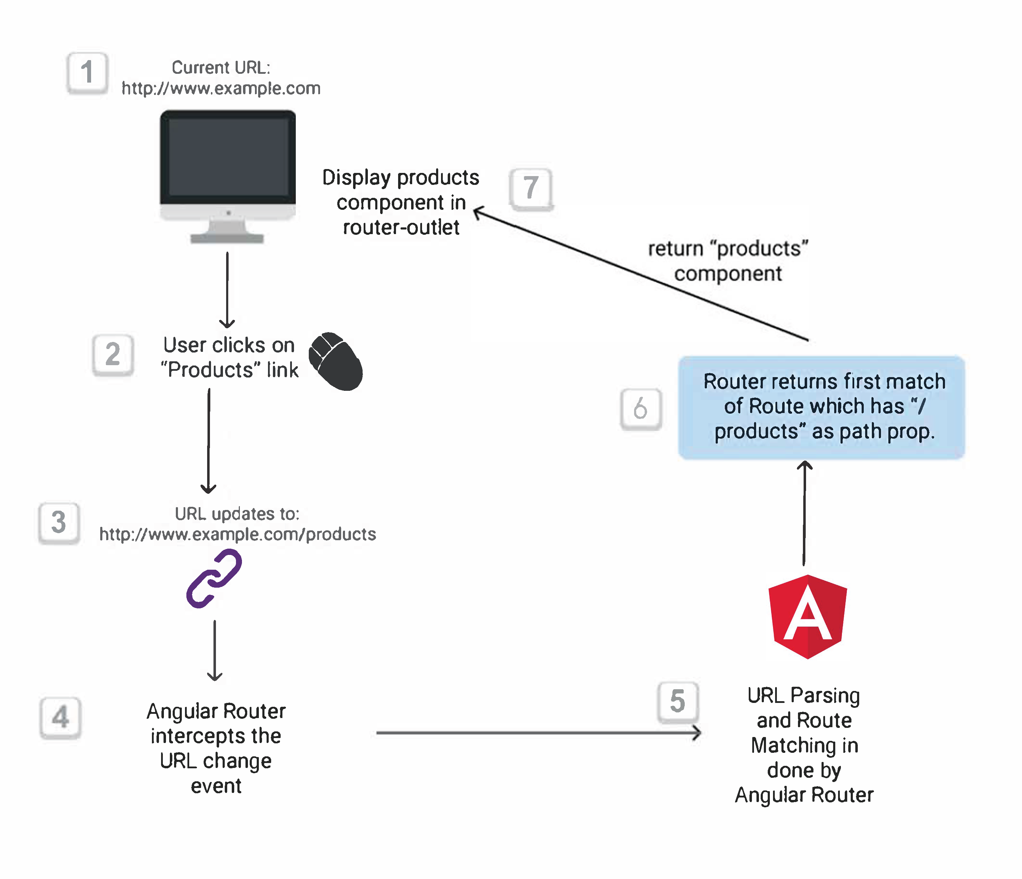
Angular Routing

Slide 107
After Navigation, What Router does?
URL Parsing:
Angular Router parses the URL and extracts information such as the URL path, query parameters, and fragment identifiers. It matches this information against the defined routes to determine the appropriate component to be displayed.
Route Matching:
Angular Router matches the parsed URL against the defined routes in the route configuration. It follows a specific order of precedence to find the best route match:
Exact Path Match: Angular Router checks for an exact match of the requested URL path against the defined paths in the route configuration.
Route Parameters: If no exact path match is found, Angular Router looks for routes with route parameters. It checks if the parameterized route pattern matches the requested URL path and extracts the parameter values.
Wildcard Route: If no exact path match or parameterized route match is found, Angular Router looks for a wildcard route (often denoted as **). The wildcard route acts as a fallback option when no other route matches.
Route Activation:
Once the route is matched, Angular Router activates the corresponding component and renders it in the designated <router-outlet> placeholder in the application's template.
Route Guards:
Angular Router can also invoke route guards before activating a route. Route guards are used to protect routes, control access, or perform additional checks.

Slide 108
Route Guards
Use route guards to prevent users from navigating to parts of an application without authorization.
CanActivate
Checks to see if a user can visit a route.
CanActivateChild
Checks to see if a user can visit a routes children.
CanDeactivate
Checks to see if a user can exit a route.
CanLoad
Checks to see if a user can route to a module that is lazy loaded.
CanMatch
Checks to see if a user can visit a route and whether we can lazily load.
Resolve
Performs route data retrieval before route activation.
Class-based Route guards are deprecated in favor of functional guards. We should use Functional Syntax to create Guards

Slide 109
Use cases of Route Guard
Checking if the user is authenticated: This is one of the most common use cases for route guards. Before navigating to a route, the guard will check if the user is authenticated. If they're not, the guard can redirect them to a login page.
Checking if the user is authorized: A guard can check if a user has the necessary permissions to access a route. For example, you might want to restrict certain pages to administrators.
Preventing navigation away from a page: As in the example I gave previously, a guard can prevent the user from navigating away from a page. This is useful for pages with unsaved changes, for example.
Pre-loading data: Using the Resolve interface, a guard can pre-load data before navigating to a route. This can be useful for routes that require specific data to be loaded.
Controlling child routes: With a CanActivateChild guard, you can control access to child routes.

Slide 110
NODE SERVER
BROWSER
HTTP + URL (localhost:3000)
NAVIGATION
Angular Application
User clicks on Admin Link, execute a code to verify token or authentication status, if unauthenticated, redirect the request to Login Component
HTML Page + JS (Angular App)
HTTP + URL (AJAX) + Username & Password
NODE SERVER
EXPRESS JS
Web API
JSON with Token
{“token”:”___”}
Send Username, Password to server, who will verify and return a token, the received token will be stored in Session Storage of the browser
AJAX – localhost:8000/api/users + Token
Send the same token to access data from the server
Database
JSON
Added by TokenInterceptor Service

Slide 111
Secure Application using Route Guards
When user clicks the Admin Link, we need to verify that we have a token in session storage, and if the token in not there in the session storage, redirect the request to login component. (CanActivateAdminGuard)
CanActivateAdminGuard uses Authenticator Service, getToken() to get the token.
If token is undefined, the request is redirected to Login Component
If token is available, the request is allowed for Admin Component.
Logging and Token Management (Authenticator Service)
On Login Component, user must give username and password, which will be sent to Node API Server
If the username & password is correct, in the response token will come from the Server
Received token will be stored in the session storage of the browser.
Reading and Attaching Token (TokenInterceptor Service)
Whenever the AJAX request is made for api, tokenInterceptor, intercepts and attaches token in the request header.
It uses authenticator service to read the token from session storage.

Slide 112
Angular Animations
Animation provides the illusion of motion: HTML elements change styling over time.
Well-designed animations can make your application more fun and easier to use.
Animations can improve your application and user experience in several ways:
Without animations, web page transitions can seem abrupt and jarring.
Motion greatly enhances the user experience, so animations give users a chance to detect the application's response to their actions.
Good animations intuitively call the user's attention to where it is needed.
An HTML element can move, change color, grow or shrink, fade, or slide off the page.
These changes can occur simultaneously or sequentially.
You can control the timing of each transformation.

Slide 113
Angular Animations
Angular's animation system is built on CSS functionality
You can animate any property that the browser considers animatable.
This includes positions, sizes, transforms, colors, borders, and more.
To Enable Animations:
Import BrowserAnimationsModule, which introduces the animation capabilities into your Angular root application module.
Importing animation functions
Add the animation metadata property to the Component
Apply animation using HostBinding or Use it on specific area using @

Slide 114
Animation Methods
The following list shows some of the methods used to build Angular animations.
The trigger(...) method encapsulates a single element of animation inside the animations array.
The state(...) method declares an animation state within a trigger attached to an element.
style(…) method declares a key/value object containing CSS properties/styles that can then be used for an animation state, within an animation sequence, or as styling data for calls to animate() and keyframes().
animate(…) method produces a reusable animation that can be invoked in another animation or sequence
transition(…) method declares an animation transition as a sequence of animation steps to run when a given condition is satisfied.

Slide 115
What to learn next?
Learn, how to use Component Library with Angular
ng-bootstrap | Angular UI Component Library
ngx-bootstrap | Angular UI Component Library (Valor Software)
Material | Angular UI Component Library
PrimeNG | Angular UI Component Library (primefaces.org)
Kendo UI for Angular | Angular UI Component Library (Telerik)
NgRx
Angular Unit Testing (Jasmine, Karma)
Angular 16 Changes

Slide 116
Contact Me
Manish Sharma | Gmail
Manish Sharma | WhatsApp
Manish Sharma | Facebook
Manish Sharma | LinkedIn

