Slide 1

Next JS

Slide 2
BROWSER
SERVER
HTTP + URL
NAVIGATION
HTML PAGES
CSS
HTML + CSS
HTTP + URL
HTML + CSS
Page
Reload!

Slide 3
BROWSER
SERVER
HTTP + URL
NAVIGATION
HTML + CSS
Server PAGES
CSS
HTTP + URL
ASP
ASP .NET
JSP
PHP
Ruby
Express JS
HTML + CSS
Page
Reload!
DB

Slide 4
BROWSER
SERVER
HTTP + URL
NAVIGATION
Server PAGES
CSS
HTML + CSS + JS
AJAX - HTTP + URL
JS
Partial
Page
Reload!
PARTIAL HTML
ID
1
<table>
<thead>
<tr>
<th>ID</th>
</tr>
</thead>
<tbody>
<tr>
<td>1</td>
</tr>
</tbody>
</table>
ASP
ASP .NET
JSP
PHP
Ruby
Express JS
ASP .NET MVC
Spring MVC
Ruby On Rails
Laravel
Sails JS
DB

Slide 5
SERVER
Single Page Application (SPA)
SERVER PAGES
CSS
BROWSER
HTTP + URL
NAVIGATION
JS
HTML + CSS + JS
(Client Side JS App)
ASP
ASP .NET
JSP
PHP
Ruby
ASP .NET MVC
Spring MVC
Ruby On Rails
Laravel
<table>
<thead>
<tr>
<th>ID</th>
</tr>
</thead>
<tbody>
<tr>
<td>1</td>
</tr>
</tbody>
</table>
SERVER
AJAX - HTTP + URL
RESTful API
ASP .NET Web API
JWS
Express JS
Python
DB
JSON to HTML on Client Side
JSON
{
“id”:1
}
Vanilla JS, jQuery, KO, BB, NG 1,
NG 2 & Above, Vue JS, React JS

Slide 6
Client-Side Rendering
Client Browser send request to the server using URL
Server responds back based on the URL requested with an HTML
Browser download the JS files referred on the page.
Once the JS files are downloaded, Browser executes React App.
Page now is Viewable and is enabled with interactions.

Slide 7
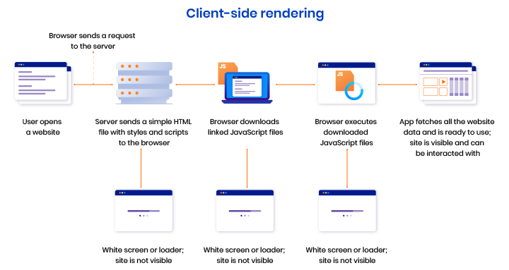

Slide 8
Pros and Cons of Client-Side
Pros of Client-Side Rendering:
Rich site interactions
Fast website rendering after the initial load.
Great for web applications.
Robust selection of JavaScript libraries.
Cons of Client-Side Rendering:
Low SEO if not implemented correctly.
Initial load might require more time.
In most cases, requires an external library.

Slide 9
Server-Side Rendering
Client Browser send request to the server using URL
Server responds back based on the URL requested, with an rendered HTML.
Browser renders the page which viewable and download the JS files referred on the page.
Once the JS files are downloaded, Browser executes React Code.
Page now is enabled with interactions.

Slide 10
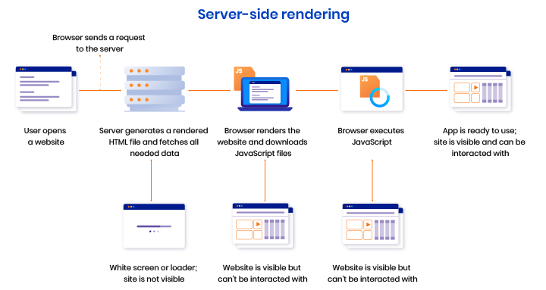

Slide 11
Pros and Cons of Server-Side
Pros of Server-Side Rendering :
Search engines can crawl the site for better SEO.
The initial page load is faster.
Great for static sites.
Cons of Server-Side Rendering:
Frequent server requests.
An overall slow page rendering.
Full page reloads.
Non-rich site interactions

Slide 12
Building Blocks of a Web Application
User Interface
Routing
Data Fetching
Rendering
Integrations
Infrastructure
Performance
Scalability
Developer Experience

Slide 13
BROWSER (Client Side)
REACTDOM
REACT COMPONENT
View* (UI) – JSX
Style (CSS) – JSX / CSS
Data (Inside) – State
Data (Outside) – Props
Behaviour – Methods
Node JS App (Server Side)
REACTDOMSERVER

Slide 14
What is Next.js?
Next.js is a React framework.
Next.js gives you all the building blocks to create a web application.
Next.js handles the tooling and configuration needed for React, and provides additional structure, features, and optimizations for your application.
Some core features of Next.js are:
Server rendering React Apps.
Automatic code splitting and lazy loading.
Built in CSS support.
Hot Reloading support.

Slide 15
React
Components
ES 2015 +
(Multiple Files)
Auto Configuration
CLI (create-next-app)
Build & Deploy your
Project on Local Server
Next JS Compiler
(SWC – Speedy Web Compiler)
Only Build & create
Distributable output
npm run dev
Browser Compatible Files
(Multiple Files)
npm run build
Bundling
BROWSER
Single File / Set of Files
Local
HTTP Server
HTML PAGE
Deploy
Inject Bundles

Slide 16
Using Next CLI (Page Router)
To Create a new application
npx create-next-app
cd <app-name>
Commands available in the application
npm run dev
Starts the development server.
npm run build
Bundles the app into static files for production.
npm run start
Build and run, in production.
npm run lint
Check errors and warnings as per es lint

Slide 17
Adding Bootstrap
Install
yarn add bootstrap bootstrap-icons
yarn add @popperjs/core
Add the Css files to _app.js
Add the bootstrap js using useEffectHook and dynamic import
If we directly import the Bootstrap-bundled JavaScript file, we will get a 'document is not defined' error.
The useEffect() Hook in React is used to instruct our React components that they need to do something after rendering, and in this scenario, we’d use it to import the Bootstrap JavaScript file.

Slide 18
Routing
Next.js has a file-system based router built on the concept of pages.
When a file is added to the pages directory, it's automatically available as a route.
Client-side transitions between routes can be enabled via the Link component exported by next/link.
For an example, consider a pages directory with the following files:
pages/index.js
pages/about.js
We can have a link to each of these pages

Slide 19
Custom App (pages/_app.js)
Next.js uses the App component to initialize pages. You can override it and control the page initialization.
Which allows you to do amazing things like:
Persisting layout between page changes
Keeping state when navigating pages
Custom error handling using componentDidCatch
Inject additional data into pages
Add global CSS
To override the default App, create the file ./pages/_app.js

Slide 20
Custom Document
A custom Document can update the <html> and <body> tags used to render a Page.
This file is only rendered on the server, so event handlers like onClick cannot be used in _document.
To override the default Document, create the file pages/_document.js

Slide 21
Pillars of Optimization
The process of optimizing a website can be divided into three main pillars:
Technical – Optimize your website for crawling and web performance.
Creation – Create a content strategy to target specific keywords.
Popularity – Boost your site's presence online so search engines know you are a trusted source.

Slide 22
Crawling and Indexing
Parts that impact Crawling and Indexing
HTTP status code
Metadata and what web crawlers look for when parsing web content.
Communicate with Google so its search crawler knows when there is new content on your site.
Leverage meta robot tags and canonical links to indicate to search engines your desired indexing status.

Slide 23
Web Performance & Core Web Vitals
Web Vitals is an initiative created by Google to provide unified guidance and metrics to measure end-user page experience on the web.
Core Web Vitals is a subset of Web Vitals, and currently consists of three metrics that measure loading, interactivity, and visual stability.
These metrics are
Largest Contentful Paint (LCP)
First Input Delay (FID)
Cumulative Layout Shift (CLS).
Achieving a great score in these three metrics will create a smoother website experience for your users.
Websites scoring poorly in each of the Core Web Vitals metrics will impact its search engine ranking.

Slide 24
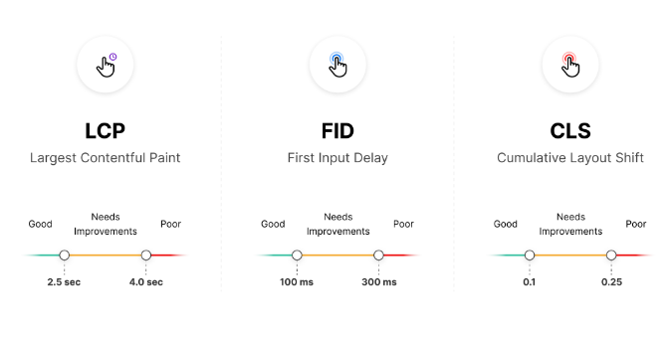
Core Web Vitals
There are three different values when measuring Core Web Vitals: "Good", "Needs Improvement", and "Poor".

Slide 25
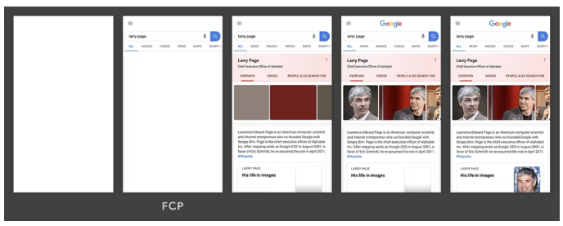
First Contentful Paint
The First Contentful Paint (FCP) metric measures the time from when the page starts loading to when any part of the page's content is rendered on the screen.
For this metric, "content" refers to text, images (including background images), <svg> elements, or non-white <canvas> elements.

Slide 26
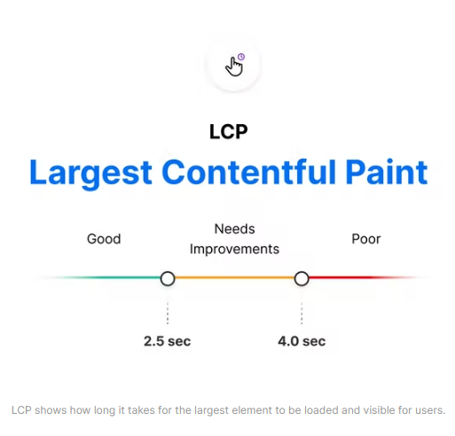
Largest Contentful Paint (LCP)
The Largest Contentful Paint (LCP) metric looks at the loading performance of your page.
LCP measures the time it takes to get the largest element on the page visible within the viewport.
This could be a large text block, video, or image that takes up the primary real estate on the page.

Slide 27
FCP vs LCP
The First Contentful Paint (FCP) metric measures the time from when the page starts loading to when any part of the page's content is rendered on the screen.
The Largest Contentful Paint (LCP) metric reports the render time of the largest image or text block visible within the viewport, relative to when the page first started loading.

Slide 28
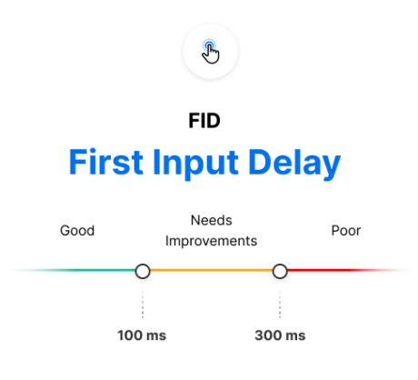
First Input Delay (FID)
The First Input Delay (FID) metric is the perception of an end user’s experience while interacting with a web page.
Imagine clicking inside an input box only for nothing to happen – this frustration with the interactivity and responsiveness of a site is caused by large input delays.
FID requires real user data and cannot be measured in the lab

Slide 29
Total Blocking Time (TBT)
The Total Blocking Time (TBT) metric measures the total amount of time between First Contentful Paint (FCP) and Time to Interactive (TTI) where the main thread was blocked for long enough to prevent input responsiveness.
Total Blocking Time (TBT) is an important lab metric for measuring load responsiveness because it helps quantify the severity of how non-interactive a page is prior to it becoming reliably interactive.

Slide 30
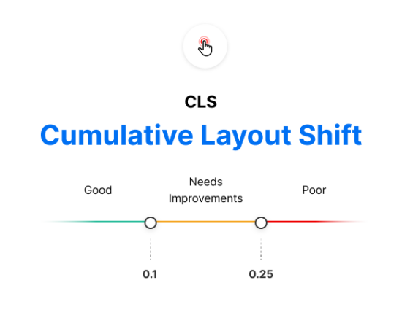
Cumulative Layout Shift (CLS)
The Cumulative Layout Shift (CLS) metric is a measure of your site’s overall layout stability.
A site that unexpectedly shifts layout as the page loads can lead to accidental user error and distraction.
Cumulative Layout Shift (CLS) occurs when elements have been shifted after initially being rendered by the DOM.

Slide 31
next/image
Next.js 10 introduced a built-in image component with automatic optimization capabilities, and this has been one of the most important features ever added to Next.js.
This was developed with the Core Web Vitals scores in mind, which are an important measurement of user experience and are factored into the Google search rankings.
Optimizations the <Image /> component include:
Faster page load: Next.js images will only be loaded when entering the viewport, being lazy-loaded by default.
Responsiveness: images will be resized according to the device used.
Visual stability: the cumulative layout shift problem is automatically avoided.
Improved performance: Next.js images can be resized and encoded on-demand, even when they are stored on remote servers or an external data source, such as CMS. This prevents you from having to create images with different sizes at build time, making it faster.

Slide 32
Next/image Layouts
intrinsic:
This is the behavior adopted by default.
The image will be adjusted visually on smaller viewports and maintain the original dimensions for larger viewports.
The height and width provided as props will act as the maximum dimensions for the image.
fixed:
The image dimensions will not change as the viewport changes.
There is no resizing or responsiveness, just as happens with the HTML <img> tag.
responsive:
The image will be scaled down for smaller viewports and scaled up for larger viewports.
fill:
The image will scale both width and height to the dimensions of the parent element, provided that the latter has position: relative in its stylesheet.
When using this layout width and height do not have to match image dimensions.

Slide 33
Font Optimization
Next.js helps you optimize loading web fonts by inlining font CSS during next build.
This optimization eliminates an extra network round trip to fetch font declaration files.
This results in improvements to First Contentful Paint (FCP) and Largest Contentful Paint (LCP).
Adding fonts to _document is preferred over individual pages. When adding fonts to a single page with next/head, font optimizations included by Next.js will not work on navigations between pages client-side.
Next.js currently supports optimizing Google Fonts and Typekit

Slide 34
Data Fetching
Data fetching in Next.js allows you to render your content in different ways, depending on your application's use case.
SSG: Static-site generation - On Build
getStaticProps(Using Page Router)
ISR: Incremental Static re-generation - On Build or after a timeout
getStaticProps(Using Page Router)
SSR: Server-side rendering - On each request
getServerSideProps(Using Page Router)
CSR: Client-side Rendering
useEffect() and other hooks

Slide 35
Next.js 13 App Router
A new paradigm for building applications

Slide 36
App Router
The App Router is a new paradigm for building applications using React's latest features.
App Router is a natural evolution of the existing file-system based router in the Pages Router.
For new applications, Next JS recommends using the App Router.
For existing applications, you can incrementally migrate to the App Router.

Slide 37
Using Next CLI (App Router)
To Create a new application
npx create-next-app@latest
cd <app-name>
Commands available in the application
npm run dev
Starts the development server.
npm run build
Bundles the app into static files for production.
npm run start
Build and run, in production.
npm run lint
Check errors and warnings as per es lint

Slide 38
File Conventions used by AppRouter
Special files to create UI with specific behavior in nested routes
layout Shared UI for a segment and its children
page Unique UI of a route and make routes publicly accessible
loading Loading UI for a segment and its children
not-found Not found UI for a segment and its children
error Error UI for a segment and its children
global-error Global Error UI
route Server-side API endpoint
template Specialized re-rendered Layout UI
default Fallback UI for Parallel Routes

Slide 39
Component Hierarchy
The React components defined in special files of a route segment are rendered in a specific hierarchy:
layout.js
template.js
error.js (React error boundary)
loading.js (React suspense boundary)
not-found.js (React error boundary)
page.js or nested layout.js

Slide 40
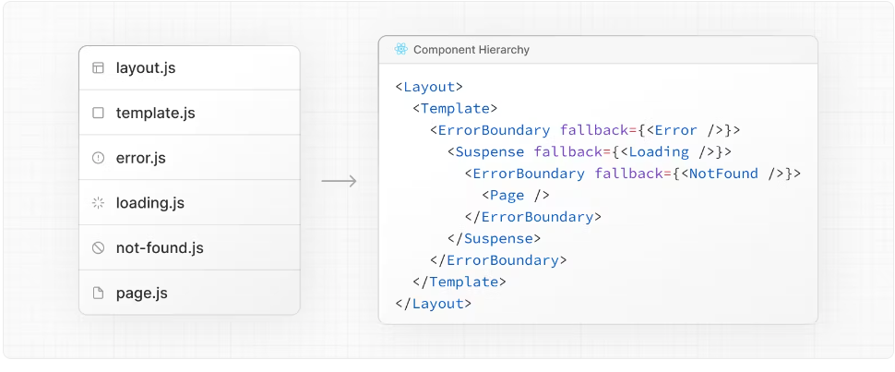
Component Hierarchy – Root Layout

Slide 41
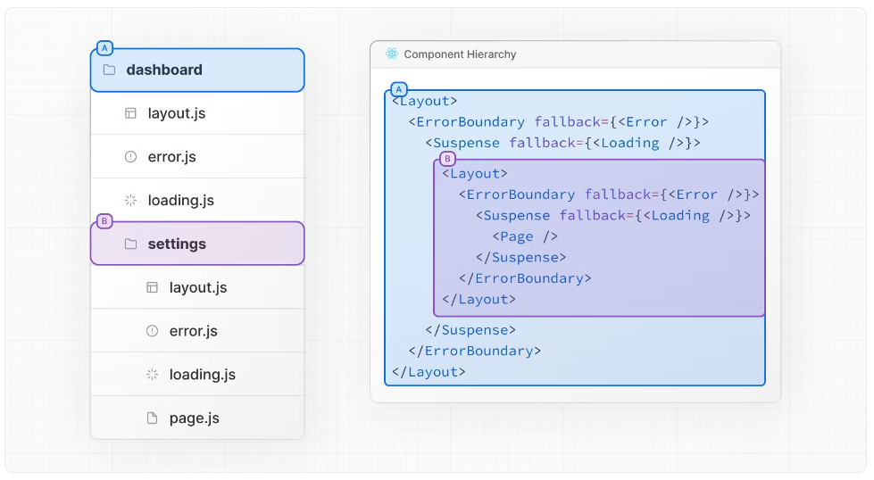
Component Hierarchy – Nested Layout

Slide 42
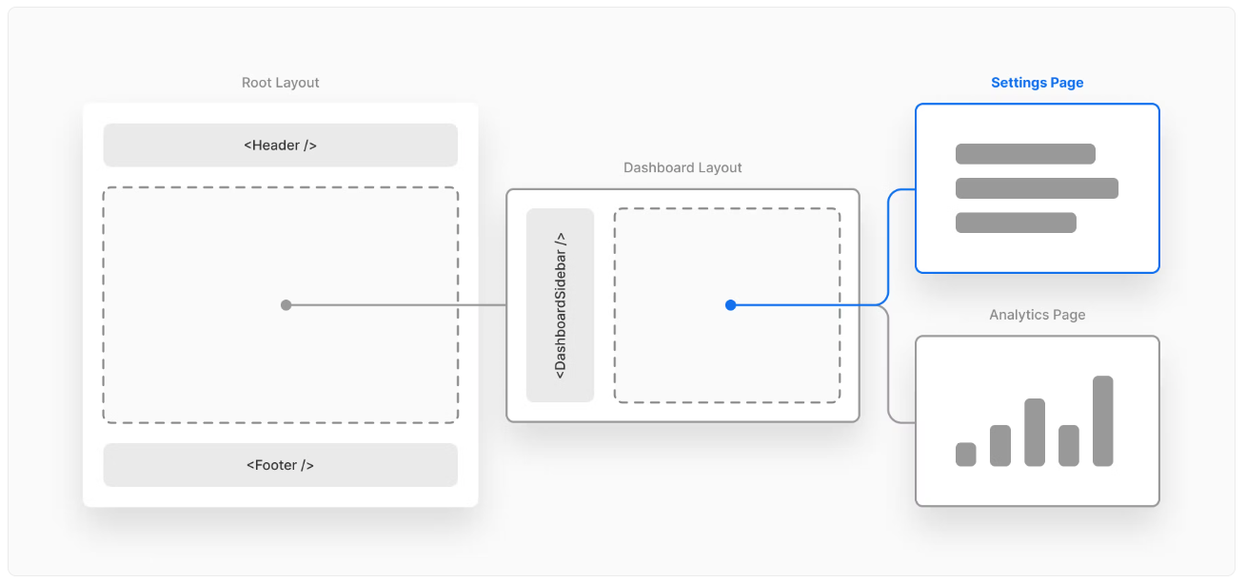
Component Hierarchy – Nested Layout

Slide 43
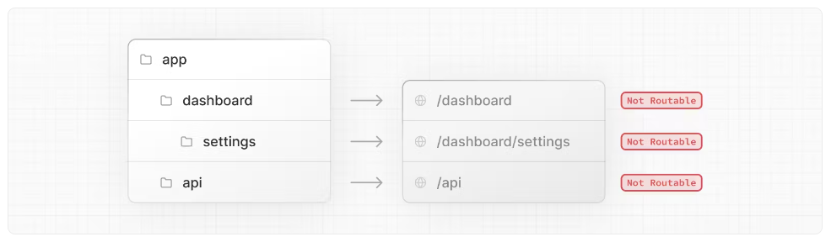
File Colocation
In the app directory, nested folder hierarchy defines route structure.
Each folder represents a route segment that is mapped to a corresponding segment in a URL path.
However, even though route structure is defined through folders, a route is not publicly accessible until a page.js or route.js file is added to a route segment.

Slide 44
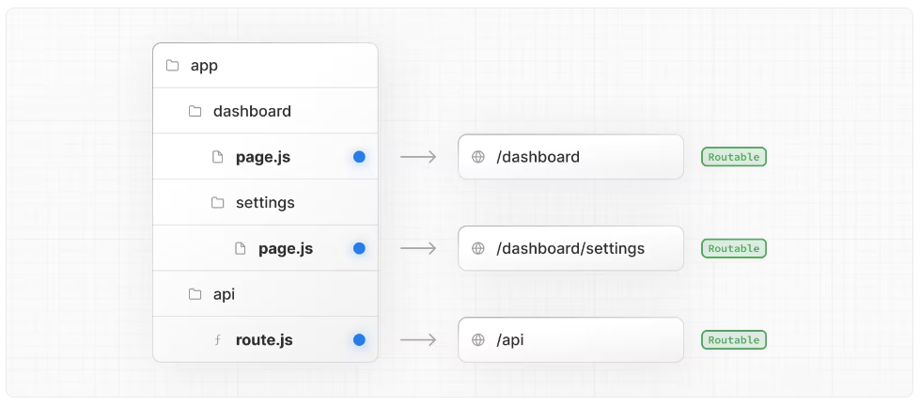
File Colocation
And, even when a route is made publically accessible, only the content returned by page.js or route.js is sent to the client.

Slide 45
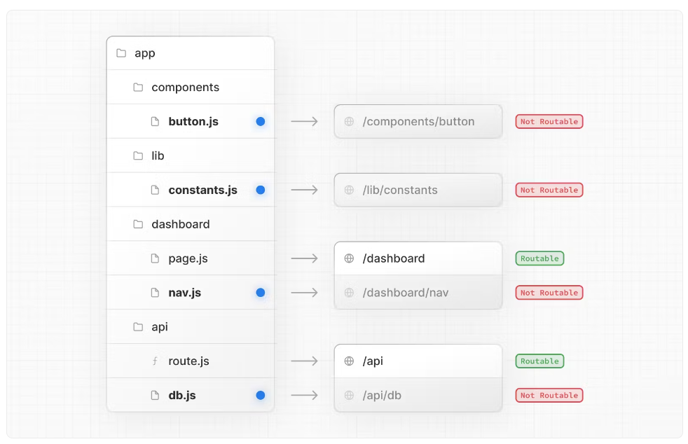
Safe Colocation
Project files can be safely collocated inside route segments in the app directory without accidentally being routable.
While you can collocate your project files in app you don't have to. If you prefer, you can keep them outside the app directory.

Slide 46
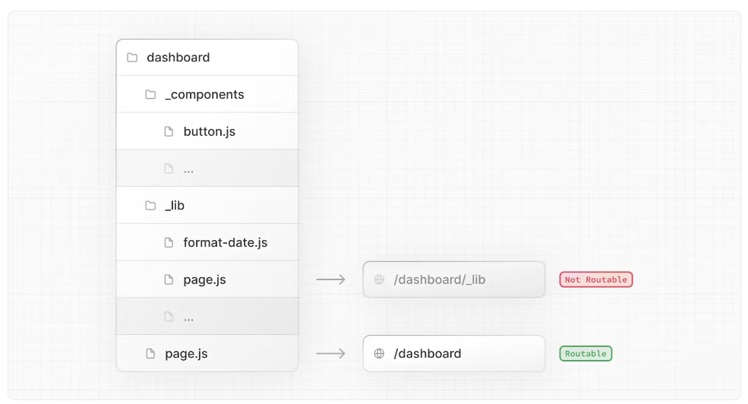
Project Organization – Private Folders
Folders can be created by prefixing a folder with an underscore: _folderName
This indicates the folder is a private implementation detail and should not be considered by the routing system
We can also mark files outside private folders as "private" using the same underscore pattern.
Notes:
Private Folders can be useful for:
Separating UI logic from routing logic.
Consistently organizing internal files across a project and the Next.js ecosystem.
Sorting and grouping files in code editors.
Avoiding potential naming conflicts with future Next.js file conventions.

Slide 47
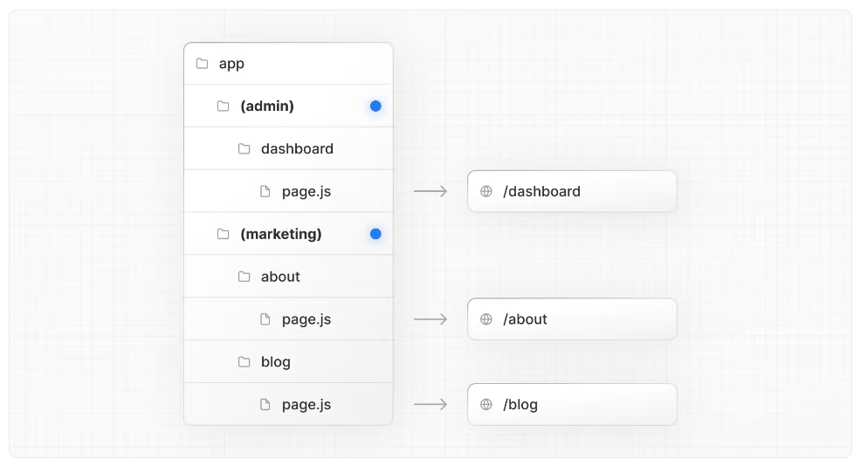
Project Organization – Route Groups
Route groups can be created by wrapping a folder in parenthesis: (folderName)
This indicates the folder is for organizational purposes and should not be included in the route's URL path.
Notes:
Private Folders can be useful for:
Separating UI logic from routing logic.
Consistently organizing internal files across a project and the Next.js ecosystem.
Sorting and grouping files in code editors.
Avoiding potential naming conflicts with future Next.js file conventions.

Slide 48
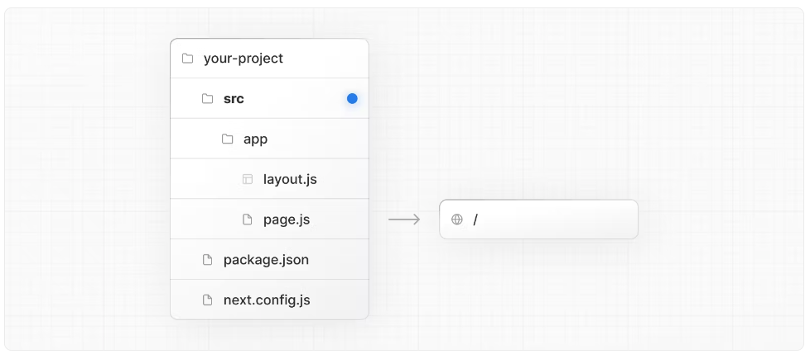
Project Organization – src Directory
Next.js supports storing application code (including app) inside an optional src directory.
This separates application code from project configuration files which mostly live in the root of a project.
Notes:
Private Folders can be useful for:
Separating UI logic from routing logic.
Consistently organizing internal files across a project and the Next.js ecosystem.
Sorting and grouping files in code editors.
Avoiding potential naming conflicts with future Next.js file conventions.

Slide 49
BROWSER
1. GET USERS PAGE
Server Components
2
PARTIAL HTML + JS
User
Repository
4. Fetch Call
API Routes
COMPONENT
3. Mount
6. State Updates
5
JSON

Slide 50
BROWSER
1. Edit User Request
Server Components
2
PARTIAL HTML WITH
DATA RENDERED FROM
SERVER + JS
User
Repository
REDIS
4. Fetch Call
API Routes
COMPONENT
3. Mount
6. State Updates
5
JSON

Slide 51
Dynamic Routes
When you don't know the exact segment names ahead of time and want to create routes from dynamic data, you can use Dynamic Segments that are filled in at request time
In Next.js you can add brackets to a page / folder [params] to create a dynamic route.
Dynamic routes can be extended to catch all paths by adding three dots (...) inside the brackets. Ex. […params]
Note:
Predefined routes take precedence over dynamic routes
And dynamic routes over catch all routes.

Slide 52
Error Handling
The error.js file convention allows you to gracefully handle runtime errors in nested routes.
Automatically wrap a route segment and its nested children in a React Error Boundary.
Create error UI tailored to specific segments using the file-system hierarchy to adjust granularity.
Isolate errors to affected segments while keeping the rest of the app functional.
Add functionality to attempt to recover from an error without a full page reload.

Slide 53
Handling Errors in Layouts
error.js boundaries do not catch errors thrown in layout.js or template.js components of the same segment.
To handle errors within a specific layout or template, place an error.js file in the layouts parent segment.
Handling Errors in Root Layouts
The root app/error.js boundary does not catch errors thrown in the root app/layout.js or app/template.js component.
To handle errors within the root layout or template, use a variation of error.js called global-error.js.

Slide 54
How to Secure your application?
Secure Dependencies
Input Validation
Authentication and Authorization
Secure Communication
Protect Secrets
CORS Protection
Rate Limiting
Content Security Policy (CSP)
Secure Session Management
Security Headers
Logging and Monitoring
Security Testing
Notes:
Secure Dependencies: Regularly update the dependencies used in your application to ensure you are using the latest versions, which often include security patches. Use package management tools like npm audit or yarn audit to identify and resolve any known vulnerabilities in your dependencies.
Input Validation: Always validate and sanitize user input on the server-side to prevent common attacks like Cross-Site Scripting (XSS) and SQL Injection. Use libraries like Joi or validator.js for input validation.
Authentication and Authorization: Implement proper user authentication and authorization mechanisms to restrict access to sensitive data and functionality. Use NextAuth.js or other authentication libraries to handle user authentication securely.
Secure Communication: Ensure that your application uses HTTPS for all communications to protect data transmitted between the client and server. Obtain an SSL certificate and configure your server to use HTTPS.
Protect Secrets: Avoid hardcoding sensitive information (such as API keys, database credentials, or access tokens) directly into your code. Instead, use environment variables or configuration files to store and retrieve these secrets securely.
CORS Protection: Set up Cross-Origin Resource Sharing (CORS) policies to control which domains are allowed to access your application's resources. Restricting CORS prevents unauthorized access from malicious sources.
Rate Limiting: Implement rate limiting to prevent brute-force attacks, DoS attacks, or abuse of your application's resources. Libraries like express-rate-limit can help you set up rate limiting in your Next.js application.
Content Security Policy (CSP): Use Content Security Policy to control what types of content can be loaded on your website and from which sources. A well-configured CSP helps prevent various attacks, such as XSS and data injection.
Secure Session Management: Ensure that session management is handled securely. Use secure session storage mechanisms, such as HTTP-only cookies with secure flags, to prevent session hijacking and XSS attacks.
Security Headers: Set appropriate security headers in your application's HTTP responses, such as Strict-Transport-Security (HSTS), X-Content-Type-Options, X-Frame-Options, and X-XSS-Protection headers.
Logging and Monitoring: Implement robust logging and monitoring mechanisms to detect and respond to security incidents promptly. Monitor your application for suspicious activities, such as unusual login attempts or excessive API requests.
Security Testing: Regularly perform security testing, including vulnerability scanning and penetration testing, to identify and address potential security weaknesses in your application.

Slide 55
Authentication
Authentication is the process of verifying the identity of a user or system entity.
It involves validating the claimed identity to ensure that it is legitimate and corresponds to the individual or entity attempting to access a resource or perform an action.
Authentication is commonly performed using credentials such as usernames and passwords, biometric data, security tokens, or other authentication factors. Successful authentication grants access to specific resources or functionalities.

Slide 56
Authorization
Authorization is the process of determining whether an authenticated user or system entity has the necessary permissions and privileges to access a specific resource or perform a particular action.
It involves checking the user's privileges, roles, or permissions against a set of defined rules or policies.
Authorization ensures that only authorized users can perform certain operations or access sensitive information within an application or system.

Slide 57
NextAuth
NextAuth.js can be considered as an identity integrator.
It provides a convenient way to integrate various authentication providers and identity systems into your Next.js application.
It acts as a middleware between your application and the identity providers, abstracting away the complexities of authentication integration.

Slide 58
NextAuth.js
NextAuth.js is an open-source authentication library for Next.js.
NextAuth.js provides a simple and customizable solution for adding authentication, authorization, and identity management to Next.js projects.
NextAuth.js simplifies the process of implementing authentication in Next.js applications by abstracting away the complexities and providing a unified interface to work with different authentication providers.

Slide 59
Key Features
Authentication Providers:
NextAuth.js supports various authentication providers out of the box, such as OAuth, JWT, email/password, and more.
Session Management:
NextAuth.js manages user sessions and provides a session object that can be accessed server-side and client-side.
Token-Based Authentication:
NextAuth.js supports token-based authentication, allowing you to issue and validate tokens for authentication purposes.
Customization and Extensibility:
NextAuth.js offers a flexible and extensible architecture, allowing you to customize and extend its functionality to meet your application's specific requirements.
SSR and API Routes Integration:
NextAuth.js seamlessly integrates with Next.js server-side rendering (SSR) and API routes, providing an API route for handling authentication-related requests and supporting server-rendered pages that require authentication.

Slide 60
Next Auth Session Management
NextAuth.js provides session management capabilities, allowing you to manage user sessions in your Next.js application.
Server-side Session Management
Client-side Session Management

Slide 61
Server-side session management
NextAuth.js manages the session state on the server-side, including session creation, storage, and validation.
When a user authenticates, NextAuth.js generates a session object that contains relevant information about the user's session, such as user ID, session ID, and expiration time.
The session object is stored and managed by NextAuth.js, typically using session storage mechanisms like cookies or database storage.
NextAuth.js handles session validation on subsequent requests to verify the authenticity and validity of the session.

Slide 62
Client-side session management
NextAuth.js provides client-side utilities to access and interact with the session object on the client-side of your application.
The session object can be accessed on the client-side using NextAuth.js hooks or utility functions, allowing you to retrieve session information, check the session status, and perform actions based on the session state.
This enables you to conditionally render different parts of your application based on the user's session status, such as showing authenticated content only to logged-in users.

Slide 63
Contact Me
Manish Sharma | Gmail
Manish Sharma | WhatsApp
Manish Sharma | Facebook
Manish Sharma | LinkedIn

