Slide 1

Node JS

Slide 2
What is Node.js?
Node.js® is a JavaScript runtime built on Chrome's V8 JavaScript engine.
As an asynchronous event-driven JavaScript runtime
Node.js is designed to build scalable network applications.

Slide 3
What is Node.js?
Node.js is
open-source
cross-platform
back-end JavaScript runtime environment
runs on the V8 engine
executes JavaScript code outside a web browser.
Node.js lets developers use JavaScript for server-side scripting.
Node.js represents a "JavaScript everywhere" paradigm
Unifying web-application development around a single programming language.

Slide 4
Installation
Install Node LTS version - https://nodejs.org/en/
Install / Update Visual Studio Code to Latest Release - https://code.visualstudio.com/
Extensions of VS Code
AutoFileName
vscode-icons
JavaScript (ES6) code snippets
Node.js Modules Intellisense
After all Extensions are installed
File Menu -> Preferences -> File Icon Theme -> Select VScode Icons

Slide 5
Node Global Objects
Node.js Global Objects are those objects which are present in all modules.
Global Objects can be used directly in the application which is available without importing any module.
Global objects have been added keeping in mind that these are some basic requirements and one can require these anytime, so it is better to keep them global rather than to add specific modules for these objects.
Some of the Node.js Global Objects:
Buffer Class
console
process
setImmediate
setTimeout

Slide 6
NODE EXE (NODE PROCESS)
node app.js
V8 Engine
Node JS API’s
Application
(JavaScript)
app.js
NATIVE CODE
O. S.

Slide 7
NODE APIs
V8 Engine
API’s
Libuv
(Asynchronous I/O)
Developer Uses the NODE API’s in JavaScript Language

Slide 8
Working of Node.js
Node.js runs on chrome v8 engine which converts JavaScript code into machine code, it is highly scalable, lightweight, fast, and data-intensive.
To operate I/O operations or requests node.js use the concept of threads. Thread is a sequence of instructions that the server needs to perform.
Node.js is an event loop single-threaded language.
Node.js basically works on two concept
Asynchronous
Non-blocking I/O (Libuv)

Slide 9
Non-blocking I/o
Non-blocking i/o means working with multiple requests without blocking the thread for a single request.
I/O basically interacts with external systems such as files, databases.
Node.js is not used for CPU-intensive work means for calculations, video processing because a single thread cannot handle the CPU works.

Slide 10
Asynchronous
Asynchronous is executing a callback function.
The moment we get the response from the other server or database it will execute a callback function.
Callback functions are called as soon as some work is finished and this is because the node.js uses an event-driven architecture.
The single thread doesn’t work with the request instead it sends the request to another system which resolves the request and it is accessible for another request.

Slide 11
Libuv
To implement the concept of the system to handle the request node.js uses the concept of Libuv.
Libuv is an open-source library built-in C. It has a strong focus on asynchronous and I/O, this gives node access to the underlying computer operating system, file system, and networking.
Libuv implements two extremely important features of node.js
Event loop
Thread pool

Slide 12
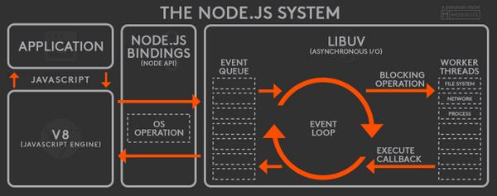

Slide 13
Event Loop
The event loop contains a single thread and is responsible for handling easy tasks like executing callbacks and network I/O.
All the applications code that is inside callback functions will run in the event loop.
EventLoop is the heart of node.js. When we start our node application the event loop starts running right away. Most of the work is done in the event loop.
Nodejs use event-driven-architecture.
Events are emitted.
Event loop picks them up.
Callbacks are called.

Slide 14
Event Queue
As soon as the request is sent the thread places the request into a queue. It is known as an event queue.
The process like app receiving HTTP request or server or a timer will emit event as soon as they are done with the work and event loop will pick up these events and call the callback functions that are associated with each event and response is sent to the client.
The event loop is an indefinite loop that continuously receives the request and processes them.
It checks the queue and waits for the incoming request indefinitely.

Slide 15
Thread Pool
Though node.js is single-threaded it internally maintains a thread pool.
When non-blocking requests are accepted there are processed in an event loop
While accepting blocking requests Node JS
Checks for available threads in a thread pool
Assigns a thread to the client’s request which is then processed and send back to the event loop
Response is sent to the respective client.

Slide 16
Steps to run TypeScript Project Folder
Download and Extract the zip file.
Open the extracted folder in Visual Studio Code
Open the terminal window on the folder path and run
npm install
Once the installation completes, run
npm run compile – Run the TypeScript Compiler in Watch mode and will compile and generate dist folder
Open the terminal window on the dist folder path and run
node app.js

Slide 17
Modules
Module in Node.js is a simple or complex functionality organized in single or multiple JavaScript files which can be reused throughout the Node.js application.
Each module in Node.js has its own context, so it cannot interfere with other modules or pollute global scope. Also, each module can be placed in a separate .js file under a separate folder.
Node.js implements CommonJS modules standard.
CommonJS is a group of volunteers who define JavaScript standards for web server, desktop, and console application.

Slide 18
Types of Modules
Core Modules (Built-in Modules)
Global Modules (Objects)
Local Modules (User Defined Modules)
External Modules (Third Party Modules)

Slide 19
require(Path)
Module Loader will search for a file on the path specified
Y
N
Load and cache the file on the memory
Module Loader will search for a folder on the path specified
Y
N
Search inside folder, file with the name ‘package.json’
Error Loading Module
Y
N
N
In ‘package.json’, read ‘main’ key
Search inside folder, file with the name ‘index.js’
N
Y
Y
Search file mentioned in ‘main’
N
Load and cache the file on the memory
Y
Load and cache the file on the memory
NODE JS Module Resolution

Slide 20
Built In Modules
Module | Description
assert | Provides a set of assertion tests
buffer | To handle binary data
child_process | To run a child process
cluster | To split a single Node process into multiple processes
crypto | To handle OpenSSL cryptographic functions
dgram | Provides implementation of UDP datagram sockets
dns | To do DNS lookups and name resolution functions
events | To create and handle events
fs | To handle the file system
http | To make Node.js act as an HTTP server
https | To make Node.js act as an HTTPS server.

Slide 21
Built In Modules Continued
Module | Description
net | To create servers and clients
os | Provides information about the operation system
path | To handle file paths
querystring | To handle URL query strings
readline | To handle readable streams one line at the time
stream | To handle streaming data
string_decoder | To decode buffer objects into strings
timers | To execute a function after a given number of milliseconds
tls | To implement TLS and SSL protocols
tty | Provides classes used by a text terminal
url | To parse URL strings

Slide 22
Built In Modules Continued
Module | Description
util | To access utility functions
v8 | To access information about V8 (the JavaScript engine)
vm | To compile JavaScript code in a virtual machine
zlib | To compress or decompress files

Slide 23
Readline Module
The readline module provides an interface for reading data from a Readable stream (such as process.stdin) one line at a time.

Slide 24
fs Module
With Node.js, you can programmatically manipulate files with the built-in fs module.
The name is short for “file system,” and the module contains all the functions you need to read, write, and delete files on the local machine.
This unique aspect of Node.js makes JavaScript a useful language for back-end and CLI tool programming.
The fs module supports interacting with files synchronously, asynchronously, or via streams;

Slide 25
fs Module Methods
fs.access(): check if the file exists and Node.js can access it with its permissions
fs.appendFile(): append data to a file. If the file does not exist, it's created
fs.chmod(): change the permissions of a file specified by the filename passed. Related: fs.lchmod(), fs.fchmod()
fs.chown(): change the owner and group of a file specified by the filename passed. Related: fs.fchown(), fs.lchown()
fs.close(): close a file descriptor
fs.copyFile(): copies a file
fs.createReadStream(): create a readable file stream
fs.createWriteStream(): create a writable file stream
fs.link(): create a new hard link to a file
fs.mkdir(): create a new folder

Slide 26
fs Module Methods
fs.mkdtemp(): create a temporary directory
fs.open(): set the file mode
fs.readdir(): read the contents of a directory
fs.readFile(): read the content of a file. Related: fs.read()
fs.readlink(): read the value of a symbolic link
fs.realpath(): resolve relative file path pointers (., ..) to the full path
fs.rename(): rename a file or folder
fs.rmdir(): remove a folder
fs.stat(): returns the status of the file identified by the filename passed. Related: fs.fstat(), fs.lstat()
fs.symlink(): create a new symbolic link to a file

Slide 27
fs Module Methods
fs.truncate(): truncate to the specified length the file identified by the filename passed. Related: fs.ftruncate()
fs.unlink(): remove a file or a symbolic link
fs.unwatchFile(): stop watching for changes on a file
fs.utimes(): change the timestamp of the file identified by the filename passed. Related: fs.futimes()
fs.watchFile(): start watching for changes on a file. Related: fs.watch()
fs.writeFile(): write data to a file. Related: fs.write()

Slide 28
What is Event-driven?
Event-driven architectures build on a common pattern in software development known as publish-subscribe or observer pattern.
In an event-driven architecture there are at least two actors: the subject and the observer.
Is JavaScript language Event Driven?
No
Can we create custom events in JavaScript?
No
If you want to create custom events, we can use
document.createEvent() – HTML Programming
Event Emitter – Node JS

Slide 29
Events
Node.js core API is built around an idiomatic asynchronous event-driven architecture in which objects called "emitters" emit named events that cause Function objects "listeners" to be called.
All objects that emit events are instances of the EventEmitter class.
These objects expose an eventEmitter.on() function that allows one or more functions to be attached to named events.
When the EventEmitter object emits an event, all the functions attached to that specific event are called synchronously.

Slide 30
Streams
A stream is an abstract interface for working with streaming data in Node.js.
Streams are one of the fundamental concepts of Node.js.
Streams are a type of data-handling methods and are used to read or write input into output sequentially.
Streams are used to handle reading/writing files or exchanging information in an efficient way.

Slide 31
ReadStream
HTTP responses, on the client
HTTP requests, on the server
fs read streams
zlib streams
crypto streams
TCP sockets
Child process stdout and stderr
process.stdin

Slide 32
WriteStream
HTTP requests, on the client
HTTP responses, on the server
fs read streams
zlib streams
crypto streams
TCP sockets
Child process stdin
process.stdout and stderr

Slide 33
HTTP Module
The HTTP core module is a key module to Node.js networking.
To use the HTTP server in node, we need to require the HTTP module. The HTTP module creates an HTTP server that listens to server ports and gives a response back to the client.
To make requests via the HTTP module http.request() method is used.

Slide 34
BankAccount Class
withdraw(amount)
deposit(amount)
Create BankAccount class with withdraw, deposit and other methods if needed.
Withdraw should show error if amount to be withdrawn is greater than balance
in account
Show message after withdraw and deposit call, showing current balance
Send a SMS after withdraw or deposit is called
Send an Email after withdraw or deposit is called
Follow SOLID principal’s of writing code
SMS Class
send(msg)
EMAIL Class
send(msg)
WhatsApp Class
send(msg)

Slide 35
What is npm?
npm is the world's largest Software Registry.
The registry contains over 800,000 code packages.
Open-source developers use npm to share software.
Many organizations also use npm to manage private development.
You can download all npm public software packages without any registration or logon.
npm consists of three distinct components:
the website: Use the website to discover packages, set up profiles, and manage other aspects of your npm experience.
the Command Line Interface (CLI): The CLI runs from a terminal, and is how most developers interact with npm
the registry: The registry is a large public database of JavaScript software and the meta-information surrounding it.

Slide 36
N
Module Loader will search inside node_modules folder of your application
N
require(ModuleName)
Module Loader will search in built-in modules
Y
Module Loader will search for a file inside node_modules
Error Loading Module
Load the module on the memory
Y
N
Load and cache the file on the memory
Module Loader will search for a folder inside node_modules
Y
N
Search inside folder, file with the name ‘package.json’
Error Loading Module
Y
N
N
In ‘package.json’, read ‘main’ key
Search inside folder, file with the name ‘index.js’
N
Y
Y
Search file mentioned in ‘main’
N
Load and cache the file on the memory
Y
Load and cache the file on the memory
NODE JS Module Resolution

Slide 37
npm cli
Local Installation
Production Packages
npm install --save <package_name>
npm install <package_name>
npm i <package_name>
Development Packages
npm install --save-dev <package_name>
npm install --dev <package_name>
npm i -D <package_name>
Local Un-installation
Production Packages
npm uninstall --save <package_name>
npm un <package_name>
Developement Packages
npm uninstall --save-dev <package_name>
npm un -D <package_name>

Slide 38
Steps to run the application
Download and Extract the zip file.
Open the extracted folder in Visual Studio Code
Open the terminal window on the folder path and run
npm install
OR
npm i
After the installation completes, run
node app.js

Slide 39
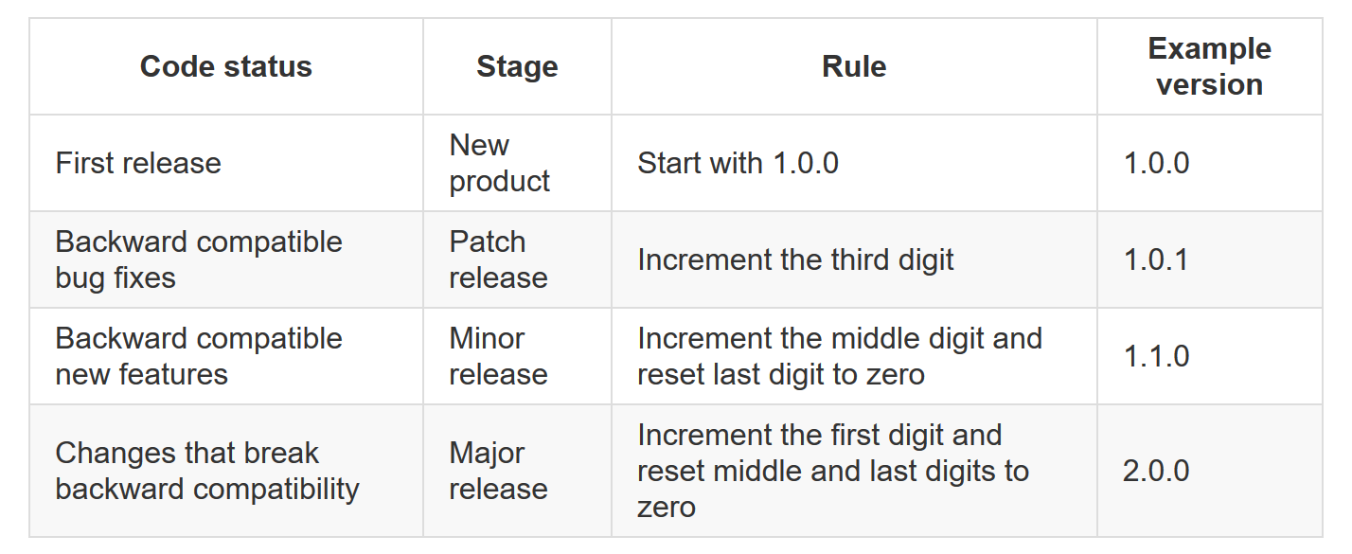

Slide 40
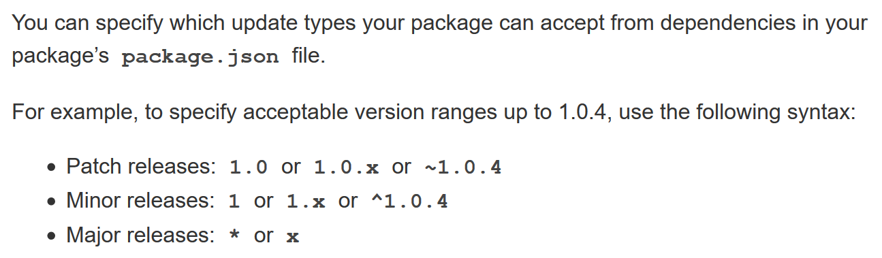

Slide 41
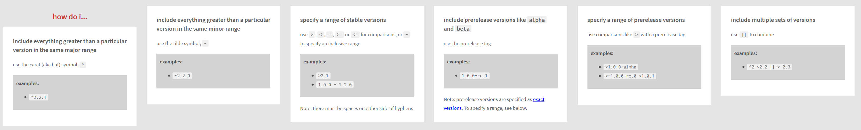

Slide 42
npm cli
Global Installation
npm install -g <package_name>
npm i -g <package_name>
Global Un-installation
npm uninstall -g <package_name>
npm un -g <package_name>
List all Global Packages installed
npm list -g --depth=0

Slide 43
Update Package Versions
npm-check-updates - npm (npmjs.com)

Slide 44
WebSocket
WebSocket is a computer communications protocol, providing full-duplex communication channels over a single TCP connection.
The WebSocket protocol was standardized by the IETF as RFC 6455 in 2011
The WebSocket API in Web IDL is being standardized by the W3C.
WebSocket uses HTTP as the initial transport mechanism but keeps the TCP connection alive after the HTTP response is received so that it can be used for sending messages between client and server.

Slide 45
NODE SERVER
BROWSER
HTTP + URL
HTML + JS
I want WebSocket Communication (WS Request)
Should have a code to accept and acknowledge the WebSocket Request
WebSocket Handshake
Acknowledgement

Slide 46
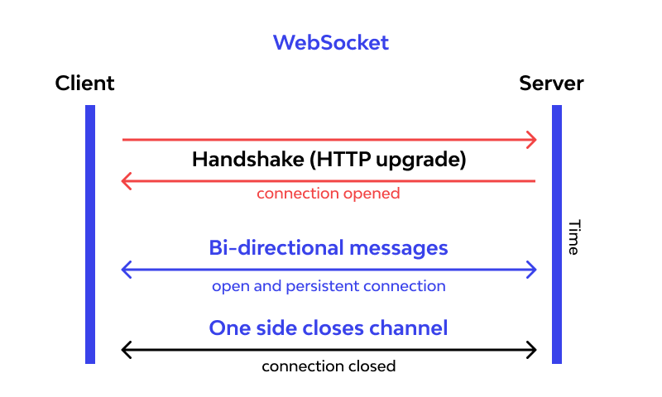

Slide 47
Express JS
Fast, unopinionated, minimalist web framework for Node.js
Express is a minimal and flexible Node.js web application framework that provides a robust set of features for web and mobile applications.
With a myriad of HTTP utility methods and middleware at your disposal, creating a robust API is quick and easy.

Slide 48
BROWSER
SERVER
HTTP + URL
NAVIGATION
HTML PAGES
CSS
HTML + CSS

Slide 49
BROWSER
SERVER
HTTP + URL
NAVIGATION
HTML + CSS
Server PAGES
CSS
Express JS + Template Engine
DB

Slide 50
Template Engines
A template engine enables you to use static template files in your application.
At runtime, the template engine replaces variables in a template file with actual values and transforms the template into an HTML file sent to the client.
This approach makes it easier to design dynamic HTML pages.

Slide 51
Template Engines
There are multiple template engines that work “out-of-the-box” with Express, some examples are:
Pug: Haml-inspired template engine (formerly Jade).
Haml.js: Haml implementation.
EJS: Embedded JavaScript template engine.
hbs: Adapter for Handlebars.js, an extension of Mustache.js template engine.
All out-of-the-box Template Engines

Slide 52
Express and Middleware
Express is a routing and middleware web framework that has minimal functionality of its own.
An Express application is essentially a series of middleware function calls.
Middleware is a subset of chained function called by the Express app before the user-defined handler is invoked.
Middleware functions have full access to the request and response objects and the next middleware function in the application’s request-response cycle.
Middleware functions can perform the following tasks:
Execute any code.
Make changes to the request and the response objects.
End the request-response cycle.
Call the next middleware function in the stack.

Slide 53
Request Processing Pipeline
REQUEST
RESPONSE
Middleware (Logging, Authentication, Authorization e.t.c.)

Slide 54
Types of middleware
An Express application can use the following types of middleware:
Application-level middleware
Router-level middleware
Error-handling middleware
Built-in middleware
Third-party middleware

Slide 55
Catching Errors
Errors that occur in synchronous code inside route handlers and middleware require no extra work. If synchronous code throws an error, then Express will catch and process it.
For errors returned from asynchronous functions invoked by route handlers and middleware, you must pass them to the next() function, where Express will catch and process them.
a try...catch block to catch's errors in the asynchronous code and pass them to Express. If the try...catch block were omitted, Express would not catch the error since it is not part of the synchronous handler code.
Use promises to avoid the overhead of the try...catch block or when using functions that return promises.

Slide 56
HTTP
Request
Routes
Views
HTTP
Response
Data Access
Database

Slide 57
MVC
MVC is an acronym for Model-View-Controller. It is a design pattern for software projects.
It is used majorly by Node developers and by C#, Ruby, PHP framework users too.
In MVC pattern, application and its development are divided into three interconnected parts.
The advantage of this is it helps in focusing on a specific part of the application name, the ways information is presented to and accepted from, the user.
It helps in allowing for efficient code reuse and the parallel development of the application.

Slide 58
MVC
Model:
Model represents the structure of data, the format and the constraints with which it is stored.
It maintains the data of the application. Essentially, it is the database part of the application.
View:
View is what is presented to the user. Views utilize the Model and present data in a form in which the user wants.
A user can also be allowed to make changes to the data presented to the user.
They consist of static and dynamic pages which are rendered or sent to the user when the user requests them.
Controller:
Controller controls the requests of the user and then generates appropriate response which is fed to the viewer.
Typically, the user interacts with the View, which in turn generates the appropriate request, this request will be handled by a controller.

Slide 59
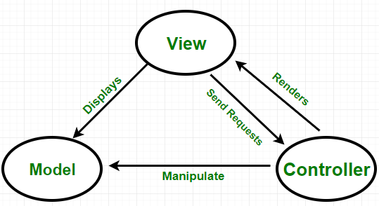

Slide 60
HTTP
Request
Router
HTTP
Response
Forward request to
appropriate controller
Controller
Views
Read/write data
Models
Database

Slide 61
Using Express Generator
npx express-generator --view=pug express-app
cd express-app
ncu -u
npm i
npm i -D nodemon
Change the start script in package.json file, to use nodemon
npm start

Slide 62
Assignment
Create a CRUD application to work with employee data using express generator.
Write code to persist the data in JSON file (employees.json)
Use Promise based implementation.
Employee Schema
id – number
name – string
designation – string
salary – number

Slide 63
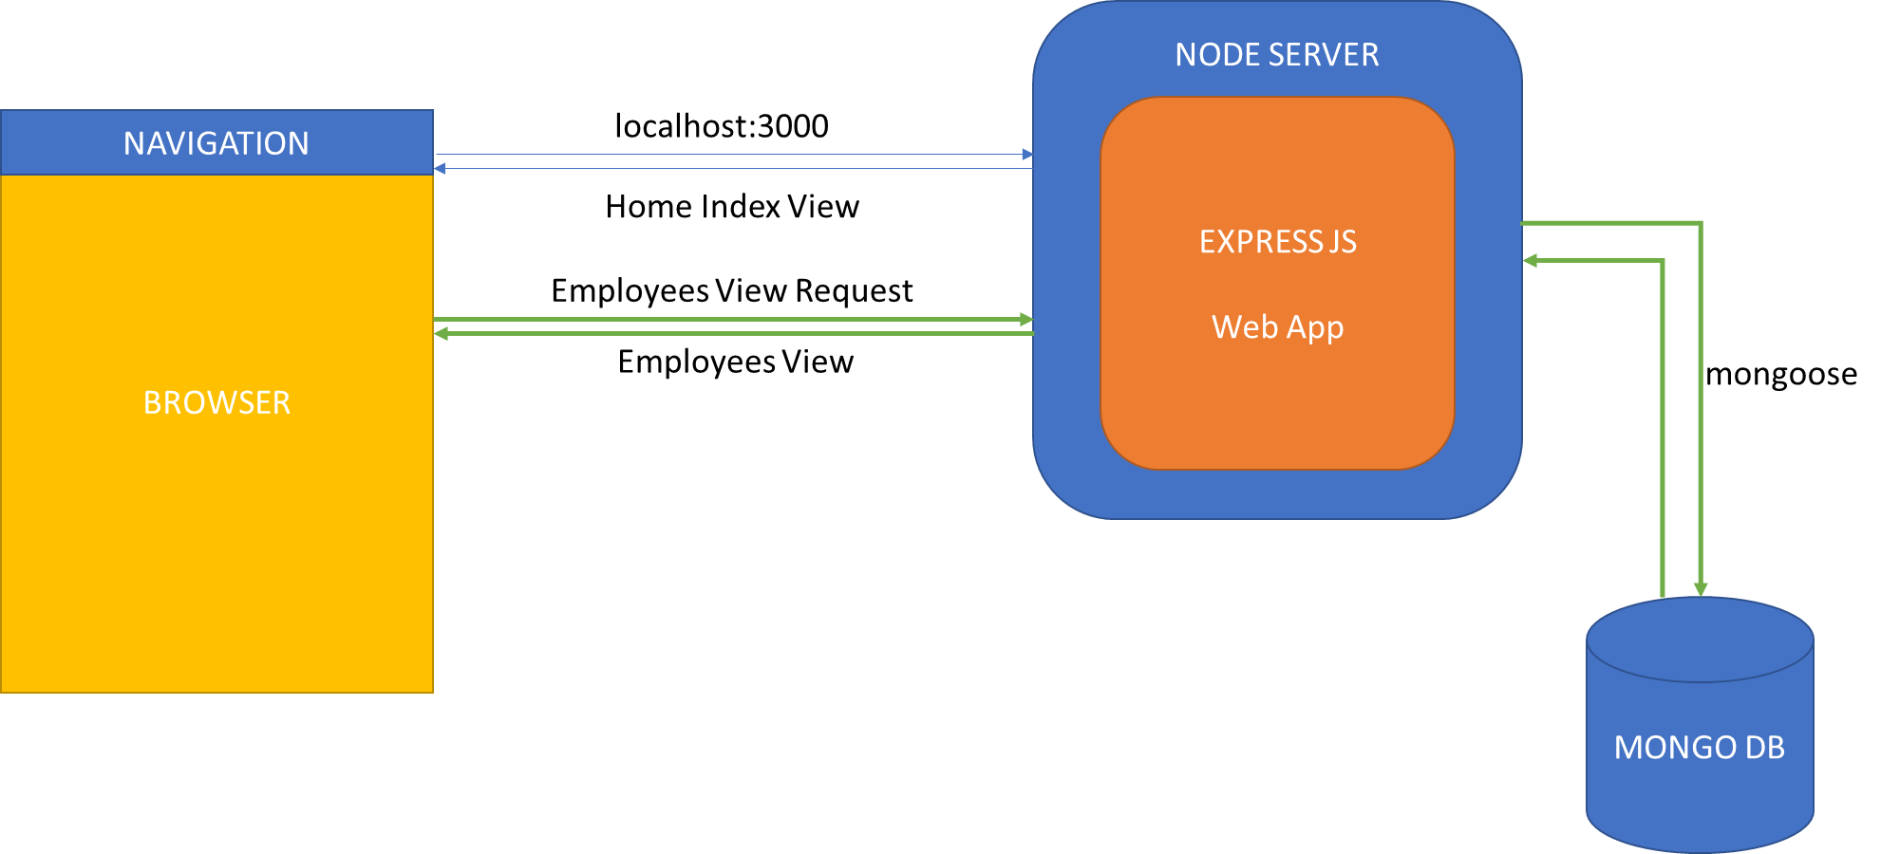
CRUD Application

Slide 64
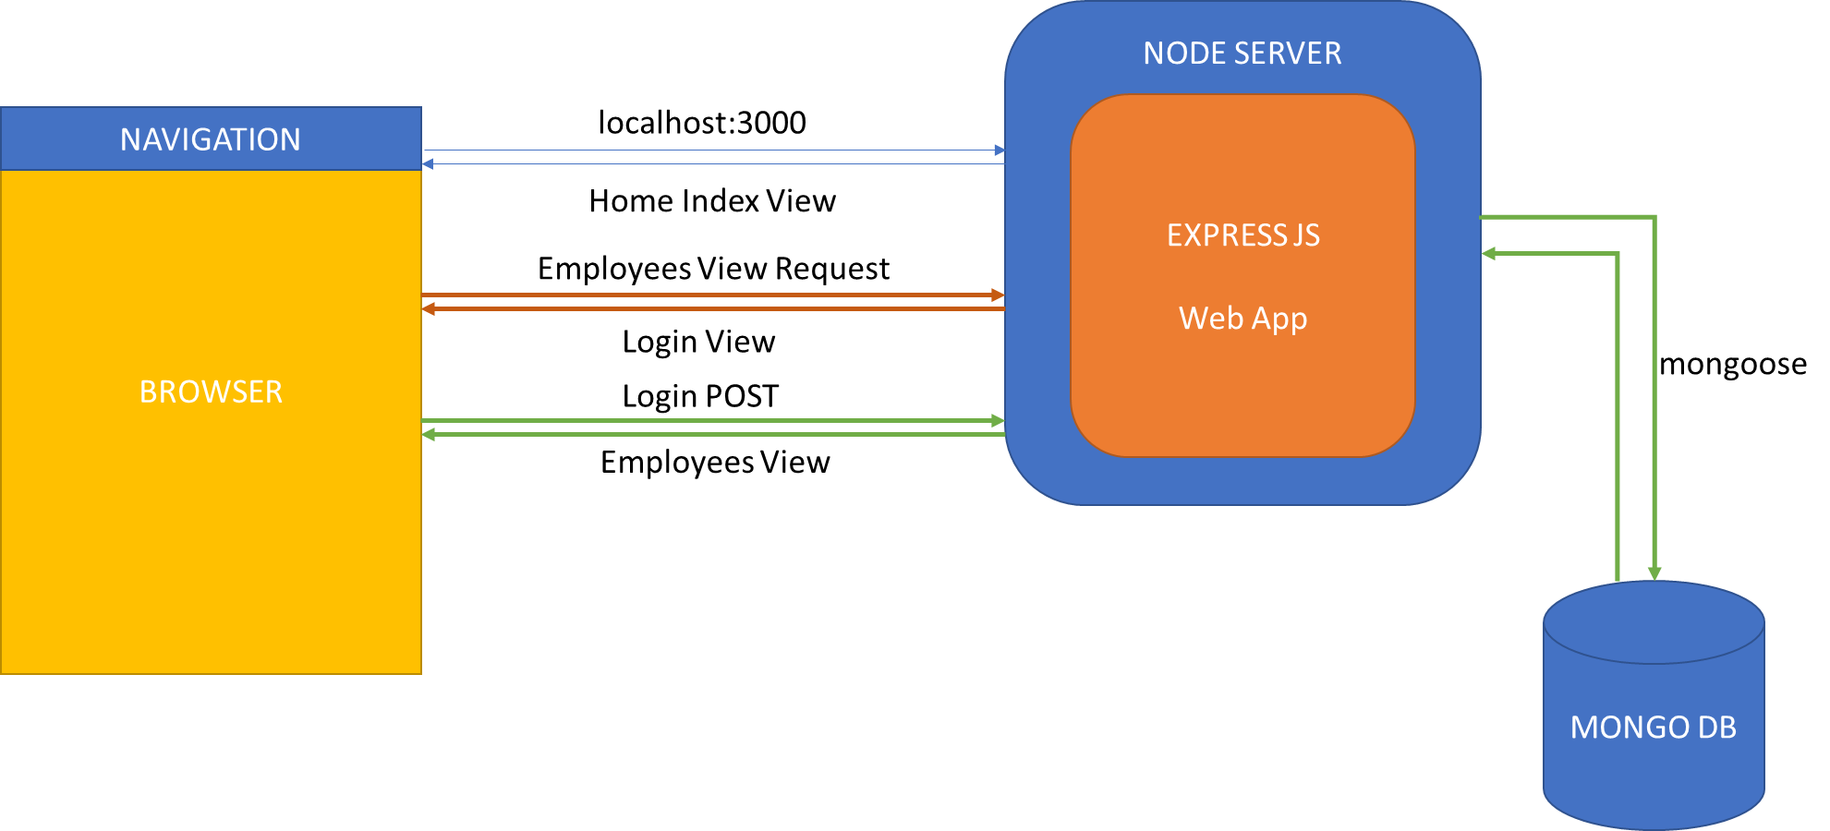
CRUD Application Secured

Slide 65
BROWSER
SERVER
HTTP + URL
NAVIGATION
localhost:3000
HTML + CSS
Server PAGES
CSS
HTTP + URL
localhost:3000/login
HTML + CSS
HTTP + URL
localhost:3000/employees
Express JS
HTML + CSS
HTTP + URL
localhost:3000/employees/create
DB
HTML + CSS

Slide 66
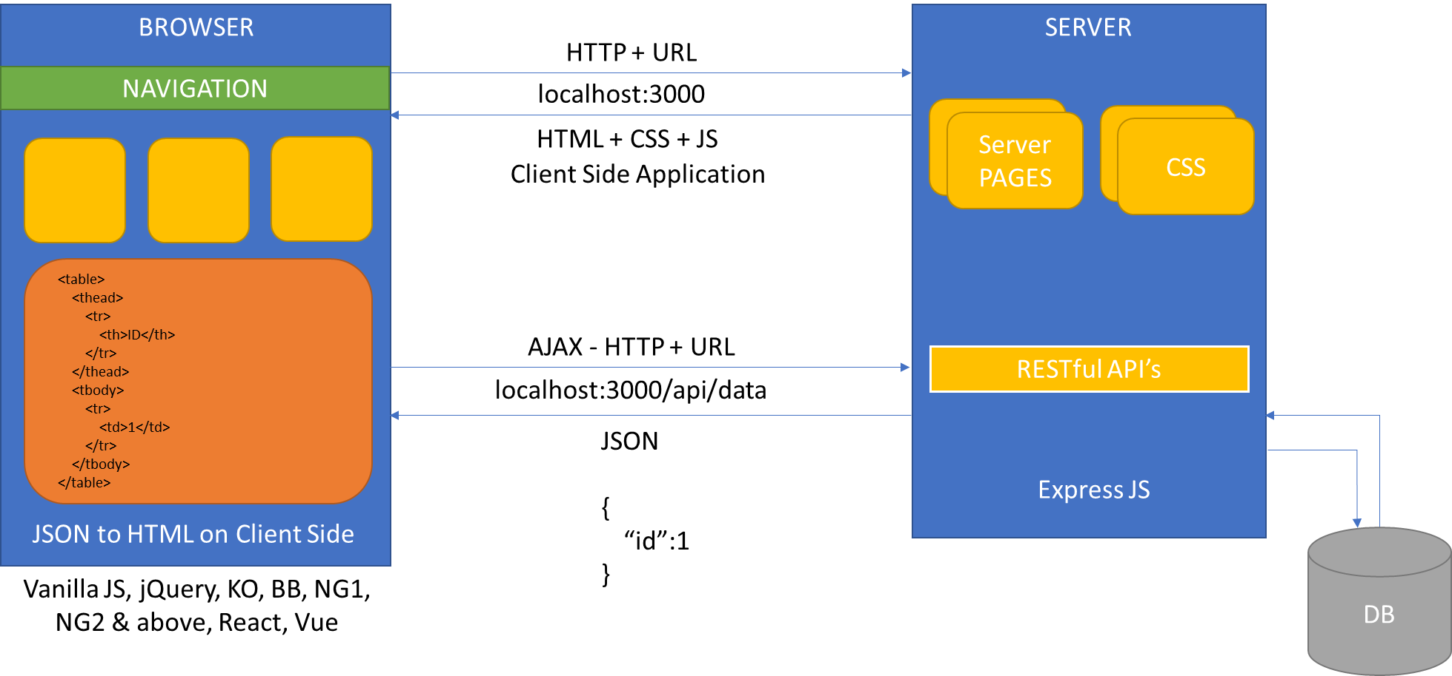
In Domain Communication

Slide 67
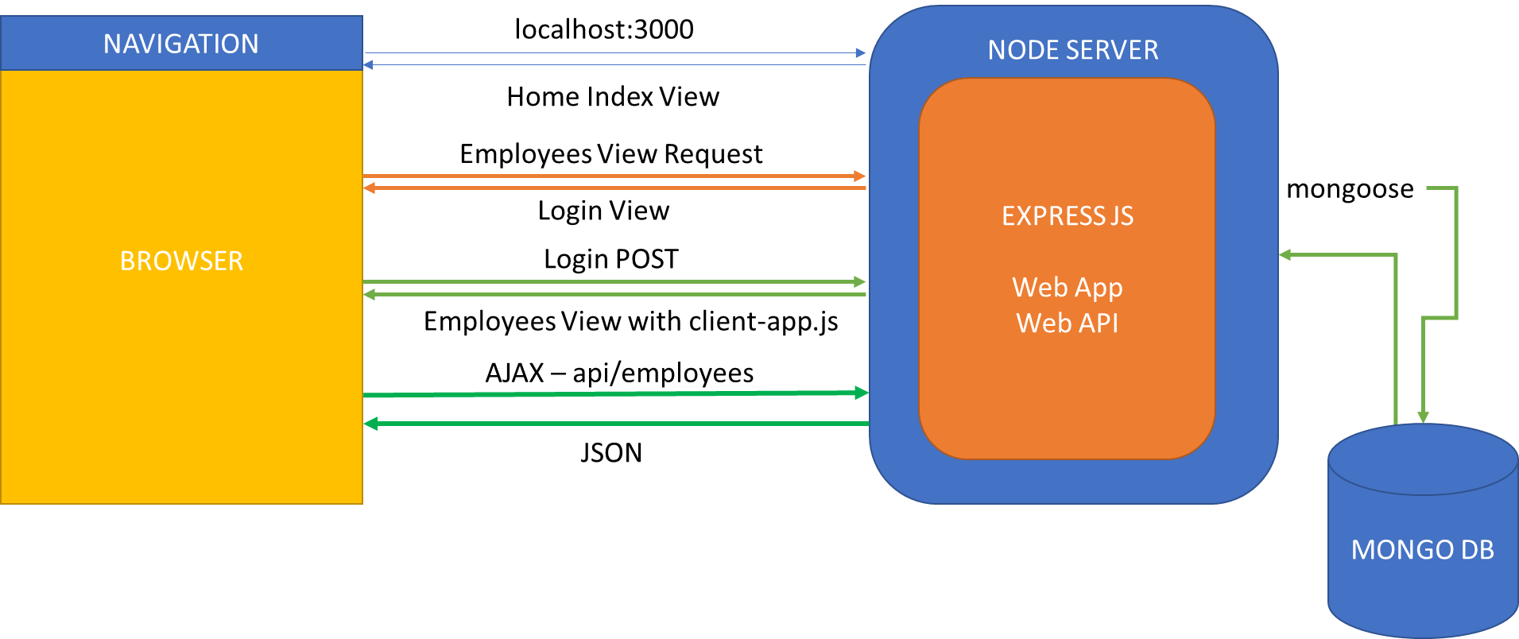
CRUD with API

Slide 68
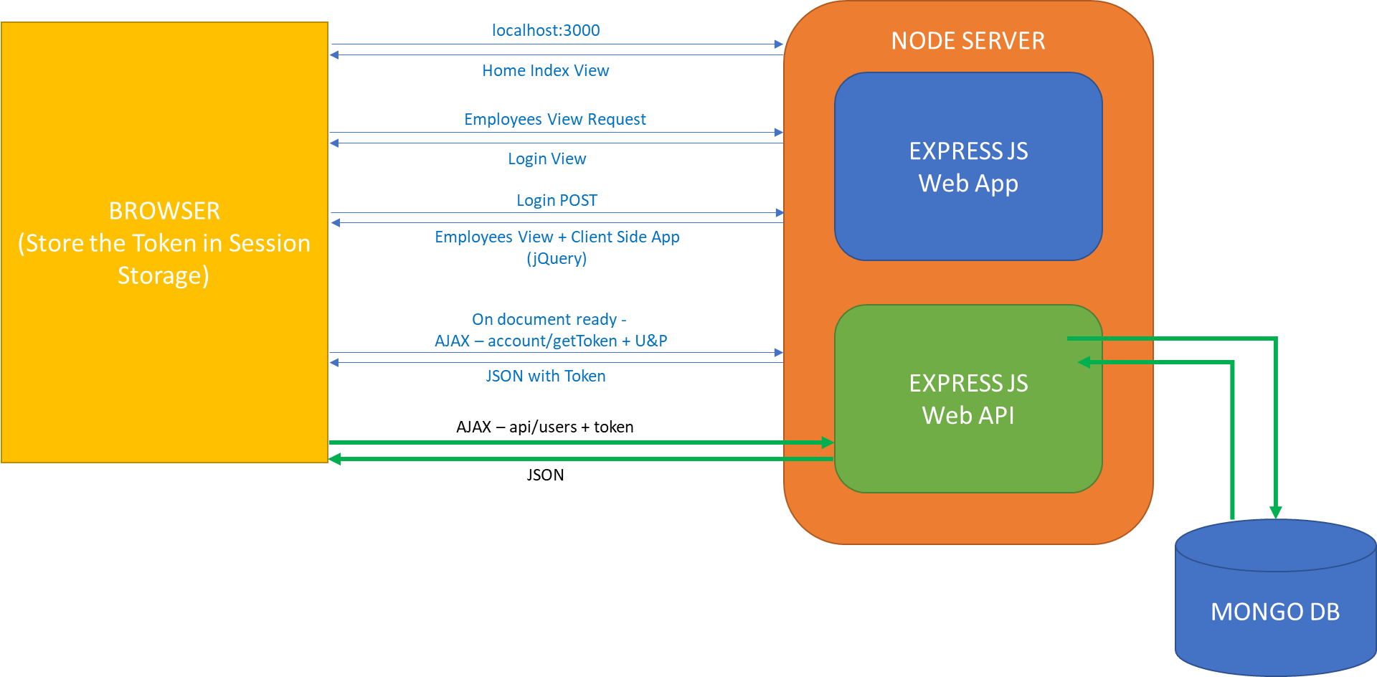
CRUD with API Secured

Slide 69
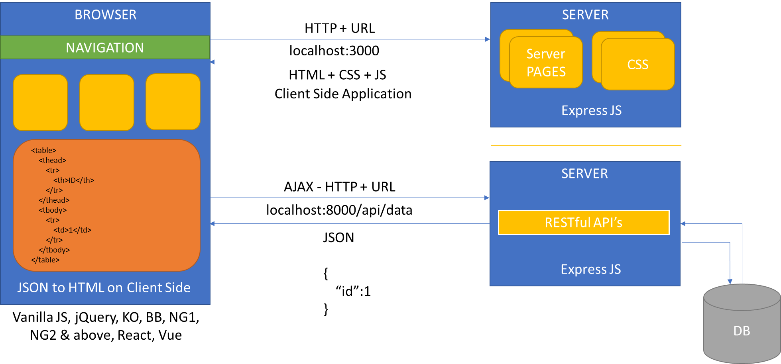
Cross Domain Communication

Slide 70
Contact Me
Manish Sharma | Gmail
Manish Sharma | WhatsApp
Manish Sharma | Facebook
Manish Sharma | LinkedIn

