Slide 1
Traditional Website Architecture
BROWSER
SERVER
NAVIGATION
HTTP + URL
HTML PAGES
CSS
HTML + CSS
HTTP + URL
HTML + CSS
Page
Reload!

Slide 2
Traditional Web Application Architecture
BROWSER
SERVER
NAVIGATION
HTTP + URL
SERVER PAGES
CSS
HTML + CSS
ASP
ASP .NET
ASP .NET MVC
JSP
PHP
Express JS
HTTP + URL
HTML + CSS
DB
Page
Reload!

Slide 3
Traditional Web Application Architecture with Post Back
BROWSER
SERVER
NAVIGATION
HTTP + URL
SERVER PAGES
CSS
HTML + CSS + JS
AJAX - HTTP + URL
JS
PARTIAL HTML
Partial
Page
Reload!
<table>
<thead>
<tr>
<th>ID</th>
</tr>
</thead>
<tbody>
<tr>
<td>1</td>
</tr>
</tbody>
</table>
ASP
ASP .NET
ASP .NET MVC
JSP
PHP
Express JS
ID
1
DB

Slide 4
Server-Side Rendering
Client Browser send request to the server using URL
Server responds back based on the URL requested, with a rendered HTML.
Browser renders the page which viewable and download the JS files referred on the page.
Once the JS files are downloaded, Browser executes JavaScript Code.
Page now is enabled with interactions.

Slide 5
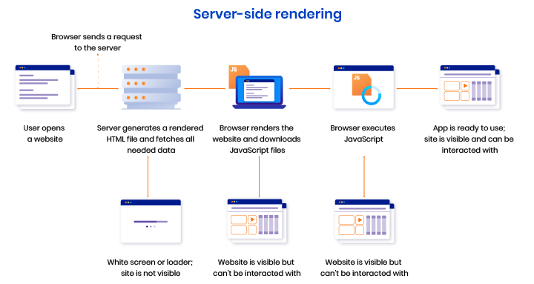

Slide 6
Pros and Cons of Server-Side
Pros of Server-Side Rendering :
Search engines can crawl the site for better SEO.
The initial page load is faster.
Great for static sites.
Cons of Server-Side Rendering:
Frequent server requests.
An overall slow page rendering.
Full page reloads.
Non-rich site interactions

Slide 7
SPA – Client side Rendering
BROWSER
APP SERVER
NAVIGATION
HTTP + URL
SERVER PAGES
CSS
HTML + CSS + JS
JS
<table>
<thead>
<tr>
<th>ID</th>
</tr>
</thead>
<tbody>
<tr>
<td>1</td>
</tr>
</tbody>
</table>
API SERVER
ID
AJAX - HTTP + URL
1
DB
JSON
RESTful Service
JSON to HTML on Client Side
Vanilla JS, jQuery, KO, BB, ExtJS, NG, Vue, React

Slide 8
Client-Side Rendering
Client Browser send request to the server using URL
Server responds back based on the URL requested with an HTML
Browser download the JS files referred on the page.
Once the JS files are downloaded, Browser executes React App.
Page now is Viewable and is enabled with interactions.

Slide 9
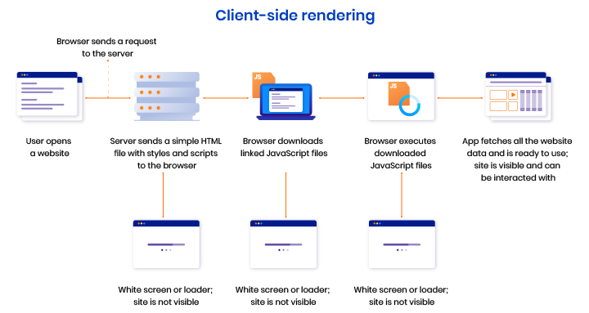

Slide 10
Pros and Cons of Client-Side
Pros of Client-Side Rendering:
Rich site interactions
Fast website rendering after the initial load.
Great for web applications.
Robust selection of JavaScript libraries.
Cons of Client-Side Rendering:
Low SEO if not implemented correctly.
Initial load might require more time.
In most cases, requires an external library.

