Slide 1
Traditional Website Architecture
BROWSER
SERVER
NAVIGATION
HTTP + URL
HTML PAGES
CSS
HTML + CSS
HTTP + URL
HTML + CSS
Page
Reload!

Slide 2
Traditional Web Application Architecture
BROWSER
SERVER
NAVIGATION
HTTP + URL
SERVER PAGES
CSS
HTML + CSS
ASP
ASP .NET
ASP .NET MVC
JSP
PHP
Express JS
HTTP + URL
HTML + CSS
DB
Page
Reload!

Slide 3
Traditional Web Application Architecture with Post Back
BROWSER
SERVER
NAVIGATION
HTTP + URL
SERVER PAGES
CSS
HTML + CSS + JS
AJAX - HTTP + URL
JS
PARTIAL HTML
Partial
Page
Reload!
<table>
<thead>
<tr>
<th>ID</th>
</tr>
</thead>
<tbody>
<tr>
<td>1</td>
</tr>
</tbody>
</table>
ASP
ASP .NET
ASP .NET MVC
JSP
PHP
Express JS
ID
1
DB

Slide 4
Server-Side Rendering
Client Browser send request to the server using URL
Server responds back based on the URL requested, with a rendered HTML.
Browser renders the page which viewable and download the JS files referred on the page.
Once the JS files are downloaded, Browser executes JavaScript Code.
Page now is enabled with interactions.

Slide 5
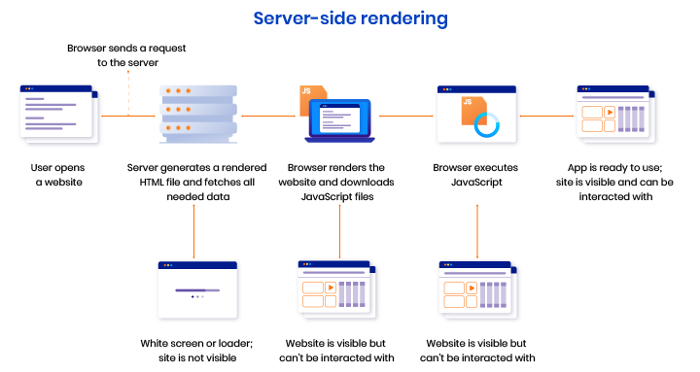

Slide 6
Pros and Cons of Server-Side
Pros of Server-Side Rendering :
Search engines can crawl the site for better SEO.
The initial page load is faster.
Great for static sites.
Cons of Server-Side Rendering:
Frequent server requests.
An overall slow page rendering.
Full page reloads.
Non-rich site interactions

Slide 7
SPA – Client side Rendering
BROWSER
APP SERVER
NAVIGATION
HTTP + URL
SERVER PAGES
CSS
HTML + CSS + JS
JS
<table>
<thead>
<tr>
<th>ID</th>
</tr>
</thead>
<tbody>
<tr>
<td>1</td>
</tr>
</tbody>
</table>
Express JS
API SERVER
ID
AJAX - HTTP + URL
1
DB
JSON
RESTful Service Express JS
JSON to HTML on Client Side
Vanilla JS, jQuery, KO, BB, ExtJS, NG, Vue, React

Slide 8
Client-Side Rendering
Client Browser send request to the server using URL
Server responds back based on the URL requested with an HTML
Browser download the JS files referred on the page.
Once the JS files are downloaded, Browser executes React App.
Page now is Viewable and is enabled with interactions.

Slide 9
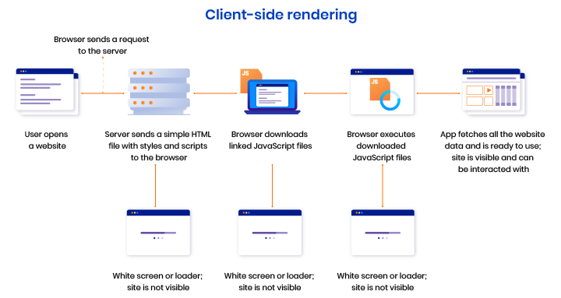

Slide 10
Pros and Cons of Client-Side
Pros of Client-Side Rendering:
Rich site interactions
Fast website rendering after the initial load.
Great for web applications.
Robust selection of JavaScript libraries.
Cons of Client-Side Rendering:
Low SEO if not implemented correctly.
Initial load might require more time.
In most cases, requires an external library.

Slide 11
Windows App
Electron JS
BROWSER (Client Side)
React DOM
REACT COMPONENT
View* (UI) – JSX
Style (CSS) – JSX / CSS
Data (Inside) – State
Data (Outside) – Props
Behaviour – Methods
Mobile App
React Native
Node JS (Server Side)
React DOM Server

Slide 12
BROWSER (Client Side)
React DOM
Next JS
REACT COMPONENT
View* (UI) – JSX
Style (CSS) – JSX / CSS
Data (Inside) – State
Data (Outside) – Props
Behaviour – Methods
Node JS (Server Side)
React DOM Server

Slide 13
What is Next.js?
Next.js is a React framework.
Next.js gives you all the building blocks to create a web application.
Next.js handles the tooling and configuration needed for React, and provides additional structure, features, and optimizations for your application.
Some core features of Next.js are:
Server rendering React Apps.
Automatic code splitting and lazy loading.
Built in CSS support.
Hot Reloading support.

Slide 14
next CLI
The Next.js CLI allows you to develop, build, start your application, and more.
Use swc to compile code
Use webpack to build the app

Slide 15
Props change
Component
Event is fired to update the state
ReactDOM.render
UI is ready for interaction
New Virtual DOM
Browser DOM will update
Delta’s
New Virtual DOM will get
compared with Old Virtual DOM

Slide 16
http://localhost:3000/conference/sessions
NEXT SERVER
BROWSER
http://localhost:8001/sessions
API SERVER
HTML
JSON

Slide 17
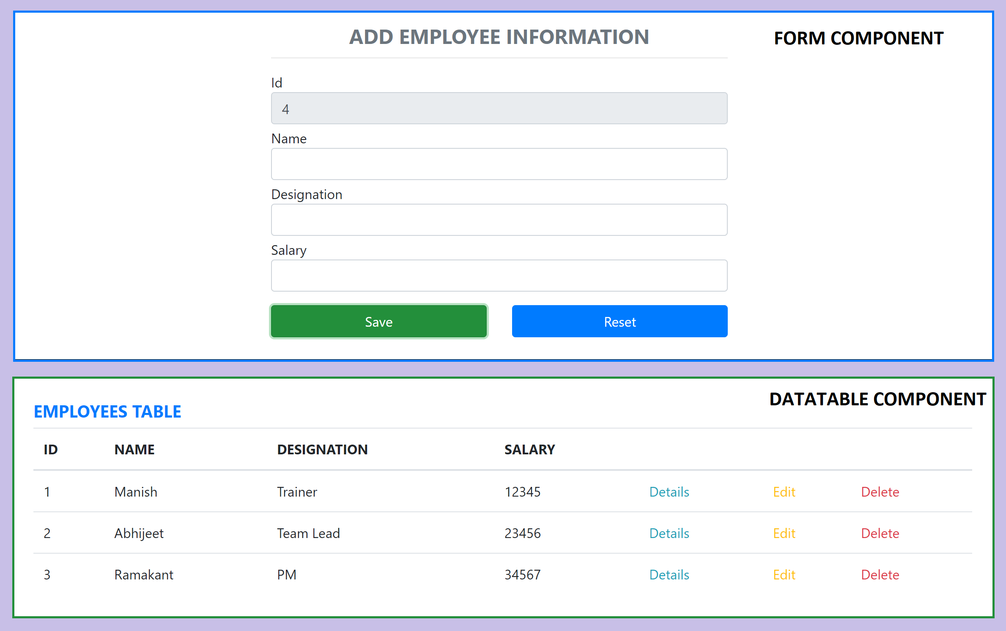
Assignment

