Slide 1


London Welcome Event
Pre-Attendance Pack
3 September 2026
Mind the gap. Grab your moment
Notes:
What does the PDP cover?
It helps colleagues wanting to better understand what living with a disability means, what are their rights and protections in the workplace, where to find resources and how to manage potentially challenging scenarios around sharing disability related information.
It also helps colleagues develop strategies to manage the workplace for them, grow their confidence and networks and become part of our growing Access Network community.
The programme is delivered by our external facilitators – Steph and Dave along with the DE&I team.

Slide 2
What We’ll Cover in This Pack
01.
An Introduction to The Day
02.
Venue Information
03.
Travelling to Our London Site
04.
Structure of the Day

Slide 3



What will the PDP cover?
An Introduction to the Day
Understand disability and neurodiversity in a work context
Develop strategies to support navigate the evolving workplace
Arrival at the venue
The welcome event starts at 1000
The registration opens at 0900 and there’s an opportunity to meet some of the other Graduates and Apprentices who will be based in your hub location
Seating
There will be no arranged seating so you can sit wherever you want on the day
This will be your seat for the day
Agenda
The agenda is on the next slide
Explore tools and techniques to grow your self-confidence and support you effectively manage your disability or neurodivergent condition
Expand your network to share ideas, offer mutual support and aid your personal growth

Slide 4

Welcome Event Agenda
Start Time | End Time | Activity
09:00 | 10:00 | Registration and refreshments
10:00 | 10:30 | Welcome
10:30 | 11:00 | Speed Networking
11:00 | 11:15 | Break
11:15 | 11:45 | Senior Leader Welcome
11:45 | 12:30 | Aspire Panel
12:30 | 13:30 | Lunch
13:30 | 13:40 | Introduction to Blueprint
13:40 | 15:15 | Part 1 ‘Faster Forward – Build Your Career from Day One’
15:15 | 15:30 | Break
15:30 | 16:45 | Part 2 ‘Faster Forward – Build Your Career from Day One’
16:45 | 17:00 | Positioning Day 2

Slide 5
Session Information
Start Time | End Time | Activity | What Does that Look Like?
09:00 | 10:00 | Registration and refreshments | Very informal, a chance to meet your peers over a coffee
10:00 | 10:30 | Welcome | We’ll hear from our Next Generation Talent Lead
10:30 | 11:00 | Speed Networking | 15 minutes to get to know more about the other Interns and IPs at your table
11:00 | 11:15 | Break
11:15 | 11:45 | Senior Leader Welcome | We’ve invited a senior leader to our event so it’s a great chance to hear about their career and ask questions
11:45 | 12:30 | Aspire Panel | Hear from our current Graduates and Apprentices with our Aspire Panel session. A great opportunity to ask questions and get real insight
12:30 | 13:30 | Lunch
13:30 | 13:40 | Introduction to Blueprint | An overview of the learning and development programme - Blueprint
13:40 | 15:15 | Part 1 ‘Faster Forward – Build Your Career from Day One’ | A session designed to introduce the Next Generation Talent proposition and how you can start to make an impact from day 1
15:15 | 15:30 | Break
15:30 | 16:45 | Part 2 ‘Faster Forward – Build Your Career from Day One’ | Continuing from earlier session, it’s designed to introduce the Next Generation Talent proposition and how you can start to make an impact from day 1
16:45 | 17:00 | Positioning Day 2 | A look forward to Day 2, collecting IT and settling in

Slide 6
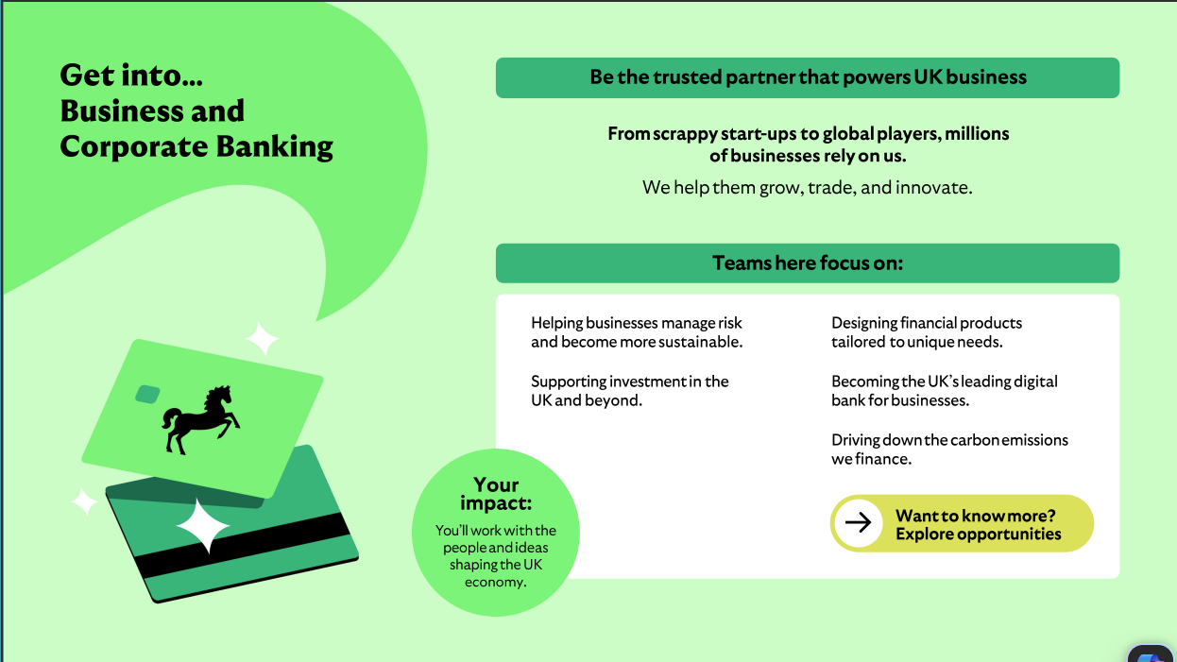

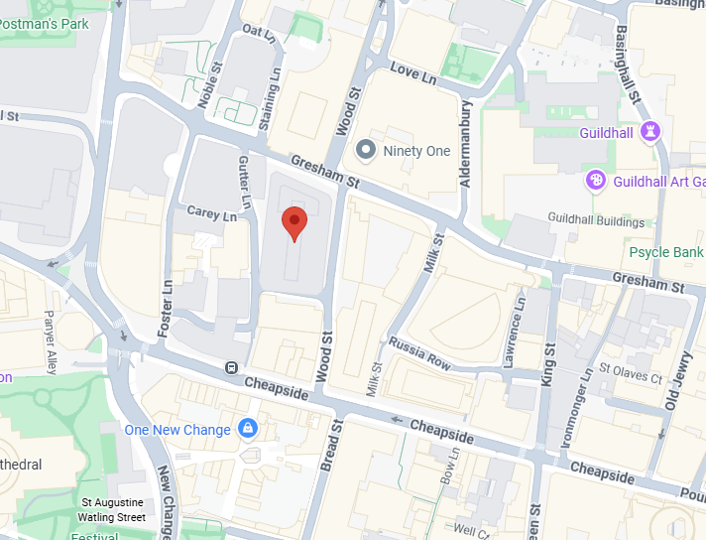

Who is the PDP For?
Venue info & location map
Venue
Information
Lloyds Banking Group
10 Gresham Street,
London
EC2V 7AE
Colleagues who feel they live with a disability and/or neurodivergent condition and identify with at least one of the following statements:
I have recently acquired or been diagnosed with my disability and/or neurodivergent condition;
I have recently experienced a significant change in my disability or neurodivergent condition;
How I work has significantly changed and this makes managing my disability or neurodivergent condition much more challenging (e.g. change of role, location, or ways of working);
I am new to managing my disability or neurodivergent condition in the workplace.
Are an LBG UK permanent colleague (i.e. excluding contractors or agency workers)
Are any grade, albeit the programme is likely to best support grades C-E.

Slide 7

Who is the PDP For?
Travelling to the Event
Getting to 10 Gresham Street by Tube
Colleagues who feel they live with a disability and/or neurodivergent condition and identify with at least one of the following statements:
I have recently acquired or been diagnosed with my disability and/or neurodivergent condition;
I have recently experienced a significant change in my disability or neurodivergent condition;
How I work has significantly changed and this makes managing my disability or neurodivergent condition much more challenging (e.g. change of role, location, or ways of working);
I am new to managing my disability or neurodivergent condition in the workplace.
Mansion House - 0.5 miles. 10-minute walk - Circle & District line
Liverpool Street (Moorgate Exit) - 0.3 miles. 6-minute walk - Elizabeth, Central & Circle line
Moorgate - 0.3 miles. 6-minute walk - Northern & Elizabeth line
Bank - 0.5 miles. 10-minute walk - Central, DLR, Northern, Waterloo & City lines
Barbican - 0.4 miles. 7-minute walk - Met, Circle, Hammersmith & City lines
Getting to 10 Gresham Street by Train
Are an LBG UK permanent colleague (i.e. excluding contractors or agency workers)
Moorgate - 0.3 miles
City Thameslink - 0.5 miles
Farringdon - 0.6 miles
Liverpool Street - 0.3 miles
Are any grade, albeit the programme is likely to best support grades C-E.

Slide 8




Inclusive Welcome Event
Quiet Space
The Venue and Logistics
Timeline 2025
Venue
The venue for your Welcome Event has been selected to be close to on on-site so that you get a feel for our buildings ad the local areas as well as minimising any additional travel
Each of the venues will have members of the Next Generation Talent if any Intern requires support
All venues will be physically accessible, and activities will be inclusive for all
Chill Room
We’ll have a quiet room available across the whole event at our venue
The room is for anyone needing to step away if feeling overstimulated or overwhelmed, needing a quiet place to recalibrate
You don’t need to let us know ahead of time - just drop in!
We’ll have fidget toys and doodling kit there
Travel
If you are having to travel to another hub for the welcome event, the Next Generation Team will be in touch to help arrange your travel
Room Usage
It’s a quiet space for attendees to use and return to the event as soon as possible
the chill room has a no calls rule
Preparing to Attend
Things to Consider…
Make sure you have a conversation with your Line Manager around any adjustment needs or concerns you have ahead of your Internship. If you’ve already shared that with us, we will have indicated to your Line Manager that you need to have this discussion so they’re ready to help
The event is planned to be inclusive – it won’t be too loud but there will be lots of new people to meet and new things to experience. If you usually use noise cancelling headphones/loops, it’s a good idea to bring them on the day

Slide 9
Work that hits like a Brick Lane bagel

