Slide 1








Developing Delta Live Table Pipeline in Azure Databricks
Chandrashekhar Deshpande

Slide 2
From Architecting, Designing and Development background
Have done more than 10 Microsoft Azure Certifications. MCT, Data Engineer Associate.
Total experience: 33+ Years
Total experience of corporate trainings: More than 2000 training days
Experience on Analytics platform: More than 800 training days
Have conducted Off-Shore and On-Site trainings.
Technology Spectrum: Maths and Statistics, Python for Analytics, Machine Learning, Azure ML Service, Azure Databricks, Azure Synapse Analytics, Azure Data Factory, Azure Storages, Azure Cognitive Services, PowerBI and so on.

Slide 3
What is Delta Live Table?
A simple declarative approach to build reliable data pipelines and task orchestration
Automatically manage your infrastructure at scale.
Seamless management of workflow for Delta Tables
The ETL framework for building reliable, maintainable and testable data processing pipeline
Build high quality data pipeline for Delta Lake.
A Lake House architecture demands for reasonably good framework for managing dependencies and data movements. The Delta Live Tables offer it.
Notes:
It’s a managed workflows for loading Delta Tables.
Define table dependencies,
Define updating of tables, streams, incremental update,
Define libraries, cluster settings and management, Monitoring
Define transformations based on expectations.
Define Error Handling

Slide 4
Concerns around Workflow Management
Dependency Management
Incremental Loads — Partitions over time periods
Checkpointing and retries i.e. error handling
Data Quality Checks — Formulas, Rules, Constraint Checks including Value Ranges
Governance — PII, Confidential Data, Controlling Access to Data, Masking/Encryption
Backdating
Version Control
Deployment
Operational Concerns
Data Recovery or Data Reload
And so on…

Slide 5
What is Lake House?
New, open data management architecture that unifies Data warehousing and advanced analytics.
Also unifies Batch and Stream Processing pipelines in a Data Flow. Can make them to interact with each other hassle-free.
Storage Reservoir, Flexible, cost-efficient, and scale the data lakes
Offers Data management and ACID transactions of data warehouses.
Enables business intelligence (BI) and machine learning (ML) on all types of data.
Notes:
Uses open data formats like Parquet and supports the well-known libraries of Python like Pandas, Spark, TensorFlow, PyTorch.

Slide 6
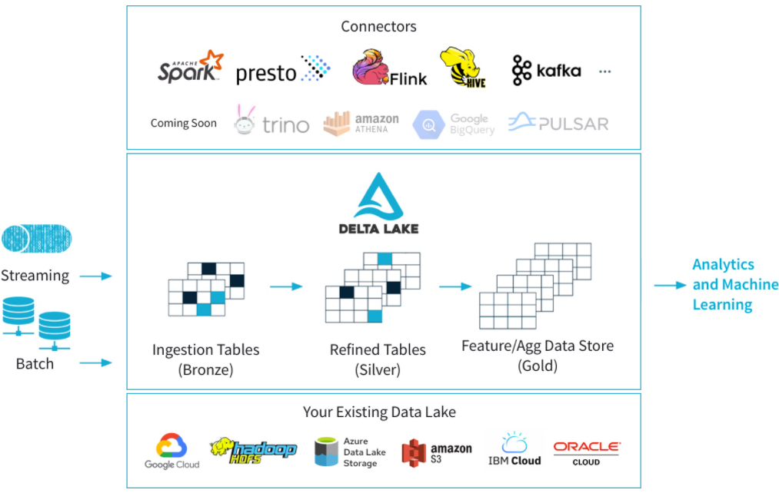
A Delta Lake architecture
Notes:
Talking points
Delta Lake is an open-source storage layer that brings ACID (atomicity, consistency, isolation, and durability) transactions to Apache Spark and big data workloads. The current version of Delta Lake included with Azure Synapse has language support for Scala, PySpark, and .NET. It is also supported on Azure Databricks. Using delta lake in a well organised data lake can aid the integrity and performance of both batch and streaming data solutions. The common misconception made with Delta lake is that people think it is a data platform service. It’s not. It is simply a format that is defined when you create a DataFrame against the storage layer, and this is what brings the ACID capabilities to the data held in the DataFrames. Couple this with organising the folders in an appropriate way, then you have an approach that can scale in an organised way that prevents your data lake becoming a data “swamp”.
In the example above, the data lake is organised using the bronze, silver and gold architecture. The input method is irrelevant, it can either be a streaming solution, or a batch solution. Essentially, we organise our data into layers, or folders as defined as bronze, silver and gold as follows:
Bronze - tables contain raw data ingested from various sources (JSON files, RDBMS data, IoT data, etc.).
Silver - tables will provide a more refined view of our data. We can join fields from various bronze tables to enrich streaming records, or update account statuses based on recent activity.
Gold - tables provide business level aggregates often used for reporting and dashboarding. This would include aggregations such as daily active website users, weekly sales per store, or gross revenue per quarter by department.
The end outputs are actionable insights, dashboards, and reports of business metrics.
The Delta Lake Architecture is a vast improvement upon the traditional Lambda architecture. At each stage, we enrich our data through a unified pipeline that allows us to combine batch and streaming workflows through a shared filestore with ACID-compliant transactions.
Instructor notes and guidance
While this is an open-source technology that is not covered by the exam objectives, it is an important area that is growing in the data engineering world and being seen by some data engineers as an architecture to replace the lambda architecture model. It is also covered in depth in the lab as we explore Azure Databricks implementing the delta lake architecture in the data lake store. In the lab, you will explore this architecture being created using Azure Databricks, but it could be done in Azure Synapse Analytics too.
You should call out the common misconception laid out in the talking points above. Make sure your students understand that Delta Lake if a format. Not a service.
Recommended reading for this slide
Describe Azure Databricks Delta Lake architecture - Learn | Microsoft Docs
Build and query a Delta Lake - Learn | Microsoft Docs

Slide 7
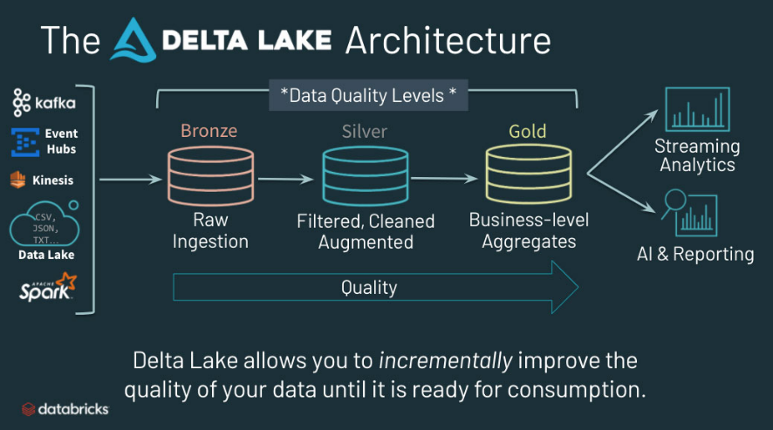
The Delta Lake
Bronze: Contains raw data ingested from JSON, RDBMS or IoT data sources
Silver: A refined view of data after joining and enriching data from Bronze tables.
Gold: Data enriched after business level aggregation by making it suitable for Reporting and Dashboarding.

Slide 8
Simplification by Delta Live Table
Declarative Approach
Define target schema for each processing step and Delta Live Table decides how to transform the data from source data set.
Enforce data quality using Expectations
By defining expected data quality and specifying how to handle records that fail those expectations.
Workflows for Delta Table Life Cycle
It’s a managed workflows for loading Delta Tables.
Notes:
It’s a managed workflows for loading Delta Tables.
Define table dependencies,
Define updating of tables, streams, incremental update,
Define libraries, cluster settings and management, Monitoring
Define transformations based on expectations.
Define Error Handling

Slide 9
Q & A
Contact: chandrashekhardeshpande@synergetics-india.com

Slide 10
References
Online reference:
https://docs.azuredatabricks.net/getting-started/index.html#getting-started-guide
https://docs.azuredatabricks.net/user-guide/index.html
https://docs.azuredatabricks.net/user-guide/dev-tools/index.html

Slide 11
Thank You

