Slide 1








Azure Databricks Delta Live Tables
Chandrashekhar Deshpande

Slide 2
Agenda
Delta Live Table and Use Cases
Brief of Lake House and Delta Tables?
Demo on implementing Delta Tables in Azure Databricks
The Delta Lake Architecture and Concepts
Delta Live Table: Manage Data Quality using Expectations
Delta Live Table Data Set.
Demo on implementing Delta Live Tables
4 Hrs webinar on ‘Developing Delta Live Tables’
Lake House, Delta Tables and Delta Live tables with concepts, architecture, use case through Demos.

Slide 3
What is Delta Live Table?
The ETL framework for building reliable, maintainable and testable data processing pipeline
A simple declarative approach to build reliable data pipelines and task orchestration
Automatically manage your infrastructure at scale.
It’s a managed workflows for loading Delta Tables.
Define table dependencies,
Define updating of tables, streams, incremental update,
Define libraries, cluster settings and management, Monitoring
Define transformations based on expectations.
Define Error Handling
Define target schema for each processing step and Delta Live Table decides how to transform the data from source data set.
Enforce data quality with Delta Live Tables expectations by defining expected data quality and specifying how to handle records that fail those expectations.

Slide 4
What is Lake House?
A data Lake House is…
New, open data management architecture that unifies Data warehousing and advanced analytics.
Storage Reservoir, Flexible, cost-efficient, and scale the data lakes
Offers Data management and ACID transactions of data warehouses.
Enables business intelligence (BI) and machine learning (ML) on all types of data.
Key Technologies and Prominent features..
Exists in 2-Tier architecture
New query engine designs enable high-performance SQL analysis by caching hot data in RAM/SSD, use of indexes, vectorized execution on modern CPUs and concurrent R/W.
Use of open data formats like Parquet make it easy for data scientists and machine learning engineers to access the data.
Support of well known and widely used libraries like pandas, Spark, TensorFlow, PyTorch.
Support of Audit History and Time Travel.
The Meta data layer associates Schema Enforcement and evolution, versions of tables, data validation.
IO Streaming without need of message buses like Apache Kafka.
Notes:
Its necessary to understand basics of Lake House and Delta Tables to understand Delta Live Tables.

Slide 5

The Delta Lake for Lake House
An open-source project that allows building Lake House Architecture on the top of
Data Lakes like HDFS, S3, ADLS, GCS.
Using compute engines like Spark, Flink, PrestoDB, Trino.
Supporting variety of language APIs like Java, Python, Scala, SQL, Rust, Ruby, NodeJS.
At the heart of the Delta Lake, data is represented as a Table which supports ACID properties, constraints, joins and complex queries. They can accommodate stream data on the fly and operations on them may also change results with fresh data pumped in.

Slide 6
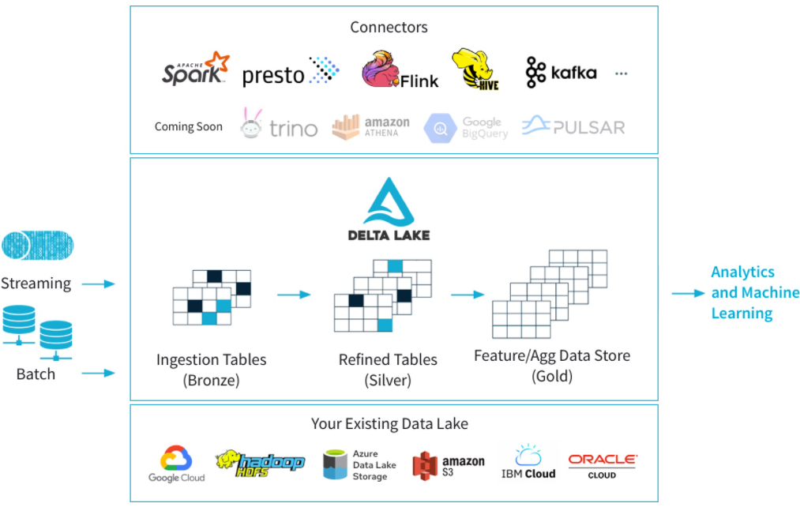
A Delta Lake architecture
Notes:
Talking points
Delta Lake is an open-source storage layer that brings ACID (atomicity, consistency, isolation, and durability) transactions to Apache Spark and big data workloads. The current version of Delta Lake included with Azure Synapse has language support for Scala, PySpark, and .NET. It is also supported on Azure Databricks. Using delta lake in a well organised data lake can aid the integrity and performance of both batch and streaming data solutions. The common misconception made with Delta lake is that people think it is a data platform service. It’s not. It is simply a format that is defined when you create a DataFrame against the storage layer, and this is what brings the ACID capabilities to the data held in the DataFrames. Couple this with organising the folders in an appropriate way, then you have an approach that can scale in an organised way that prevents your data lake becoming a data “swamp”.
In the example above, the data lake is organised using the bronze, silver and gold architecture. The input method is irrelevant, it can either be a streaming solution, or a batch solution. Essentially, we organise our data into layers, or folders as defined as bronze, silver and gold as follows:
Bronze - tables contain raw data ingested from various sources (JSON files, RDBMS data, IoT data, etc.).
Silver - tables will provide a more refined view of our data. We can join fields from various bronze tables to enrich streaming records, or update account statuses based on recent activity.
Gold - tables provide business level aggregates often used for reporting and dashboarding. This would include aggregations such as daily active website users, weekly sales per store, or gross revenue per quarter by department.
The end outputs are actionable insights, dashboards, and reports of business metrics.
The Delta Lake Architecture is a vast improvement upon the traditional Lambda architecture. At each stage, we enrich our data through a unified pipeline that allows us to combine batch and streaming workflows through a shared filestore with ACID-compliant transactions.
Instructor notes and guidance
While this is an open-source technology that is not covered by the exam objectives, it is an important area that is growing in the data engineering world and being seen by some data engineers as an architecture to replace the lambda architecture model. It is also covered in depth in the lab as we explore Azure Databricks implementing the delta lake architecture in the data lake store. In the lab, you will explore this architecture being created using Azure Databricks, but it could be done in Azure Synapse Analytics too.
You should call out the common misconception laid out in the talking points above. Make sure your students understand that Delta Lake if a format. Not a service.
Recommended reading for this slide
Describe Azure Databricks Delta Lake architecture - Learn | Microsoft Docs
Build and query a Delta Lake - Learn | Microsoft Docs

Slide 7
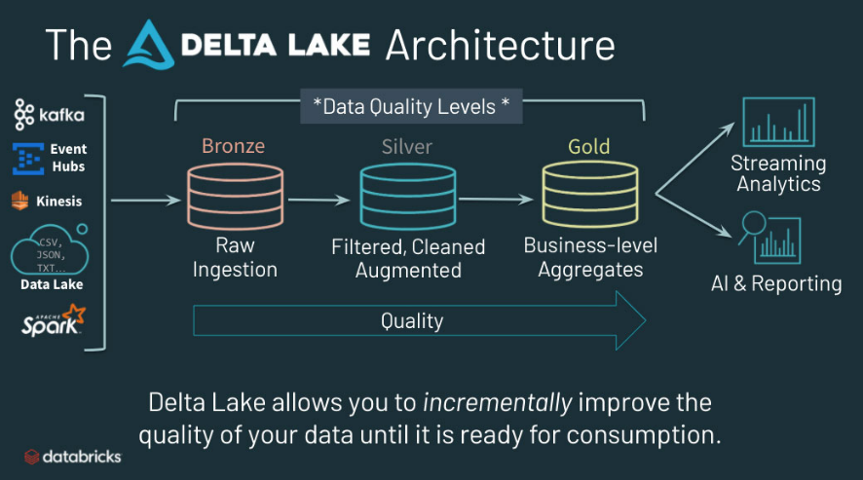
The Delta Lake

Slide 8
The Bronze, Silver and Gold Layers
Bronze tables contain raw data ingested from various sources (JSON files, RDBMS data, IoT data, etc.).
Silver tables will provide a more refined view of our data. We can join fields from various bronze tables to enrich streaming records, or update account statuses based on recent activity.
Gold tables provide business level aggregates often used for reporting and dashboarding. This would include aggregations such as daily active website users, weekly sales per store, or gross revenue per quarter by department.

Slide 9
Hands-On Lab-1
Following code intends to implement concepts of Delta Tables
Notebook110_DeltaLakeArchitecture

Slide 10
Delta Live Table Concepts
The Pipeline:
A Directed Acyclic Graph (DAG) linking data source to target data set.
It defines the steps of Data Cleaning, Transformation on a Data Frame.
The Delta Live Table may be combining one or more Pipelines to define end to end transformation from a source data to destination.
It can be created using Azure Databricks Notebook.
More generic pipeline by defining Parameters can be designed.
Queries
It implements data transformation by defining data source and target data set.
Can be implemented using Python or SQL.

Slide 11
Delta Live Table Concepts: Manage Data Quality
The Expectations:
An elegant approach to manage Data Quality
They define data quality constraints on contents of the data set.
Can be define using decoration in Python or constraints in SQL
Expectation Decorators accept Python Dictionary with key-value pair of Constraint name and Constraint condition.
Data Quality metrics can be observed by querying Delta Live Tables event log.
Define expectations to retain records that fail validation, drop records that fail validation, or halt the pipeline when a record fails validation.

Slide 12
Manage Data Quality with single data quality constraint
The Expectations: The expectations expect, expect_or_drop, expect_or_fail can define single data quality constraint.
Expectation type | Example
Retain Invalid Records | @dlt.expect("valid timestamp", "col(“timestamp”) > '2012-01-01'")
Records that violate the expectation are added to the target dataset along with valid records | CONSTRAINT valid_timestamp EXPECT (timestamp > '2012-01-01')
Drop Invalid Records | @dlt.expect_or_drop("valid_current_page", "current_page_id IS NOT NULL AND current_page_title IS NOT NULL")
Records that violate the expectation are dropped from the target dataset | CONSTRAINT valid_current_page EXPECT (current_page_id IS NOT NULL and current_page_title IS NOT NULL) ON VIOLATION DROP ROW
Fail on Invalid Records | @dlt.expect_or_fail("valid_count", "count > 0")
When invalid records are unacceptable, use the expect or fail operator to halt execution immediately when a record fails validation. All previously applied operations are rolled-back. | CONSTRAINT valid_count EXPECT (count > 0) ON VIOLATION FAIL UPDATE

Slide 13
Manage Data Quality with single data quality constraint
The Expectations: The expectations expect_all, expect_all_or_drop, expect_all_or_fail can define multiple data quality constraint.
Expectation type | Example
Retain Invalid Records | @dlt.expect_all({"valid_count": "count > 0", "valid_current_page": "current_page_id IS NOT NULL AND current_page_title IS NOT NULL"})
Records that violate the expectation are added to the target dataset along with valid records
Drop Invalid Records | @dlt.expect_all_or_drop({"valid_count": "count > 0", "valid_current_page": "current_page_id IS NOT NULL AND current_page_title IS NOT NULL"})
Records that violate the expectation are dropped from the target dataset
Fail on Invalid Records | @dlt.expect_all_or_fail({"valid_count": "count > 0", "valid_current_page": "current_page_id IS NOT NULL AND current_page_title IS NOT NULL"})
When invalid records are unacceptable, use the expect or fail operator to halt execution immediately when a record fails validation. All previously applied operations are rolled-back.

Slide 14
Hands-On Lab-2
Note that to run following DLT code, All purpose cluster does not work but the Job of Delta Live Table.
Notebook210_DeltaLiveTablesWithPySpark
Notebook220_DeltaLiveTablesWithSQL
Notebook211_CheckDatabricksFileSystem

Slide 15
Delta Live Table Concepts: Data Ingestion
The basic building block of data pipeline is Spark Data Frame.
The Datasets: There are two types of data sets.
The Views: An alias for some computation. Breaks a complicated query to a short and simple one. Available within pipeline only and can not be queried interactively.
The Tables: These are materialized views. They are created in delta format and are always updated with the latest result of the query through which they are created.
The Live Table/View: Always reflects the results of the query that defines it, including when the query defining the table or view is updated, or an input data source is updated.
The Streaming Live Table/View: Processes data that has been added only since the last pipeline update. They are stateful; if the defining query changes, new data will be processed based on the new query and existing data is not recomputed.

Slide 16
Ingest data into Delta Live Tables
The Datasets: There are two types of data sets.
The Views: An alias for some computation. Breaks a complicated query to a short and simple one. Available within pipeline only and can not be queried interactively.
The Tables: These are materialized views. They are created in delta format and are always updated with the latest result of the query through which they are created.
The Live Table/View: Always reflects the results of the query that defines it, including when the query defining the table or view is updated, or an input data source is updated.
The Streaming Live Table/View: Processes data that has been added only since the last pipeline update. They are stateful; if the defining query changes, new data will be processed based on the new query and existing data is not recomputed.

Slide 17
Hands-On Lab-3
Following code intends to bring Generalization and Dynamism while designing DLT. This LAB will be covered subject to availability of time
Notebook230_DLT_Parameters

Slide 18
Q & A
Contact: chandrashekhardeshpande@synergetics-india.com

Slide 19
References
Online reference:
https://docs.azuredatabricks.net/getting-started/index.html#getting-started-guide
https://docs.azuredatabricks.net/user-guide/index.html
https://docs.azuredatabricks.net/user-guide/dev-tools/index.html

Slide 20
Thank You

