Slide 1
Real-time Analytics using Azure services
Manasi Shahane

Slide 2
Agenda
Overview of the webinar
What is Stream processing?
Batch v/s Stream processing
What is Internet of Things (IoT)?
What is Azure IoT and IoT Hub?
Demo- Connect devices to Azure IoT Hub.
Brief introduction to Apache Spark and Spark Streaming.
Real-time Stream Analytics tools in Azure
What is Azure Databricks?
Demo- Ingest data from Azure IoT Hub to Azure Databricks

Slide 3
Agenda
What is Delta Lake? How to use Delta Lake for real-time stream processing?
Demo- Ingest data from IoT Hub to Azure Databricks using Bronze and Gold layers of Delta lake.
What is visualization? Why use visualization? What is Power BI?
Demo- Visualize your data using Power BI.

Slide 4
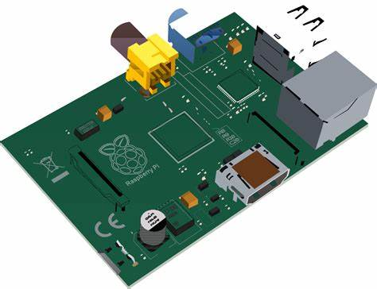
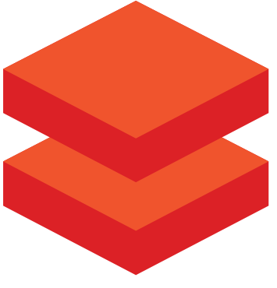
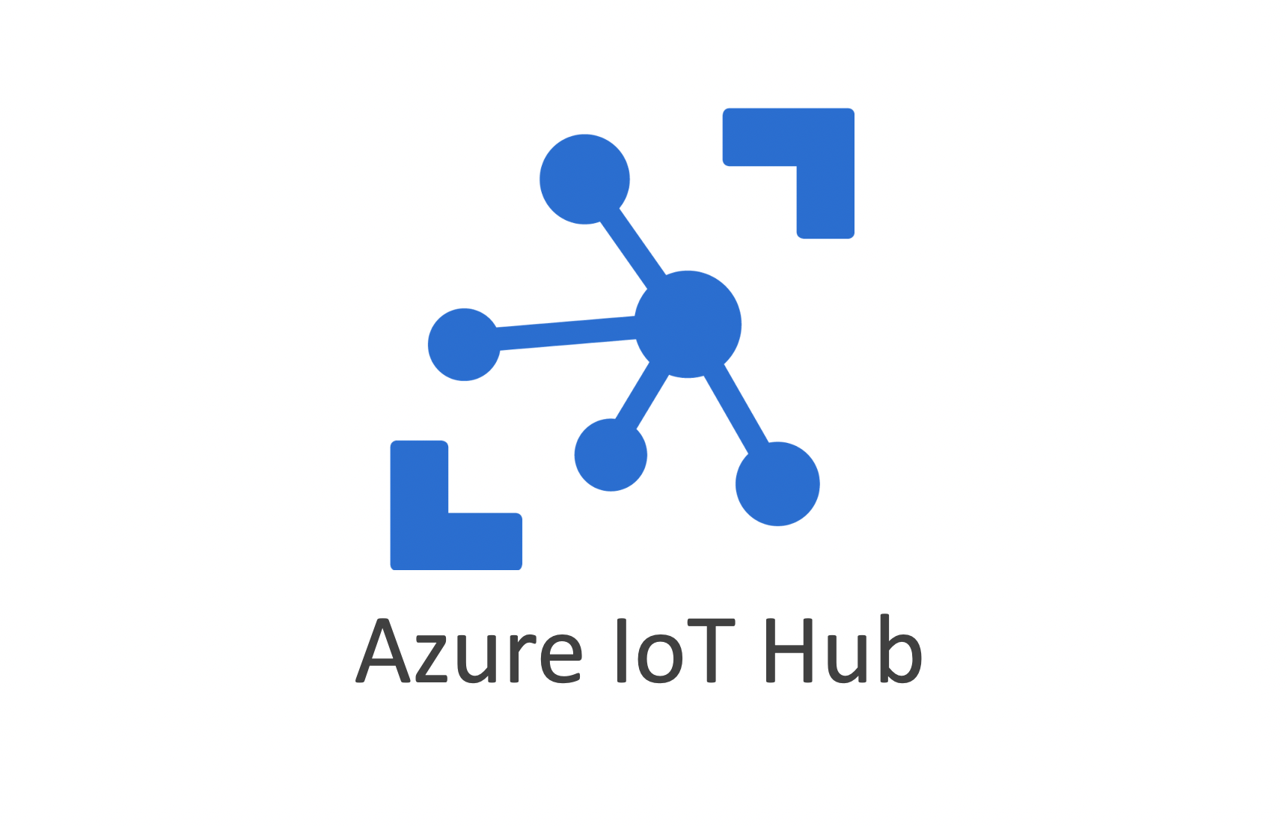
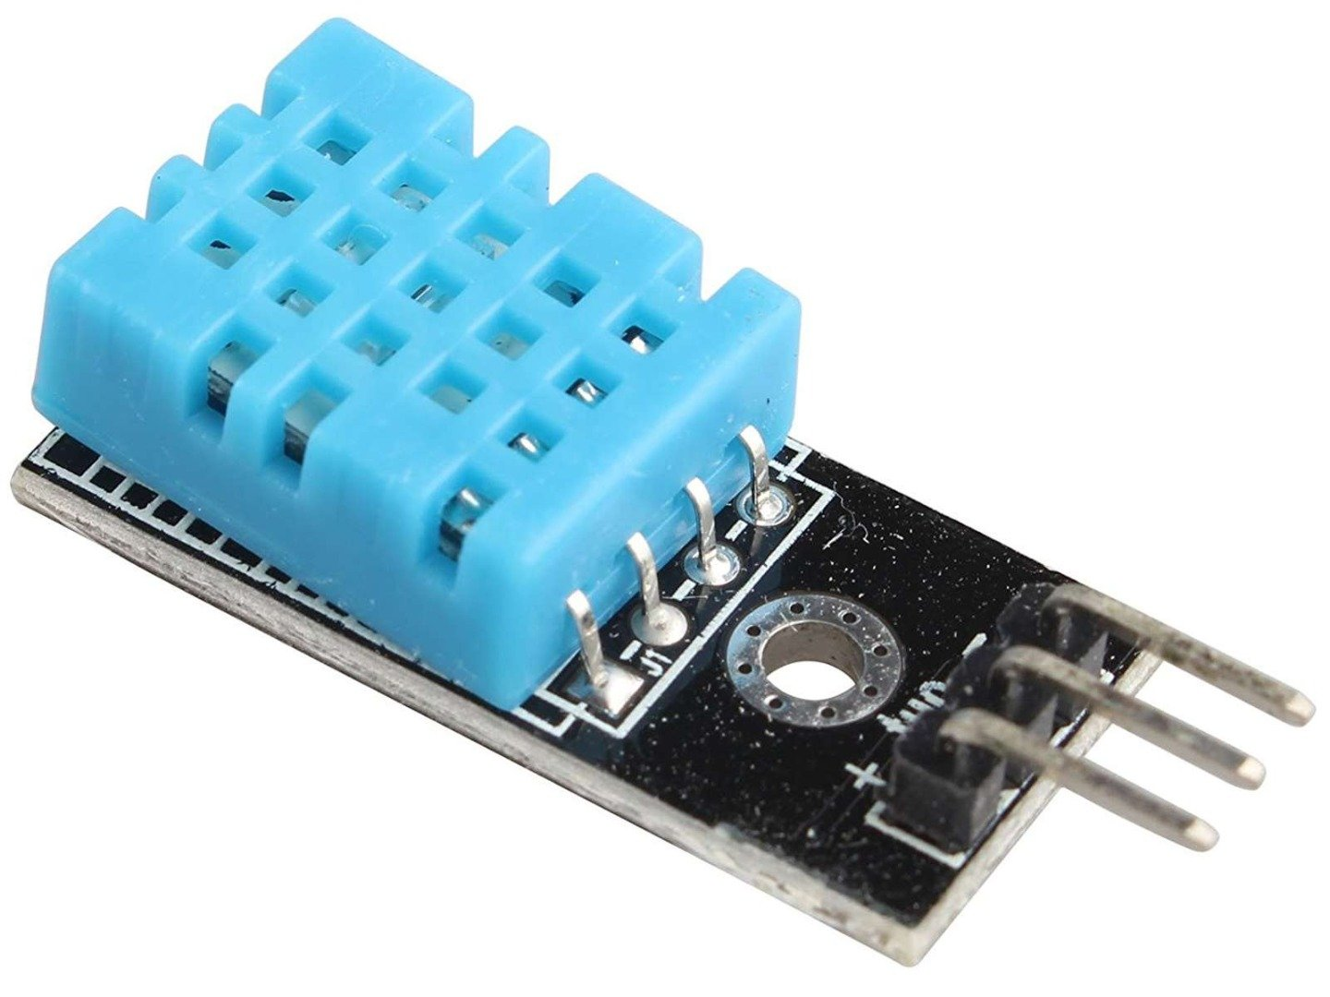
Overview
1
2
Connect using a Primary connection string
Install Maven library
Demo 1: Ingest real-time temperature and humidity readings from sensors into Azure IoT Hub
Demo 2: Ingest incoming data from Azure IoT Hub into Azure

Slide 5
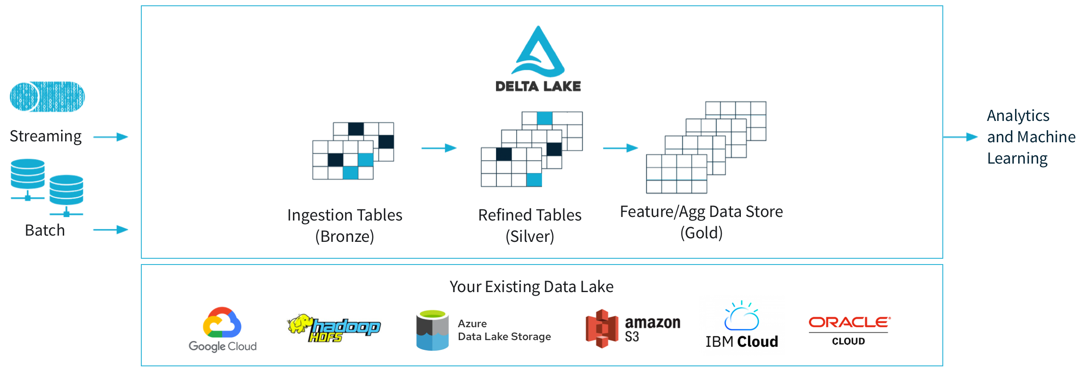
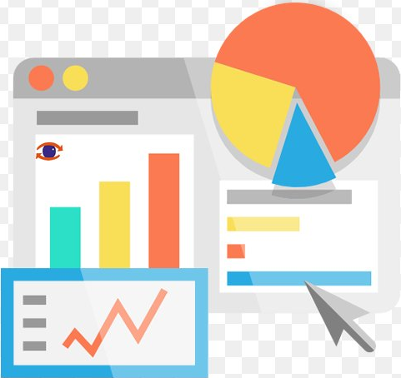
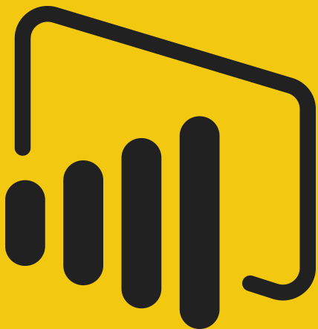
Ingest Data into Bronze and Gold Layers
Use Databricks Partner Connects
3
4
Demo 3: Ingest data from Azure Databricks into Delta Lake and make it ready for visualization.
Demo 4: Visualize data using Power BI

Slide 6
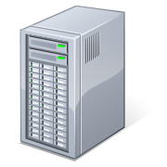
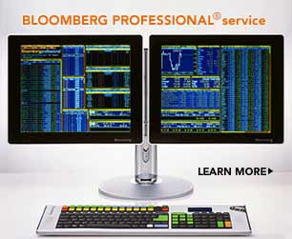

Stream Processing
Sources
Application at Runtime
Targets
Input
Adapters
Devices, Sensors
Pagers &
Monitoring devices
Standing Queries
Web servers
1
Query Logic
Query Logic
4
2
3
KPI Dashboards
Query Logic
Stream processing is the act of taking action on a set of data as it is being created.
Commonly used actions are Aggregations (Sum, Mean, Standard Deviation), Analytics(predicting), Transformations, Enrichment and ingestion are all actions that Stream processing performs on the data.

Slide 7
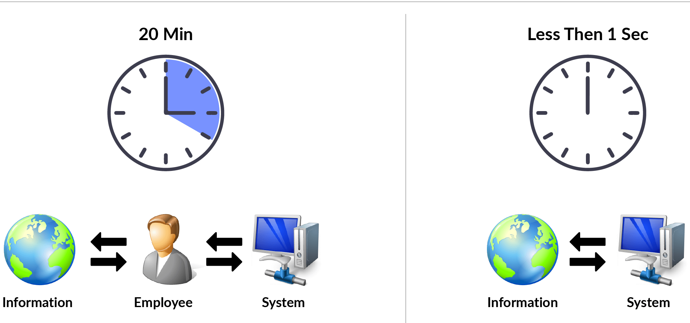
Batch v/s Stream processing
Notes:
Data processing is simply the conversion of raw data to meaningful information through a process. There are two general ways to process data:
Batch processing, in which multiple data records are collected and stored before being processed together in a single operation.
Stream processing, in which a source of data is constantly monitored and processed in real time as new data events occur.
In batch processing, newly arriving data elements are collected and stored, and the whole group is processed together as a batch. Exactly when each group is processed can be determined in a number of ways. For example, you can process data based on a scheduled time interval (for example, every hour), or it could be triggered when a certain amount of data has arrived, or as the result of some other event.
For example, suppose you want to analyze road traffic by counting the number of cars on a stretch of road. A batch processing approach to this would require that you collect the cars in a parking lot, and then count them in a single operation while they're at rest.
If the road is busy, with a large number of cars driving along at frequent intervals, this approach may be impractical; and note that you don't get any results until you have parked a batch of cars and counted them.
A real world example of batch processing is the way that credit card companies handle billing. The customer doesn't receive a bill for each separate credit card purchase but one monthly bill for all of that month's purchases.
Advantages of batch processing include:
Large volumes of data can be processed at a convenient time.
It can be scheduled to run at a time when computers or systems might otherwise be idle, such as overnight, or during off-peak hours.
Disadvantages of batch processing include:
The time delay between ingesting the data and getting the results.
All of a batch job's input data must be ready before a batch can be processed. This means data must be carefully checked. Problems with data, errors, and program crashes that occur during batch jobs bring the whole process to a halt. The input data must be carefully checked before the job can be run again. Even minor data errors can prevent a batch job from running.
In stream processing, each new piece of data is processed when it arrives. Unlike batch processing, there's no waiting until the next batch processing interval - data is processed as individual units in real-time rather than being processed a batch at a time. Stream data processing is beneficial in scenarios where new, dynamic data is generated on a continual basis.
For example, a better approach to our hypothetical car counting problem might be to apply a streaming approach, by counting the cars in real-time as they pass.
Apart from the way in which batch processing and streaming processing handle data, there are other differences:
Data scope: Batch processing can process all the data in the dataset. Stream processing typically only has access to the most recent data received, or within a rolling time window (the last 30 seconds, for example).
Data size: Batch processing is suitable for handling large datasets efficiently. Stream processing is intended for individual records or micro batches consisting of few records.
Performance: Latency is the time taken for the data to be received and processed. The latency for batch processing is typically a few hours. Stream processing typically occurs immediately, with latency in the order of seconds or milliseconds.
Analysis: You typically use batch processing to perform complex analytics. Stream processing is used for simple response functions, aggregates, or calculations such as rolling averages.

Slide 8
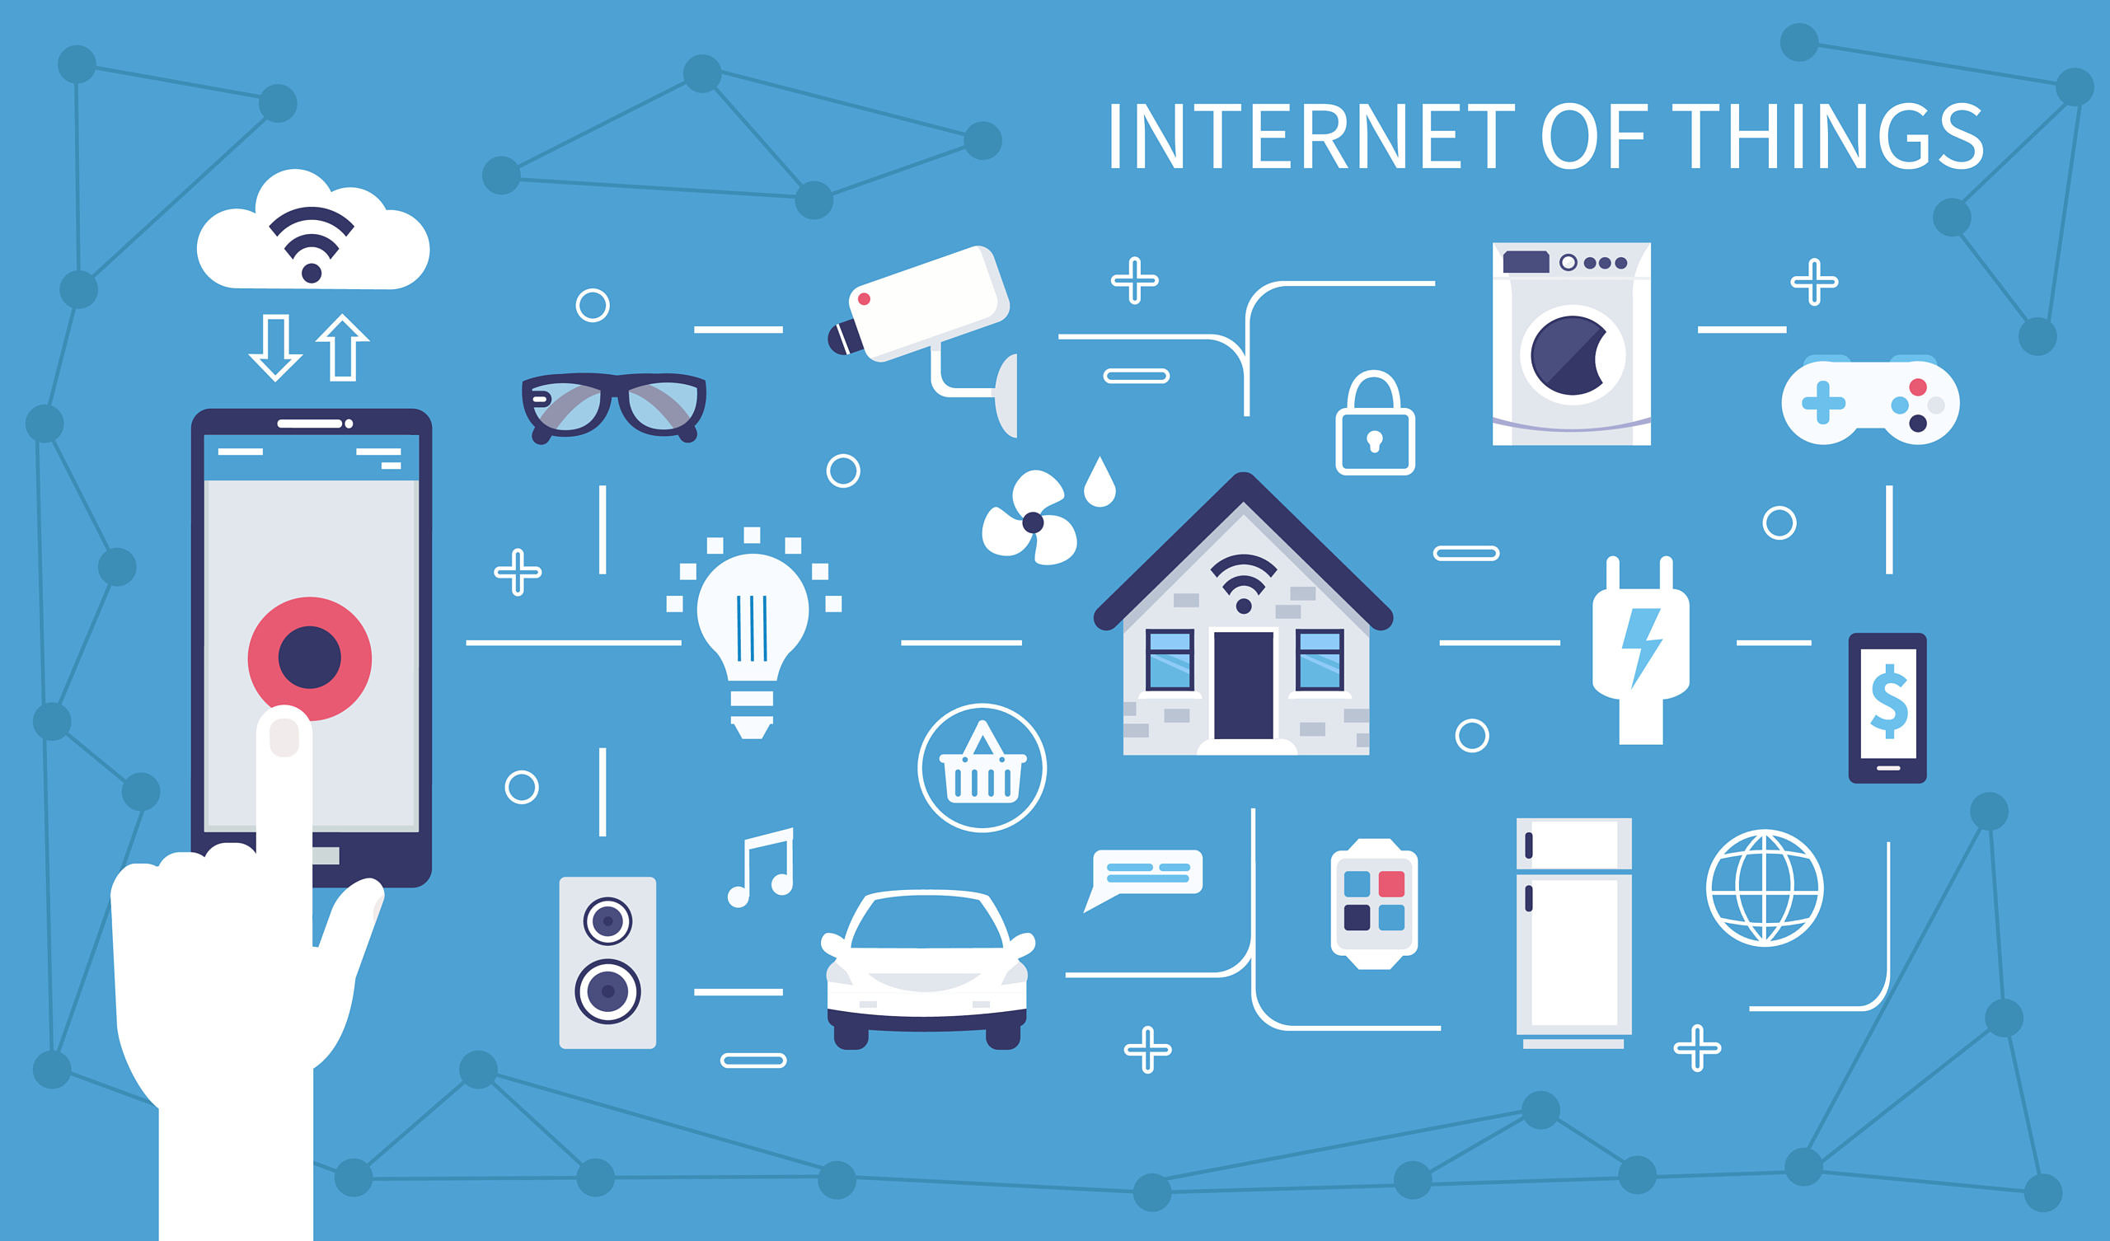
Internet of Things
Notes:
The Internet of Things (IoT) is a network of physical devices that connect to and exchange data with other devices and services over the Internet or other network. There are currently over ten billion connected devices in the world and more are added every year. Anything that can be embedded with the necessary sensors and software can be connected over the internet.

Slide 9



Azure Internet of Things
Internet of Things (IoT) is the ability for devices to garner and then relay information for data analysis.
Azure IoT Central
Azure IoT Hub
Azure Sphere
Notes:
Azure IoT Central -- is a fully-managed global IoT SaaS solution that makes it easy to connect, monitor, and manage your IoT assets at scale.
Azure IoT Hub -- is a managed service hosted in the cloud that acts as a central message hub for bidirectional communication between your IoT application and the devices it manages.
Azure IoT Sphere -- is a comprehensive IoT security solution—including hardware, OS, and cloud components.

Slide 10
Azure IoT Hub
Azure IoT Hub is a managed service hosted in the cloud that acts as a central message hub for communication between an IoT application and its attached devices.
Notes:
Azure IoT Hub is a managed service hosted in the cloud that acts as a central message hub for communication between an IoT application and its attached devices. You can connect millions of devices and their backend solutions reliably and securely. Almost any device can be connected to an IoT hub.

Slide 11
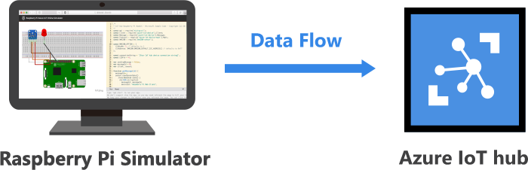
Demo 1: Connect devices to Azure IoT Hub

Slide 12
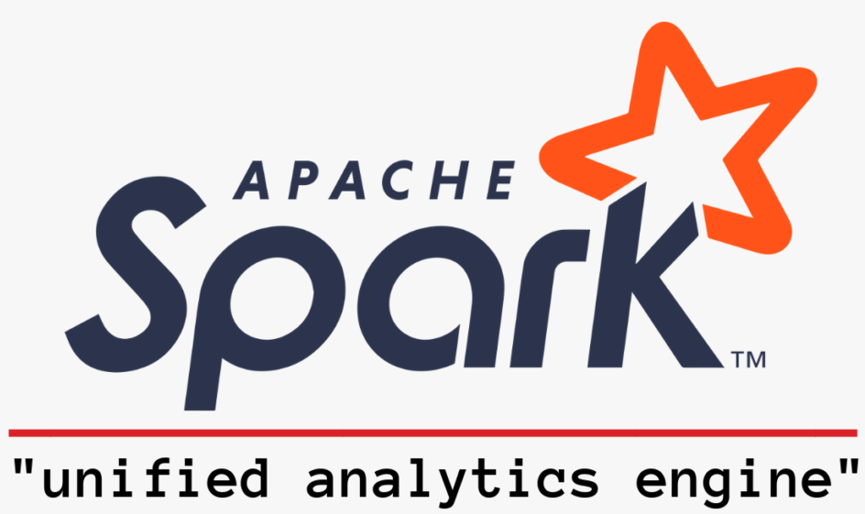
Apache Spark
Apache Spark is an open-source, distributed processing system used for big data workloads. It utilizes in-memory caching, and optimized query execution for fast analytic queries against data of any size.
It provides development APIs in Java, Scala, Python and R, and supports code reuse across multiple workloads—batch processing, interactive queries, real-time analytics, machine learning, and graph processing.
Notes:
Apache Spark is an open-source, distributed processing system used for big data workloads. It utilizes in-memory caching, and optimized query execution for fast analytic queries against data of any size. It provides development APIs in Java, Scala, Python and R, and supports code reuse across multiple workloads—batch processing, interactive queries, real-time analytics, machine learning, and graph processing.
How does Apache Spark work?
Hadoop MapReduce is a programming model for processing big data sets with a parallel, distributed algorithm. Developers can write massively parallelized operators, without having to worry about work distribution, and fault tolerance. However, a challenge to MapReduce is the sequential multi-step process it takes to run a job. With each step, MapReduce reads data from the cluster, performs operations, and writes the results back to HDFS. Because each step requires a disk read, and write, MapReduce jobs are slower due to the latency of disk I/O.
Spark was created to address the limitations to MapReduce, by doing processing in-memory, reducing the number of steps in a job, and by reusing data across multiple parallel operations. With Spark, only one-step is needed where data is read into memory, operations performed, and the results written back—resulting in a much faster execution. Spark also reuses data by using an in-memory cache to greatly speed up machine learning algorithms that repeatedly call a function on the same dataset. Data re-use is accomplished through the creation of DataFrames, an abstraction over Resilient Distributed Dataset (RDD), which is a collection of objects that is cached in memory, and reused in multiple Spark operations. This dramatically lowers the latency making Spark multiple times faster than MapReduce, especially when doing machine learning, and interactive analytics.

Slide 13
Spark Framework
Prog. Inter
Scala
Java
Python
R
Library
SQL
ML Lib
Graph X
Streaming
Engine
Spark Core
Platforms
YARN
MESOS
Scheduler
Standalone
Storage
Local
HDFS
HBase
RDBMS
NoSQL
AWS S3
Azure Blob Storage / Data Lake Store

Slide 14
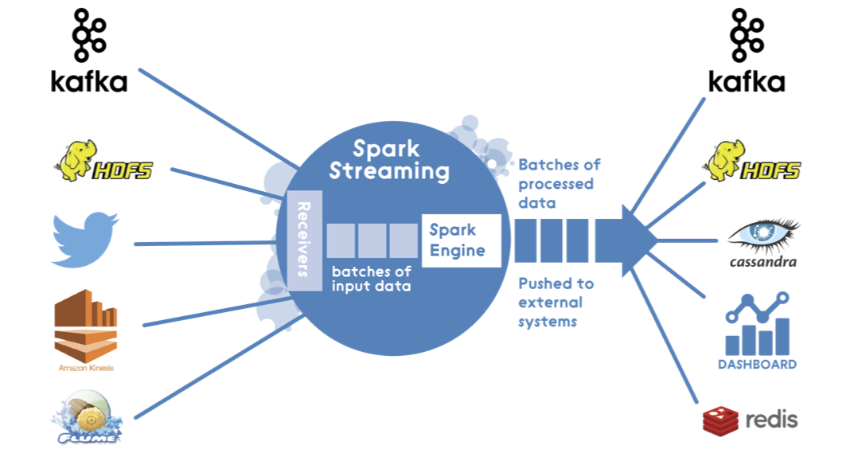
What is Spark Streaming?
Spark Streaming is a scalable fault-tolerant streaming processing system that natively supports both batch and streaming workloads.
Spark Streaming is an extension of the core Spark API that allows data engineers and data scientists to process real-time data from various sources.
Notes:
Apache Spark Streaming is a scalable fault-tolerant streaming processing system that natively supports both batch and streaming workloads. Spark Streaming is an extension of the core Spark API that allows data engineers and data scientists to process real-time data from various sources including (but not limited to) Kafka, Flume, and Amazon Kinesis. This processed data can be pushed out to file systems, databases, and live dashboards.

Slide 15
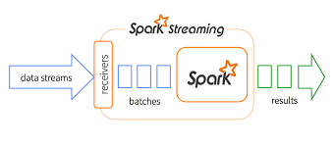
Why Spark Streaming?
One of the real powers of Spark
Typically analytics is performed on data at rest:
Databases, Flat files. The historical data, survey data etc.
The real time analytics is performed on data the moment generated
Complex Event Processing, Fraud detections, click stream processing etc.
What Spark Stream can do?
Look at data the moment it is arrived from source.
Transform, summarize, analyze
Perform machine learning
Prediction in real time

Slide 16





Real time Analytics in Azure
Azure Synapse Analytics
Azure HDInsight
Azure Databricks
Azure Stream Analytics
Azure Data Explorer

Slide 17
Azure Databricks
Is a platform that provides a unified set of tools for building, deploying, sharing, and maintaining enterprise-grade data solutions at scale.
Azure Databricks integrates with cloud storage and security in your cloud account, and manages and deploys cloud infrastructure on your behalf.
This platform’s architecture is composed of two primary parts: the infrastructure used by Azure Databricks to deploy, configure, and manage the platform and services, and the customer-owned infrastructure managed in collaboration by Azure Databricks and your company.
Notes:
The Azure Databricks Lakehouse Platform provides a unified set of tools for building, deploying, sharing, and maintaining enterprise-grade data solutions at scale. Azure Databricks integrates with cloud storage and security in your cloud account, and manages and deploys cloud infrastructure on your behalf.
The Azure Databricks platform architecture is composed of two primary parts: the infrastructure used by Azure Databricks to deploy, configure, and manage the platform and services, and the customer-owned infrastructure managed in collaboration by Azure Databricks and your company.
Unlike many enterprise database companies, Azure Databricks does not force you to migrate your data into proprietary storage systems in order to use the platform. Instead, you configure an Azure Databricks workspace by configuring secure integrations between the Azure Databricks platform and your cloud account, and then Azure Databricks deploys ephemeral compute clusters using cloud resources in your account to process and store data in object storage and other integrated services you control.
Unity Catalog further extends this relationship, allowing you to manage permissions for accessing data using familiar SQL syntax from within Azure Databricks.
Azure Databricks has deployed workspaces that meet the security and networking requirements of some of the world’s largest and most security-minded companies. Azure Databricks makes it easy for new users to get started on the platform, and removes many of the burdens and concerns of working with cloud infrastructure from end users, but does not limit the customizations and control experienced data, operations, and security teams require.

Slide 18
What is Azure Databricks used for?
Azure Databricks workspace provides user interfaces for many core data tasks, including tools for the following:
Interactive notebooks
Workflows scheduler and manager
SQL editor and dashboards
Data ingestion and governance
Data discovery, annotation, and exploration
Compute management
Machine Learning (ML) experiment tracking
ML model serving
Feature store
Source control with Git
Notes:
Our customers use Azure Databricks to process, store, clean, share, analyze, model, and monetize their datasets with solutions from BI to machine learning. You can use the Azure Databricks platform to build many different applications spanning data personas. Customers who fully embrace the lakehouse take advantage of our unified platform to build and deploy data engineering workflows, machine learning models, and analytics dashboards that power innovations and insights across an organization.
The Azure Databricks workspace provides user interfaces for many core data tasks, including tools for the following:
Interactive notebooks
Workflows scheduler and manager
SQL editor and dashboards
Data ingestion and governance
Data discovery, annotation, and exploration
Compute management
Machine learning (ML) experiment tracking
ML model serving
A feature store
Source control with Git

Slide 19

Maven library
Maven is an automation and management tool developed by Apache Software Foundation.
It is written in Java Language to build projects written in C#, Ruby, Scala, and other languages.
It allows developers to create projects, dependency, and documentation using Project Object Model and plugins.
Notes:
Maven is an automation and management tool developed by Apache Software Foundation. It is written in Java Language to build projects written in C#, Ruby, Scala, and other languages. It allows developers to create projects, dependency, and documentation using Project Object Model and plugins. It has a similar development process as ANT, but it is more advanced than ANT.
Why use Maven?
Maven is chiefly used for Java-based projects, helping to download dependencies, which refers to the libraries or JAR files. The tool helps get the right JAR files for each project as there may be different versions of separate packages.
After Maven, downloading dependencies doesn’t require visiting the official websites of different software. You can visit mvnrepository to find libraries in different languages. The tool also helps to create the right project structure in struts, servlets, etc., which is essential for execution.

Slide 20
Demo 2: Ingest data coming from Azure IoT Hub into Azure Databricks
Azure Databricks

Slide 21

What is Delta Lake?
Delta Lake is the optimized storage layer that provides the foundation for storing data and tables in the Databricks Lakehouse Platform.
It is fully optimized with Apache Spark APIs, and was developed for tight integration with Structured Streaming.
The most important feature of Delta Lake is that it has ACID properties with the strongest isolation.
It is the default storage format for all operations in Azure Databricks.
Notes:
It’s an open-source project that allows building Lake House Architecture on the top of Data Lakes like HDFS, S3, ADLS, GCS using compute engines like Spark, Flink, PrestoDB, Trino through APIs of languages like Java, Python, Scala, SQL, Rust, Ruby and so on.
Delta Lake is the optimized storage layer that provides the foundation for storing data and tables in the Databricks Lakehouse Platform.
Delta Lake is fully compatible with Apache Spark APIs, and was developed for tight integration with Structured Streaming, allowing you to easily use a single copy of data for both batch and streaming operations and providing incremental processing at scale.

Slide 22
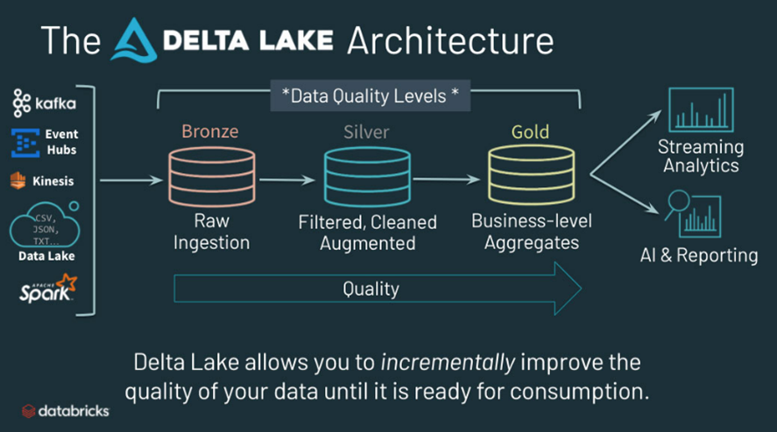
Delta Lake Architecture
Notes:
In a typical Data Processing Pipeline, data changes its shape as it passes through different processing stages. After ingesting data from the Data Source, different operations like Data Cleaning, de-duplicating, enriching, transforming and converting into a dimensional model are the inevitable steps to carry out before being brought for actual analytical processing. This leads to have layers of maturity levels across the data pipeline. The Databricks Delta Lake has suggested and used the following levels of maturity.
The Bronze Layer: The layer contains the raw data ingested directly from Source Files. The structure of these tables thus resembles the structure of ingested data from Data Source. The data exist here is in the pre-state of cleaning and further processing of data. The Bronze tables represent data in the ‘Delta’ format irrespective of the format of the ingested data (JSON, Parquet, Avro, ORC). The tables in the Bronze Layer are further enriched by cleaning, de-duplicating, transforming, wrangling to get a new version of data which is called as Silver Layer.
The Silver Layer: The layer contains tables having cleaned and enriched data thereby offering a refined view of data. It may be necessary to do look-up, joins with other Bronze/Silver tables, updates and so on to prepare the Data Model in this layer. The Silver Layer represents the data up-to-date for analytical processing.
The Gold Layer: The data from the silver layer will be converted into Dimensional Model, aggregation to represent a Gold Layer. The aggregation done here can be used further for reporting, business processing and Dashboard designing by end-user or other applications.

Slide 23

Demo 3: Ingest data coming from Azure Databricks to Delta Lake
Azure Databricks

Slide 24
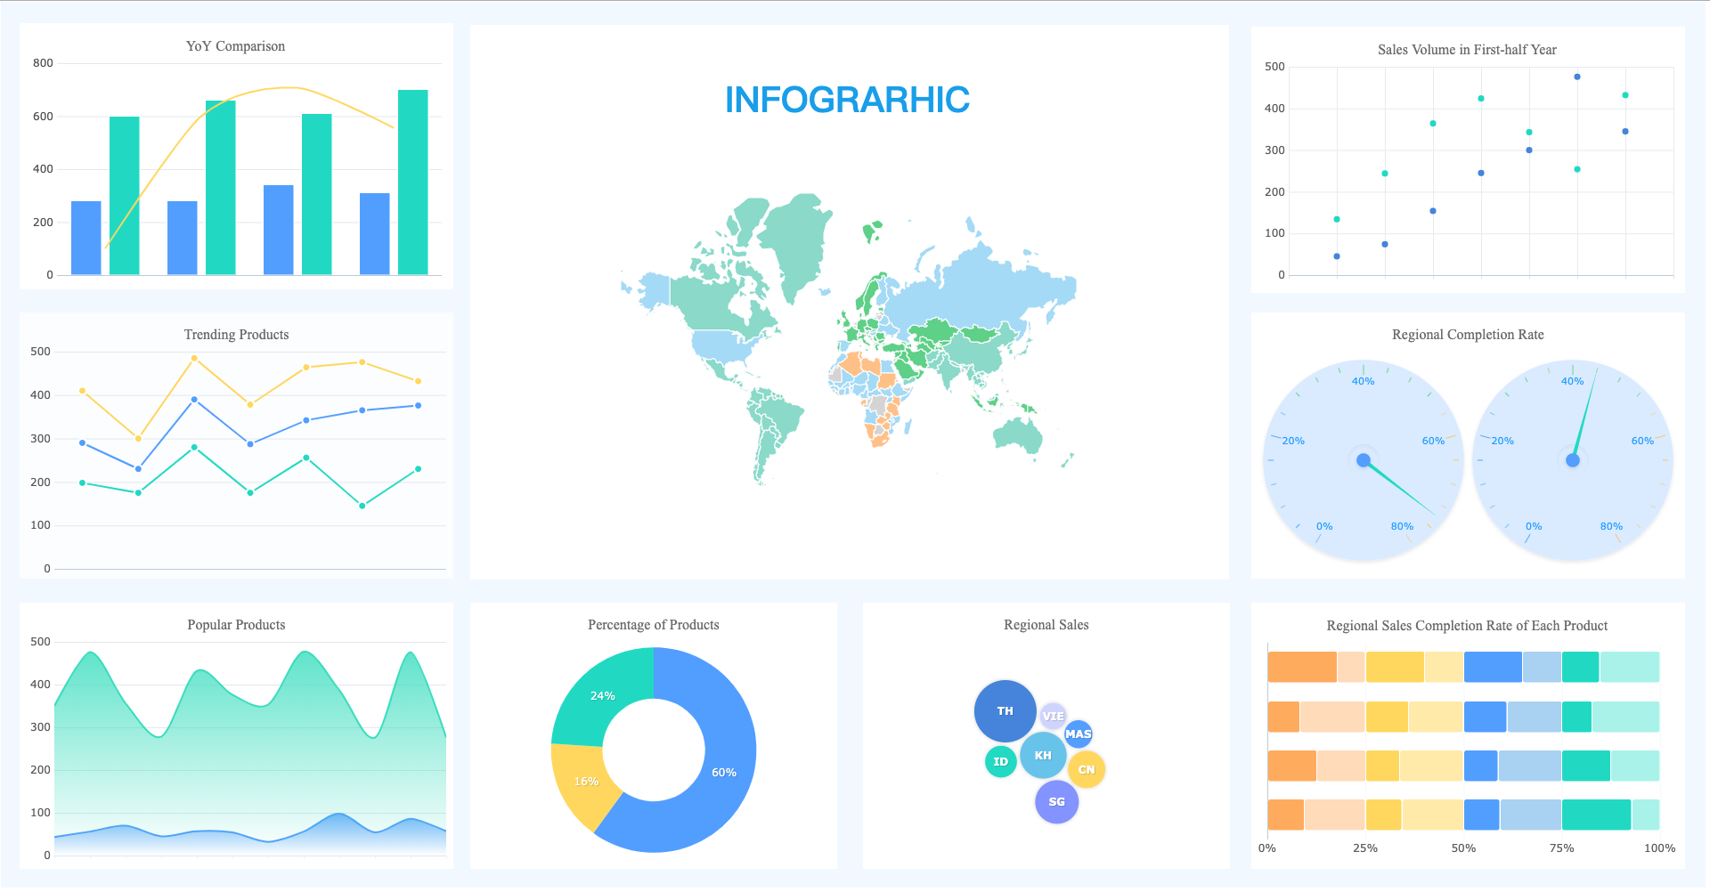
What is data visualization?
Data visualization is the representation of data through use of common graphics, such as charts, plots, infographics, and even animators.
These visual displays of information communicate complex data relationships and data-driven insights in a way that is easy to understand.
Notes:
Data visualization is the representation of data through use of common graphics, such as charts, plots, infographics, and even animations. These visual displays of information communicate complex data relationships and data-driven insights in a way that is easy to understand.
Data visualization is a critical step in the data science process, helping teams and individuals convey data more effectively to colleagues and decision makers. Teams that manage reporting systems typically leverage defined template views to monitor performance.

Slide 25
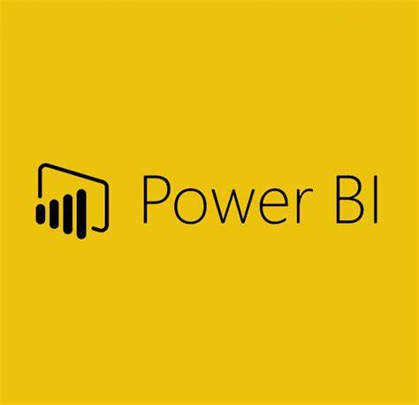
Power BI
Power BI is a collection of software services, apps, and connectors that work together to turn your unrelated sources of data into coherent, visually immersive, and interactive insights.
Power BI consists of three elements:
Power BI Desktop
Power BI Service
Power BI Mobile App
Notes:
Power BI is a collection of software services, apps, and connectors that work together to turn your unrelated sources of data into coherent, visually immersive, and interactive insights. Your data might be an Excel spreadsheet, or a collection of cloud-based and on-premises hybrid data warehouses. Power BI lets you easily connect to your data sources, visualize and discover what's important, and share that with anyone or everyone you want.
Power BI consists of several elements that all work together, starting with these three basics:
A Windows desktop application called Power BI Desktop.
An online software as a service (SaaS) service called the Power BI service.
Power BI Mobile apps for Windows, iOS, and Android devices.

Slide 26
Demo 4: Visualize data using Power BI
Azure Databricks

Slide 27
Thank You

