Slide 1
ONNX
SMIT SHAH

Slide 2
What is ONNX
ONNX (Open Neural Network Exchange Format) is a format designed to represent any type of Machine Learning and Deep Learning model.
Examples of supported frameworks: PyTorch, TensorFlow, Keras, SAS, Matlab, and many more.
Easy to convert models from one framework to another.
The main goal is to bring together all the different AI frameworks and make as easy as possible to make them communicate with each other in order to build better models which can be supported on any type of platform or hardware.

Slide 3
Why ONNX ?
The Open Neural Network eXchange (ONNX) is an open format designed to represent any type of machine learning or deep learning model.
The result of a machine learning training is a model file that represents the relationship between the input data and output predictions.
These models can be trained using various frameworks including PyTorch, TensorFlow, and Caffe, to name a few.
Each of these frameworks generates trained models in different formats making them non-portable for use in a variety of software environments.
ONNX format allows for framework interoperability by providing a uniform format that acts as an intermediate between machine learning frameworks.
This interoperability allows trained models to be easily deployed in different software platforms.

Slide 4
ONNX Runtime
It is an open-source inference engine for executing ONNX models.
High-performance and lightweight,
Support wide range of hardware platforms for deployment…
Edge devices,
Servers
Cloud services.
The ONNX Runtime provides a C++ API, a C# API, and a Python API for executing ONNX models.
It also provides support for multiple backends, including CUDA and OpenCL, which allows it to run on a wide range of hardware platforms, such as NVIDIA GPUs and Intel CPUs.

Slide 5
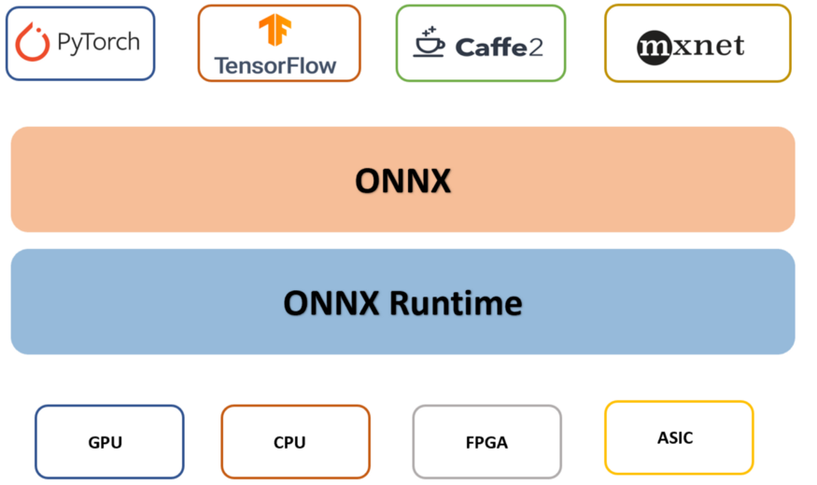
ONNX Runtime
ONNX Runtime can be very useful since you can use models in inference with a single framework no matter what hardware you are going to use.

Slide 6
ONNX Runtime
One of the main advantages of ONNX Runtime is its performance.
It uses various techniques such as Just-In-Time (JIT) compilation, kernel fusion and subgraph partitioning to optimize the performance of the model.
It also supports thread pooling and inter-node communication for distributed deployment which makes it a suitable choice for large-scale deployment.
ONNX Runtime also provides support for a wide range of models, including both traditional machine learning models and deep learning models.
This makes it a versatile inference engine that can be used in a wide range of applications, from computer vision and natural language processing to speech recognition and autonomous vehicles.

Slide 7
Let’s Code
Let’s look at an example now, where we create a Machine Learning model using the classic scikit-learn, and then convert this model to ONNX format so that we can use it with ONNX Runtime.
from sklearn.datasets import load_iris from sklearn.model_selection import train_test_split from sklearn.ensemble import RandomForestClassifier import joblib #import data iris = load_iris() x,y = iris.data, iris.target x_train, x_test, y_train, y_test = train_test_split(x, y) #train and save model clr = RandomForestClassifier() clr.fit(x_train, y_train) joblib.dump(clr, 'model.pkl', compress = 9)

Slide 8
Let’s Code
Now that we have trained and saved the model, we can reimport it and convert it to an ONNX model.
%%capture
!pip install skl2onnx
from skl2onnx import convert_sklearn
from skl2onnx.common.data_types import FloatTensorType
import joblib
clr = joblib.load('model.pkl')
initial_type = [('float_input', FloatTensorType([None, 4]))]
onx = convert_sklearn(clr, initial_types = initial_type)
with open('model.onnx' , 'wb') as f:
f.write(onx.SerializeToString())

Slide 9
Let’s Code
Now that we have the model in ONNX format we can import it and use it on some data to make inferences.
Well, you got your results by leveraging ONNX Runtime. It only took a few simple commands!
%%capture
!pip install onnxruntime
import onnxruntime as rt
import numpy as np
data = np.array([[5.4, 6.3, 2.6, 7.4], [3.4, 6.2, 7.4, 2.3],[5.2, 6.4, 4.2,5.6]])
sess = rt.InferenceSession('model.onnx')
input_name = sess.get_inputs()[0].name
label_name = sess.get_outputs()[0].name
pred_onx = sess.run([label_name], {input_name: data.astype(np.float32)})[0]
print(pred_onx)

Slide 10
ONNX_Lab_01
Contents:
Importing Libraries
Training and Saving the Model
Importing the Saved Model
LAB IMPLEMENTATION

Slide 11
Deep Learning Frameworks

Slide 12



Pytorch Introduction
Tensors and Dynamic neural networks in Python with strong GPU acceleration
Flexible Development
Research-oriented imperative model
Python flow-control constructs
Dynamic graph support with autograd
Released Jan 18th (500,000+ downloads)
2700+ community repos
17,200+ user posts
351 contributors

Slide 13
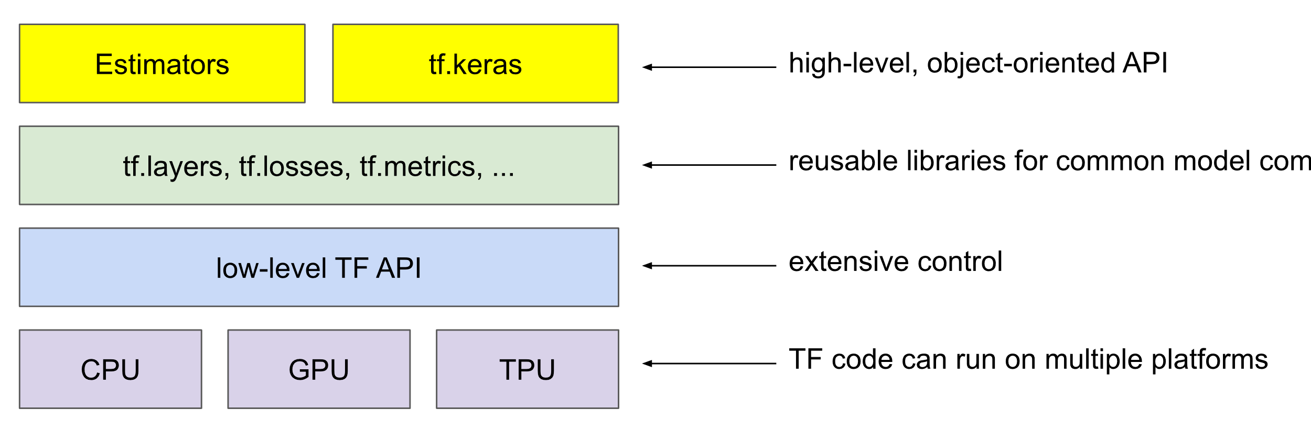
Tensorflow Introduction
TensorFlow is an end-to-end open source platform for machine learning.
TensorFlow is a rich system for managing all aspects of a machine learning system
TensorFlow APIs are arranged hierarchically, with the high-level APIs built on the low-level APIs.
The following figure shows the hierarchy of TensorFlow toolkits:

Slide 14





Research to Production
Reimplementation takes weeks or months

Slide 15
Merge Frameworks
Model transfer is important, but less common
Difficult to optimize the tools for all cases
Separate but interoperable tools is more efficient
Reimplementation takes weeks or months

Slide 16



Shared Model Format

Slide 17
Let’s Code
Import required libraries and classes
import torch
import torch.nn as nn
import torch.nn.functional as F
import torch.optim as optim
from torchvision import datasets, transforms
from torch.autograd import Variable
import onnx
from onnx_tf.backend import prepare

Slide 18
Let’s Code
Define the model
class Net(nn.Module):
def __init__(self):
super(Net, self).__init__()
self.conv1 = nn.Conv2d(1, 10, kernel_size=5)
self.conv2 = nn.Conv2d(10, 20, kernel_size=5)
self.conv2_drop = nn.Dropout2d()
self.fc1 = nn.Linear(320, 50)
self.fc2 = nn.Linear(50, 10)
def forward(self, x):
x = F.relu(F.max_pool2d(self.conv1(x), 2))
x = F.relu(F.max_pool2d(self.conv2_drop(self.conv2(x)), 2))
x = x.view(-1, 320)
x = F.relu(self.fc1(x))
x = F.dropout(x, training=self.training)
x = self.fc2(x)
return F.log_softmax(x, dim=1)

Slide 19
Let’s Code
Code for training and testing the model
def train(model, device, train_loader, optimizer, epoch):
model.train()
for batch_idx, (data, target) in enumerate(train_loader):
data, target = data.to(device), target.to(device)
optimizer.zero_grad()
output = model(data)
loss = F.nll_loss(output, target)
loss.backward()
optimizer.step()
if batch_idx % 1000 == 0:
print('Train Epoch: {} \tLoss: {:.6f}'.format(
epoch, loss.item()))
def test(model, device, test_loader):
model.eval()
test_loss = 0
correct = 0
with torch.no_grad():
for data, target in test_loader:
data, target = data.to(device), target.to(device)
output = model(data)
test_loss += F.nll_loss(output, target, reduction='sum').item() # sum up batch loss
pred = output.max(1, keepdim=True)[1] # get the index of the max log-probability
correct += pred.eq(target.view_as(pred)).sum().item()
test_loss /= len(test_loader.dataset)
print('\nTest set: Average loss: {:.4f}, Accuracy: {}/{} ({:.0f}%)\n'.format(
test_loss, correct, len(test_loader.dataset),
100. * correct / len(test_loader.dataset)))

Slide 20
Let’s Code
Download the datasets and normalize them
train_loader = torch.utils.data.DataLoader(
datasets.MNIST('../data', train=True, download=True,
transform=transforms.Compose([
transforms.ToTensor(),
transforms.Normalize((0.1307,), (0.3081,))
])),
batch_size=64, shuffle=True)
test_loader = torch.utils.data.DataLoader(
datasets.MNIST('../data', train=False, transform=transforms.Compose([
transforms.ToTensor(),
transforms.Normalize((0.1307,), (0.3081,))
])),
batch_size=1000, shuffle=True)
torch.manual_seed(1)
device = torch.device("cuda")
model = Net().to(device)
optimizer = optim.SGD(model.parameters(), lr=0.01, momentum=0.5)
for epoch in range(2):
train(model, device, train_loader, optimizer, epoch)
test(model, device, test_loader)

Slide 21
Let’s Code
Save the Pytorch model
Load the saved Pytorch model and export it as an ONNX file
Load the ONNX file and import it into Tensorflow
torch.save(model.state_dict(), 'mnist.pth')
trained_model = Net()
trained_model.load_state_dict(torch.load('mnist.pth'))
dummy_input = Variable(torch.randn(1, 1, 28, 28))
torch.onnx.export(trained_model, dummy_input, "mnist.onnx")
# Load the ONNX file
model = onnx.load('mnist.onnx')
# Import the ONNX model to Tensorflow
tf_rep = prepare(model)

Slide 22
Let’s Code
Run and test the Tensorflow model
import numpy as np
from IPython.display import display
from PIL import Image
print('Image 1:')
img = Image.open('/content/3.png').resize((28, 28)).convert('L')
display(img)
output = tf_rep.run(np.asarray(img, dtype=np.float32)[np.newaxis, np.newaxis, :, :])
print('The digit is classified as ', np.argmax(output))
print('------------------------------------------------------------------------------')
print('Image 2:')
img = Image.open('/content/7.png').resize((28, 28)).convert('L')
display(img)
output = tf_rep.run(np.asarray(img, dtype=np.float32)[np.newaxis, np.newaxis, :, :])
print('The digit is classified as ', np.argmax(output))

Slide 23
ONNX_Lab_02
Contents:
Importing Libraries
Defining the Model
Training and Testing the Model
Saving the Model
Importing the Saved Model
LAB IMPLEMENTATION

Slide 24
Final Thoughts
ONNX is an open-source standard that makes it easy to move deep learning models between different frameworks and hardware platforms.
It provides a set of tools for optimizing and quantizing models, and it is supported by a wide range of companies and organizations.
As a result, ONNX is becoming an important standard for deep learning, making it easy to share models and deploy them across different platforms.

Slide 25
Thank You

