Slide 1
CLOSED
CAPTIONING
Make content accessible to everyone

Slide 2
TABLE OF CONTENTS
01.
03.
02.
04.
AUTOMATION
DATA MODEL
SECURITY
DEMO & QUESTIONS

Slide 3
01.
DATA MODEL

Slide 4
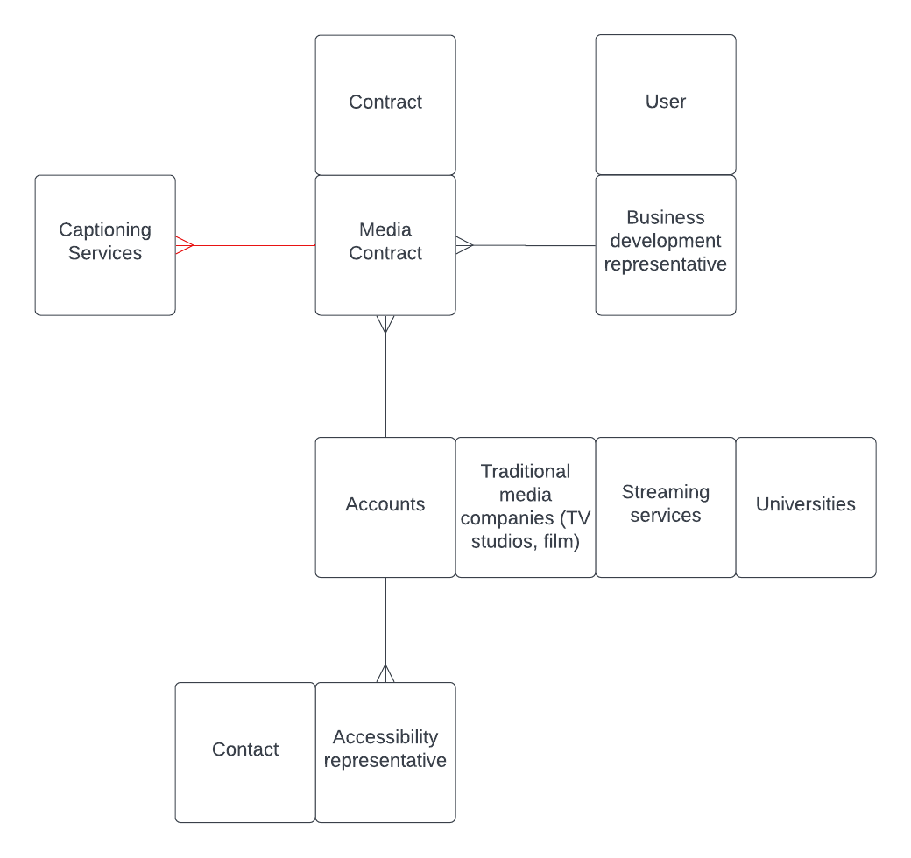

Slide 5
02.
SECURITY

Slide 6
ORG-LEVEL
SECURITY
LOGIN HOURS
No one outside of service staff and administrators are allowed to log in outside of business hours.
IP RANGE RESTRICTIONS
No one outside of support staff and administrators are allowed to log in outside of the IP range.
PASSWORD REQUIREMENTS
15 character minimum with alpha, numeric, and special characters required.

Slide 7
OBJECT LEVEL SECURITY
ACCOUNT DIRECTOR | YES | YES | YES
ACCOUNT MANAGER | YES | PARTIAL | PARTIAL
SUPPORT SPECIALIST | YES | READ ONLY | READ ONLY
CAPTION SERVICE
CASE
CONTRACT

Slide 8
03.
AUTOMATION

Slide 9
FLOWS
SCREEN
BEFORE-SAVE
AFTER-SAVE
Create a media contract & bulk create account
Change the priority of escalated cases
Send an email to the head of Sales whenever a short-term contract is created
AUTO-LAUNCHED
Send a weekly reminder email for Friday review meeting

Slide 10
04.
DEMO

Slide 11
THANKS!
Does anyone have any questions?

