Slide 1

NodeJS

Slide 2
Training Agenda
JavaScript Overview
NodeJS Overview
Modules System
File System
Event System
Express
View Engines
NodeJS Securities
Data Persistence
Socket Programming
Microservices

Slide 3
Prerequisites:
Basic knowledge of HTML, CSS & JavaScript
Interest to Learn

Slide 4
JavaScript Overview
Light-Weight
Scripting Language
Interpreter Based
Event driven
Single Threaded

Slide 5
JavaScript Building Blocks
Functions
Function Expressions
HOF
Nested Functions
IIFE
Objects Creation Methods
Literal
Constructor
Instance

Slide 6
NodeJS
“Node.js is a platform built on Chrome's JavaScript runtime for easily building fast and scalable network applications. Node.js uses an event-driven, non-blocking I/O model that makes it lightweight and efficient, perfect for data-intensive real-time applications that run across distributed devices.”

Slide 7
NodeJS : Features
Extremely fast
I/O is Asynchronous
Event Driven
Single threaded
Highly Scalable
Open source

Slide 8
NodeJS Process Model
Node.js runs in a single process and the application code runs in a single thread.
All the user requests to web application will be handled by a single thread and all the I/O work or long running job is performed asynchronously for a request.
An event loop is constantly watching for the events to be raised for an asynchronous job and executing callback function when the job completes.
Internally, Node.js uses libuv for the event loop which in turn uses internal C++ thread pool to provide asynchronous I/O.

Slide 9
Node Package Manager
Commands | Description
npm install | Install the packages/ dependencies
npm uninstall | Uninstall the packages/dependencies
npm config get/set | Get /set the npm eco-system
npm update | Update the project dependencies
npm ls | List down the dependencies
npm search | Search the listed package on npm registry
npm init | Generates package.json file in local project directory
NPM is the eco-system to manage the project dependencies

Slide 10
NodeJS : Module System
Use of imports/exports for importing and exporting the modules in application.
Following are a few salient points of the module system:
Each file is its own module.
Each file has access to the current module definition using the module variable.
The export of the current module is determined by the module.exports variable.
To import a module, use the globally available require function.

Slide 11
NodeJS : Require Function
The Node.js require function is the main way of importing a module.
The require function blocks further code execution until the module has been loaded.
Call require() based on some condition and therefore load the module on-demand
After the first time a require call is made to a particular file, the module.exports is cached.
Module allows you to share in-memory objects between modules.
Treats module as an object factory

Slide 12

NodeJS : Module System
If something is a core module, return it.
If something is a relative path (starts with ‘./’ , ‘../’) return that file OR folder.
If not, look for node_modules/filename or node_modules/foldername each level up until you find a file OR folder that matches something.
If it matched a file name, return it. If it matched a folder name and it has package.json with main, return that file.
If it matched a folder name and it has an index file, return it.

Slide 13
NodeJS : Few Core Modules
path
os
event
utils
http
fs
and many more

Slide 14
NodeJS: Working with File System
Node.js includes fs module to access physical file system.
The fs module is responsible for all the asynchronous or synchronous file I/O operations.

Slide 15

Task – Notes App
Notes App should provide following features -
User should be able to run command from command prompt to create, read, delete and list the notes.
Should use local file storage
Should use terminal colors
Commands to run -
> node index.js add --title="New Title" --body="New Title Body"
> node index.js read --title="Some Title"
> node index.js remove --title="Some Title"
> node index.js list

Slide 16
NodeJS : Built-in Global Variables
Console
The console plays an important part in quickly showing what is happening in your application when you need to debug it.
Timers
setTimeout only executes the callback function once after the specified duration. But setInterval calls the callback repeatedly after every passing of the specified duration.
__filename and __dirname
These variables are available in each file and give you the full path to the file and directory for the current module.
Process
Use the process object to access the command line arguments. Used to put the callback into the next cycle of the Node.js event loop.
Buffer
Native and fast support to handle binary data

Slide 17
NodeJS : Event System
EventEmitter is a class designed to make it easy to emit events and subscribe to raised events.
Subscribing :
built-in support for multiple subscribers is one of the advantages of using events.
Unsubscribing :
EventEmitter has a removeListener function that takes an event name followed by a function object to remove from the listening queue.
EventEmitter provides a function `once` that calls the registered listener only once.
EventEmitter has a member function listeners, that takes an event name and returns all the listeners subscribed to that event.
Memory Leak : A common cause of memory leak is forgetting to unsubscribe for the event.
A number of classes inside core Node.js inherit from EventEmitter.

Slide 18
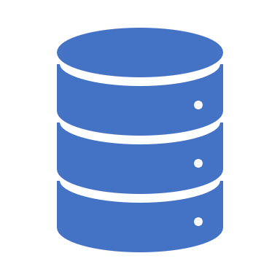
Buffers & Streams
Streams play an important role in creating performant web applications.
Main motivation behind steams -
Improvement in user experience
better utilization of server resources
All of the stream classes inherit from a base abstract Stream class which in turn inherits from EventEmitter.
All the streams support a pipe operation that can be done using the pipe member function.

Slide 19
NodeJS : Streams (Cntd…)
Readable
A readable stream is one that you can read data from but not write to.
Process. stdin, which can be used to stream data from the standard input.
Writable
A writable stream is one that you can write to but not read from.
Process.stdout, which can be used to stream data to the standard output.
Transform
A transform stream is a special case of a duplex stream where the output of the stream is in some way computed from the input.
Encryption and compression streams.
Duplex
A duplex stream is one that you can both read from and write to.
Network socket. You can write data to the network socket as well as read data from it.

Slide 20
Express Fast, unopinionated, minimalist web framework
Web application framework for Node apps.
Express can accept middleware using the ‘use’ function which can be registered with http.createServer.
Express Request / Response objects are derived from standard NodeJS http Request / Response
Request object can handle URL : Route Parameter & Querystrings
Express Router is used to mount middlewares and access all REST APIs

Slide 21
Task – Weather App
Weather App should provide following features -
User should be able to see the weather of the provided location.
Should use mapbox API
Should use Darksky API

Slide 22
Data Persistence
Why NoSQL ?
– Scalability
– Ease of Development
NoSQL servers can be placed into four broad categories:
Document databases (e.g. MongoDB)
Key-value databases (e.g. Redis)
Column-family databases (e.g. Cassandra)
Graph databases (e.g. Neo4J)

Slide 23

MongoDB
A MongoDB deployment consists of multiple databases.
Each database can contain multiple collections.
A collection is simply a name that you give to a collection of documents.
Each collection can contain multiple documents.
A document is effectively a JSON document
> npm install mongodb

Slide 24
Mongoose
Mongoose provides a straight-forward, schema-based solution to model your application data.
It includes built-in type casting, validation, query building, business logic hooks and more, out of the box.
> npm install mongoose

Slide 25
Task – REST API : Todo App
Todo App should provide following API
METHOD | API | Description
GET | /todos | Get all todo items
POST | /todos | Create todo item
GET | /todos/{id} | Get single todo item
PATCH | /todos/{id} | Update single todo item
DELETE | /todos/{id} | Delete single to item

Slide 26
NodeJS : Securities
A JSON Web Token (JWT), defines an explicit, compact, and selfcontaining secured protocol for transmitting restricted information.
The JWT Claims Set represents a compact URL-safe JSON object, that is base64url encoded and digitally signed and/or encrypted.
The JSON object consists of zero or more name/ value pairs, where the names are strings and the values are arbitrary JSON values.

Slide 27
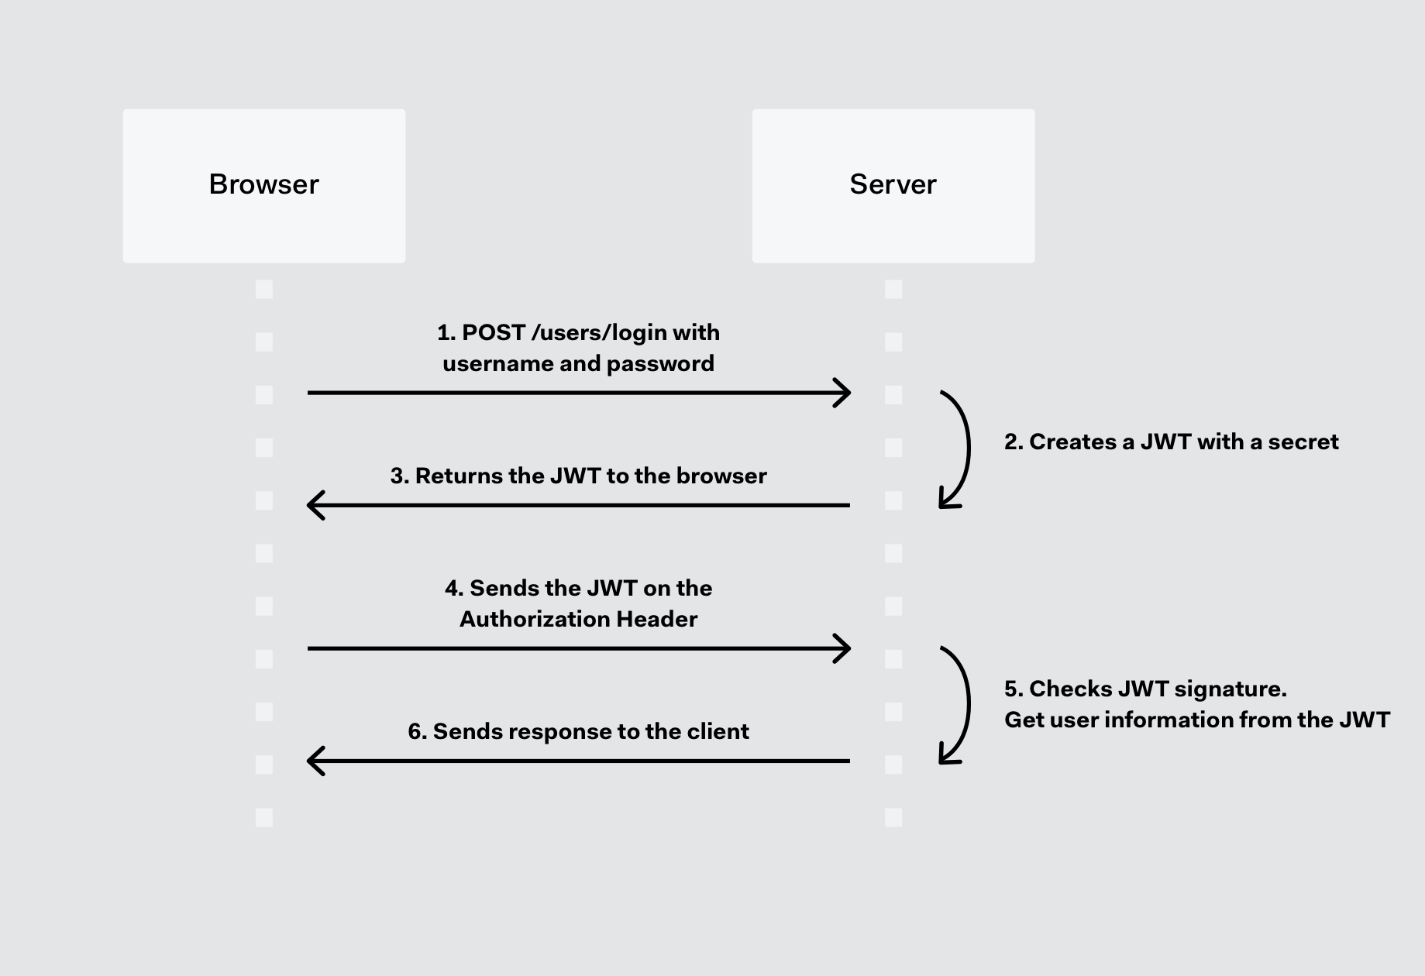
JWT : Understanding

Slide 28
View Engines
Jade
Uses whitespace and indentation as a part of the syntax.
Handlebar
Developers can’t write a lot of JavaScript logic inside the templates.
EJS
Follows JavaScript-ish syntax. Embed JavaScript code in template. Commonly used.
Vash
Vash is a template view engine that uses Razor Syntax. Look familiar to people who have experience in ASP.Net MVC.

Slide 29

Testing
Mocha
Feature-rich JavaScript test framework
Simple Asynchronous Testing API
Chai
Chai is a BDD / TDD assertion library for node
Can be paired with any Javascript testing framework

Slide 30
References
Books
NodeJS by Basarat Ali Syed
Web
Node.JS Web Development by David Herron
https://nodejs.org
http://npmjs.com
https://github.com/mongodb/node-mongodb-native
https://mongoosejs.com/docs/api.html
http://expressjs.com/
https://stackoverflow.com

