Slide 1

Angular
Superheroic framework

Slide 2
Training Agenda
TypeScript : Introduction
Angular : Introduction
Angular Building Blocks
Component
Modules
Directives
Services
Pipes
Data Binding
Forms
HTTP
Routing
Authentication / Authorization
Security
Deployment

Slide 3
Why Angular ?
Angular is easy
ES2015+ features
Corporate Care-taker
Performance and Mobile
Project architecture and Maintenance
Component based architecture

Slide 4
AngularJS vs. Angular
Description | AngularJS | Angular
Nested scopes ($scope, watches) | Used heavily | Gone
Directive vs controllers | Used together | Component directives
Component and service implementations | Functions | ES6 classes
Module system | Angular’s modules | ES6 module system
Transpilation | Not used | Typescript

Slide 5
What is Angular ?
Angular is a structural framework for dynamic (SPA) web apps.
01
Extension of standard HTML markups.
02
Keeps the front-end clean; separation of concerns.
03

Slide 6
Why Typescript ?
Microsoft extension for JS
Object oriented features
ES6+ features
Type definition
Angular itself programmed in TS

Slide 7
TypeScript features
Classes & Inheritance
Module system
Arrow functions
Template String
Constants and block scopes
Destructuring
Spread & Rest operators
Decorators
Additional types

Slide 8
Understanding Angular Environment Setup
Node
TypeScript
SystemJS / Webpack
Angular Packages
RxJS
ZoneJS

Slide 9
Components
A component controls a patch of screen real estate that we could call a view, and declares reusable UI building blocks for an application.
Passing data into components
Property binding
Event binding
Two way data-binding
Nested components
Data projection
Component types :
Smart components
Dump components

Slide 10
Component Life Cycle
ngOnChanges - called when an input binding value changes
ngOnInit - after the first ngOnChanges
ngDoCheck - after every run of change detection
ngAfterContentInit - after component content initialized
ngAfterContentChecked - after every check of component content
ngAfterViewInit - after component's view(s) are initialized
ngAfterViewChecked - after every check of a component's view(s)
ngOnDestroy - just before the component is destroyed

Slide 11
Directives
A Directive modifies the DOM to change appearance, behavior or layout of DOM elements.
Directive Types :
Component Directive : directive with template
Attribute Directive : directives that change the behavior of a component or element but don't affect the template
Structural Directives : directives that change the behavior of a component or element by affecting how the template is rendered

Slide 12
Pipes
Pipes are used to filter/format data for template
Built-in Pipes :
Currency
Date
Uppercase
Lowercase
Number
JSON
Percent
Async
Custom pipes
Pure
Impure

Slide 13
Forms
Template Driven Forms
Angular infers the Form Object from the DOM
Model Driven Forms
Form is created programmatically and sync with the DOM
Use of FormControl, FormGroup, FormBuilder
App logic resides inside the template
App logic resides inside the component

Slide 14
DI & Services
Angular's DI system is controlled through @NgModule.
Services implement DI concepts in an Angular App.
Services are simple ES6 classes.
Services are registered with Angular App using providers.
Services are Singleton.

Slide 15
Hierarchical Injector
Root Module
Same instance of service is available Application-wide
Root Component
Same instance of service is available for all components (but not for other services)
Other Component
Same instance of service is available for the component and it’s own child components

Slide 16
HTTP
Http is Angular's mechanism for communicating with a remote server over HTTP.
To make Http available everywhere in the app :
Open the root Module
Import the HttpModule symbol from @angular/http
Add it to the @NgModule.imports array

Slide 17
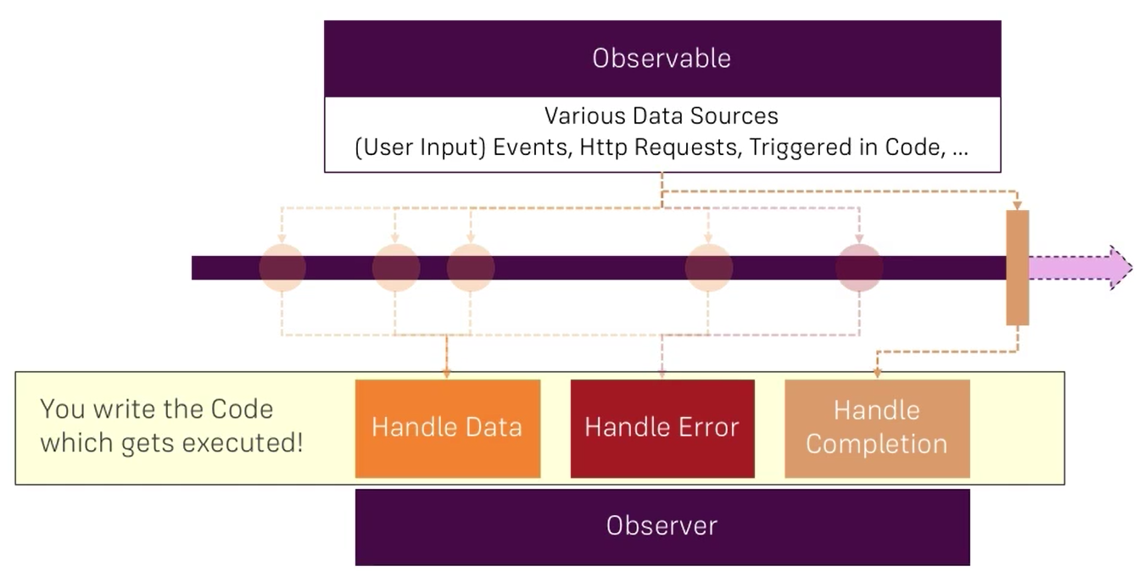
Observables : An Overview

Slide 18
HttpClient
The HttpClient in @angular/common/http offers a simplified client HTTP API for Angular applications that rests on the XMLHttpRequest interface exposed by browsers.
Benefits of HttpClient:
Typed request and response objects
Request and response interception
Observable APIs
Streamlined error handling.

Slide 19
HttpClient : Unlocking
Open the root AppModule
Import the HttpClientModule symbol from @angular/common/http
Add it to the @NgModule.imports array

Slide 20
Routing
Routing allows to:
Maintain the state of the application
Implement modular applications
Implement the application based on the roles (certain roles have access to certain URLs)
5 steps routing:
Checking the base href tag in index file
Configuring routes with components
Tell angular about routing app
Setting up the routing links
Provide space on template to load the component

Slide 21
Routing (Cntd..)
Programmatic navigation
Child routing
Routes with parameters
Route guard (Authentication)
Query Parameters

Slide 22
Modules
A module is a mechanism to group components, directives, pipes and services that are related
Module Types -
Root Module : one per application
Feature Module : depends on application features
Modules can be instantiate lazily

Slide 23
Deployment Steps :
Build the App
Consider AOT Compilation
Set the correct <base>
Domain name with App Directory
Server should return index file
Servers would not know the routes

Slide 24
Debugging Angular Apps
Prevent Bugs with TypeScript
Using Debugger Statements to Stop JavaScript Execution
Inspect Data with the JSON pipe
Console Debugging
Augury Chrome Plugin
Debugging RxJS Observables using ‘do’ operator

Slide 25
Securing Angular Apps
Best Practices :
Keep current with the latest Angular library releases
Don't modify your copy of Angular.
Avoid Angular APIs marked in the documentation as “Security Risk.”
Preventing cross-site scripting (XSS)
Angular treats all values as untrusted by default.
Angular sanitizes and escapes untrusted values.
Interpolated content is always escaped
Angular recognizes the binded value as unsafe and automatically sanitizes it
Never generate template source code by concatenating user input and templates, instead use the offline template compiler (template injection)

Slide 26
Securing Angular Apps
Avoid direct use of DOM APIs
The built-in browser DOM APIs don't automatically protect you from security vulnerabilities
Content security policy
To enable CSP, configure your web server to return an appropriate Content-Security-Policy HTTP header
Use the offline template compiler
Use the offline template compiler in production deployments; don't dynamically generate templates.
Server-side XSS protection
Don't generate Angular templates on the server side using a templating language; doing this carries a high risk of introducing template-injection vulnerabilities.

Slide 27
Securing Angular Apps
Trusting Safe Values : To mark a value as trusted, inject DomSanitizer and call one of the following methods -
bypassSecurityTrustHtml
bypassSecurityTrustScript
bypassSecurityTrustStyle
bypassSecurityTrustUrl
bypassSecurityTrustResourceUrl
HTTP-level vulnerabilities : Angular has built-in support to help prevent two common HTTP vulnerabilities -
Cross-Site Request Forgery (CSRF or XSRF)
Cross-Site Script Inclusion (XSSI) / JSON vulnerability

Slide 28
Optimizing Angular App Performance
Using onPush change detection strategy
Using trackBy function
Avoid computing values in templates
Using lazy loading
Disable change detection (if required)

Slide 29
References
Books
Rangle’s Angular2 Training Book
Ngbook2
Web
http://angular.io
http://rangle.io
http://www.egghead.io
http://www.youtube.com

