Slide 1
REACT
A JAVASCRIPT LIBRARY FOR BUILDING USER INTERFACES

Slide 2
WHAT IS REACT?
React is a JavaScript library used to build the user interface for web applications
React was developed and maintained by the folks at Facebook
An open source project with an active developer community.
Write less and do more!!

Slide 3
MORE ABOUT REACT APP
In a React application, you should break down your site, page or feature into smaller pieces of components. It means that your site will be built by the combination of different components. These components are also built on the top of other components and so on.

Slide 4
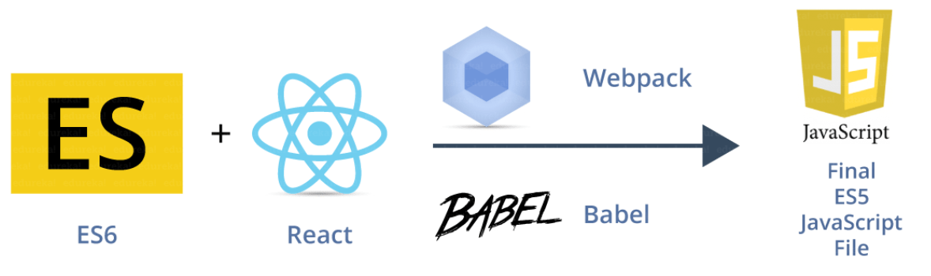
KEY TERMINOLOGIES

Slide 5
KEY TERMINOLOGIES
JSX (JavaScript Extension)
JSX Allows us to include ‘HTML’ in the same file along with ‘JavaScript’ (HTML+JS=JSX). Each component in React generates some HTML which is rendered by the DOM
ES6 (ES2015)
The sixth version of JavaScript is standardized by ECMA International in 2015. Hence the language is referred to as ECMAScript.
ES5(ES2009)
The fifth JavaScript version and is widely accepted by all modern browsers,
Webpack
A module bundler which generates a build file joining all the dependencies
Babel
This is the tool used to convert ES6 to ES5. This is done because not all web browsers can render React (ES6+JSX) directly.

Slide 6
WHY REACT?
Easy to understand for developers with the knowledge of XML/HTML
UI state becomes difficult to handle with Vanilla JavaScript
High Performant Apps
Huge Ecosystem
Active community
Easy to test

Slide 7
REACT INTERNALS
UNDERSTANDING REACT INTERNALLY

Slide 8
REACT INTERNALS - VIRTUAL DOM
Virtual DOM is in memory lightweight representation of actual DOM.
For every DOM object, there is a corresponding Virtual DOM object.
Pure JS intermediate representation.
React never reads from real DOM, only writes to it.
Manipulating the DOM is slow. Manipulating the virtual DOM is much faster, because nothing gets drawn onscreen.

Slide 9
VIRTUAL DOM UPDATE PROCESS
The virtual DOM gets compared to previous vs current virtual DOM
React figures out what object has changed.
The changed objects, and the changed objects only, get updated on the real DOM.
Changes on the real DOM cause the screen to change.

Slide 10
VIRTUAL DOM IN NUTSHELL
To track down model changes and apply them on the DOM (rendering) we have to be aware of two important things:
When data has changed?
Which DOM element(s) to be updated?
For the change detection, React uses an observer model instead of dirty checking (continuous model checking for changes). That’s why it doesn't have to calculate what is changed, it knows immediately.
For the DOM changing challenge, React builds the tree representation of the DOM in the memory and calculates which DOM element should change.
React tries to keep as much DOM elements untouched as possible. Given the less DOM manipulation can be calculated faster based on the object representation, the costs of the DOM changes are reduced nicely

Slide 11
HOW REACT RENDERS THE VIEW?
JSX code written describing the app
JSX is converted in JS by compiler
React turns JSX into Virtual DOM
React updates Virtual DOM and then update real DOM in efficient manner
Underlying Data model is update
Virtual DOM is applied to real DOM

Slide 12
COMPONENTS
Components let you split the UI into independent, reusable pieces, and think about each piece in isolation.
React components are the core building blocks of a React application that represent how a particular element would be visualized on the User Interface.
Combining tens to thousands of components together makes up your application.
A component must be designed in a way that makes it reusable across any page or even projects.
A component may be responsible for performing a single task
A typical React app is a component tree having one root component ("App") and then a potentially infinite amount of nested child components.

Slide 13
CREATE-REACT-APP : THE REACT CLI TOOL
CRA involves configuring a combination of things such as webpack, babel, and react.
To install CRA
npm install -g create-react-app
To create an App
create-react-app <app-name>
CRA Commands
npm run start
npm run build
npm run eject

Slide 14
COMPONENT TYPES
Functional Component
Class Based Component
All function component is created using a JavaScript function.
Class components as its name suggests are created using the ES6 class syntax.
Function component can be a named function or using an arrow function
Every class that extends the React.Component class is obligated to implement the render() method.
Function components are also referred as Stateless components.
The render() method returns a React element

Slide 15
JSX : A SYNTAX EXTENSION TO JAVASCRIPT
JSX is a Markup language used in order to create React elements.
JSX produces React “elements”.
You can put any valid JavaScript expression inside the curly braces in JSX, but not the reserved keywords eg class, for etc.
After compilation, JSX expressions become regular JavaScript function calls and evaluate to JavaScript objects.
You can put any valid JavaScript expression inside the curly braces in JSX.

Slide 16
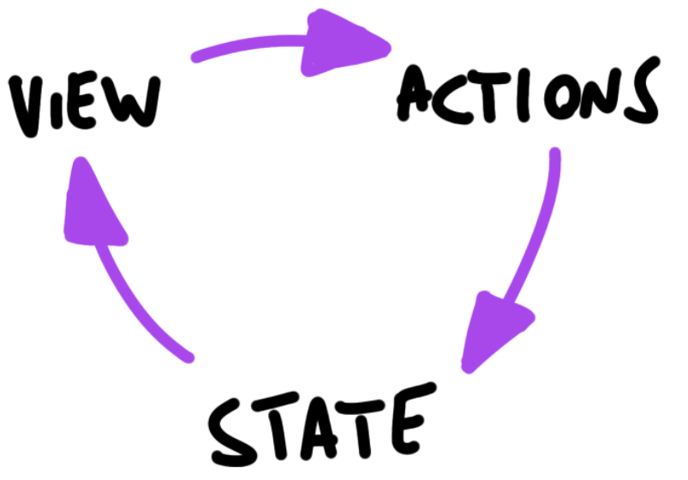
UNIDIRECTIONAL (ONE WAY) DATA FLOW
Unidirectional data flow means that data has one, and only one, way to be transferred to other parts of the application.
State is passed to the view and to child components
Actions are triggered by the view
Actions can update the state
The state change is passed to the view and to child components

Slide 17
MORE ABOUT ONE WAY DATA FLOW
A state is always owned by one Component. Any data that’s affected by this state can only affect Components below it: its children.
Changing state on a Component will never affect its parent, or its siblings, or any other Component in the application: just its children.
The state is often moved up in the Component tree, so that it can be shared between components that need to access it.

Slide 18
PROPS
A React component is a reusable component which can be used over and over again in the UI, but not always we are going to render the same component with same data. Sometimes we have to change the data or content inside a component. That’s why props are introduced in React.
Props allow you to pass data from a parent component to a child component
Only changes in props and/or state trigger React to re-render your components and potentially update the DOM in the browser.
Props are considered as “immutable”
Props are supplied as attribute to components

Slide 19
STATE
A state in React Component is its own local state, the state cannot be accessed and modified outside the component and can only be used inside the component
React components can be made dynamic by adding state to it.
State is used when component needs to change independently of its parent.
Changes to state also trigger an UI update.
React component’s state can be updated using setState()
Best practice : top level components are stateful which keep all interaction logic, manage UI state, and pass the state down to hierarchy to stateless components using props.

Slide 20
COMPONENTS
REUSABLE PIECE OF CODE

Slide 21
FUNCTIONAL COMPONENTS
React Function Components are the equivalent of React Class Components but expressed as functions instead of classes.
In the past, it wasn’t possible to use state or side-effects in Function Components – that’s why they were called Functional Stateless Components – but that’s not the case anymore with React Hooks which rebranded them to Function Components.
The only constraint for a functional component is to accept props as an argument and return valid JSX.
React Hooks were also introduced to bring side-effects to Function Components. We cover commonly used hooks later.

Slide 22
CLASS BASED COMPONENT
React Class Components were introduced with JavaScript ES6, because JS classes were made available to the language.
All the internal React Component logic comes from the extends React.Componentvia object-oriented inheritance
React class components offer several lifecycle methods for the mounting, updating, and un-mounting of the component.
By using this.state, this.setState(), and lifecycle methods, state management and side-effects can be used side by side in a React class component

Slide 23
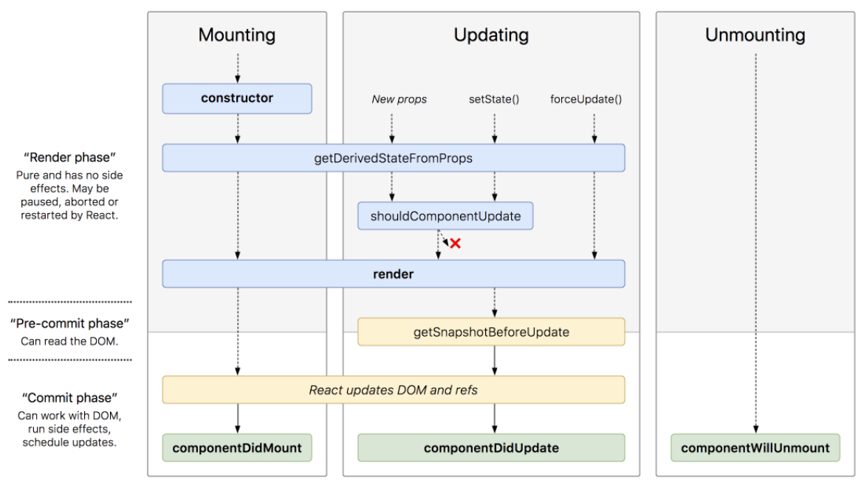
COMPONENT LIFE CYCLE METHODS

Slide 24
COMPONENT LIFE CYCLE METHODS
Lifecycle methods are various methods which are invoked at different phases of the lifecycle of a component.
Mounting
Unmounting
Updating
Mounting refers to the loading of components on the DOM.
This phase starts when the react component has taken birth on the browser and grows by receiving new updates.
In this phase, the component is not needed and the component will get unmounted from the DOM.
This phase contains a set of methods which get invoked when the component is getting initialized, and loaded on to the DOM.
The component can be updated in two ways, sending new props from parents or updating the current state.

Slide 25
MOUNTING PHASE METHODS
constructor
This is the first method that gets called whenever a component is created.
The constructor is called only once in the whole lifecycle of a component.
It’s used to set up the initial values of variables and component state.
render
This is the required method in a React component, as this method prepares the element that gets mounted on to the browser DOM.
componentDidMount
This is the hook method which is invoked immediately after the component did mount on the browser DOM.

Slide 26
UPDATING PHASE METHODS
shouldComponentUpdate
This method tells React that when the component is being updated, it should re-render or skip rendering altogether.
render
And then the component gets rendered
componentDidUpdate
executed when the newly updated component has been updated in the DOM.

Slide 27
UNMOUNTING PHASE METHOD
componentWillUnmount
This method is the last method in the lifecycle. This is executed just before the component gets removed from the DOM

Slide 28
WHY FUNCTIONAL COMPONENTS ?
Functional components make your code easier to read and understand
functional components are easier to test. No hidden state / props.
Avoid unnecessary overhead such as lifecycle events.
Functional components depend only on the props they are given to produce an output which makes debugging easier.
Functional components can reduce coupling

Slide 29
ADD KEYS : RENDERING LIST OF ITEMS
Each child in an array or iteration must be uniquely identified by assigning unique key with the help of “key” prop.
The key should always be supplied directly to the components in an array, not to the container element.
The key is not really about performance, its more about identity (which in turns
Identity and state of each component must be maintained across render passes.

Slide 30
FORMS
ACCEPTING USER INPUTS

Slide 31
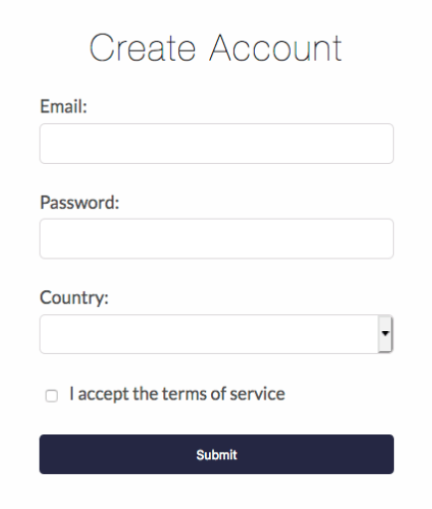
WORKING WITH FORMS
Form elements naturally keep some internal state.
An input form element whose value is controlled by React in this way is called a “controlled component”.
With a controlled component, the input’s value is always driven by the React state.
A controlled component takes its current value through props and notifies the changes through callbacks like an onChange event.

Slide 32
ACCESSING USER INPUT USING REFS
There are mainly two types of form input in React.
Controlled : Element state managed by React Component
Uncontrolled : Element state managed by DOM itself
HTML elements maintain their own state that will be updated when the input value changes.
For Uncontrolled elements, there is no need to write an event handler for every state update. You can use a ref to access the input field value of the form from the DOM

Slide 33
HOOKS
MAKING FUNCTIONAL COMPONENTS POWERFUL

Slide 34
HOOKS
Hooks are a new addition in React 16.8. e.g. useState, useEffect, useContext, useReducer and many more.
They let you use state and other React features without writing a class component.
Don’t call Hooks inside loops, conditions, or nested functions. Only call Hooks at the top level.
Only call Hooks from React functional components

Slide 35
Hook : useState()
const [state, setState] = useState(initialState);
Returns a stateful value, and a function to update it.
During the initial render, the returned state is the same as the value passed as the first argument (initialState).
The setState function is used to update the state. It accepts a new state value and re-render the component
If the new state is computed using the previous state, you can pass a function to setState. The function will receive the previous value, and return an updated value.

Slide 36
Hook : useEffect()
useEffect(didUpdate);
Accepts a function that contains imperative, possibly effectful code.
All side-effects can run eg. Mutations, subscriptions, timers, logging, and other possible side effects.
By default, effects run after every completed render, but you can choose to fire them only when certain values have changed.
useEffect may return a clean-up function.

Slide 37
Hook : useContext()
const value = useContext(MyContext);
Accepts a context object (the value returned from React.createContext) and returns the current context value for that context.
The current context value is determined by the value prop of the nearest <MyContext.Provider> above the calling component in the tree.
The argument to useContext must be the context object itself.

Slide 38
Hook : useReducer()
const [state, dispatch] = useReducer(reducer, initialArg, init);
Accepts a reducer of type (state, action) => newState, and returns the current state paired with a dispatch method.
useReducer is usually preferable to useState when you have complex state logic that involves multiple sub-values or when the next state depends on the previous one

Slide 39
Hook : useCallback()
const memoizedCallback = useCallback(cb,[]);
Returns a memoized callback.
Pass an inline callback and an array of dependencies. useCallback will return a memoized version of the callback that only changes if one of the dependencies has changed.
This is useful when passing callbacks to optimized child components that rely on reference equality to prevent unnecessary renders
useCallback(fn, deps) is equivalent to useMemo(() => fn, deps).

Slide 40
Hook : useMemo()
const memoizedValue = useMemo(() => computeExpensiveValue(a, b), [a, b]);
Pass a “create” function and an array of dependencies.
The function passed to useMemo runs during rendering.
useMemo will only recompute the memoized value when one of the dependencies has changed.
If no array is provided, a new value will be computed on every render.

Slide 41
Routing & Navigation
Creating Single Page Apps

Slide 42
ROUTING IN REACT
npm install react-router-dom
React Router is a standard library for routing in React
It enables the navigation among views of various components in a React Application.
React Router allows changing the browser URL and keeps the UI in sync with the URL.

Slide 43
MAIN COMPONENTS OF REACT ROUTER
BrowserRouter
BrowserRouter is a router implementation that uses the HTML5 history API to keep your UI in sync with the URL.
Route
Route is the conditionally shown component that renders some UI when its path matches the current URL.
Link
Link component is used to create links to different routes and implement navigation around the application. It works like HTML anchor tag.
Switch
Renders the first child <Route> or <Redirect> that matches the location.

Slide 44
REDUX
PREDICTABLE STATE MANAGEMENT CONTAINER

Slide 45
SHOULD I USE REDUX ?
You have reasonable amounts of data changing over time
You need a single source of truth for your state
You find that keeping all your state in a top level component is no longer sufficient

Slide 46
REDUX : OVERVIEW
npm install redux react-redux
Redux is a predictable state container for JavaScript apps.
It helps you write applications that behave consistently, run in different environments (client, server, and native), and are easy to test.
It provides a great developer experience, such as live code editing combined with a time traveling debugger.

Slide 47
THREE PRINCIPLES OF REDUX
Single source of truth
The state of your whole application is stored in an object tree within a single store.
State is read only
The only way to change the state is to emit an action , an object describing what happened.
Changes are made with pure functions
To specify how the state tree is transformed by actions, you write pure reducers

Slide 48
ACTIONS
Actions are payloads of information that send data from your application to your store
{
type : “ADD_TODO”,
payload : “Hello”
}
They are the only source of information for the store.
You send them to the store using store.dispatch()

Slide 49
REDUCER
The reducer is a pure function that takes the previous state and an action , and returns the next state.
Reducers specify how the application's state changes in response to actions sent to the store.
Actions only describe what happened, but don't describe how the application's state changes.
(prevState, action) => newState

Slide 50
DON’TS FOR REDUCERS
Things you should never do inside a reducer:
Mutate its arguments.
Perform side effects like API calls and routing transitions.
Call non pure functions, e.g. Date.now( ) or Math.random( )

Slide 51
STORE
The Store is the single object.
Holds application state.
Allows access to state.
Allows state to be updated via dispatching action
Registers listeners via subscribe(listener).

Slide 52
DATA FLOW IN REDUX
Redux architecture revolves around a strict unidirectional data flow.
View
Action
Reducer
Store
Middleware
The data lifecycle in any Redux app follows these 4 steps:
Your view will dispatch the Action
The Redux store calls the reducer function.
The root reducer may combine the output of multiple reducers into a single state tree.
The Redux store saves the complete state tree returned by the root reducer.

Slide 53
MICRO-FRONTEND
LET’S SPLIT IT UP

Slide 54
WHAT ARE MICRO-FRONTENDS?
Divide a monolithic App into multiple, smaller apps
Each smaller app is responsible for a distinct feature of the whole App

Slide 55
WHY MICRO-FRONTENDS?
Multiple engineering team can work in isolation
Each smaller app is easier to understand and make changes to.

Slide 56
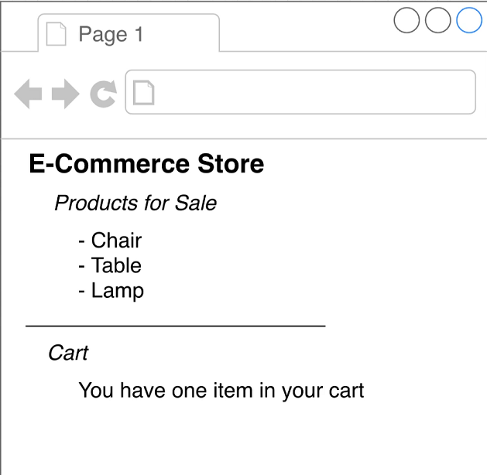
MONOLITHIC APP
React / Vue / Angular
Single Page App
App Component
ProductList Component
Cart Component

Slide 57
MICRO-FRONTEND APP
Decides when and where to
show each Micro-frontend
Container
MFE #1
MFE #2
Cart Component
ProductList Component

Slide 58
INTEGRATION
How and when does the container get access to the source code in MFE #1 & MFE #2
There is no single perfect solution for integration
There are many soltions, each have pros and cons
Look at what your requirements are, then pick a solution

Slide 59
MAJOR INTEGRATION TYPE
Build Time Integration
Run Time Integration
Server Integration
Before container gets loaded in the browser, it get access to MFE source code
After container gets loaded in the browser, it get access to MFE source code
While sending JS to load the container, a server decides on whether or not to include MFE source code

Slide 60
BUILD TIME INTEGRATION
Engineering develops MFE (ProductList)
Easy to setup and deploy
Time to deploy
NPM Registry
Container has to be re-deployed every time ProductList is updated
Publish ProductList as NPM package
Time
ProductList
Team in-charge of container installs the ProductList as a dependency
Tightly Coupling Container with ProductList
Container Team builds their app
Output bundle that includes all the code from ProductList

Slide 61
RUN TIME INTEGRATION
Engineering develops MFE (ProductList)
ProductList can be deployed independently at any time
Time to deploy
Different Versions of ProductList can be deployed and Container can choose from.
ProductList deployed at http://my-app.com/product-list.js
Time
Most flexible and performant solution around
User navigates to my-app.com, Container App is loaded
Container App fetches ProductList.JS and executes it
Tooling and setup is complicated

Slide 62
VERSION UPDATE
Working versions can be installed by running the following commands:
npm install webpack@5.68.0 webpack-cli@4.9.2 webpack-dev-server@4.7.4 faker@5.1.0 html-webpack-plugin@5.5.0

Slide 63
WEBPACK INTRODUCTION
Dependency
Webpack
Webpack-dev-Server
index.js
Dependency
bundle.js
Dependency
Combines many JS
files into one Single file

Slide 64
IMPLEMENTING MODULE FEDERATION
Designate one App as the Host container and one app as the remote
In the remote, decide, which file you want to available to other projects
Setup module federation plugin to expose these files
In the host, decide which file you want to get from the remote
Setup Module Federation to to fetch those files
In the host, import whatever file s you need from the remote

Slide 65
SUB-APP EXECUTION CONTEXT
Team #1 in-charge of Products
Team #2 in-charge of Cart
Team #3 in-charge of Container
Run ‘npm start’
Run ‘npm start’
Run ‘npm start’
Navigate to localhost:9091
Navigate to localhost:9092
Navigate to localhost:9090
Index.html
Index.js
Index.html
Index.js
Index.html
Index.js
bootstrap.js
Products
Cart
Container
Index.html file only used during development of Product and Cart
Index.html file used during development and production

Slide 66
LINKING MULTIPLE APPS TOGETHER
React App
Container
Products
Dashboard
Authentication
React App
Vue App
Angular App

Slide 67
REQUIREMENTS TO CHOOSE CORRECT MF ARCHITECTURE
Requirement #1
Zero coupling between child projects
No import of functions/objects/classes etc
No shared state
Shared libraries through MF is OK
Requirement #2
Non-Zero coupling between Container and child projects
Container should not assume that child is using a particular project
Any necessary communication will done via callbacks / simple Events

Slide 68
REQUIREMENTS TO CHOOSE CORRECT MF ARCHITECTURE
Requirement #3
Version Control (monorepos or separate) should not have any impact on overall project
Requirement #4
CSS from one project should not affect others
Requirement #5
Container should be able to decide to always use the latest version of micro-frontend or specify a specific version

Slide 69
TESTING
GETTING STARTED WITH TESTS

Slide 70
WHAT IS TESTING ?
Manual Testing
Automated Testing
Write Code <> Preview and test in Browser
Code that test your code
Very Important. You see what your user will see.
You test individual building blocks of your app
Error-prone. Its hard to test all possible combination and scenerios
Very technical, but allows you to test all building blocks at once

Slide 71
DIFFERENT KIND OF AUTOMATED TESTS
Unit Tests
Integration Tests
End-to-End (e2e) Tests
Tests the individual building blocks ( functions, components) in isolation.
Tests the combination of multiple building blocks
Tests complete scenarios in your app as the user would experience them
Projects typically contains dozens or hundreds of Unit tests
Projects typically contain a couple of integration tests
Projects typically contain only a few of e2e tests
The most common / important kind of test
Also important, but focus on Unit Tests in most cases
Important but also can be done manually

Slide 72
Thank You
Now you have required foundation to go ahead on you exciting and lucrative journey.
ALL THE BEST

