Slide 1
Mapping Studies – Why and How
Andy Burn

Slide 2
Resources
The idea of employing evidence-based practices in software engineering was proposed in (Kitchenham et al., 2004).
Some experiences of our own are embodied in the paper (Brereton et al., 2007) and a good example of a published systematic literature review is given in (Jørgensen & Shepperd, 2007).
A useful book is:
  Mark Petticrew & Helen Roberts (2006). Systematic Reviews in the Social Sciences: A Practical Guide, Blackwell Publishing
www.ebse.org.uk
Mapping Studies – Why and How

Slide 3
Overview
Why conduct a mapping study?
  Literature reviews
  The evidence-based paradigm
  Secondary studies
  Mapping studies
How to conduct a mapping study
  Protocol design
  Data collection
  Data aggregation
  Literature review
Mapping Studies – Why and How

Slide 4
Literature Reviews
In many domains there are well-established journals that publish ‘review papers’, usually by an expert in a field, where they review the literature and draw any appropriate conclusions.
In computing, we have the ACM Computing Surveys journal, which more or less does that.
However, such reviews are essentially ‘expert reviews’ and hence it is possible that two different experts might select different papers and draw separate conclusions!
This leads us to...
Mapping Studies – Why and How

Slide 5
The Evidence-Based Paradigm
The evidence-based paradigm originated in clinical medicine (and relatively recently) following concerns over the quality of research evidence being used to inform practice/teaching.
Evidence-Based Medicine (EBM) seeks to employ secondary studies to find, judge and synthesise the outcomes of all relevant empirical studies to draw conclusions about particular treatments. It has had a major impact upon clinical practice and upon healthcare in general.
Mapping Studies – Why and How

Slide 6
Secondary Studies
Seek to aggregate the outcomes of many primary studies in an objective and unbiased manner, using either quantitative or qualitative forms of analysis
Major tool is the systematic literature review for which a protocol will define the question of interest, how it can be categorised in keywords, and how and where the search for source material will be conducted
Sometime use the first steps of systematic literature review to perform a mapping study, which identifies the set of papers addressing a topic but is mainly concerned with formulating a research question
Mapping Studies – Why and How

Slide 7
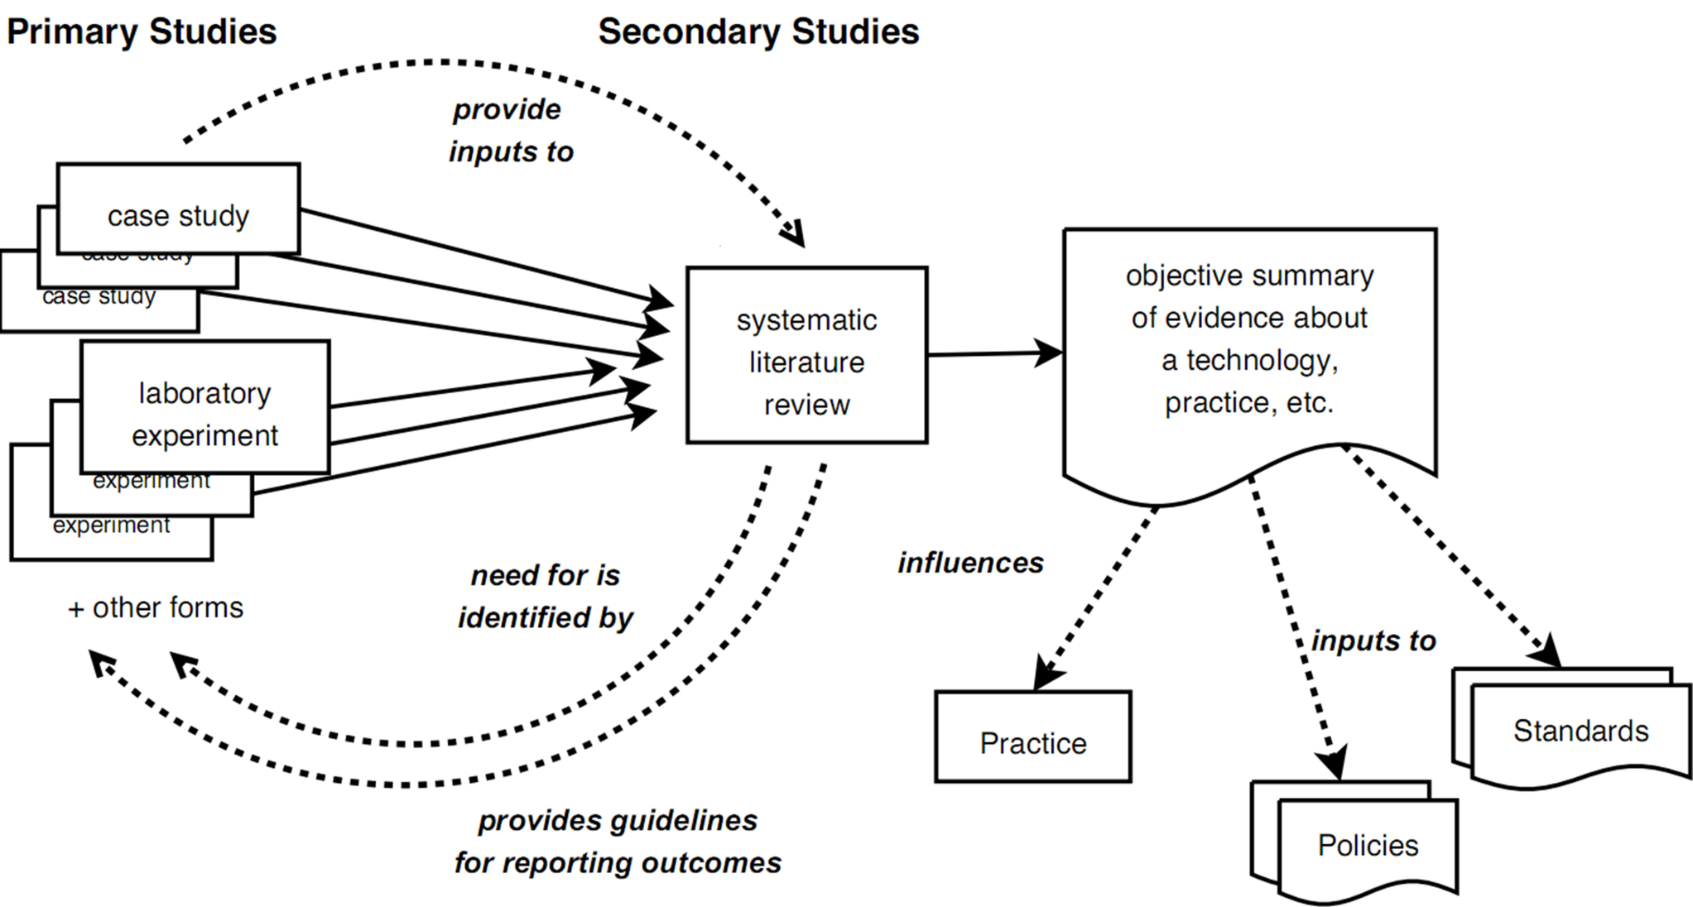
Primary vs Secondary Studies
Mapping Studies – Why and How

Slide 8
EBSE
Evidence-Based Software Engineering
  Convert need for information (about a technique, method, etc.) into an answerable question
  Find the best evidence with which to answer the question
  Critically appraise the evidence for its validity (closeness to the truth), its impact (size of effect) and its applicability (usefulness)
  Integrate the critical appraisal with SE expertise and with stakeholders’ values and circumstances
  Evaluate the effectiveness and efficiency of the process in steps 1--4 and seek ways to improve them
Steps 1--3 are essentially the process of systematic literature review
Mapping Studies – Why and How

Slide 9
Systematic Literature Review
1. Specify Research Questions
Phase 1
Plan Review
2. Develop Review Protocol
3. Validate Review Protocol
4. Identify Relevant Research
5. Select Primary Studies
Phase 2
Conduct Review
6. Assess Study Quality
7. Extract Required Data
8. Synthesise Data
Phase 3
Document Review
9 & 10. Write & Validate Report
Mapping Studies – Why and How

Slide 10
Mapping Studies
1. Specify Research Questions
Phase 1
Plan Review
2. Develop Review Protocol
3. Validate Review Protocol
4. Identify Relevant Research
5. Select Primary Studies
Phase 2
Conduct Review
6. Assess Study Quality
7. Extract Required Data
8. Synthesise Data
Phase 3
Document Review
9 & 10. Write & Validate Report
Mapping Studies – Why and How

Slide 11
Conducting a Mapping Study
Develop your protocol
Identify studies and papers
Aggregate and analyse the results
Mapping Studies – Why and How

Slide 12
Develop Study Protocol
A document describing the design of a study
  Create before the study
  Try it out with a dry run – change if necessary
  Record all divergences from the protocol in the final study
The protocol should describe
  Keywords
  Sources
    Search engines, such as ACM, IEEEXplore, Science Direct, Google Scholar...
    Manual search, e.g. prior knowledge, asking an expert, snowballing...
  Inclusion criteria
    Grey literature?
    Date restrictions?
Mapping Studies – Why and How

Slide 13
Identifying Studies
Selection is based on titles and abstracts
  Fast and simple, but often inaccurate
Papers and studies have a many-to-many relationship
  One study may be reported in several papers
  One paper may report several studies
  Don’t confuse ‘papers’ and ‘studies’ in your documents
Data extraction:
  Title, author, abstract, year, reference
  Source – search engine, search string
  Topic or category
Validation
  Second opinion
  Expert search
Mapping Studies – Why and How

Slide 14
Notes on Search Engines
Each engine has a different syntax
Different engines cover a subset of sources and overlap each other
Results are sometimes inconsistent, even within the same engine
  E.g. Changing the order of the search terms can change the results
Anecdotally, snowballing adds about 10% over automated searching
Spelling
  Modeling vs modelling
  Visualisation vs visualization
Mapping Studies – Why and How

Slide 15
Data Aggregation
Remember
  The aim of a mapping study is to find the limits, shape and nature of the research on a topic
Aggregation creates an overview of your results
This overview lets you
  Make statements about the current state of research on a topic
  Find gaps and clusters
  Create research questions based on these gaps and clusters
Mapping Studies – Why and How

Slide 16
Experiences
Many areas of Computer Science and Software Engineering have a very weak empirical basis
Titles and abstracts are often poor
  Not descriptive of the research
  Frequent misuse of the terms ‘experiment’ and ‘case study’
Managing large sets of results is difficult and time-consuming
  Several tools exist, none of them are ideal
Mapping Studies – Why and How

Slide 17
Final Notes
A mapping study doesn’t have to search for empirical research
  Might be looking for tools or frameworks
A mapping study provides a solid basis for a strong literature review
  Ideally the study will be extended into a complete systematic literature review
  In a postgraduate time-scale, more likely to be used to
    Shape your research question
    Increase confidence in the set of studies used in your literature review
Mapping Studies – Why and How

Slide 18
For More Information
www.ebse.org.uk
  Templates
  Guidelines
  Glossary
  Bibliography
  Previous studies and protocols
Mapping Studies – Why and How

