Slide 1
Introduction to Research Methods in Education

Slide 2
Research Methods
Why is it important to understand research methods for interdisciplinary researchers?
Types of research
How do you measure learning experimentally?
  Within subjects design
  Between subjects design
What are you measuring?
Important Statistical terms
[other methods]

Slide 3
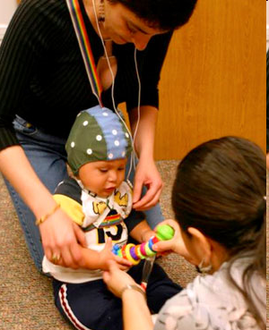
Research methods as boundary object in interdisciplinary research
Study of cross-disciplinary research collaboration (Mercier, Penuel, Remold, Villalba, Kuhl & Romo, under review)
The Bilingual Baby Project
  4-year longitudinal study
  Neuroscience, cognitive science, sociology
  How does growing up in a bilingual environment influence cognitive development & school readiness?
  Biggest issues was sample selection (methods)

Slide 4
  … [a child] was brought back for me to test, and I was putting [an ERP] cap on and then his mom said, well, he’s used to this from going to the neurologist … and then she told me that he has epilepsy. And I thought to myself, well, okay, I’m wasting the next two-hours because I’m not going to be able to use the data….. A quantitative researcher would never include a child that—you wouldn’t even waste the time and resources.

Slide 5
It’s difficult because you do form close relationships with the families…. So it was then much harder for our group to eliminate them from the pool, which we didn’t. We have followed up, we’ve gone and interviewed her, and it would be very interesting to see what kind of school readiness skills that child has and what kind of problems that mother has encountered. I know that they wanted children who had no other disabilities in order to focus on their language acquisition, but not all children are of this type

Slide 6
Two Types of Research
Quantitative
  Experimental
  Surveys (usually)
Qualitative
  Biography, phenomenology, grounded theory, ethnography & case study
Mixed methods
  You can’t account for context with numbers
  The plural of anecdote is not data

Slide 7
What do you want your data & results to look like?
Do you want to show learning, engagement, the process of the activity?
Do you want to show that your tool works, or that it is better than an alternative?
Do you want to describe, code, run statistics, present a case study?
How will you design the study to get the type of results you want to present?

Slide 8
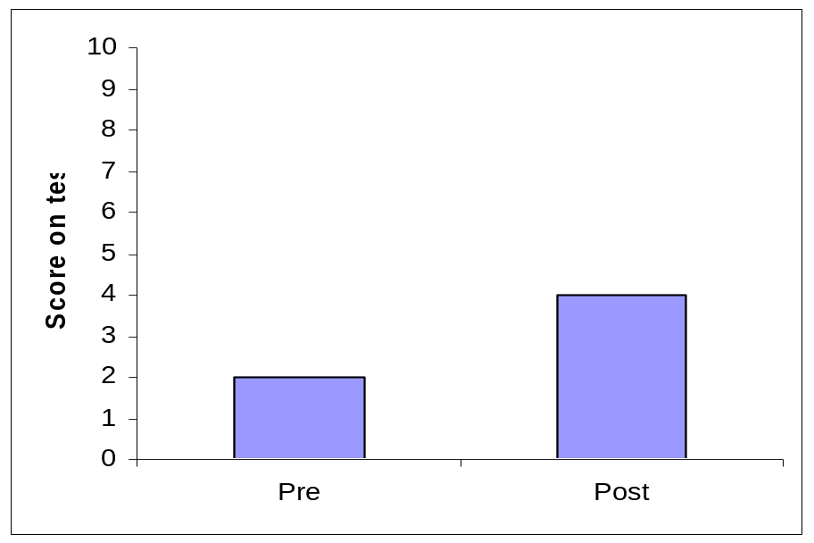
How do you measure learning experimentally?
Ecology lesson
Aim: to teach 5 year olds about complex systems
Ten 1-hour long sessions over 5 weeks
“Embodied curriculum”
  Technology; dancing; drawing
CLAIM: Embodied curriculum is a good way to teach complex systems
No way to know whether it was the curriculum, or just being taught that led to learning

Slide 9
How do you measure learning experimentally?
(and know that it’s because of what you did…)
Pre/post test design (within subjects)
  Sequestered problem solving (SPS)
  Preparation for future learning (PFL)
  Free-write/free recall
  Delayed post-test
  Multiple baseline/single case design
Notes:
Dancing kindergarteners

Slide 10
How do you measure learning experimentally?
(and know that it’s because of what you did…)
Control design (between subjects)
  Only some of the participants receive intervention & compare post-test scores between control & experimental groups
  Compare ‘experimental group’ with previous groups who did not receive intervention
  Randomized control trials (the medical model)

Slide 11
2x2 design
Godden & Baddeley (1975)
 |  | Recall Condition
 |  | On Land | Under water
Learning condition | On Land | 20 | 20
 | Under Water | 20 | 20

Slide 12
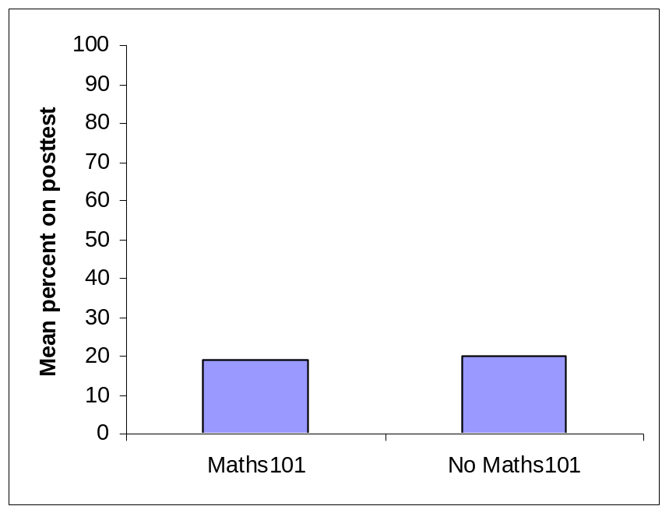
But what are you measuring?
Prerequisites for Maths Course
Is maths101 necessary to pass stats202?
Half of students had taken maths101
All students take stats202
Contrast outcomes
CLAIM: No need to take maths101 before taking stats202
Floor effect: either the post-test didn’t measure the content or very little was learned from stats202.

Slide 13
But what are you measuring…
Is it valid?
  Internal validity (is the effect caused by the IV)
  External validity (would it replication beyond the sample)
Is it reliable?
  test-retest reliability
  Split-test reliability
[piloting]

Slide 14
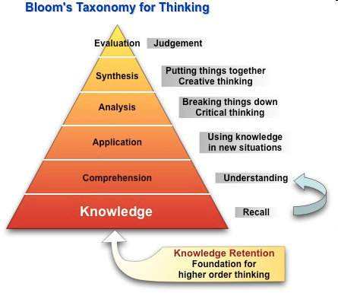
What sort of learning will you measure?

Slide 15
Important statistical ideas
Independent variables
  The thing you manipulate/control for
  Main effects & Interaction effects between IV
Dependent variables
  The outcome measure
  Floor effects & ceiling effects
Statistical significance
  Usually <.05 for social science
  Indicates whether the effect is genuine or due to chance

Slide 16
Important statistical ideas
Level of measurement
  Nominal
  Ordinal
  Interval (& ranking)
Population & sample
  Normal distribution
Descriptive statistics
  Means, standard deviations, standard errors,
Parametric and non-parametric statistics

Slide 17
Assumptions for parametric statistics
Level of measurement must be at least interval
Sample is drawn from a normally distributed population
Homogeneity of Variance
  Variance of two samples is not significantly different
Independence of scores

Slide 18
Questions?

Slide 19
Key things to look for:
Are the differences between conditions significant:
  T-tests, ANOVA, Chi Square
Is there a relationship between variables?
  Correlations (note: you can’t tell causation from this)
  Pay attention to r values (between 1 and -1).
Which of the IVs cause the DV?
  Regression Analysis (note: need very large sample size; controversial technique)

Slide 20
Survey design
In the past 24 hours, did you watch more than an hour of television programming, or not? Yes/No
In the past 24 hours, did you read a daily newspaper, or not? Yes/No
On a scale of 1 to 7, please rate
How satisfied were you with what you learned and the usability of the software?
(1) Agree strongly…….(7) disagree strongly

Slide 21
Survey design (things to remember)
Is there only one question in each item?
Pilot with a number of people – do they read the question the way it was intended?
Are all your scales in the same direction (if not, reverse them before analysis)
Do the answers match the questions?
How will you make sense of the answers
  What sort of analysis can you do on rating, frequency, open-ended items?
Are particular answers ‘socially desirable?’

