Slide 1
SynergyNet
Overview

Slide 2
Investigators
Dr Elizabeth (Liz) Burd (Director – Active Learning in Computing)
Dr John Adams (Cognitive Psychology)
Prof Julian (Joe) Elliott (Motivation/Cognitive Enhancement)
Dr Andrew Hatch (Technology-Enhanced Learning)
Prof Steve Higgins (Pedagogy/Learning)
Dr Phyo Kyaw (Technology-Enhanced Learning)
Prof Malcolm Munro (Software Engineering & Software Visualisation)
Dr Shamus Smith (Human-Computer Interaction)

Slide 3
Research Associates
Dr. Iyad Alagha (University of Durham)
Dr. Linxiao Ma (formerly University of Strathclyde)
Dr. Emma Mercier (formerly Stanford University)

Slide 4
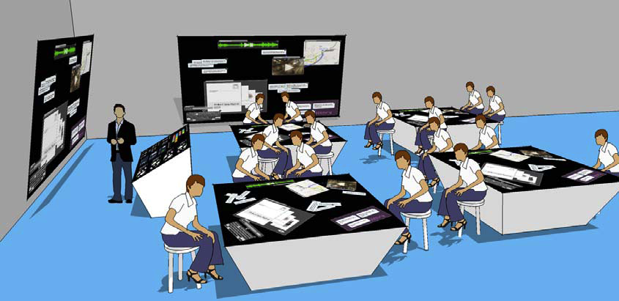
The Proposal: Classroom

Slide 5
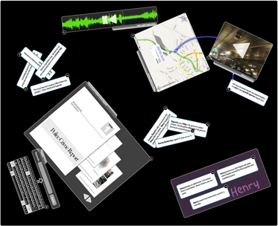
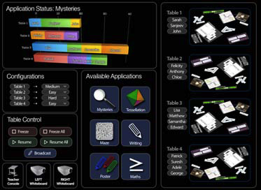
The Proposal: Software

Slide 6
The Proposal: Timeline
Higher Education (start Oct 2008)
Visits by school groups (start Sept 09)
Primary Education (start Sept 2010)
Secondary School (start Sept 2011)

Slide 7
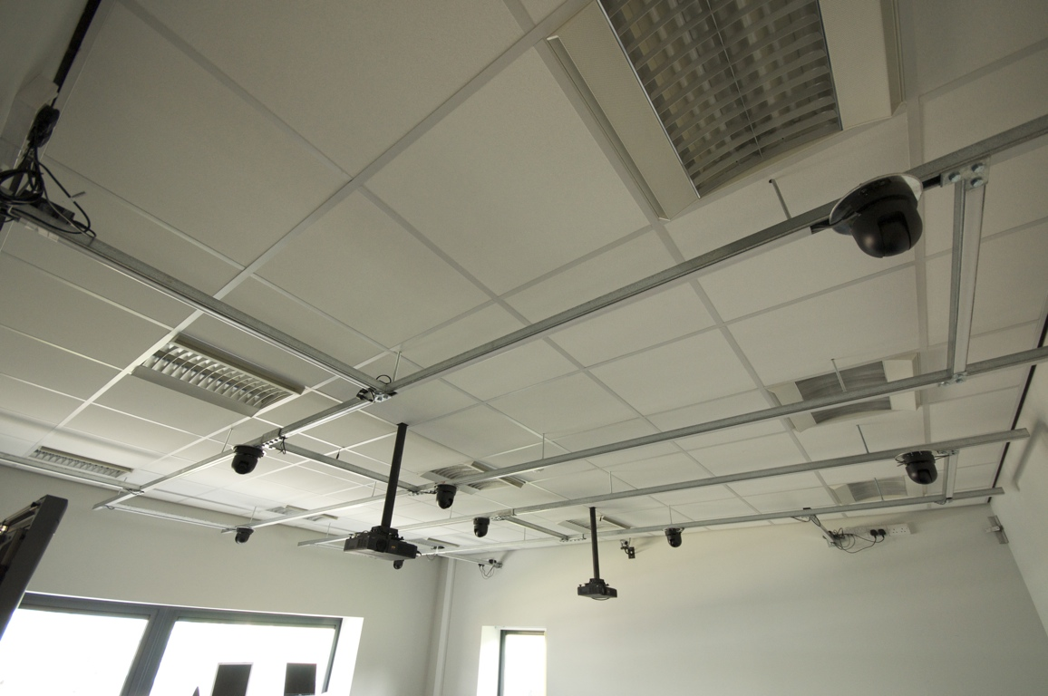

Usability Lab
10 Cameras; Screen Capture; Audio

Slide 8
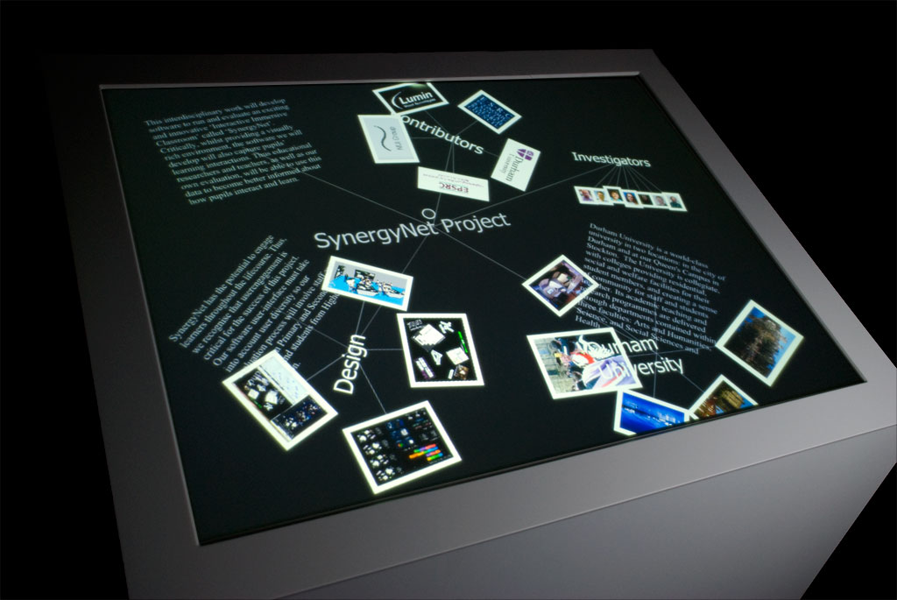
Teacher Lectern
Lumin/Evoluce

Slide 9
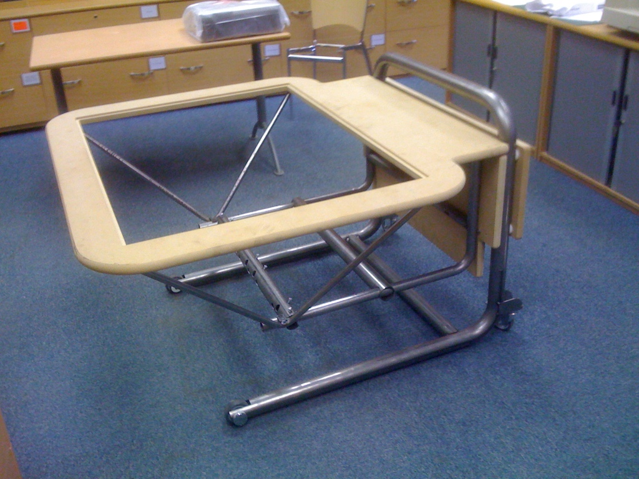
Table Design
NESS Furniture & Evoluce

Slide 10
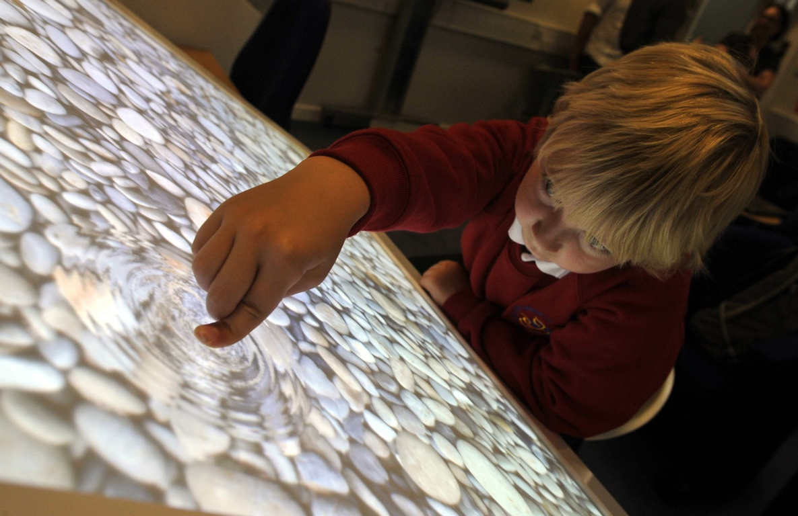

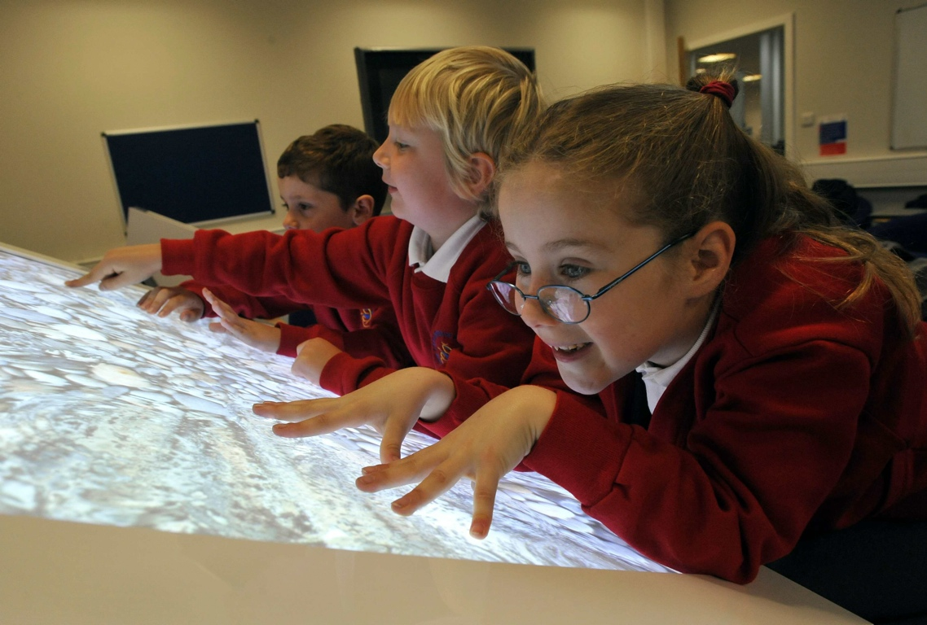
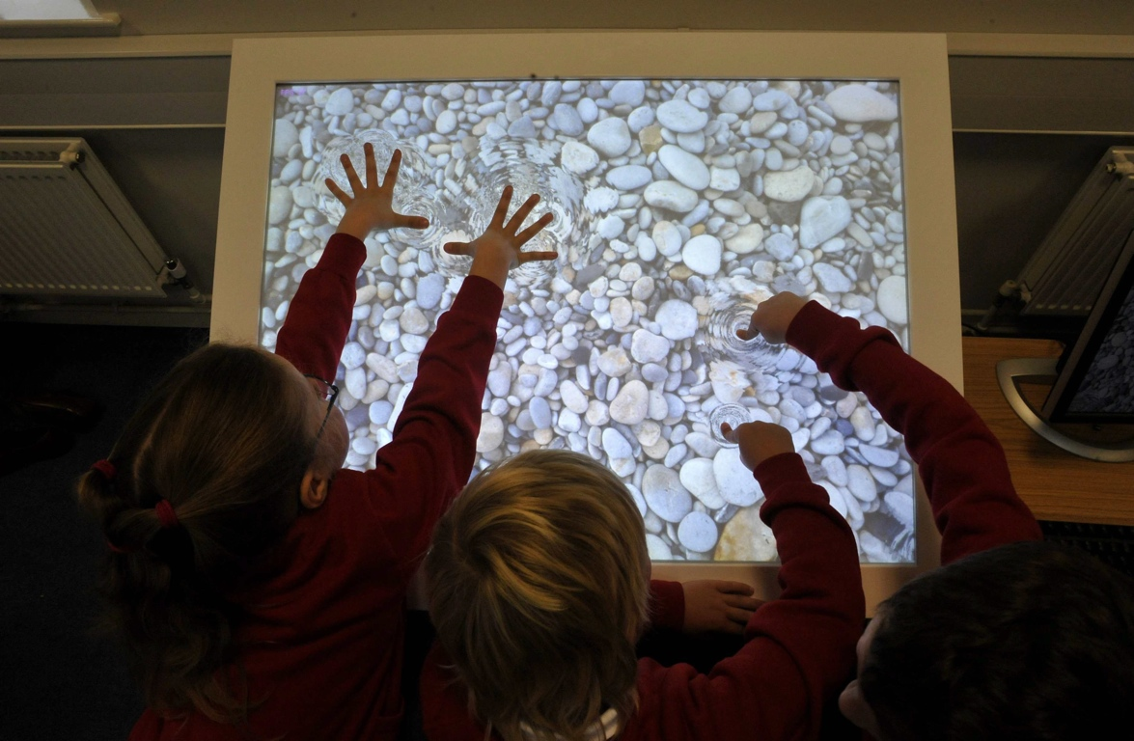
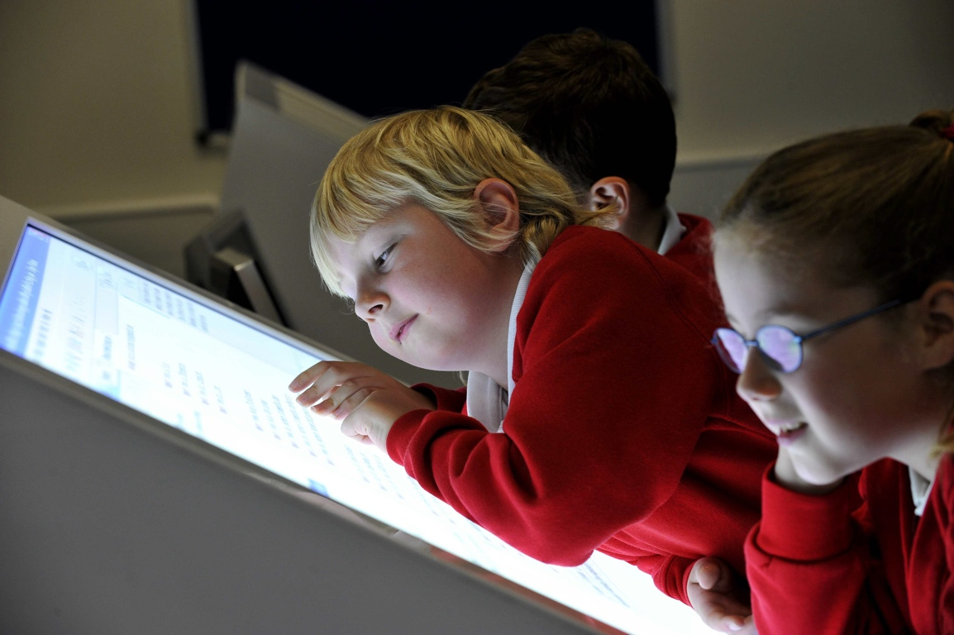
Media Coverage: BBC; Tyne-Tees TV; National and International Broadsheets; Our Lady Queen of Martyrs

Slide 11
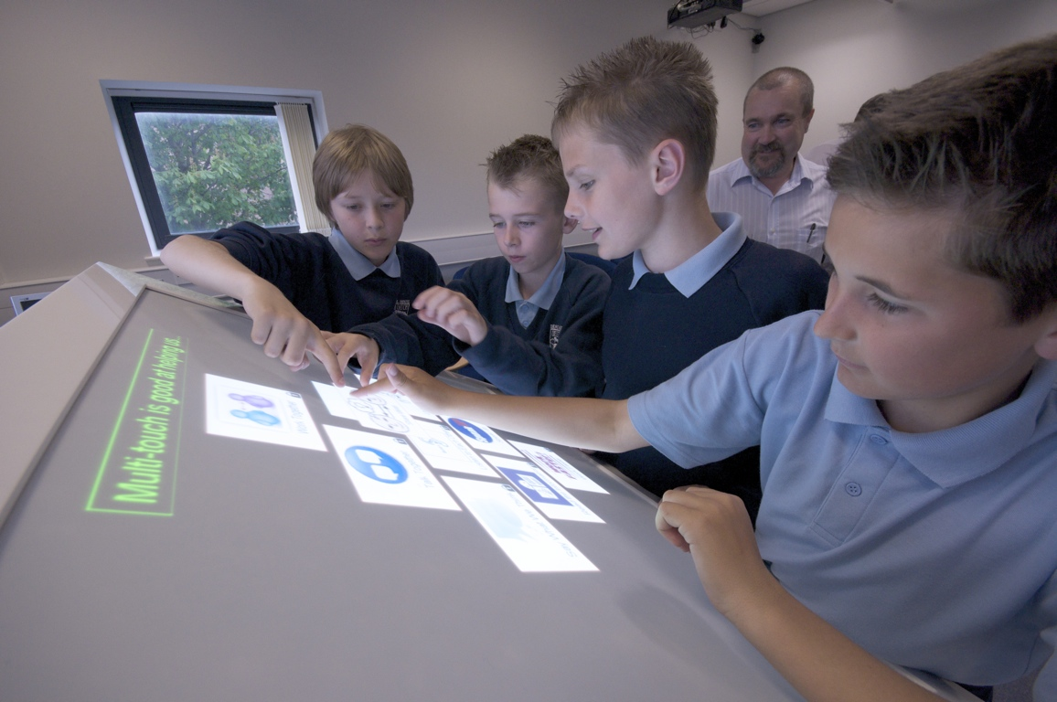

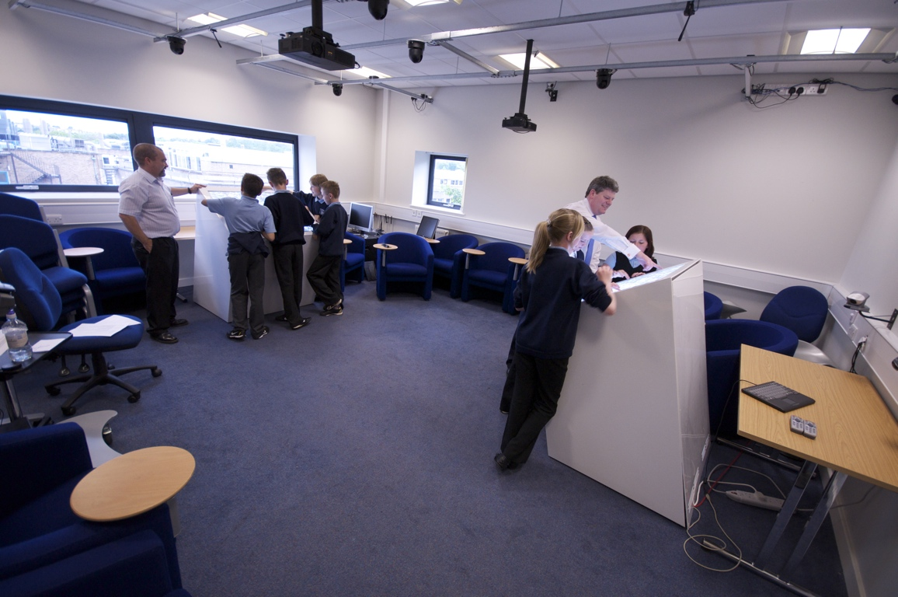
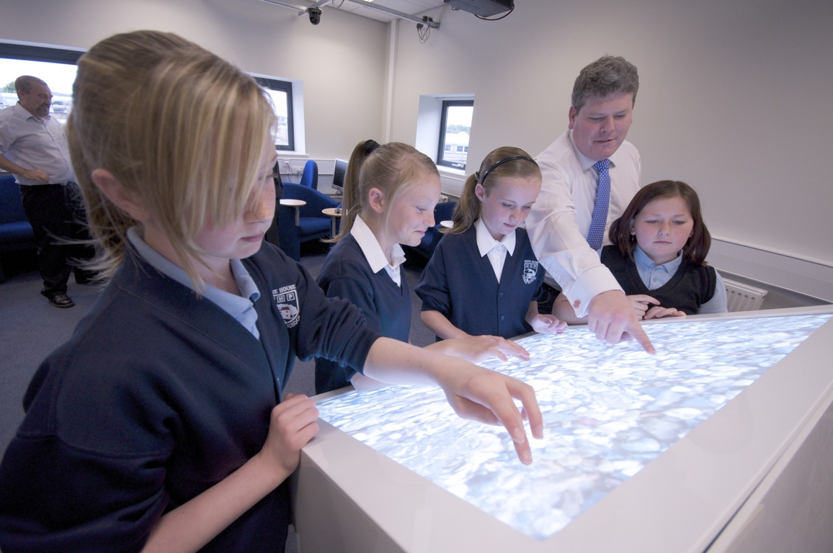
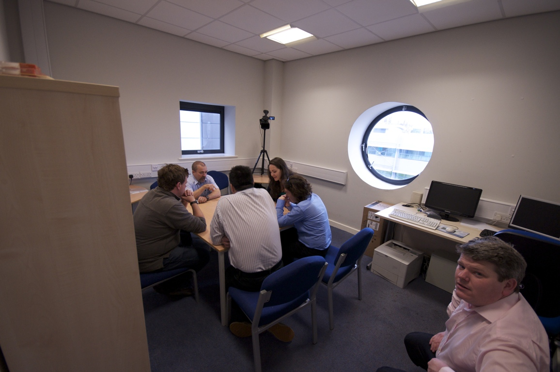
Comparing multi-touch mysteries to paper-based mysteries

Slide 12

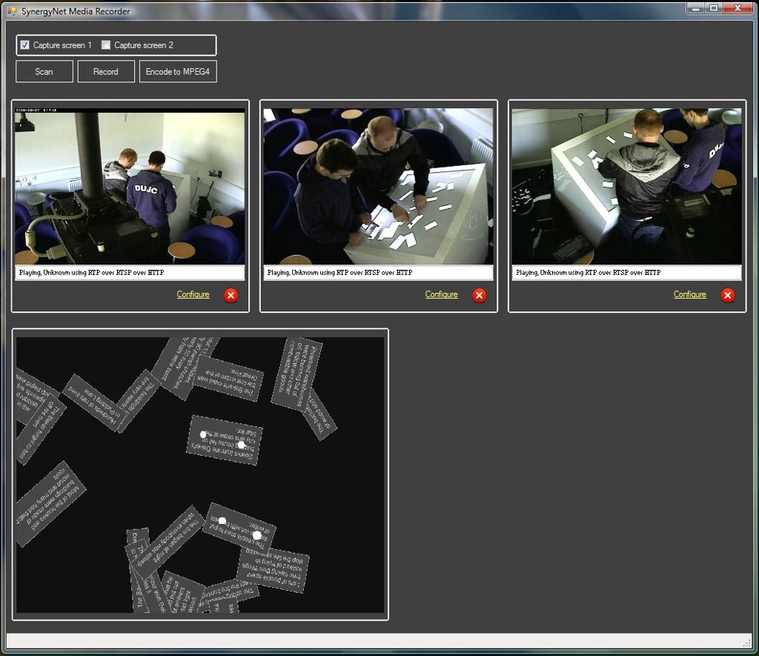
Analysis Software

