Slide 1
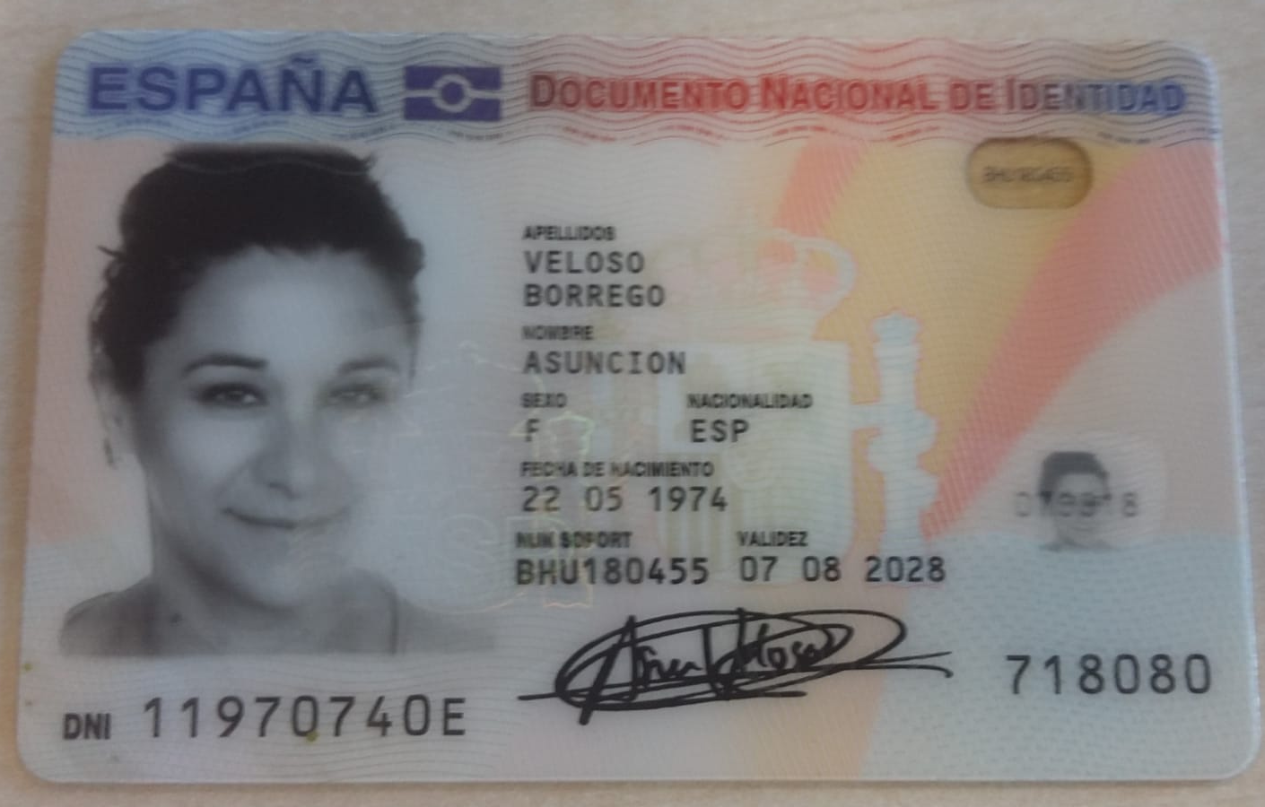
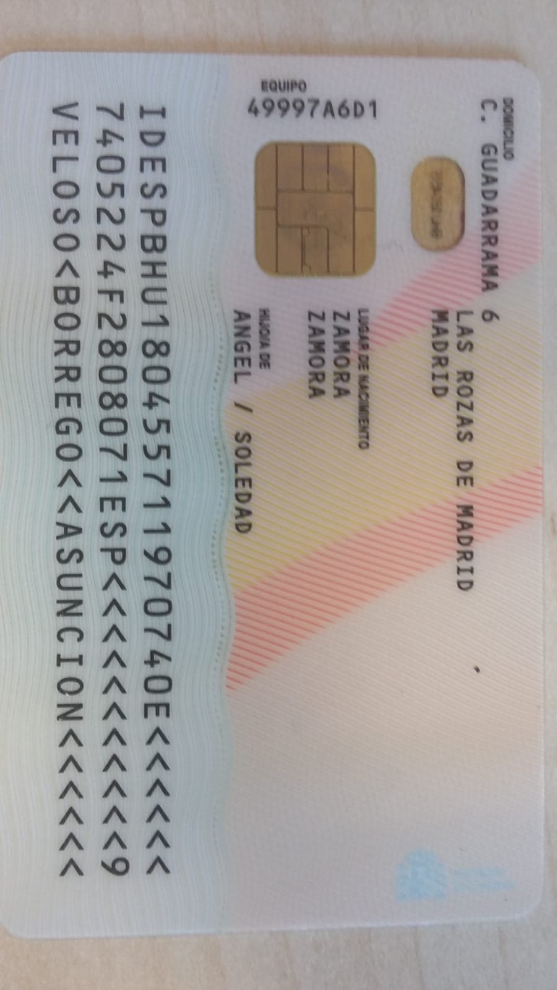
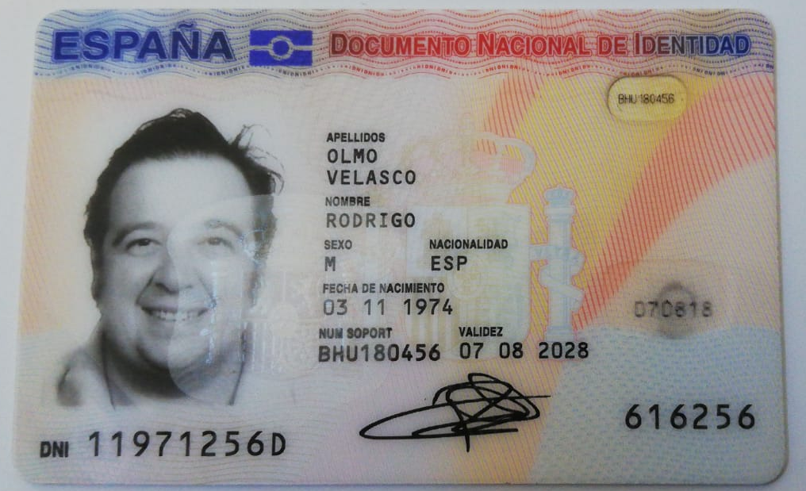

Slide 2
gdfgsdfgfsd
Gsdfgdfsgdfgd
Gdsgdsgdsfgds
Sdfgsdgdsgdsg
Sdfgsdfgsdfgdsds

