Slide 1
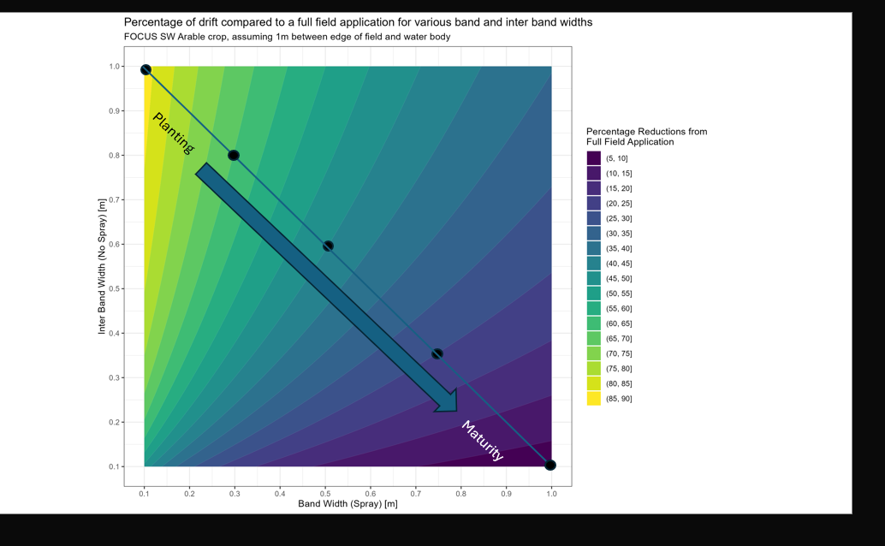
BBCH 0
BBCH 10
BBCH 20
BBCH 30
BBCH 40
BBCH 50

Slide 2
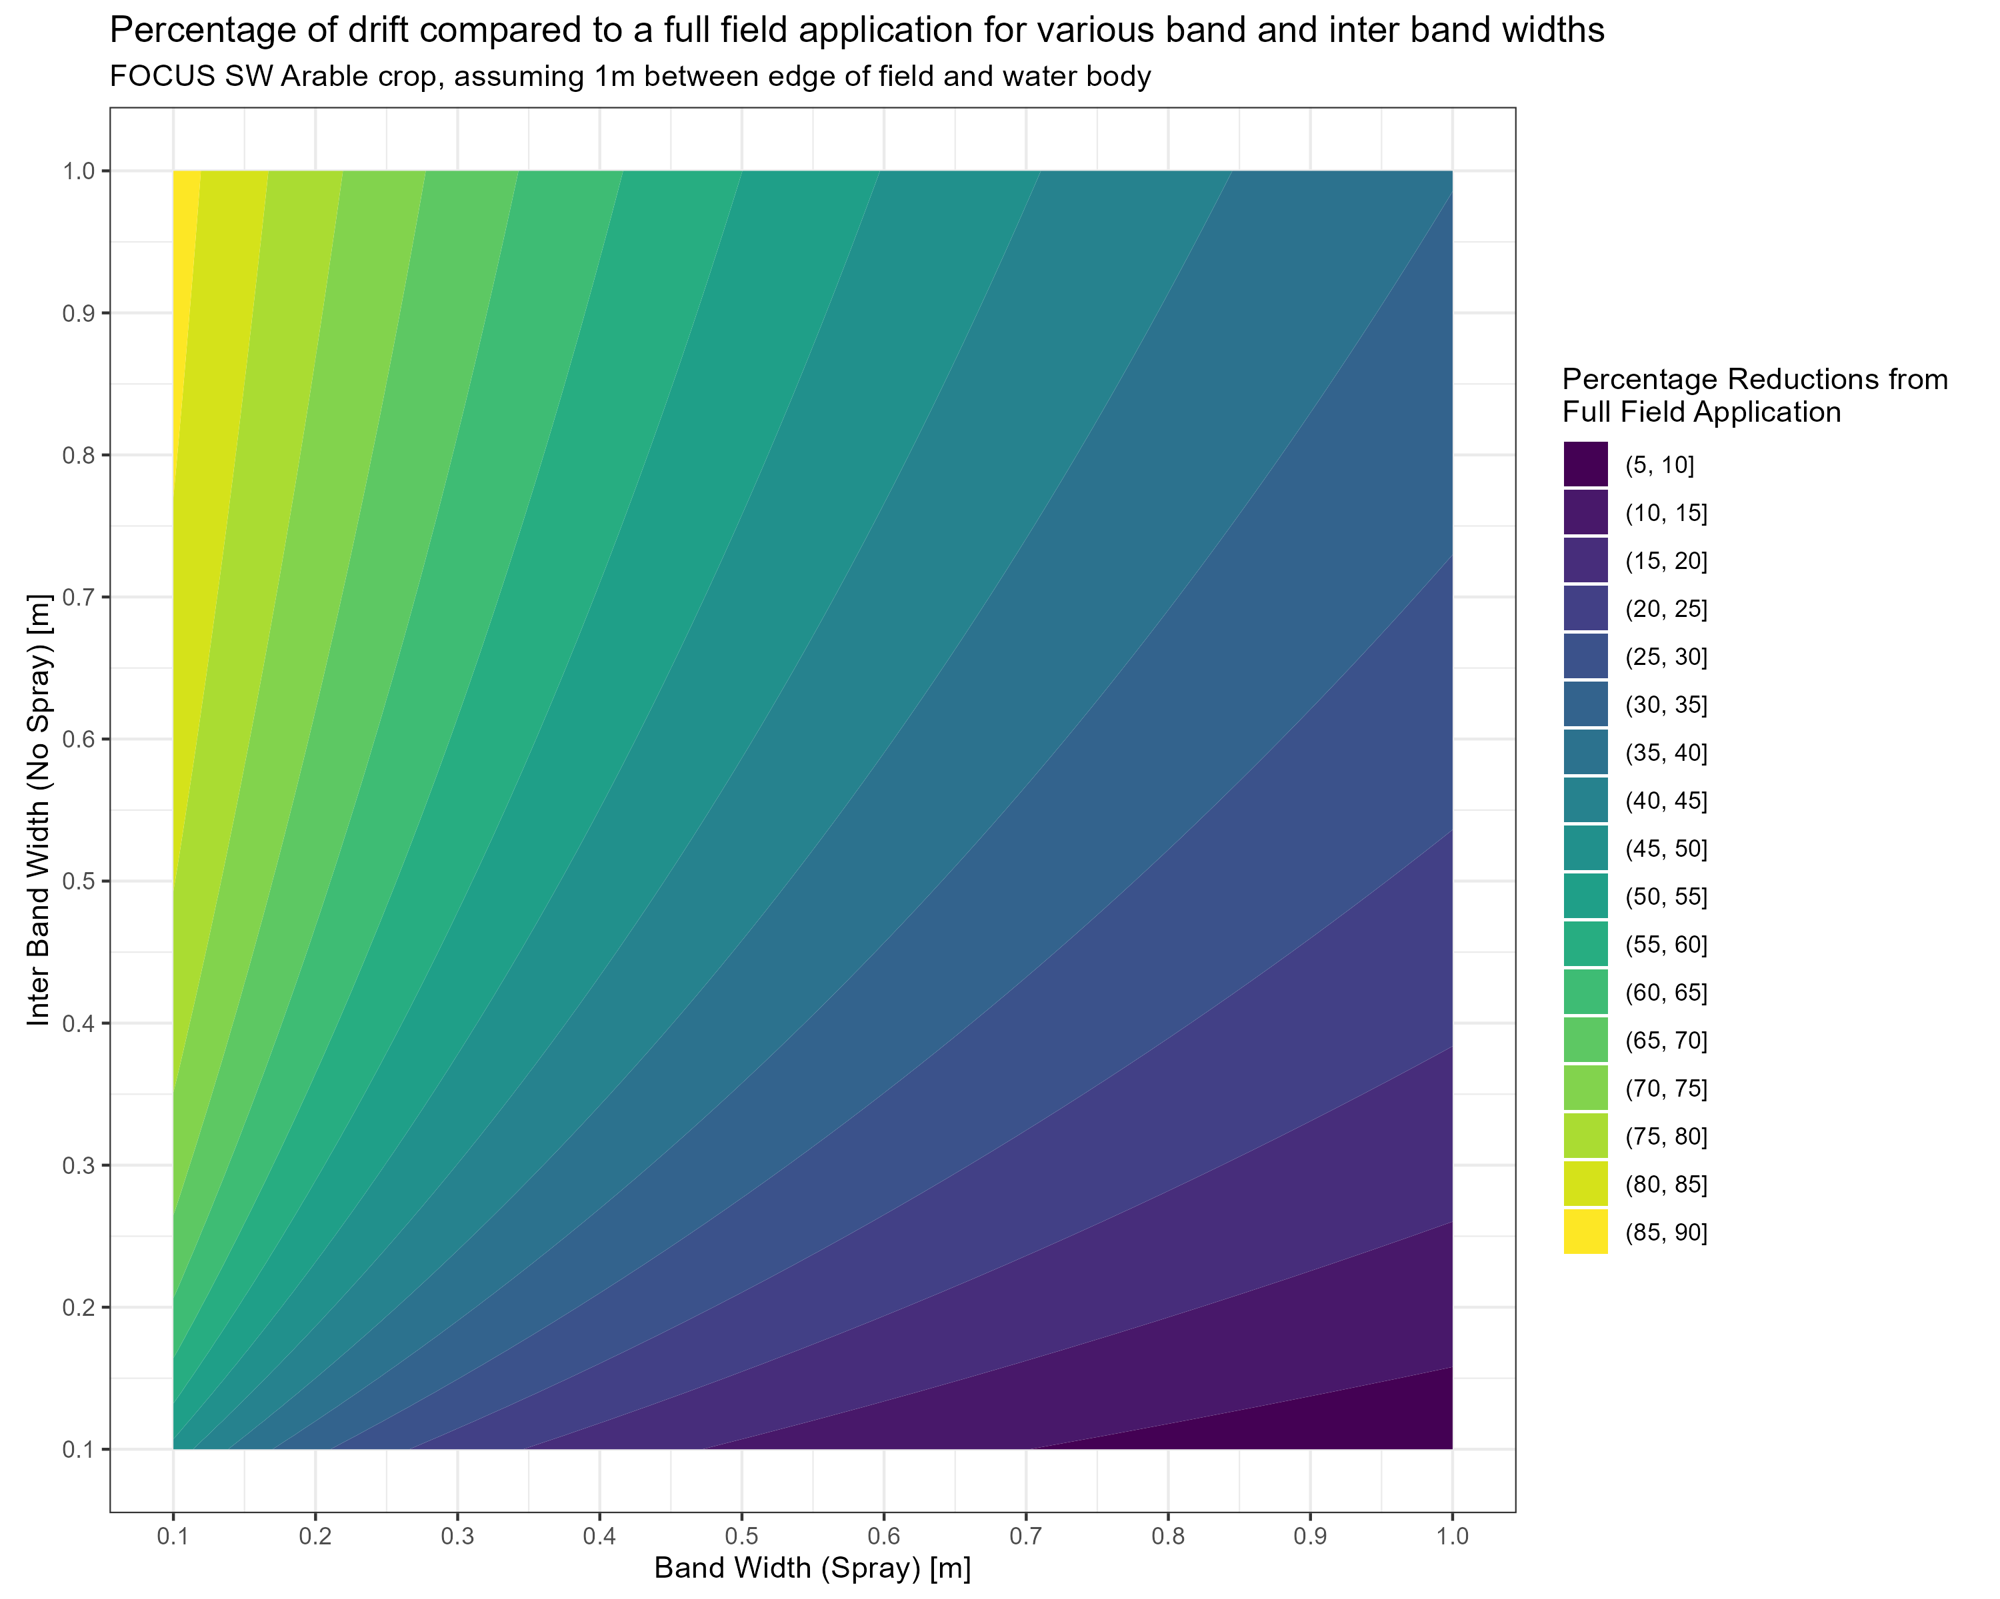



Planting
Maturity

Slide 3
Planting
Maturity

Slide 4
20m

