Slide 1
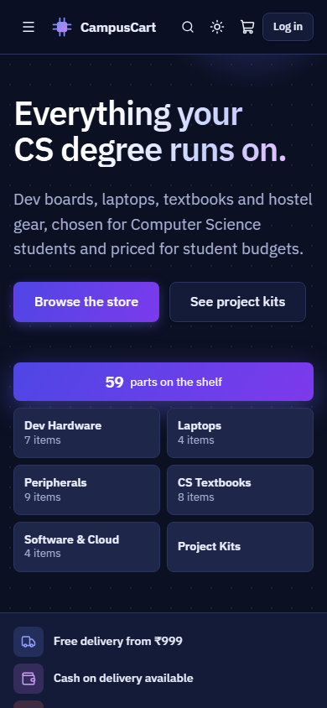
CampusCart
Everything your CS degree runs on. A full-stack store built with React, Node.js, Express and MongoDB.
[Your name] | [Roll number] | [College]
Notes:
Introduce yourself and the project. CampusCart is an online store built specifically for Computer Science students. Keep this to about 20 seconds.

Slide 2
General stores do not know what a CS student needs
Scattered
No context
Budget blind
Dev boards, textbooks and hostel gear sit in unrelated departments, surrounded by things students never need.
No store can answer "what does my IoT lab need?" or "what do I need for semester 5?".
Students plan a whole desk on a fixed budget, but stores only show one product at a time.
CampusCart organizes a store around how CS students actually shop.
Notes:
A CS student needs a Raspberry Pi for one lab, the CLRS textbook for another course, and a bag for a laptop. A general store has all of them, spread across unrelated departments, and it cannot answer "what do I need this semester?". The project is built around that gap.

Slide 3
A complete store, from first search to delivery
Discover
Search, filter, compare
Cart
Live stock and coupons
Checkout
Address and demo payment
Fulfil
Admin updates status
Track and review
Timeline, verified reviews
12
74
10
59
modules
API routes
database collections
products in the demo catalog
Notes:
This is the whole workflow you are about to see. A student moves left to right. The admin takes over for fulfilment, and the status they set is what the student sees on the tracking timeline. Mention the numbers: 12 modules, 74 API routes, 10 database collections.

Slide 4
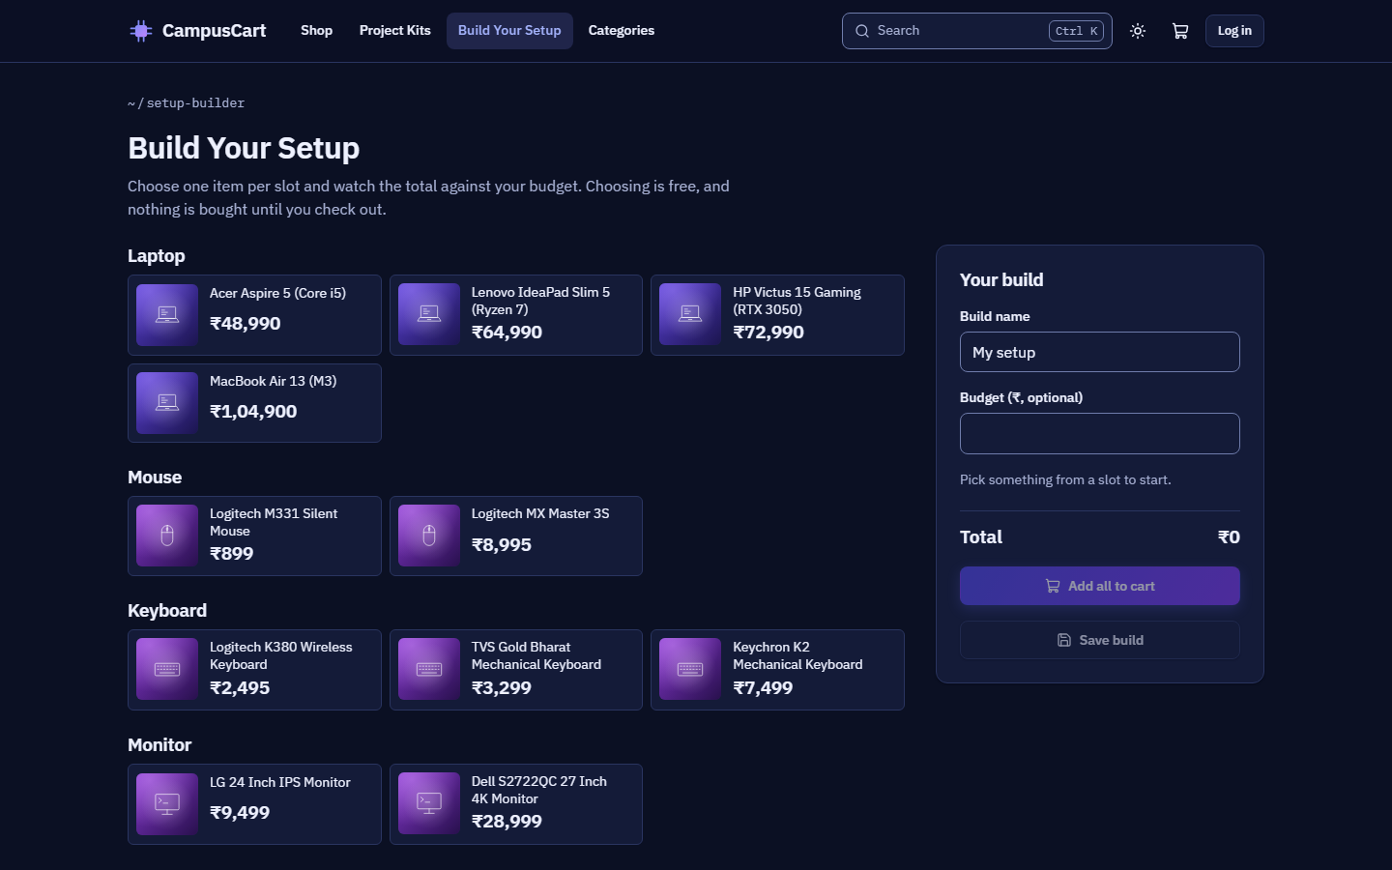
Built around how CS students shop
Project Kits
A whole lab or semester, added to the cart in one click
Build Your Setup
Plan a desk against a budget, with a running total
Compare
Up to 4 products, with differences highlighted
Semester filter
See what is relevant to where you are in the degree
Notes:
These are what separates the project from a generic store. Project Kits answer "what do I need for this lab?" in one click. Build Your Setup plans a whole desk against a budget. Compare lines up technical specs. The screenshot shows the setup planner. You will see these live in the demo.

Slide 5
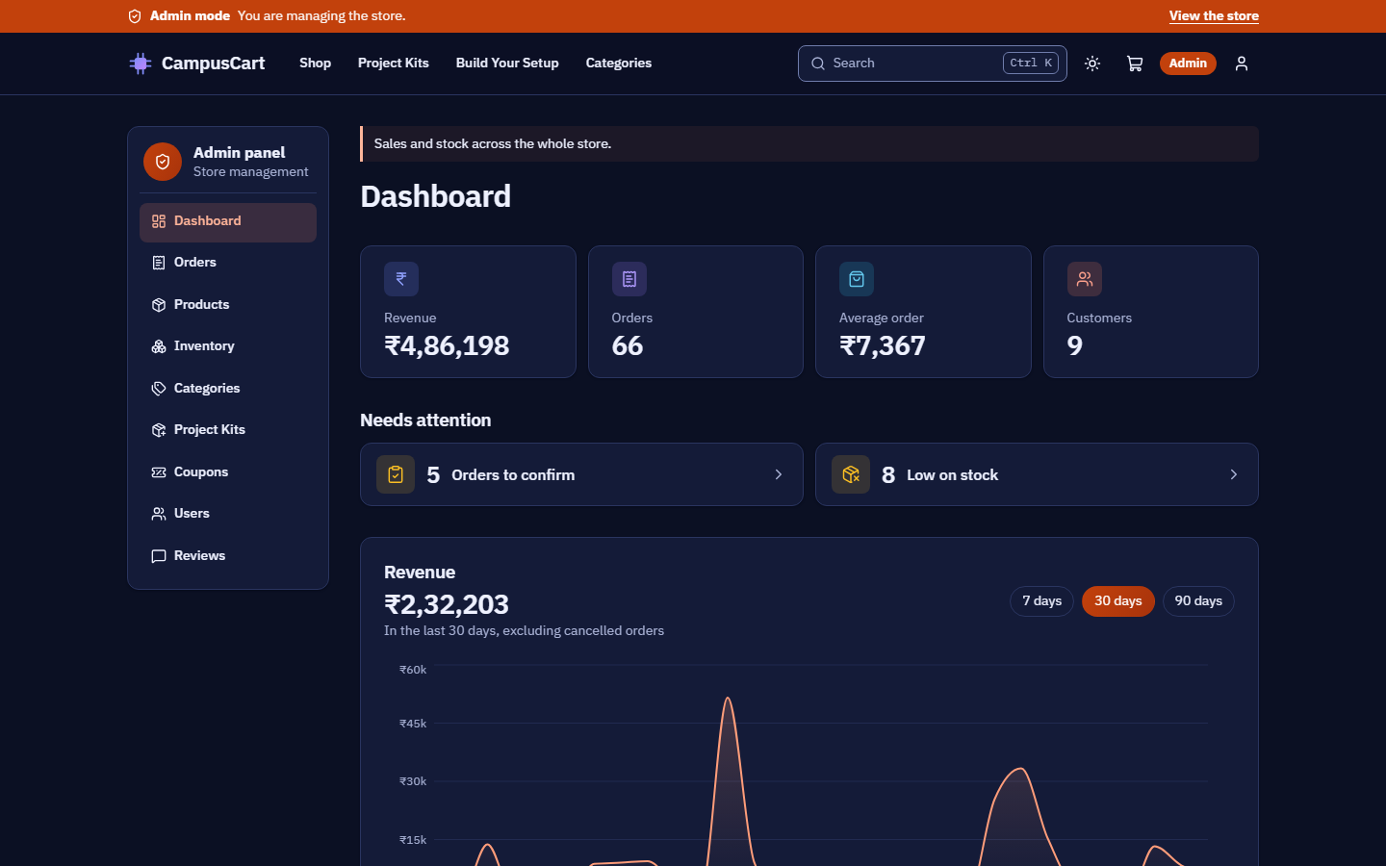
Admins see the whole store at a glance
Live analytics
Revenue, category sales, top products
Order processing
Pending to Delivered, one enforced step at a time
Inventory
Inline stock edits and low-stock alerts
Full management
Products, kits, coupons, users, reviews
Notes:
The admin side is a real management tool, not an afterthought. The dashboard figures come from live database queries over the order data, and cancelled orders are excluded from revenue. From here, an admin can act on low stock and pending orders straight away.

Slide 6
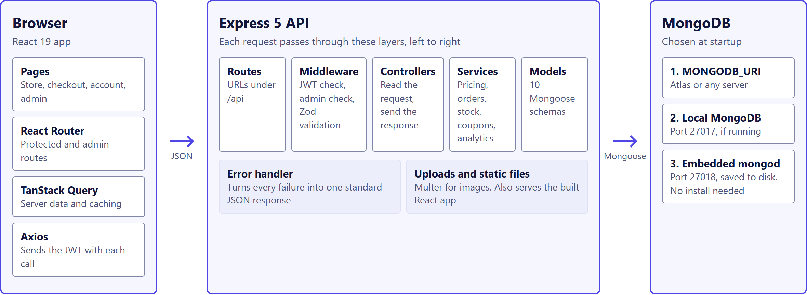
Three tiers, with business rules in one layer
Notes:
React talks to Express over JSON, and Express talks to MongoDB through Mongoose. Inside the API, each request passes through the same layers. The key point is that pricing, stock and order rules all live in the services layer, so they can be tested directly. On the right: the database is chosen at startup, so the project runs with nothing to install.

Slide 7
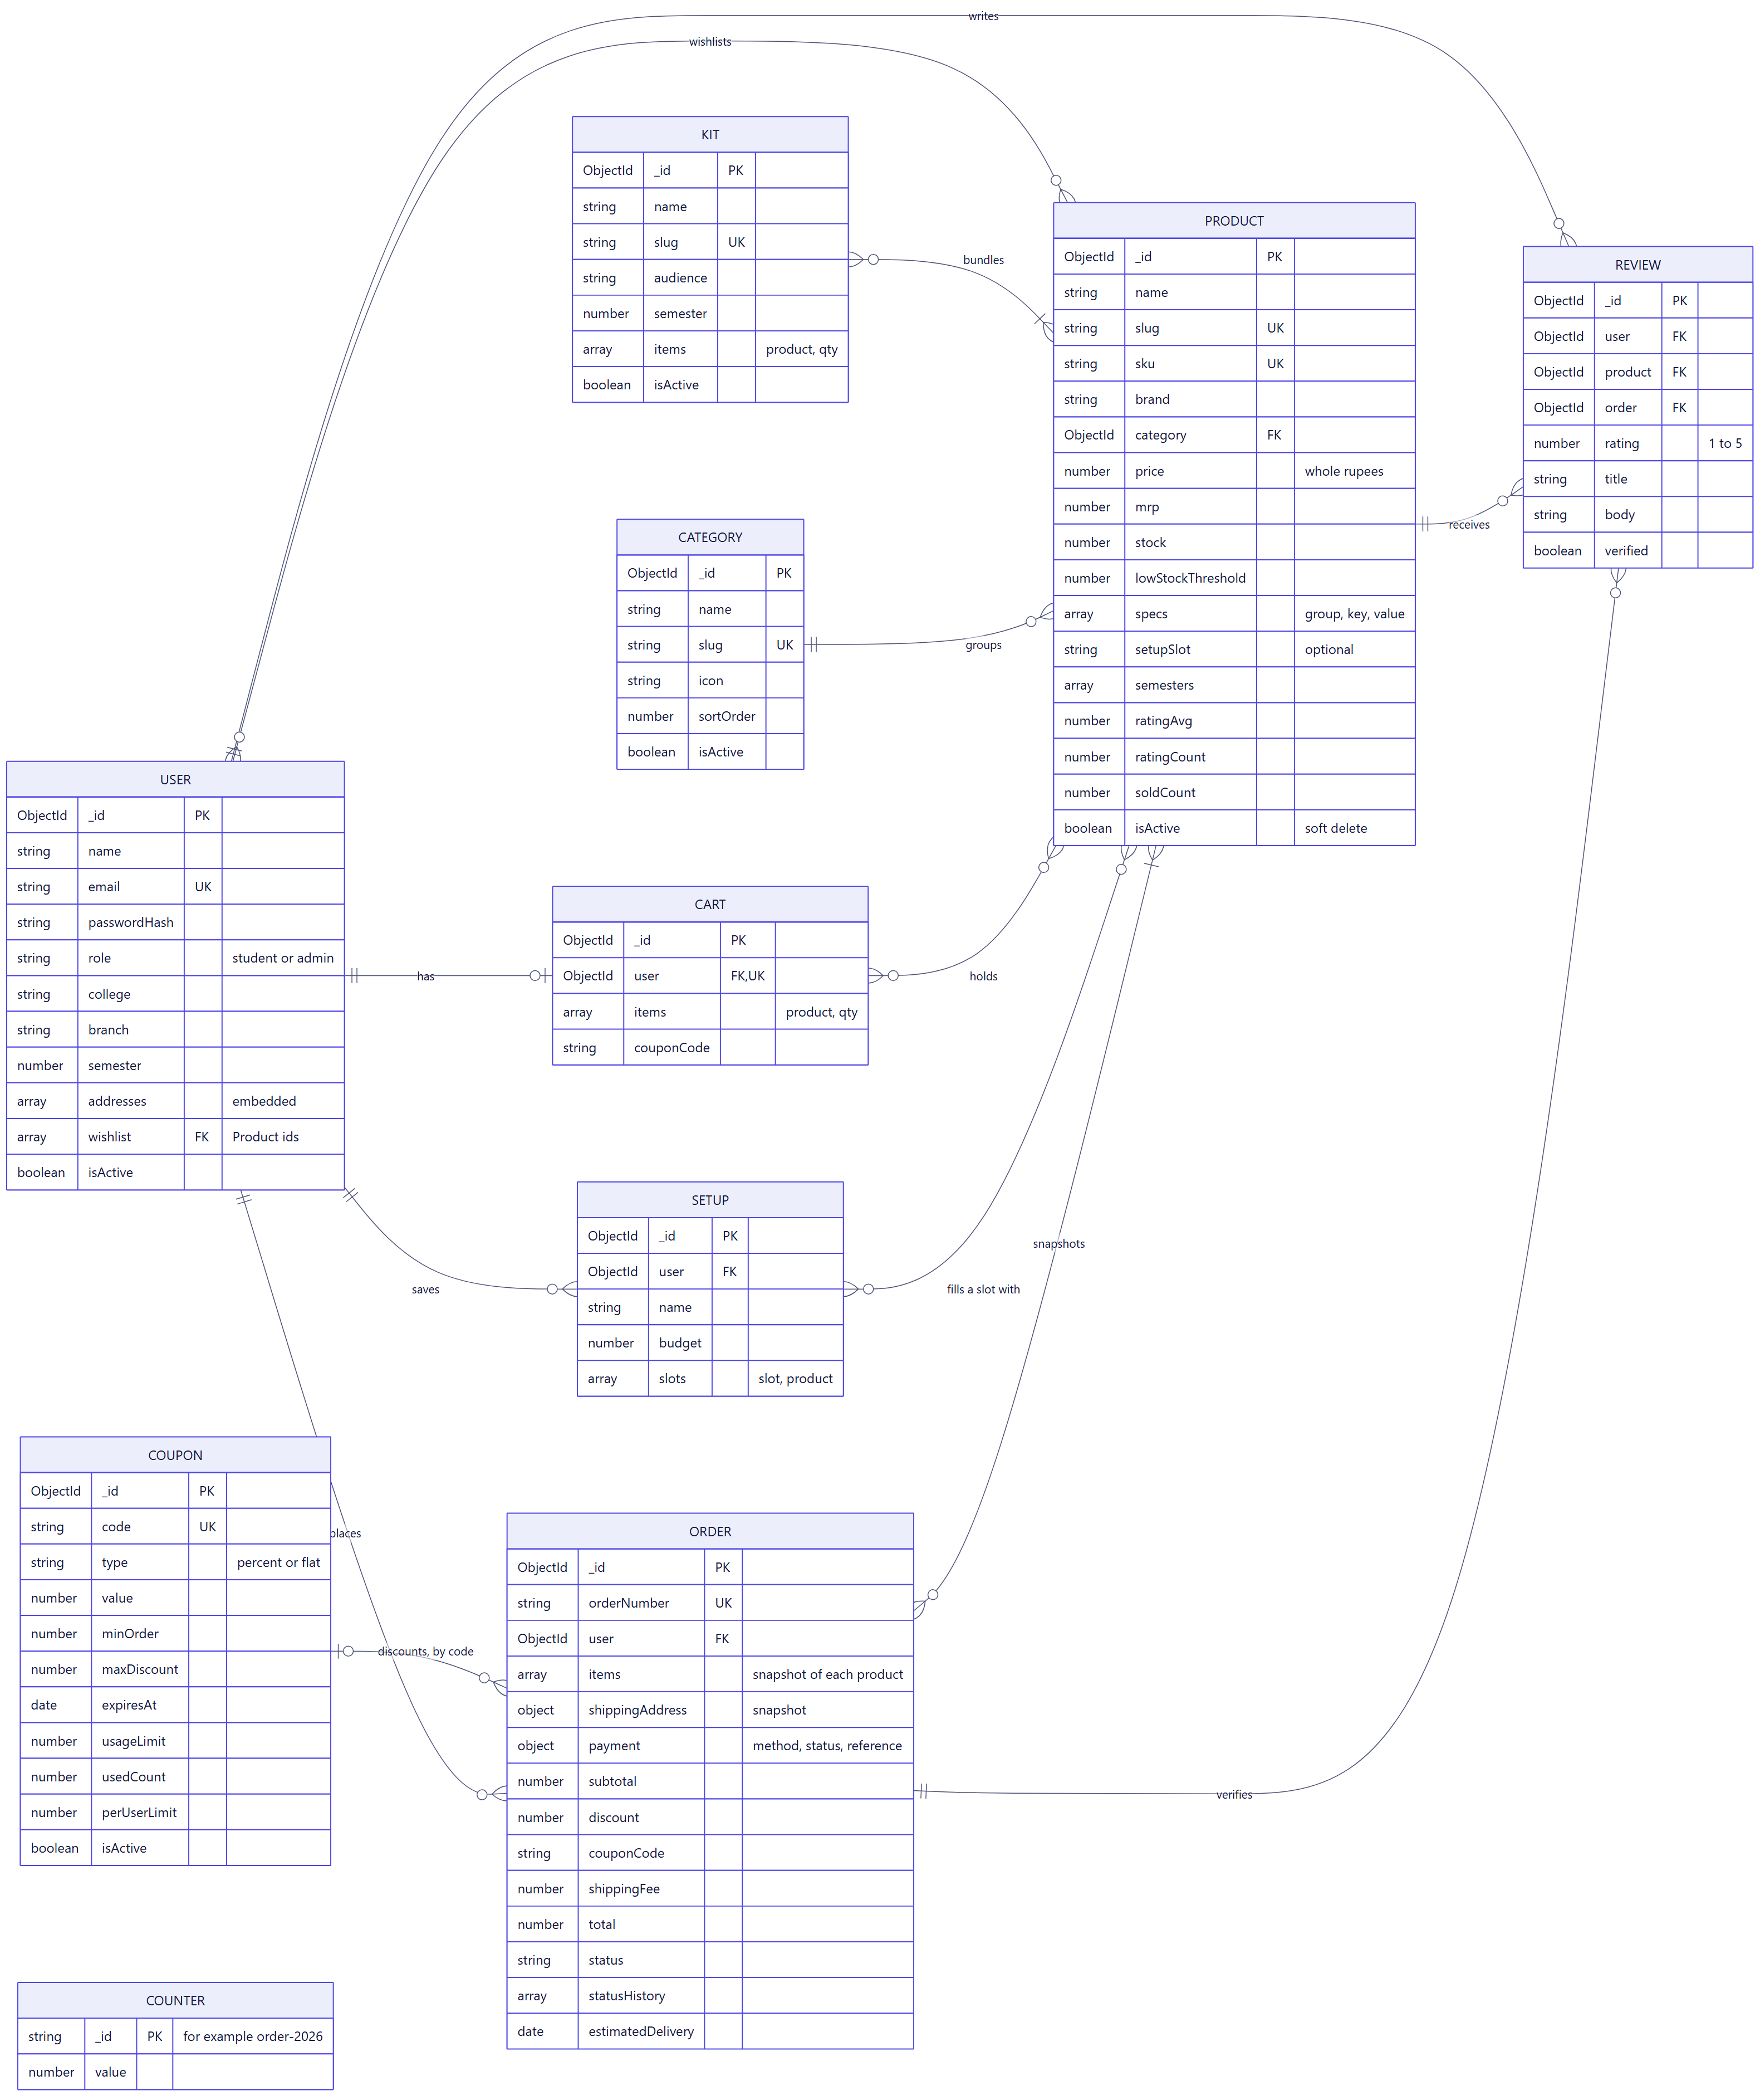
The data model protects past records
Orders copy their data
A later product edit cannot rewrite an old order
Carts store no prices
Totals always come from current prices
Products are hidden, not deleted
Past orders and reviews keep working
The database enforces uniqueness
One review per user and product
Notes:
There are 10 collections. The decisions that matter are about correctness over time. An order keeps its own copy of each item, so a later price change cannot rewrite history. Carts hold no prices, so they cannot show a stale one. And products are hidden rather than deleted, so old orders still work. The full diagram is in the report.

Slide 8
Two students, one unit left: only one order wins
Not this: two separate steps
CampusCart: one atomic update
if (product.stock >= qty) {
// Another order can arrive here
product.stock -= qty;
}
Product.findOneAndUpdate(
{ _id, stock: { $gte: qty } },
{ $inc: { stock: -qty } },
);
Proven by a test
Two competing orders run together, and exactly one succeeds
Undone on failure
If a later step fails, stock, coupon use and the cart are all restored
Notes:
This is the most interesting engineering problem in the project. If you check stock and then update it in two separate steps, two students can both pass the check. Instead, the check and the update are a single conditional database operation, which MongoDB applies atomically. If the order fails later, stock, coupon use and the cart are all restored. An automated test runs this exact race.

Slide 9
Tested at three levels, and it found real bugs
167
What testing caught
Lost data on restart
A test failing 1 run in 3 revealed unjournaled writes
API tests
64
A crash on every page change
An effect returned a value React treated as cleanup
browser tests, including WCAG AA audits
Low contrast in the light theme
Found by the automated accessibility audit
100
Free products
A blank price field was being converted to ₹0
Postman requests
Notes:
Every number here is from a real run of the final version, and all of them passed. More importantly, testing found real defects. Repeating one test showed that data was sometimes lost on restart, because stopping the database on Windows is an instant kill. Browser tests found a crash on every page change. The accessibility audit found low-contrast badges. A code review found that a blank price became a free product. All are fixed, each with a test.

Slide 10
Scoped for a review, with a clear path forward
Deliberately out of scope
What comes next
Real payments
Payment is simulated and asks for no real details
A seller role
Students reselling used textbooks and hardware
Production hardening
Such as rate limiting and email verification
Real payments and email
Razorpay, order notifications, password reset
Product photos
Demo images are generated, though admins can upload photos
Recommendations
Based on branch and semester
Notes:
Be direct about limits. Payment is simulated on purpose, and production security hardening was out of scope. Then point to what comes next. A seller role is the most natural extension, because it would let students resell used books and hardware to each other.

Slide 11
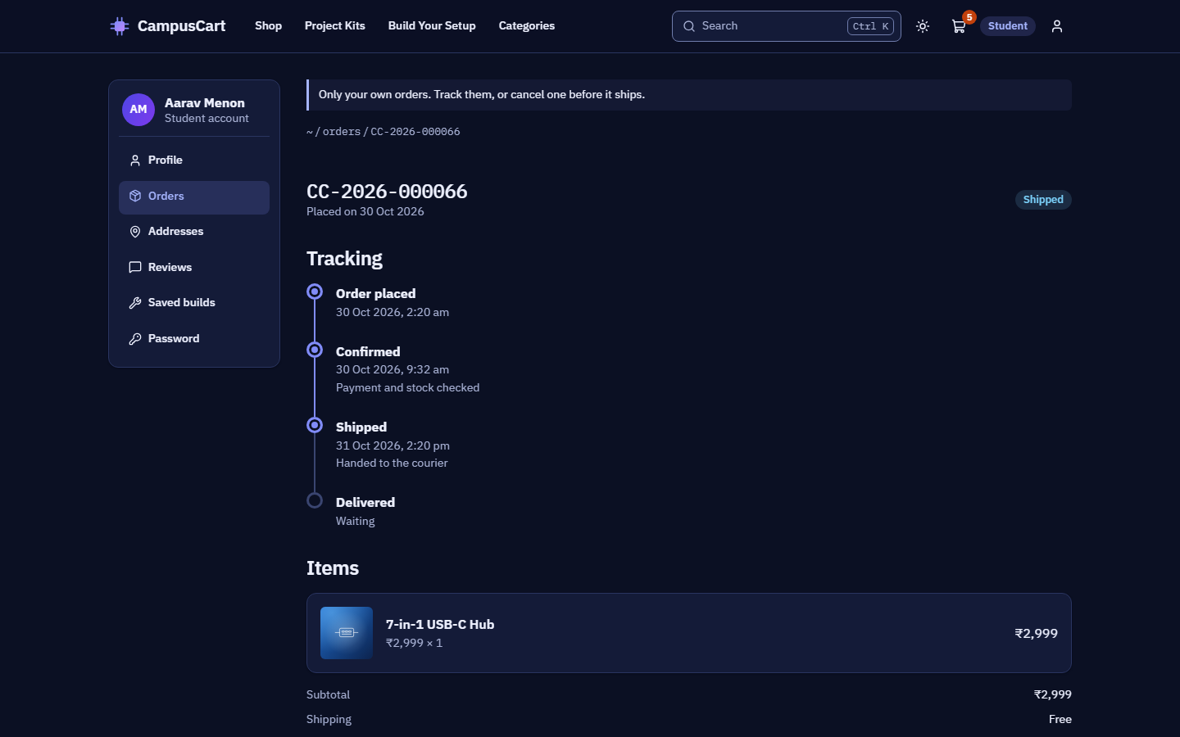
See it running
The live demo covers a student order from search to tracking, then the admin side.
Notes:
Switch to the browser and follow docs/DEMO-SCRIPT.md. Before the review, run npm run db:reset, then npm start, so the demo data is clean. Finish by taking questions. The demo script has answers ready for the most likely ones.

