Slide 1
CUDA & CUDNN

Slide 2
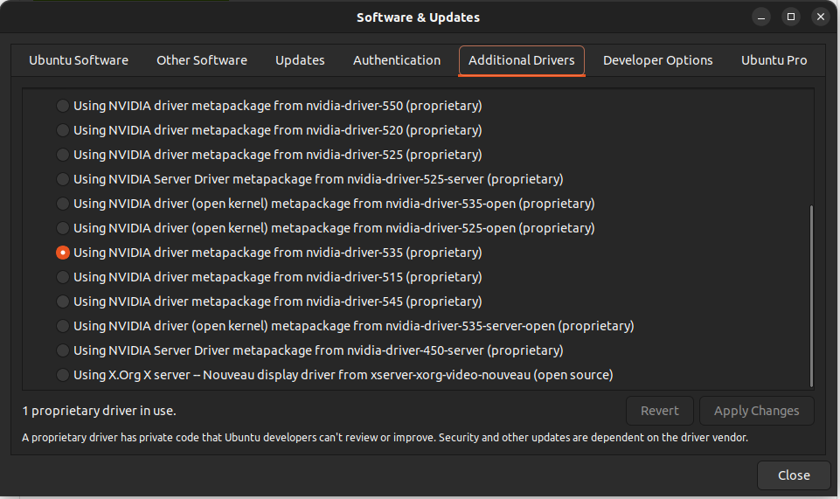
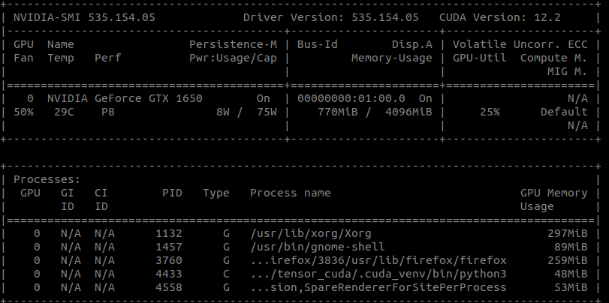
Nvidia 드라이버 버전확인
터미널에 nvidia-smi ( 535 버전이 아니거나 쿠다가 12.2가 아니면
윈도우 키를 누르고 software & updates 에 additional drivers )

Slide 3
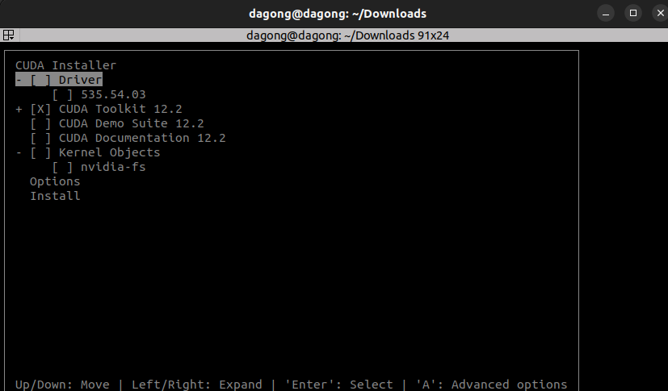
Cuda 설치
wget https://developer.download.nvidia.com/compute/cuda/12.2.0/local_installers/cuda_12.2.0_535.54.03_linux.run
전부 다운로드가 완료되면 같은 폴더에
sudo sh cuda_12.2.0_535.54.03_linux.run
진행 후 아래와 같이 체크
처음에 Abort 말고 Continue

Slide 4
Bashrc 수정
sudo vi ~/.bashrc
export PATH="/usr/local/cuda-12.2/bin:$PATH"
export LD_LIBRARY_PATH="/usr/local/cuda-12.2/lib64:$LD_LIBRARY_PATH"
source ~/.bashrc

Slide 5
Cudnn
https://developer.nvidia.com/rdp/cudnn-archive
Download cuDnn v8.9.7 for CUDA 12.x에서
Local Installer for Linux x86_64 (Tar) 다운로드
Cd ~/Downloads
tar -xvf cudnn-linux-x86_64-8.9.7.29_cuda12-archive.tar.xz
cd cudnn-linux-x86_64-8.9.7.29_cuda12-archive
sudo cp include/cudnn* /usr/local/cuda/include
sudo cp lib/libcudnn* /usr/local/cuda/lib64
sudo chmod a+r /usr/local/cuda/include/cudnn.h /usr/local/cuda/lib64/libcudnn*

Slide 6
Tensorflow & pytorch 설치
Pip uninstall tensorflow pytorch
Pip install tensorflow[and-cuda]==2.15.*
python3 -c "import tensorflow as tf; print(tf.config.list_physical_devices('GPU'))"
pip3 install --pre torch torchvision torchaudio --index-url https://download.pytorch.org/whl/nightly/cu121

