Slide 1
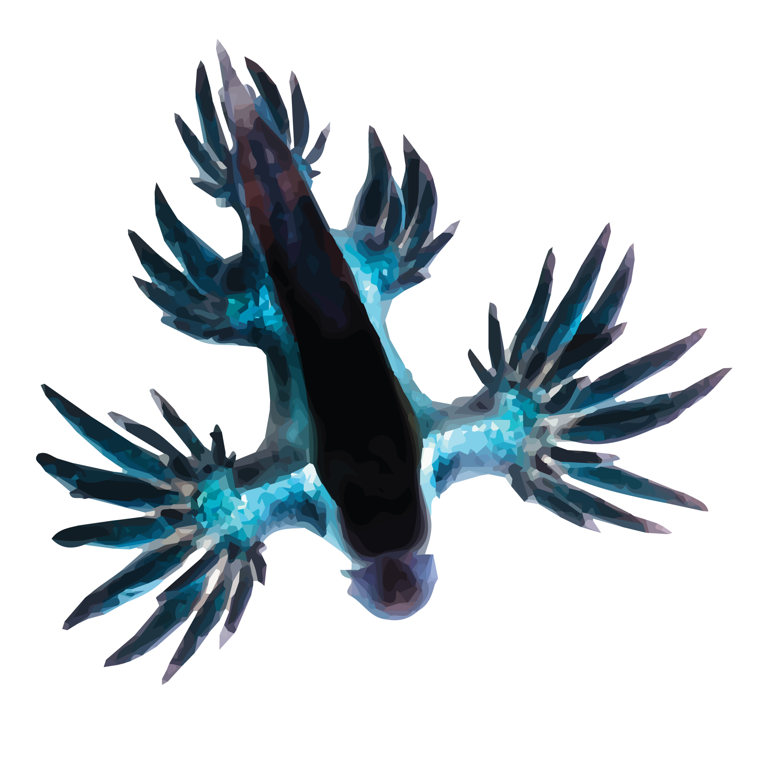

Training and deploying SNN applications with Rockpool and Xylo
Telluride | June 2023
All code:

Slide 2




…
…
0010010101
0001010100
1010010010
1001010101
0010101010
1110001110
0001110101
1010010010
…
Simulatable
network
Trained
network
Computational
graph
Mapped
parameters
Quantised
parameters
Bitstream
HW configuration
Define network
Train
Convert to graph
Map to HW architecture
Quantise parameters
Deploy to HW
rockpool.ai
Notes:
* Our application development pipeline is also available for these devices
* Python-based, supporting all steps of model devlopment, training, quanlisation and mapping to HW, and deployment to the dev kit
* These are based on industry-standard toolchains for NN training

Slide 3


Slide 4
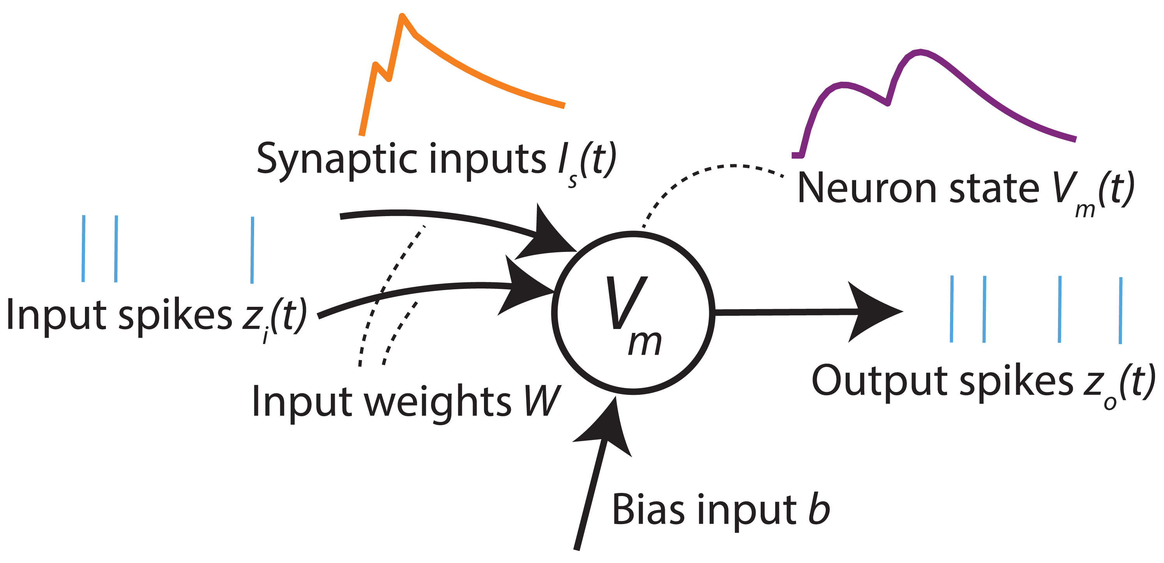
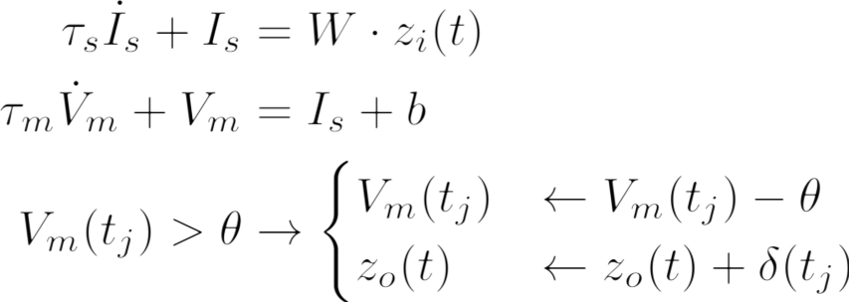
Current-Based Leaky-Integrate-and-Fire (CuBa LIF) neuron model

Slide 5
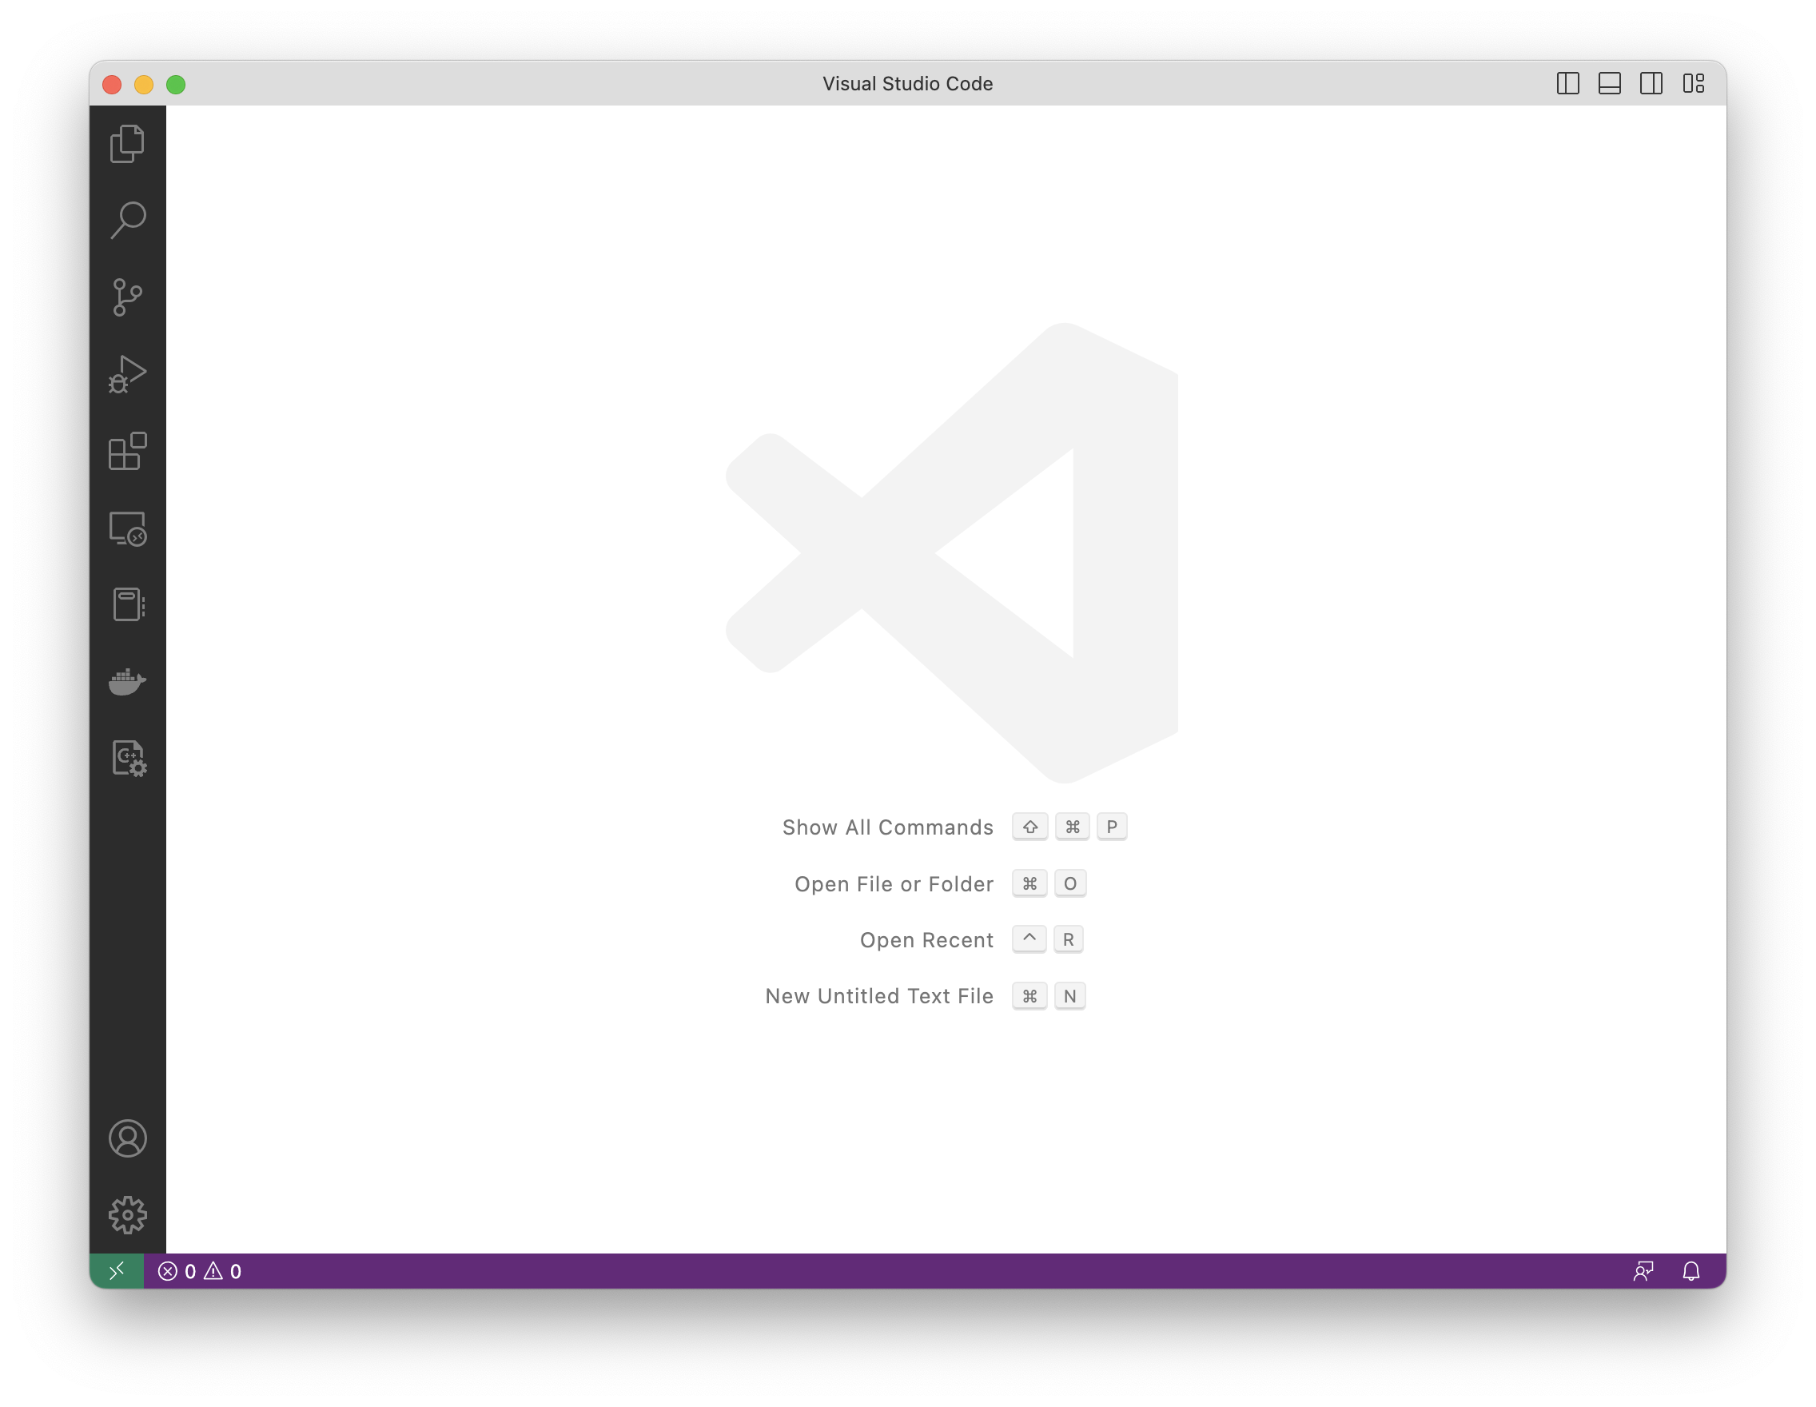

Slide 6
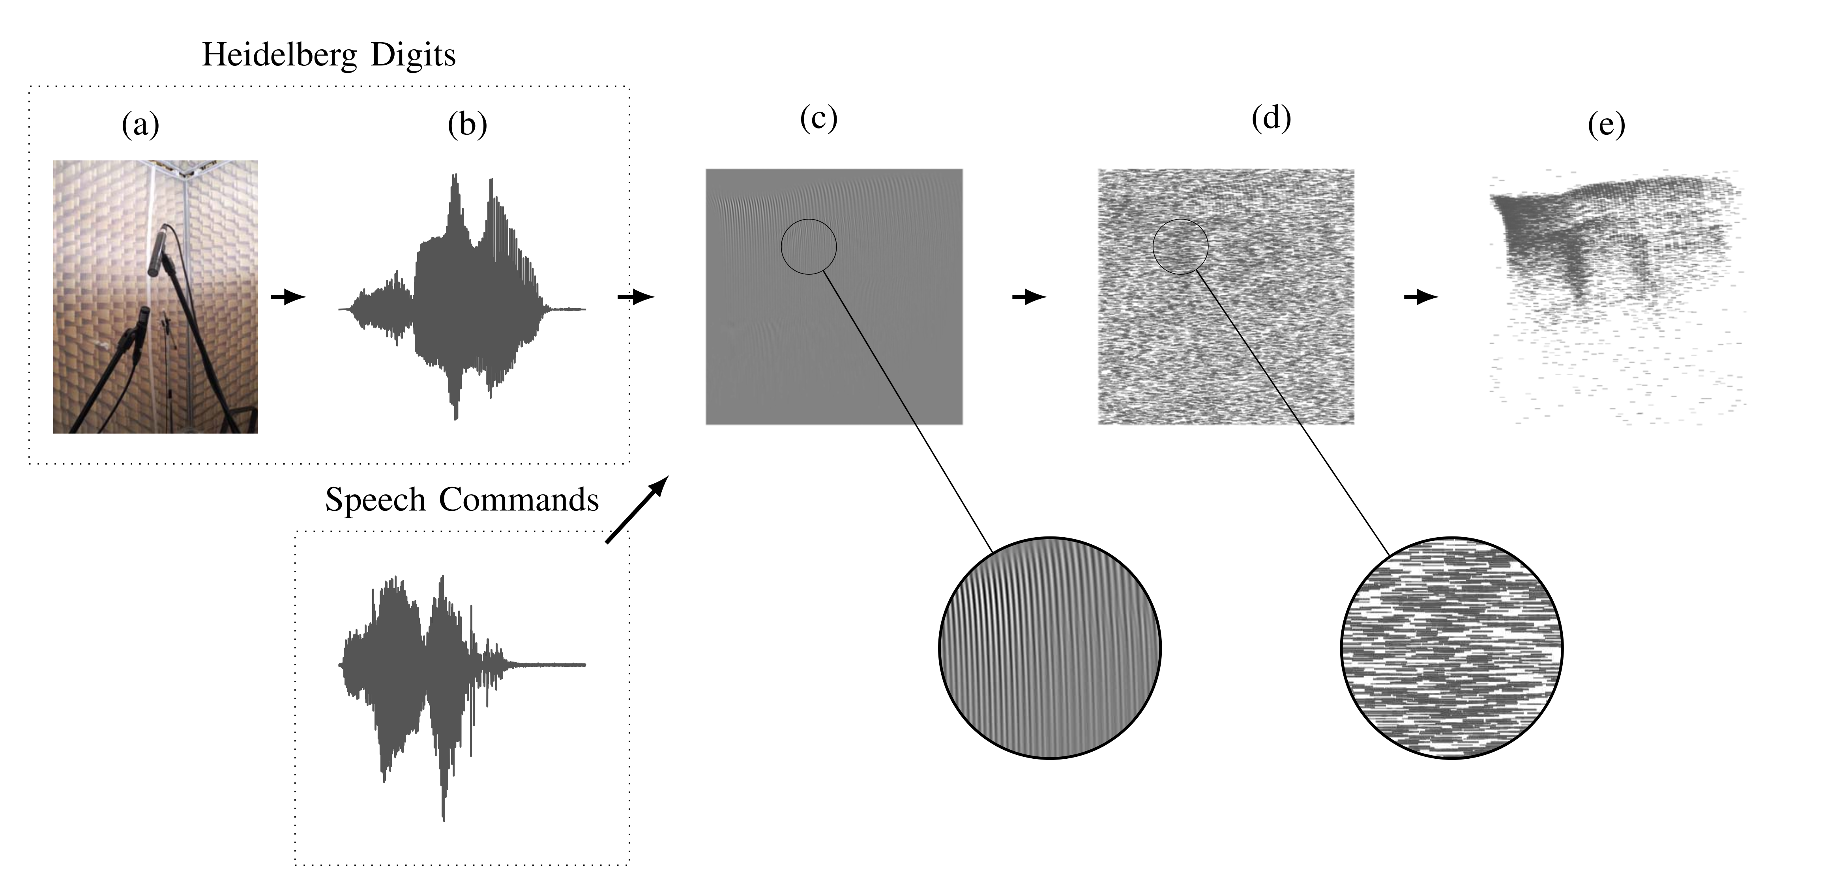

Spiking Hiedelberg Digits
Spoken digits, English and German
20 classes
Pre-processed with highly detailed basilar membrane / cochlea model
Input data provided as spike events
Cramer et al. 2022. IEEE Trans. NNLS 33 2744–2757.

Slide 7

Neuromorphic datasets
  SHD, S-MNIST, DVSGesture, …
Data transformations
Data augmentation
Caching
Open source ❤️
…
tonic.readthedocs.io

Slide 9
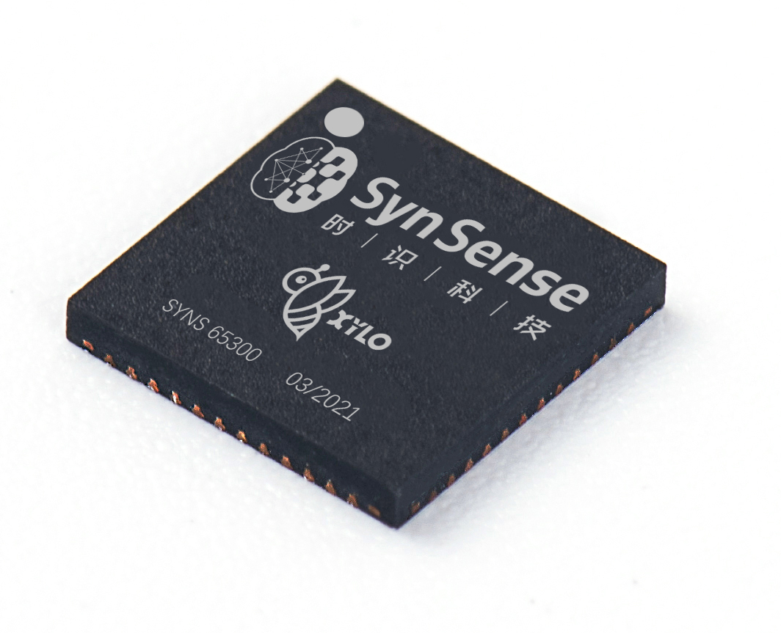
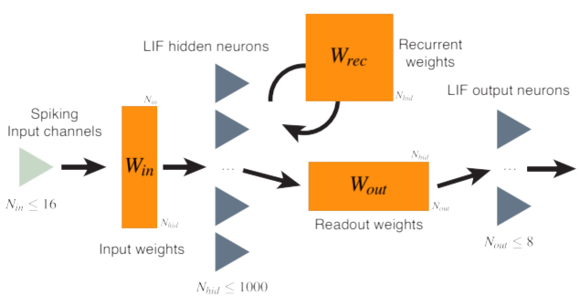
Xylo digital SNN architecture
Logical network architecture
Notes:
The network implemented by the processor has this logical architecture
Up to 16 event-based input channels are supported
Linear input weights are provided for the 1000 hidden LIF neuron population
The hidden population supports recurrent connectivity
A set of readout weights are provided to an 8-neuron LIF spiking output population, producing up to 8 output channels for the chip

Slide 10
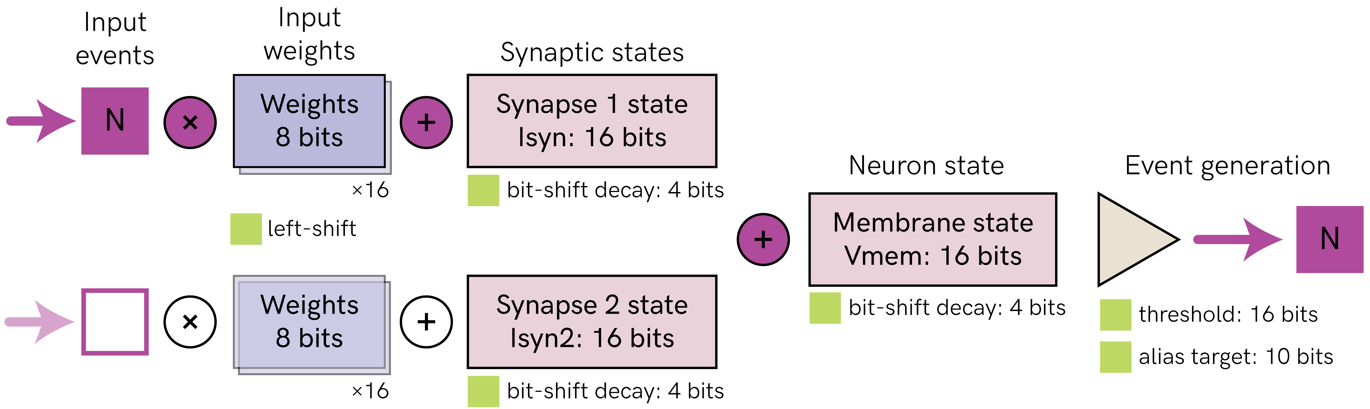
Xylo digital SNN architecture
Digital LIF Neuron
Notes:
We also designed with the IC team a digital neuron tailored for temporal signal processing applications
This architecture is called “Xylo”.
I’m showing here the neuron architecture
It’s an all-digital architecture, which includes synaptic and membrane states with leak

Slide 12

PyTorch, Jax backends
GPU/CUDA, TPU, MPS acceleration
Constrained optimization for SNNs
Time constant & threshold training
Deployable adaptive LIF models
Quantization-aware training
Mixed-signal HW-aware training
Easily extensible
Open source ❤️
…

