Slide 1
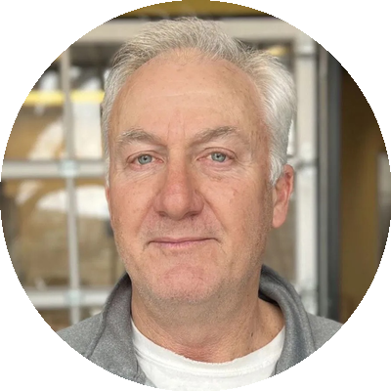
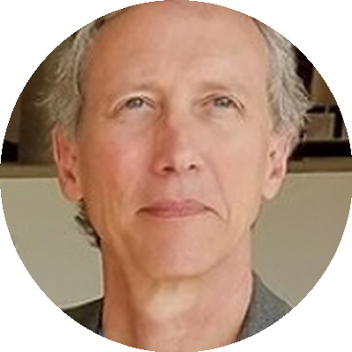
SyntaxisBio Advisory Board
David Raymes
Steve Guengerich
Advisor
Advisor
Accomplished entrepreneur, seasoned executive, and startup investor. Comprehensive experience across B2B and high-tech industries with successful M&A track record.
Technology entrepreneur with 30+ years experience. Founding shareholder of BSG Corporation (acquired for $330M) and Senior Advisor for Innovation at UT Dallas.
SyntaxisBio • Unclonable Cellular Identification • syntaxisbio.com

