Slide 1
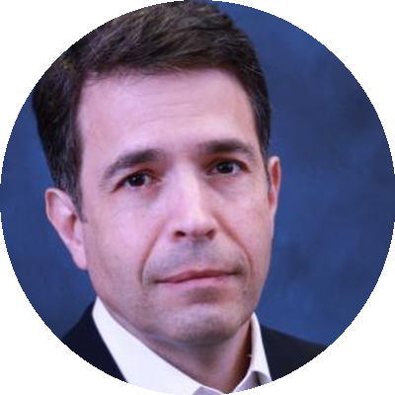
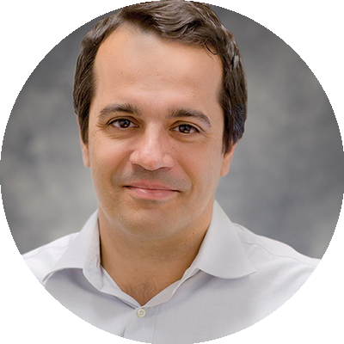
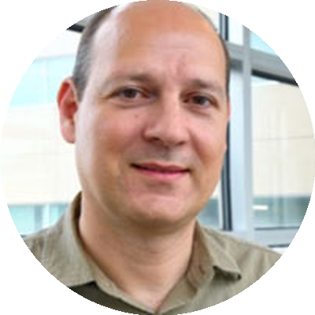
SyntaxisBio Leadership Team
Dr. Alex Pertsemlidis
Dr. Leo Bleris
Dr. Yiorgos Makris
Co-Founder and CEO
Co-Founder and CSO
Chief Strategy Officer
Expert in genomics and bioinformatics, developing computational approaches for genetic PUF analysis and validation.
Expert in synthetic biology and genome editing, pioneering the development of genetic PUF technology for cellular identification.
Expert in hardware security and PUF technologies, translating semiconductor security concepts to biological systems.
SyntaxisBio • Unclonable Cellular Identification • syntaxisbio.com

