Slide 1
Elementary Statistics
Professor Cheryl Dickter

Slide 2
Intro to Stats
Statistics: branch of applied math that scientists use to:
Gather, organize and analyze data
Present data to other researchers
Make inferences about data – answer questions that initiated the research

Slide 3
What is a Statistic?
Sample
Sample
Population
Sample
Sample
Parameter: value that describes a population
Statistic: a value that describes a sample
PSYCH → almost always uses samples!!!

Slide 4
Descriptive & Inferential Statistics
Descriptive Statistics
Organize
Summarize
Simplify
Presentation of data
Inferential Statistics
Generalize from samples to populations
Hypothesis testing
Relationships among variables
Describing data
Make predictions

Slide 5
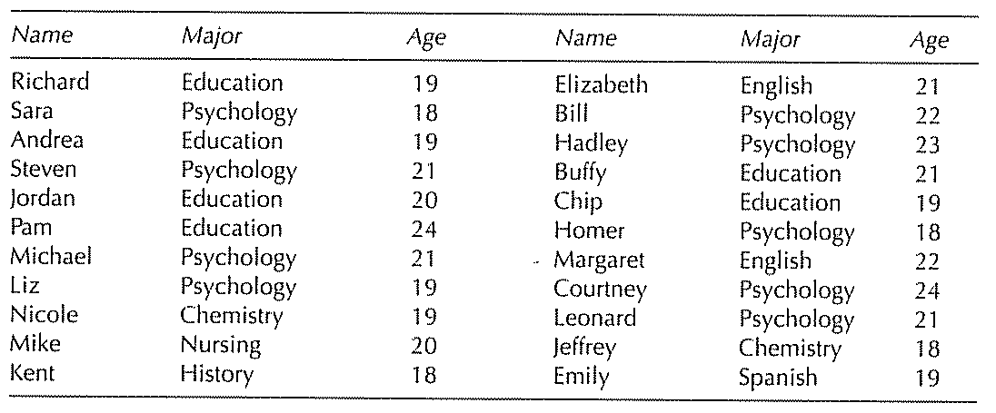
Descriptive Statistics
Organizing, summarizing, and communicating numerical information

Slide 6
Descriptive Statistics
3 Types
1. Frequency Distributions
3. Summary Stats
# of Ps that fall
into a particular category
Describe data in just one
number
2. Graphical Representations
Graphs & Tables

Slide 7
Inferential Statistics
Using samples to draw conclusions about a population
What is the difference between a population and a sample?
N = population n = sample

Slide 8
data
Are our inferences valid?…Best we can do is to
calculate probability about inferences

Slide 9
Important Terms
Variable:
Characteristic or condition that changes or has different values for different individuals
Constant:
Characteristic or condition that does not change across individuals

Slide 10
Important Terms
Parameter: A characteristic of the population. Denoted with Greek letters such as μ or σ
Statistic: A characteristic of a sample. Denoted with English letters such as X or S

Slide 11
Important Terms
Data:
A set of observations or measurements.
Raw score (Datum):
A single observation or measurement.

Slide 12
Review of Basic Research Methods
Hypothesis testing: the process of drawing conclusions about whether a particular relation between variables is supported by the evidence
Hypothesis: a possible explanation for the behavior being studied that is based on previously gathered facts and theories

Slide 13
Review of Basic Research Methods
Experiments: demonstrate a cause-and-effect relationship between variables
Manipulation of independent variable(s) and measurement of dependent variable(s)
Random assignment: every participant in the study has an equal chance of being assigned to any condition
Control: researcher controls situation so that extraneous variables do not influence results

Slide 14
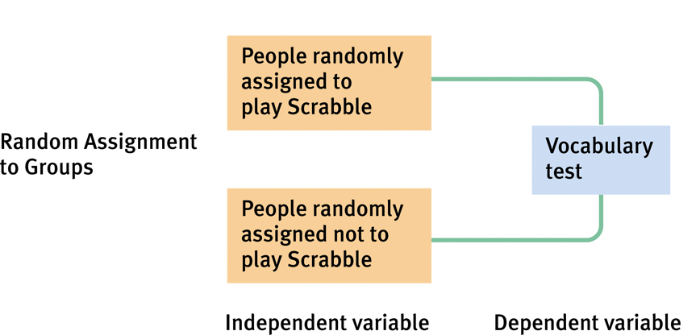
Experimental Design

Slide 15
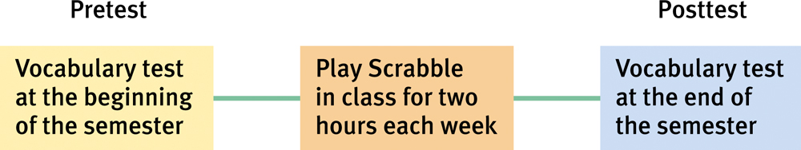
Review of Basic Research Methods
Nonexperiments
Looking for associations
Cannot make causal statements

Slide 16
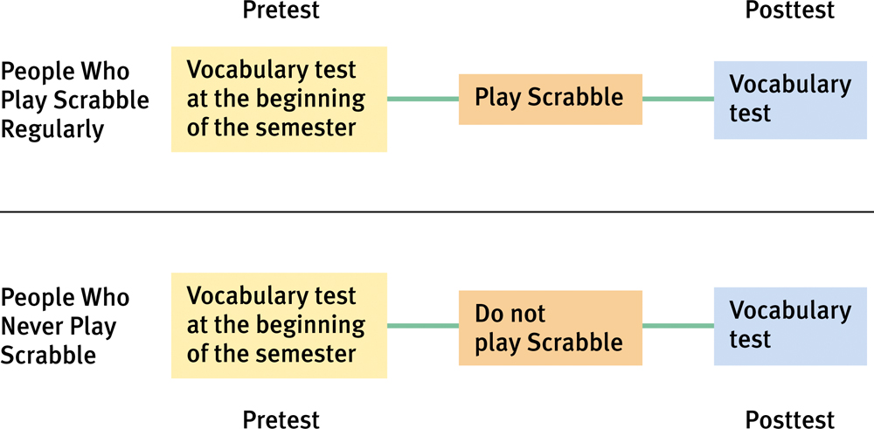
Review of Basic Research Methods
Quasi-Experiments
When randomization is not possible
Cannot make causal statements
Caution making generalizations

Slide 17
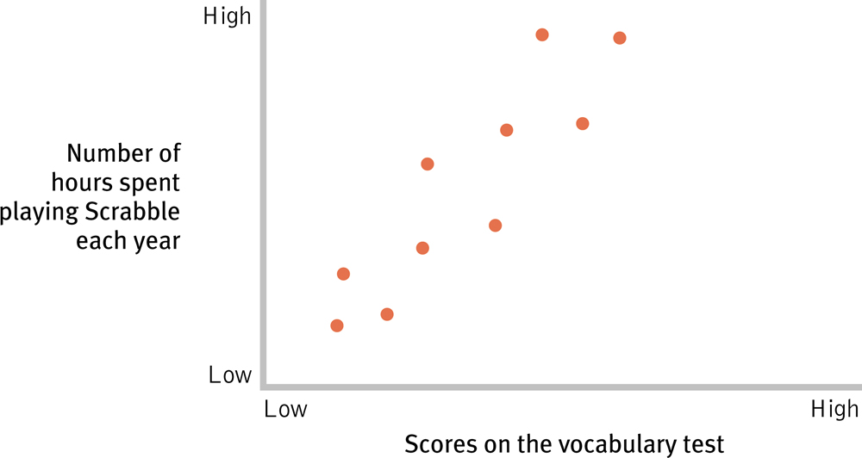
Review of Basic Research Methods
Correlation: association between two or more variables

Slide 18
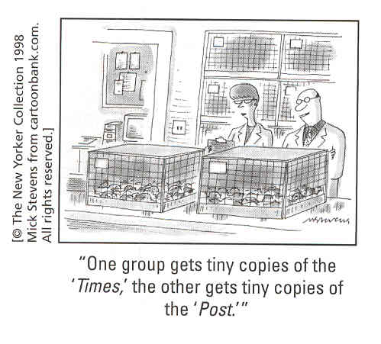
Variables
Independent variable: factor manipulated by researcher and interpreted as the cause of change in DV
Dependent variable: measurable behavior exhibited by participant

Slide 19
Variables
Operational definition: specifies the operations or procedures used to measure or manipulate a variable

Slide 20
Variables
Continuous variable: a variable that can take any value
Discrete variable: a variable that can only take on a small number of possible values

Slide 21
Variables
Confounding variable: anything that systematically varies with the IV so we cannot logically determine which variable is at work

Slide 22
Scales of Measurement
The distinction among scales of measurement are important because they identify the limitations of certain types of measurements and because certain statistical procedures are appropriate for data collected on some scales but not on others

Slide 23
Scales of Measurement
Nominal: variable is qualitative and based on a category
Label and categorize observations, but do not make quantitative distinctions between observations
Ex: race, gender, college major
You can say that 2 individuals are different from one another but you can’t identify the direction or size of the differences

Slide 24
Scales of Measurement
Ordinal: data are ranked and organized in an ordered sequence
Can determine difference and the direction of difference
Ex: standings in a race
You can determine whether 2 individuals are different and the direction of difference

Slide 25
Scales of Measurement
Interval: ranks of scores with equal distances between scores
Difference between two variables is meaningful
E.g., temperature – the difference between 80 and 90 degrees is the same as between 70 and 80
But, no meaningful 0 point – can’t make ratio comparisons (score of 6 is not necessarily twice than score of 3)
E.g., temperature - 0 does not equal no heat, 100 degrees is not twice as hot as 50

Slide 26
Scales of Measurement
Ratio: interval scale with meaningful zero point
e.g.: # of aggressive acts performed, height, weight
OK to compute.... | Nominal | Ordinal | Interval | Ratio
Frequency distribution | Yes | Yes | Yes | Yes
Median and percentiles | No | Yes | Yes | Yes
Add or subtract | No | No | Yes | Yes
Mean, standard deviation, standard error of the mean | No | No | Yes | Yes
Ratio, or coefficient of variation | No | No | No | Yes

Slide 27
Some Notes on Calculations: Rounding
Use Appendix in your text for a basic math review
When calculating problems, round to four decimal places (.0874)
When reporting answers, round to two decimal places (.09)

Slide 28
Some Notes on Calculations
Summations: Σ
Subject | Score (X)
1 | 5
2 | 3
3 | 2
=
Sum of all X’s for subscripts i = 1 to N

