Slide 1
Frequency Distributions and Graphs

Slide 2
Organizing Data
Distributions: ways to visually describe and organize data
Ranked distribution
Frequency distribution
Grouped frequency distribution
Frequency histograms
Frequency polygon
Notes:
2

Slide 3
Ranked Distribution
Ordering the scores from highest to lowest

Slide 4
Frequency Distribution
Listing all possible score values and indicating how often each score occurs
Can be a table or graph
e.g., how many nights do college students go out each week?

Slide 5
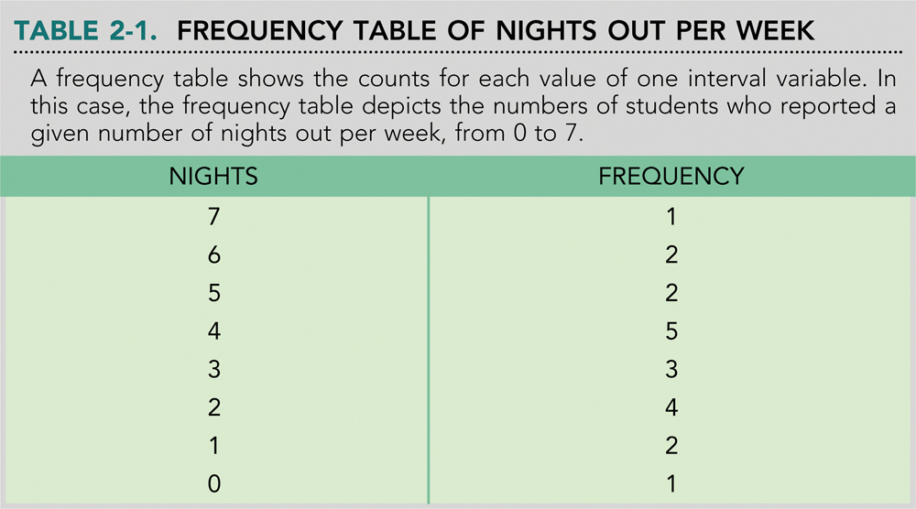
Nights = X
Frequency = f
What is ΣX?

Slide 6
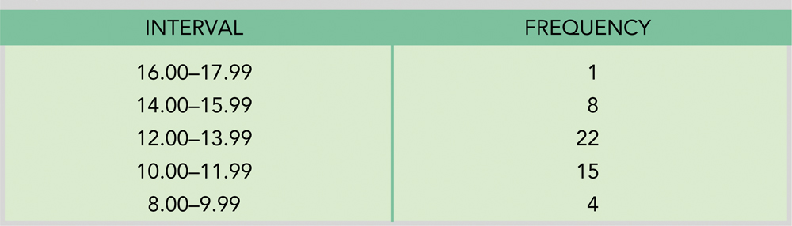
Grouped Frequency Distribution: Stroop Data
Raw data are combined into equal-sized groups (class intervals)

Slide 7
Grouped Frequency Distribution
How do you construct class intervals?
Compute range (highest score – lowest score)
Select an interval size – a simple number is best
5-20 data points cover entire range of data

Slide 8
Grouped Frequency Distribution
X f
50-54 2
45-49 4
40-44 5
35-39 4
30-34 6
25-29 1
20-24 3
15-19 1
10-14 2

Slide 9
Cumulative Frequency and Cumulative Percentage
Percentile rank: percentage of individuals in the distribution with scores at or below the value
Cumulative frequencies – represent the number of people in or below each category on the scale

Slide 10
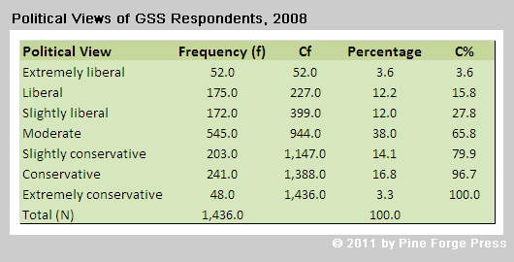
Cumulative Frequency Table

Slide 11
Group Exercise
Data from statistics exam:
51 98 55 71 87 82 83 55 90 65 76 90 71 82 97 67 99 71 88 59
Ranked Distribution
Frequency Distribution
Grouped Frequency Distribution
Cumulative Frequency

Slide 12
Constructing a Graph
Graphs often show relationships between IVs and DVs
X-axis: IV
Y-axis: DV
Give your graph a clear title
Assign appropriate labels and numbers to each axis

Slide 13
Frequency Histogram
Height of bars = frequency for that category
Width of bars = real limits of the category
Shape of a frequency distribution
Symmetrical
Skewed – positive or negative

Slide 14
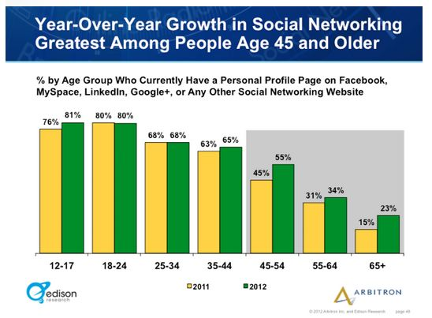
Frequency Histogram

Slide 15
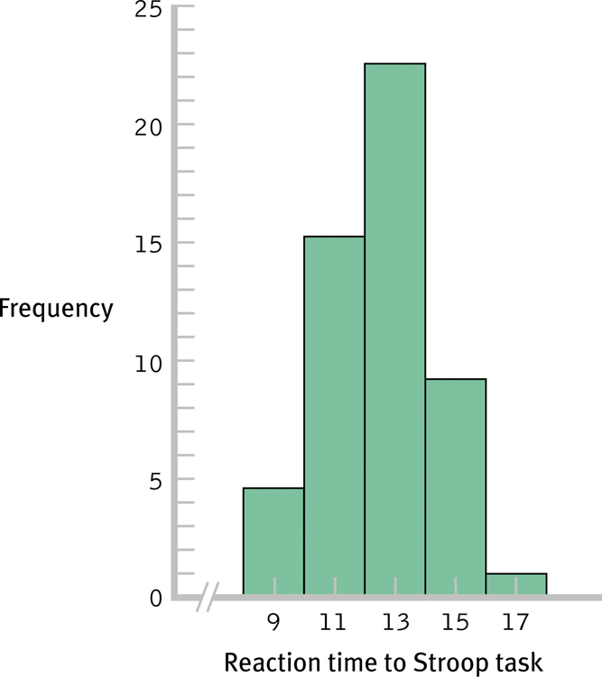
Histogram for the Grouped Frequency Table of Stroop Data

Slide 16
Locus of Control and Health
Raps et al., 1982: nursing home study
Some residents were given a plant to take care of and were given decisions to make about activities, furniture, etc. vs. comparison condition

Slide 17
Raps et al., 1982 results
Percentage of residents who died

Slide 18
Locus of Control and Health
In a similar study, Schulz and Hanusa (1978) induced control for 2 months and then withdrew the control
Compared to a condition in which Ps had no control, those who had temporary control and lost it were more likely to die afterwards

Slide 19
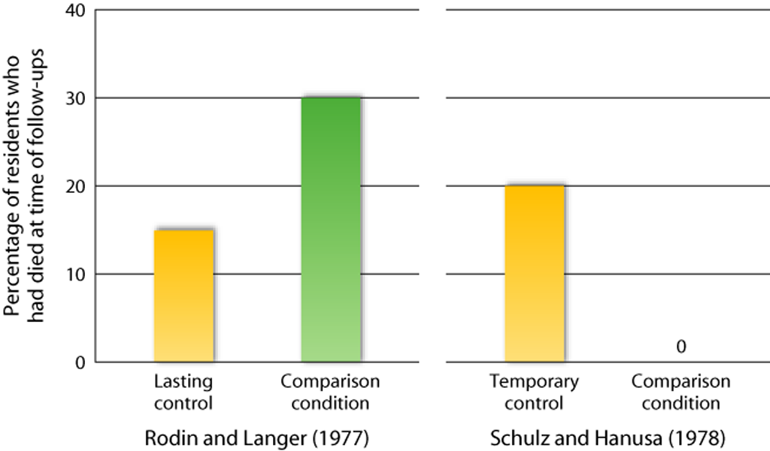

Slide 20
Frequency Polygons
Dot above each score – position of dot = frequency for the category
Draw a continuous line between dots
Draw final line to x-axis (f = 0) at each end of the range

Slide 21
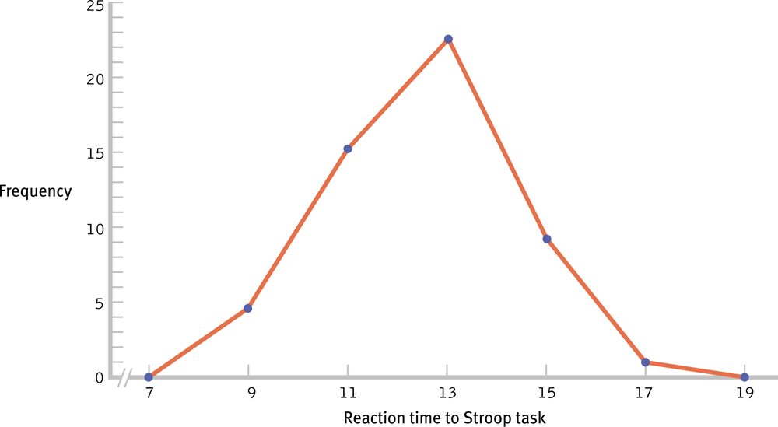
Frequency Polygons
Another Graphing Option for the Stroop Data

Slide 22
Nominal or Ordinal Data
Use bar graphs – with spaces between bars
Nominal – spaces between bars emphasizes that the scale consists of separate, distinct categories
Ordinal – separate bars are used because you cannot assume that the categories are all the same size

Slide 23
Bartholow & Anderson (2002): Does playing violent video games increase aggression?
Male and female participants play a violent or control video game
Then they compete with “opponent” on reaction-time trials.
After losing (winning) a trial, they receive (give) low or high intensity noise blasts.

Slide 24
Bartholow & Anderson (2002)
# High Intensity Noise Blasts
(out of 25)

Slide 25
Stem-and-Leaf Diagrams
Student Pulse Rates:
75 68 77 69 90 70
72 102 78 97 83 77
83 75 81 68 90 72
95 73 80 110 98 105
65 74 75 95 85 87

Slide 26
75 68 77 69 90 70
72 102 78 97 83 77
83 75 81 68 90 72
95 73 80 110 98 105
65 74 75 95 85 87
Range = 65 – 110
So, stem & leaf range = 6 to 11

Slide 27
Stems Leaves
6 5 8 9 8
7 5 2 5 3 4 7 8 5 0 7 2
8 3 1 3 0 7 5
9 5 5 0 7 0 8
10 2 5
11 0

Slide 28
Stem-and-Leaf Diagrams
Females Stems Males
5 8 6 9 8
5 4 3 5 8 2 7 5 7 0 7 2
0 1 3 8 3 5 7 5 9 0 7 0 8 5
2 10 5
11 0

Slide 29
Research Example: Towler & Dipboye (1998)
Students ask friends and/or look at instructor evaluations to decide if a class is worth taking
Kelley (1950) found that instructor reputation affects actual teaching ratings
Towler and Dipboye (1998) asked:
Does an instructor's prior reputation affect student ratings?

Slide 30
Research Example: Towler & Dipboye (1998)
Participants randomly assigned to either:
"Charismatic instructor": Professor was always lively and stimulating in class, and commanded respect from everyone. She used differing teaching methods and frequently allowed students to experiment and be creative. Outside the classroom, Professor was always approachable and treated students as individuals
"Punitive instructor" : Professor did not show an interest in students' progress or make any attempt to sustain student interest in the subject. When students asked questions in class, they were frequently told to find the answers for themselves. Professor consistently seemed to grade students harder than other lecturers in the department.

Slide 31
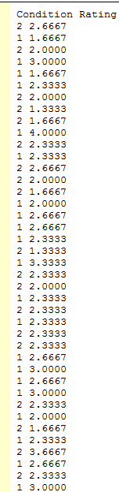
Research Example: Towler & Dipboye (1998)
Participants watched the same 20 min lecture given by the exact same lecturer.

Slide 32
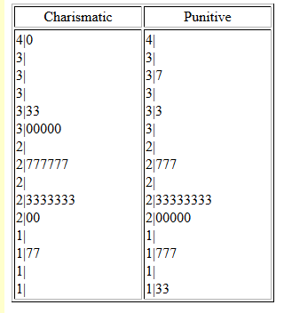

Slide 33
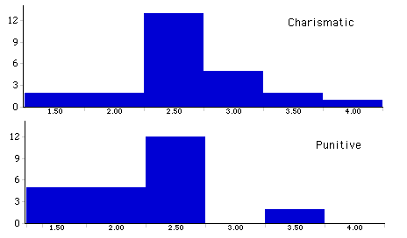

Slide 34
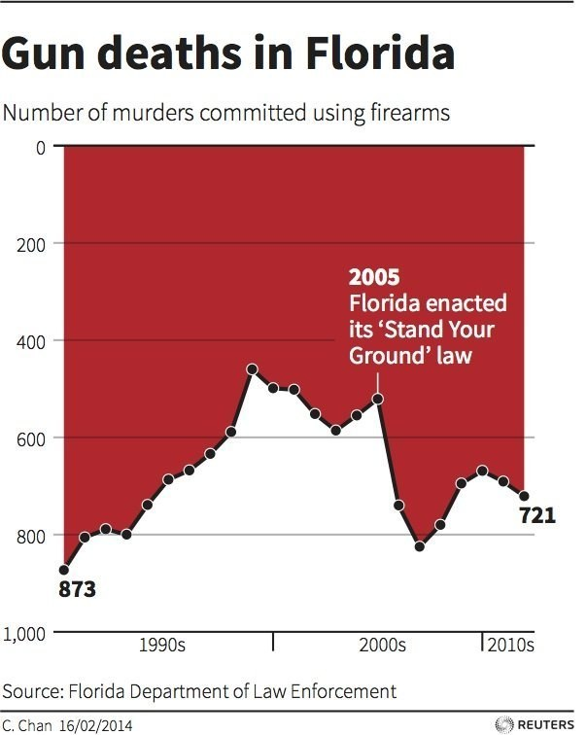
How Graphs can Lie

Slide 35
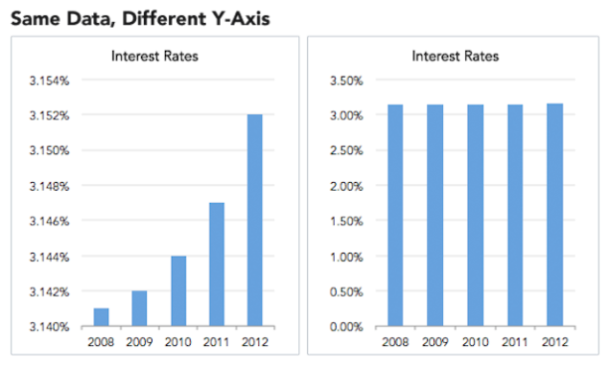
Same Data, Different Y-axis

Slide 36
