Slide 1
Central Tendency and Variability

Slide 2
Central Tendency
Central tendency: the descriptive statistic that best represents the center of a data set
Identifies the average, or typical score, to serve as a representative value for each group

Slide 3
Measures of Central Tendency
Commonly called the “average.” Sum of the scores divided by the number of scores.
Mean
Sample mean:
Population mean:
Median
The “middle” value of the distribution, below which 50% of the observations fall. The 50th percentile.
Mode
The most frequent score in the distribution.

Slide 4
Properties of the Mean
51 54 57 60 63 66 69 72 75 78 81
Height (in)
The mean is the balance point of the distribution

Slide 5

Properties of the Mean
It is sensitive to extreme scores
This causes mean to go toward the outliers
Outlier
Annual income

Slide 6
Properties of the Mean
The sum of the deviations about the mean equals zero
Symbolically:
For example, consider the scores 5, 8, 6, 5
X_{i} | X_{i} - X
5 | -1
8
6
5

Slide 7
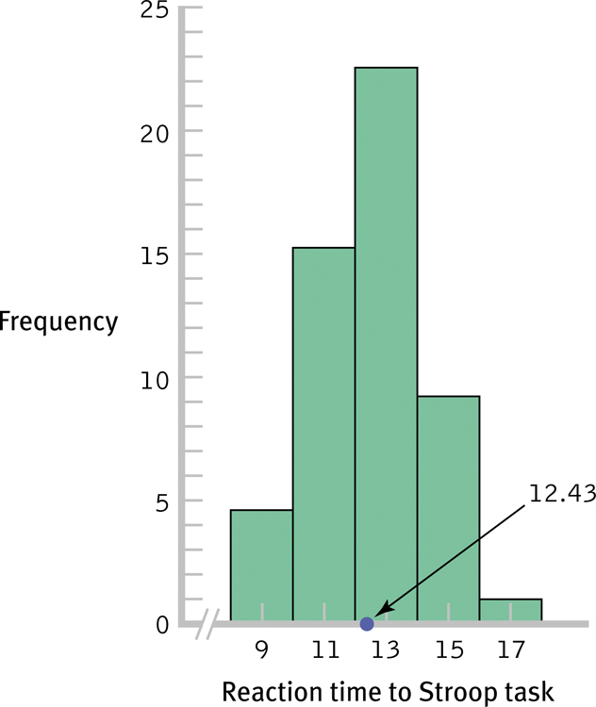
Properties of the Mean

Slide 8
Properties of the Mean
Sample mean is the measure of central tendency that best represents the population mean
Mean is VERY sensitive to extreme scores that can “skew” or distort findings

Slide 9
Median
Divides distribution in half so that 50% of the individuals in a distribution have scores at or below the median
For odd number of scores, pick middle score
For even number, the median is the average of the middle two scores

Slide 10
Median
Case 1: Odd number of scores
E.g., 8, 5, 200, 3, 10
List scores from lowest to highest:
3, 5, 8, 10, 200
Select the middle score in the list:
3, 5, 8, 10, 200
Case 2: Even number of scores
E.g., 3, 4, 6, 200, 3, 10
List scores from lowest to highest:
3, 3, 4, 6, 10, 200
Average the two middle scores
3, 3, 4, 6, 10, 200

Slide 11
Mode
Unimodal: distribution that has one mode
Bimodal: distribution that has two modes
Mulitmodal: more than two modes

Slide 12
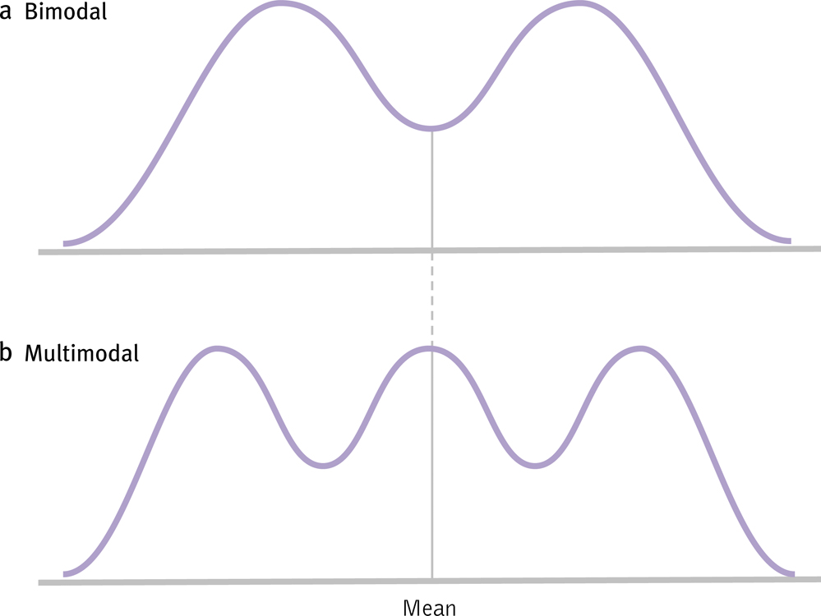
Mode

Slide 13
When to Use each Measure…
Use the Mode
when the data are nominal (e.g., gender) or discrete (e.g., 2.5 children)
Use the Median
when you have extreme scores or skewed distributions
for ordinal data
Use the Mean
in most other cases

Slide 14
Reporting Measures of Central Tendency
APA Style:
Rats in the treatment group completed the maze faster (M = 4.67 sec) than those in the control group (M = 7.04 sec).
The median number of errors made by the rats was 3.00 in the treatment group and 6.50 in the control group.
The modal major was Psychology, with 35 out of 40 students declaring this major.

Slide 15
Reporting Measures of Central Tendency
 | Treatment | Control
Morning | 4.94 | 7.81
Evening | 4.61 | 8.02
Table 1. Average RT as a function of time of day and treatment condition.

Slide 16
Skew
Skew: general shape of a distribution
No skew: shape is symmetrical – use mean
Skewed: most of the scores at one end – use median or mode

Slide 17
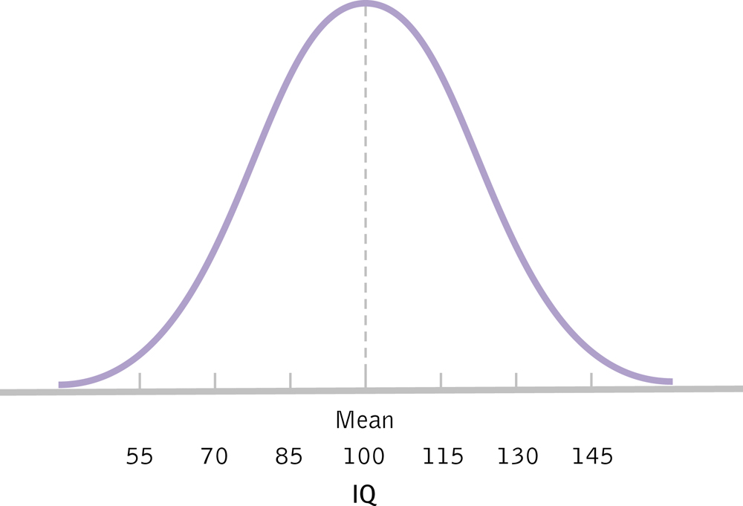
No skew

Slide 18
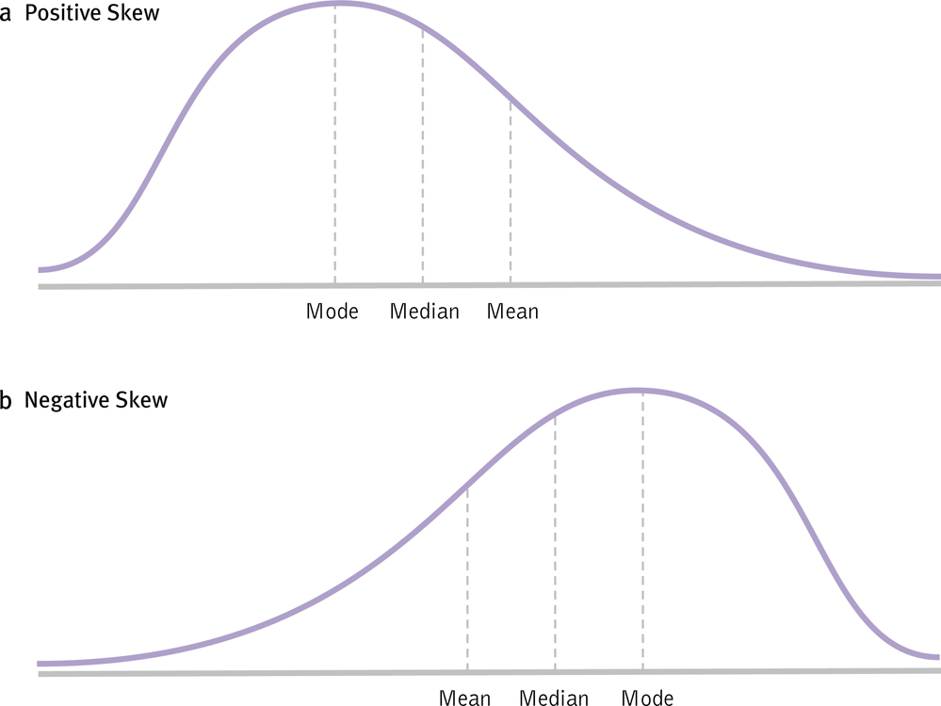
Skew

Slide 19
Kurtosis
Describes shape of curve: how skinny or fat it is
Mesokurtic: normal distribution with most scores in middle
Leptokurtic: tall and thin with thicker tails
Platykurtic: short and fat and have thinner tails

Slide 20
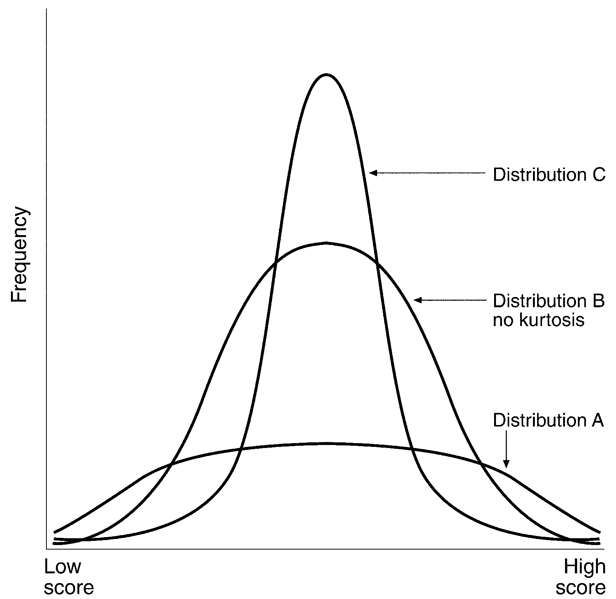
Leptokurtic
Mesokurtic
Platykurtic

Slide 21
Measures of Variability
Measures of central tendency can summarize an important aspect of a distribution, but distributions have more properties than just their center
Measures of variability help us describe our data
They give us an idea of how much scores in the distribution vary from the average score

Slide 22
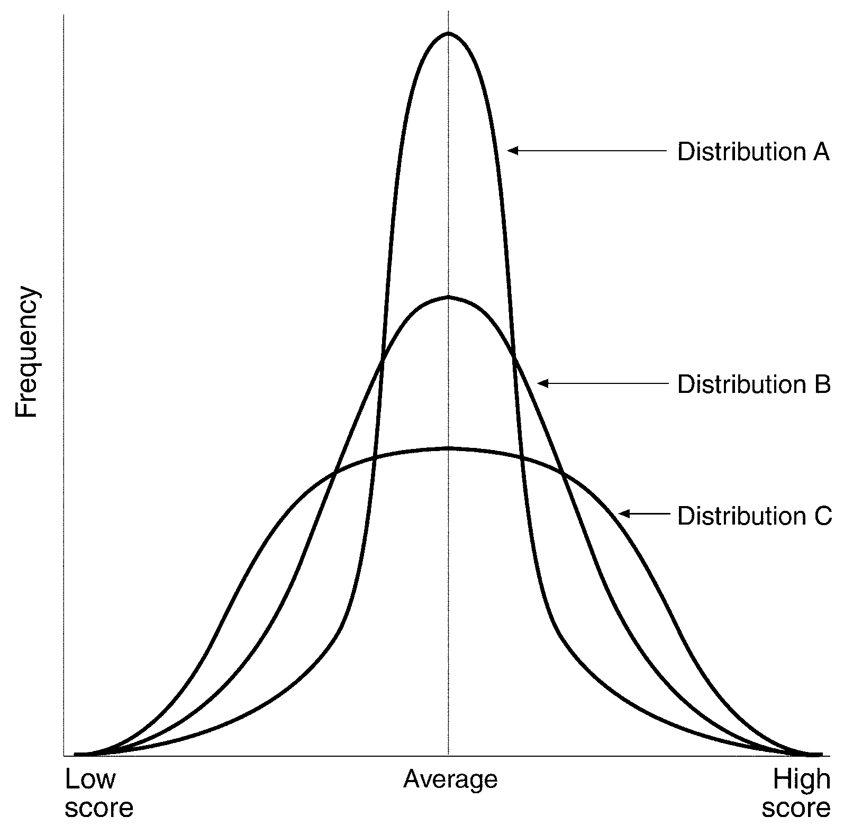

Slide 23
Measures of Variability
Range: Full extent of scores in a distribution, from lowest to highest
Range = X_{max} – X_{min}
Why is it important to take the range into consideration and not just the mean?

Slide 24
Measures of Variability
0 10 20 30 40 50 60 70 80 90 100 110 120 130
0 10 20 30 40 50 60 70 80 90 100 110 120 130

Slide 25
Measures of Variability
Range = 20
0 10 20 30 40 50 60 70 80 90 100 110 120 130
0 10 20 30 40 50 60 70 80 90 100 110 120 130
Range = 110

Slide 26
Measures of Variability
However, the range reflects only the values of the most extreme scores and may not be representative of all of the scores.
0 10 20 30 40 50 60 70 80 90 100 110 120 130
0 10 20 30 40 50 60 70 80 90 100 110 120 130
These two distributions have the same range

Slide 27
Measures of Variability
Standard deviation:
Uses the mean of distribution as a reference point – represents average distance from the mean
Measures variability by considering distance between each score and the mean

Slide 28
Measures of Variability
Variance: average of the squared deviations from the mean
population variance = σ² =
sample variance = S² =

Slide 29
Measures of Variability
Why do we need to square the deviations?
Why n-1?
The standard deviation is an estimate of the population standard deviation and is an unbiased estimate, but only when we use n-1.
By subtracting 1 from n, we force the standard deviation to be larger than it would otherwise – this is a conservative estimate

Slide 30
Measures of Variability
Standard deviation: square root of variance – in original units
population s.d.=σ =
sample s.d. = s =

Slide 31
Measures of Variability
SS =

Slide 32
Computational Formulas
Variance = S² =
Standard deviation = S =

Slide 33
Computational Formulas
Sum of Squares

Slide 34
Reporting the Mean and Standard Deviation
APA style:
Children who viewed the violent cartoon displayed more aggressive responses (M = 12.45, SD = 3.70) than those who viewed the control cartoon (M = 4.22, SD = 1.04).

