Slide 1
CST336 Challenge activity
NOTE: For Attendance, you must submit the
Google Form by the end of the session
Databases/ Javascript/php

Slide 2
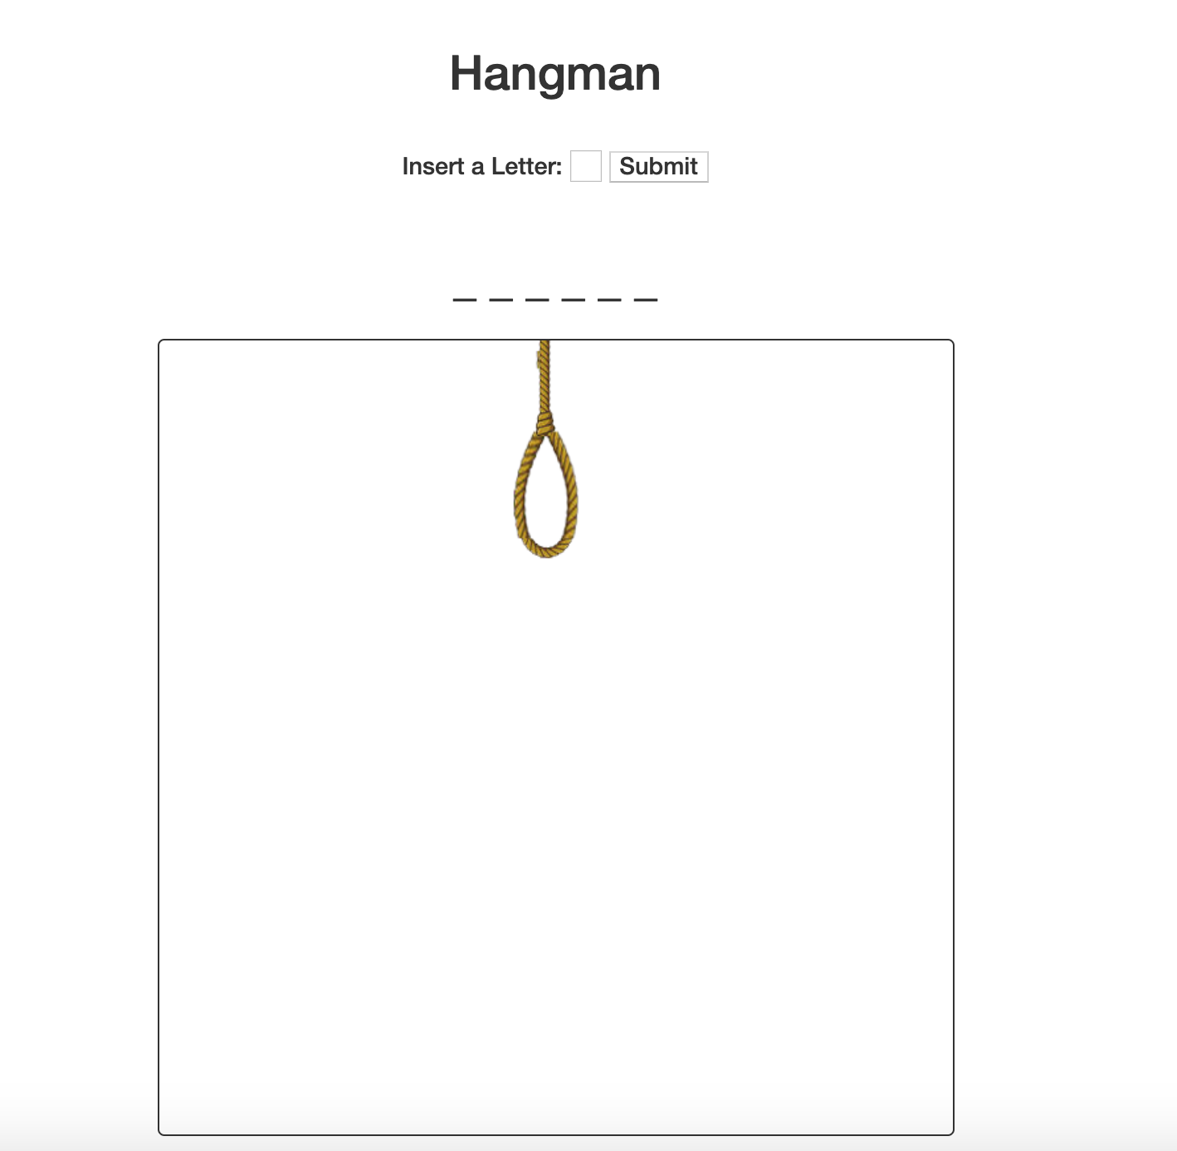
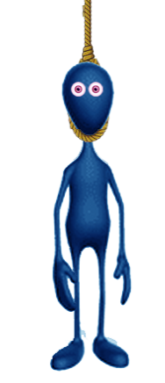
Task: Hangman

Slide 3
Directions:
You’ll start working INDIVIDUALLY for 10 minutes.
Individually, do the following:
1) Within the “practice” folder, create a new folder called “p6”
2) Upload all files and folders from the “hangman” folder in your local computer to the “p6” folder
3) Upload the SQL to myphpadmin
4) Open the “index.html”
5) Start implementing the rubric requirements. Do as much as you can!

Slide 4
Directions:
Work in pairs for 50 minutes.
In pairs, do the following:
You MUST use ONLY ONE computer
The teammate to the right must start coding for 7 minutes. The other teammate must observe and help.
After every 7 minutes, you MUST switch (the coder becomes the observer and the other way around)
BOTH of you must be engaged in the activity
Those who complete the activity in 50 minutes will get three extra points in a homework assignment.
A few completers will be selected to show your work

Slide 5
Rubric:
You MUST use ONLY ONE computer and SWITCH typing every 7 min. Three Points:
Upon reloading the page, a new random word is chosen using an API and the number of blanks corresponds with the random word. The word is not returned from the API.
Upon submitting a letter in the word, the blank is replaced with the letter, done in an ajax call to a PHP API
Upon submitting a letter not in the word, a piece of the hangman is displayed
When the hangman is fully drawn out there is a lose message
There is a win message when the word is solved Two Bonus Points!
Upon ”Winning” or ”Losing” the input, the submit button is not displayed
Upon ”Winning” or “Losing” a button to allow for a New Word is displayed
Letters the user has already guessed are displayed

