Slide 1
ETL Pipeline for Synthea Database
Group 2

Slide 2
The problem —
Raw Synthea healthcare data is complex and not optimized for analysis. To simplify insights and reporting, we built dimensional data marts for key domains like patients, Clinician, and Transaction.

Slide 3
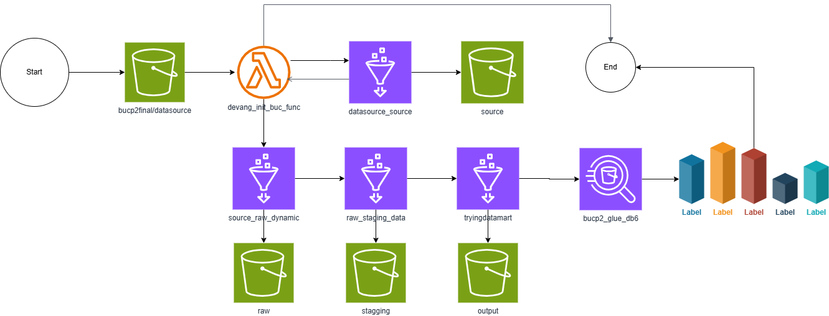
Data Flow
./run_synthea –p 1000
On Failure
On Success
On Success
On Success
On Success
PowerBi
Glue Workflow

Slide 4
Implementation Summary
Initial Cleaning - Source to Raw (Glue Job 1) - Minor data cleaning is performed
Removed unnamed columns
Handling extra commas
Moving clean data to raw.
Deep Cleaning – Raw To Staging (Glue job 2) - Major data cleaning is performed.
Remove duplicates, replace null with none.
Casting columns to correct data type.
Standardizing and trimming column names
Formatting phone numbers.
Splitting multi valued columns.
Converting CSV to Parquet format for Optimization.

Slide 5
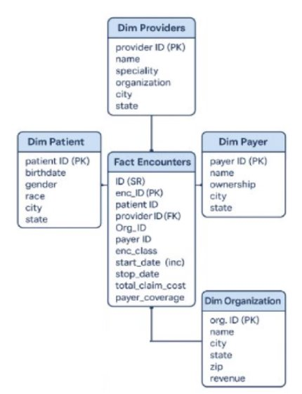
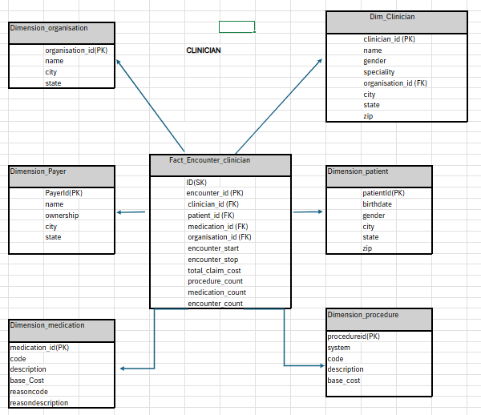
Data marts
Transaction

Slide 6
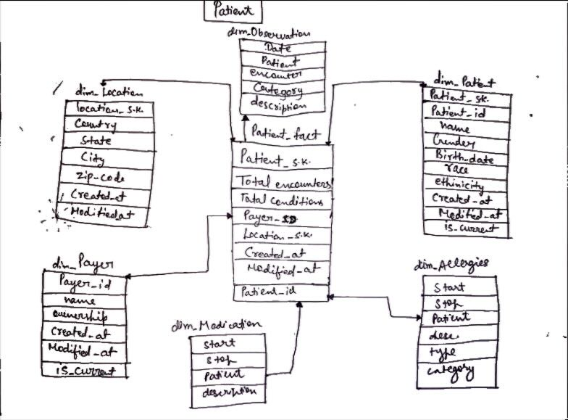
Data marts

Slide 7
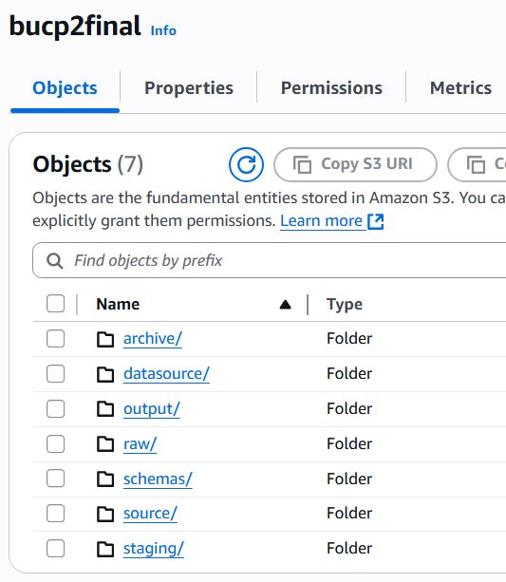
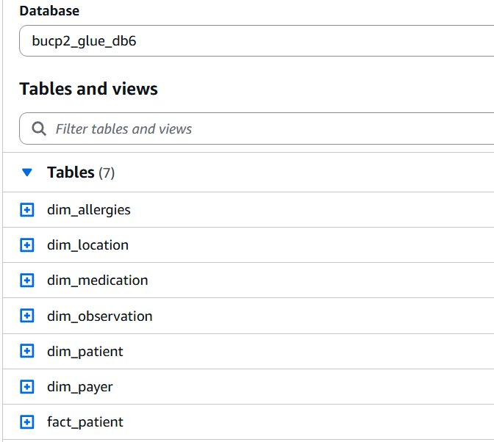
Working...
S3
Data mart

Slide 8
Conclusion
1. We implemented a scalable and efficient AWS data pipeline using:​
Amazon S3 for data storage​
AWS Glue for ETL (cleaning & transformation)​
Amazon Quick Sight for business intelligence and reporting​.
2. The pipeline performs:
Raw data ingestion into S3
Minor data cleaning in Glue (e.g., removing unnamed columns, handling extra commas)
Conversion to Parquet for optimized analytics
Structuring into a Data Mart for fast querying
3. This architecture ensures:
Improved data quality
Faster processing and querying
Seamless integration for analytics and dashboards

