Slide 1
Dynamic Module
kantou-emacs #3 2016/APR/23
Syohei YOSHIDA

Slide 2
Agenda
What is dynamic module ?
Use cases
Performance
Code reading: Eject
Demo
Problems

Slide 3
What is dynamic module ?
Introduced at Emacs 25
  Disable by default
  Build emacs with –with-modules option
Write extension in other than Emacs Lisp
  C, C++
  No Interprocess communication
Works on all platforms(maybe)

Slide 4
Use cases
C/C++ library bindings
Faster implementation
Access to operating system

Slide 5
C, C++ binding
There are many libraries in C, C++
  Fast, stable, well maintenance
For example
  Fast parsing(JSON, YAML)
  Embed language intepreter(mruby, Lua)
  Database access(sqlite, MySQL)
  etc

Slide 6
Parson binding vs json.el
json.el is pure emacs JSON encoder/decoder implementation
Y-axis means second
Lower is better
Conclusion
  Calling C function overhead maybe be small

Slide 7
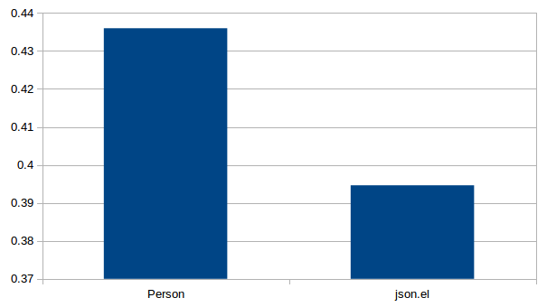
Encoding scalar 100,000 times

Slide 8
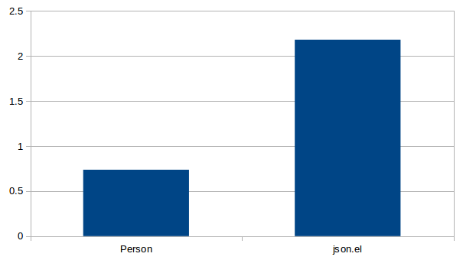
Encoding 5 elements list
100,000 times

Slide 9
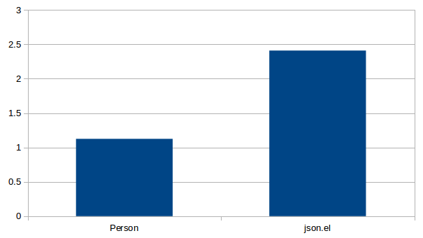
Encoding complex object
10,000 times

Slide 10
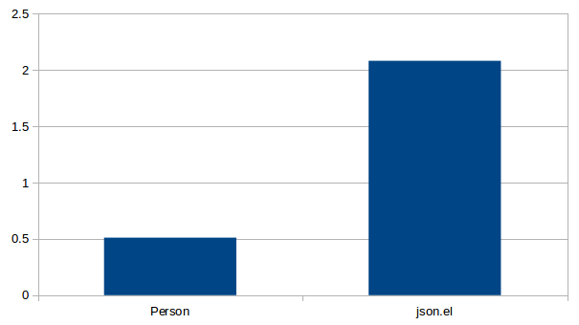
Decoding empty list 100,000 times

Slide 11
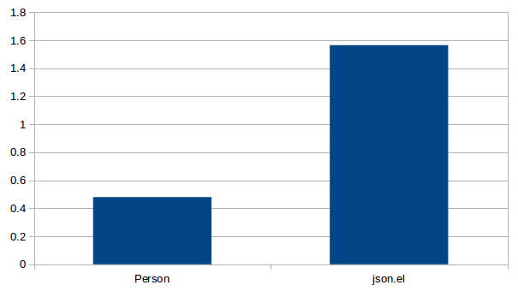
Decoding empty object
100,000 times

Slide 12
How to write code
Licensed by GPL compatible license
Understand emacs_env type
All values of Emacs lisp are emacs_value type
Code like mruby gems

Slide 13
emacs_env
Most important data structure
Define in src/emacs_module.h
Use for using Emacs Lisp feature
  make_{integer,float,string,function}
  extract_{integer,float}
  vec_{get,set,size}
  funcall, intern
  etc

Slide 14
emacs_value
Type of all emacs lisp value
  Arguments type of C/C++ function
  Return value type of C/C++ function
  C/C++ data must be cased to this type at calling Emacs Lisp function

Slide 15
Register function
Make function object from C function
by env->make_function
Register function object by fset

Slide 16
Function signature
emacs_env *env
ptrdiff_t nargs(Passed arguments number)
emacs_value args[](Arguments)
void *data(extra argument by make_function)

Slide 17
My Practice
Write Emacs Lisp wrapper
  Not access C API directly
Emacs Lisp is more powerful than C
  Validation
  Assertion
  Type conversion

Slide 18
Code Reading
eject

Slide 19
Demo

Slide 20
Problems
No way to install
  Header file(emacs_module.h) is not installed
  package.el does not support yet
Poor API
  Hash, string, type comparison
  Need more useful API !!
Poor documentation
Few samples

Slide 21
Enjoy hacking dynamic module

Slide 22
Thank you

