Slide 1

Artificial Intelligence in Daily Life
What is Artificial Intelligence?
How AI helps people in everyday activities
Examples of AI around us

Slide 2

AI in Smartphones
Voice assistants like Siri and Google Assistant
Face recognition for unlocking phones
Smart photo organization

Slide 3
AI in Smart Homes
Smart speakers and home assistants
Automatic lighting and temperature control
Security cameras with AI detection

Slide 4
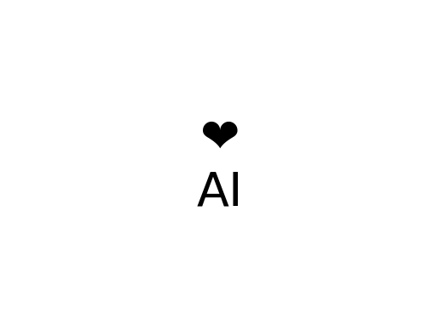
AI in Healthcare
Disease detection using AI
Health monitoring apps
AI helping doctors analyze medical data

Slide 5
AI in Transportation
Navigation apps suggesting fastest routes
Self‑driving car technology
Traffic prediction systems

Slide 6
AI in Education
Personalized learning apps
AI tutors and chatbots
Automatic grading systems

Slide 7
Conclusion
AI is becoming part of everyday life
It helps make tasks easier and faster
Future will include even more AI technologies

