Slide 1
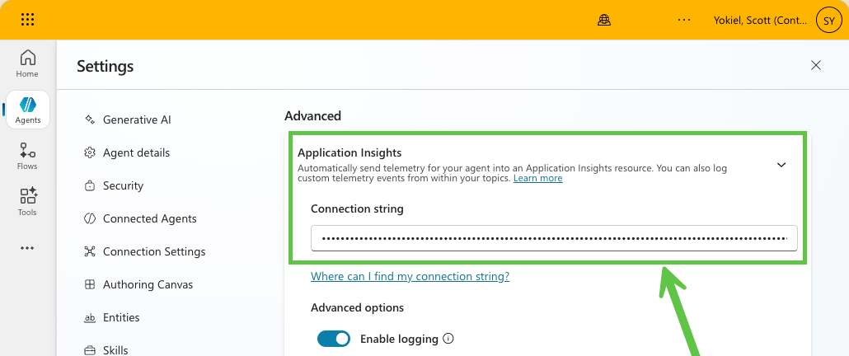

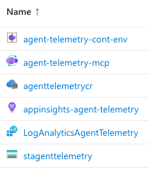



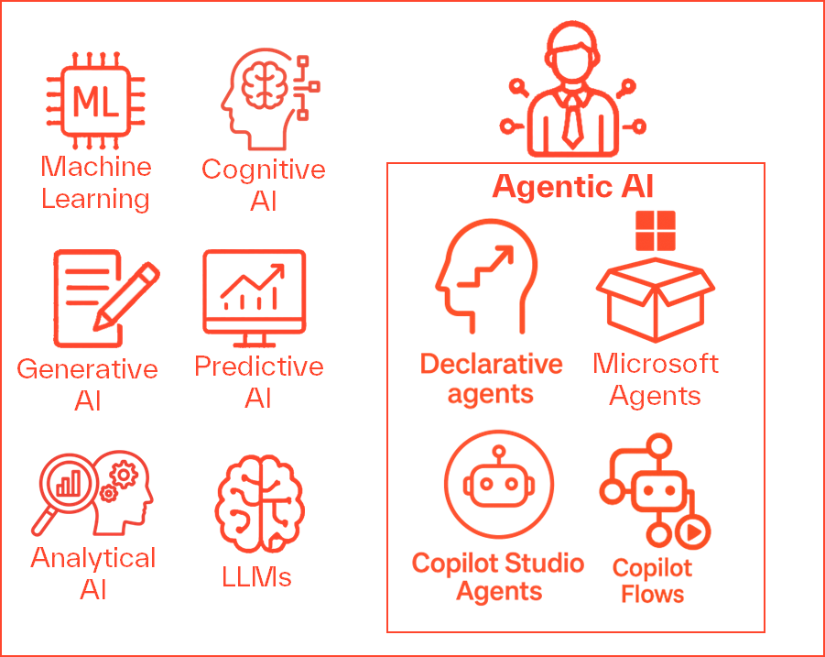


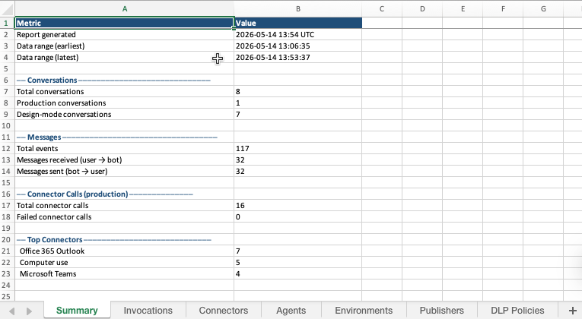

Simple Telemetry Solution for Copilot Studio Low Code Agents
Customer Agent
Customer Agent
Simple 1 line update to Copilot Studio Agent. (Can be scripted)
Microsoft Secured Endpoint
.venv/bin/python -m src.main all # fetch + upload db & generate excel
.venv/bin/python -m src.main sync # fetch + upload db
.venv/bin/python -m src.main export # generate excel from local db
* Resource group: rgWorkTest_west2
* Region: West US 2
MCP Server
Copilot Studio agent → Application Insights → Log Analytics workspace → KQL queries → Python → SQLite → Excel

Slide 2
