Slide 1
HeNe
Laser
Ti:Sapphire
Laser
Tungsten
Lamp
A – aperture
F – filter
M – mirror
BS – beam splitter
L – lens
C – cryogenic chamber
S – sample
Sp – spectrometer
CCD - camera
PC - computer
A
F1
F2
F3
M
BS
Sp/CCD
S
A
BS
BS
A
A
L
PC
C

Slide 2
z
x
y

Slide 3
Wafer
25mm
Sample
Top
Side
5.95μm
R

Slide 4

25mm
Sample
Top
25mm
Side
5.95μm

Slide 5
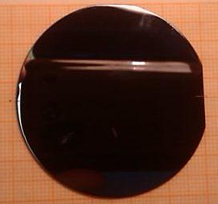
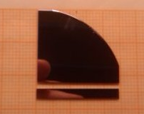
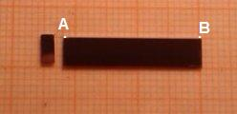
(a)
(b)
(c)

Slide 6
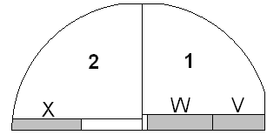
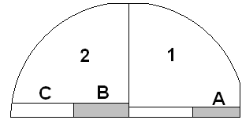
(a)
(b)

Slide 7
4
3
1
2
1
2
25
10
0
15.5
0
15
2
2
25
11.5
25
(a)
(b)

Slide 8
Top
4-7-10.1
1
A
2
B
3
1
C
2
4-6-10.1
R
2 mm
11.5 mm
15 mm
25 mm
1
A
2
B
3
R

Slide 9
(a)
(b)

Slide 11
x – PL maximum
o – Reflection minimum
PL peak
Reflection side-windows
Cavity mode
2
Distance from wafer center (mm)
25

Slide 12
x – PL maximum
o – Reflection minimum
Side windows
Cavity mode
2s exciton
2DEG peak
1s exciton
2
Distance from wafer center (mm)
25

Slide 16
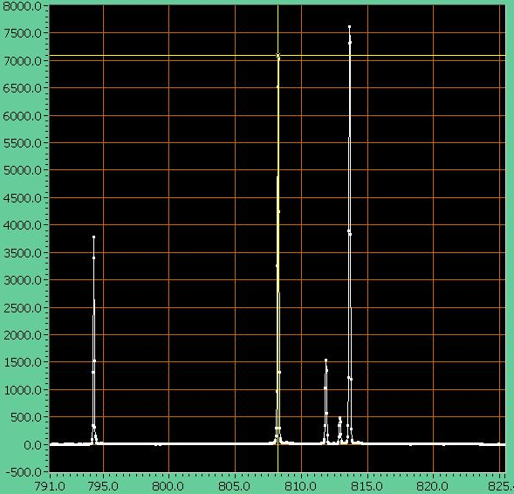

Slide 17
4-6-10.1

Slide 18
x – PL maximum
o – Reflection minimum
15
Distance from wafer center (mm)
25

Slide 19
x – PL maximum
o – Reflection minimum
15
Distance from wafer center (mm)
25

Slide 20
1
0
Distance from wafer center (mm)
11.5

Slide 21
0
Distance from wafer center (mm)
11.5

Slide 22
4-7-10.1

Slide 23
x – PL maximum
o – Reflection minimum
2
Distance from wafer center (mm)
13.5

Slide 24
1
2
3
4
5
x – PL maximum
o – Reflection minimum
2
Distance from wafer center (mm)
13.5

Slide 25
Cavity mode
x – PL maximum
o – Reflection minimum
15.5
Distance from wafer center (mm)
25

Slide 26
Cavity mode
x – PL maximum
o – Reflection minimum
Side-window
15.5
Distance from wafer center (mm)
25

Slide 27
Reflection spectrum experimental data
Structure description
Calculate reflection spectrum for various δ
Extract manually the cavity mode energy
Extract the cavity mode energy
Interpolation

Slide 28
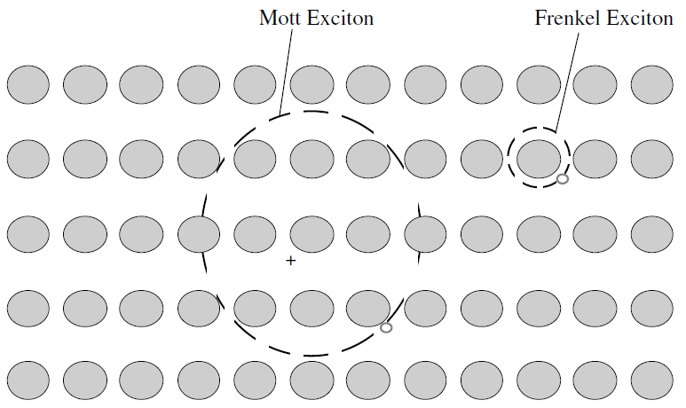

Slide 29
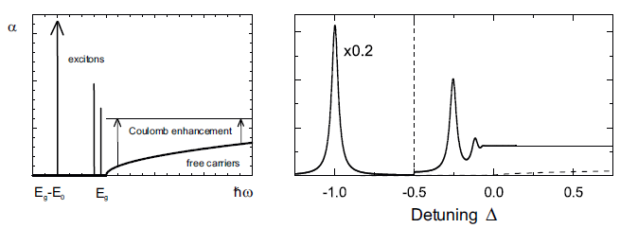
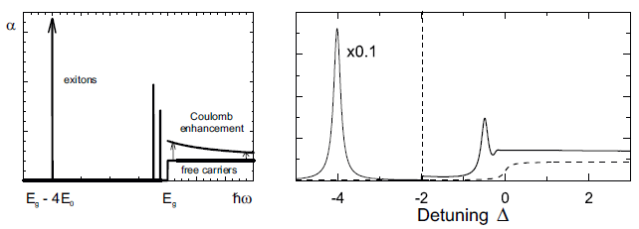
(a)
(b)

