Slide 1
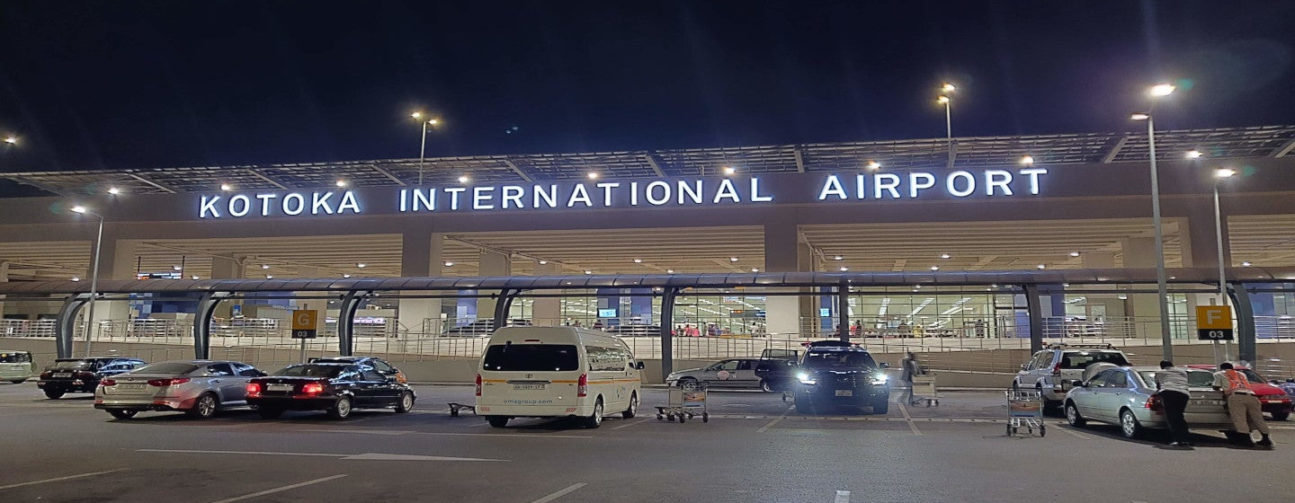
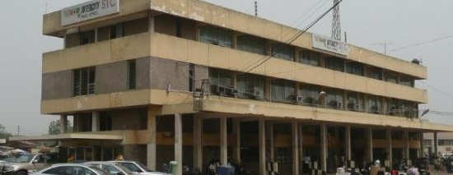
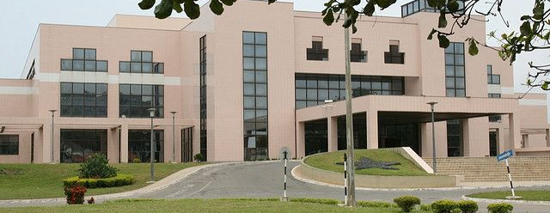
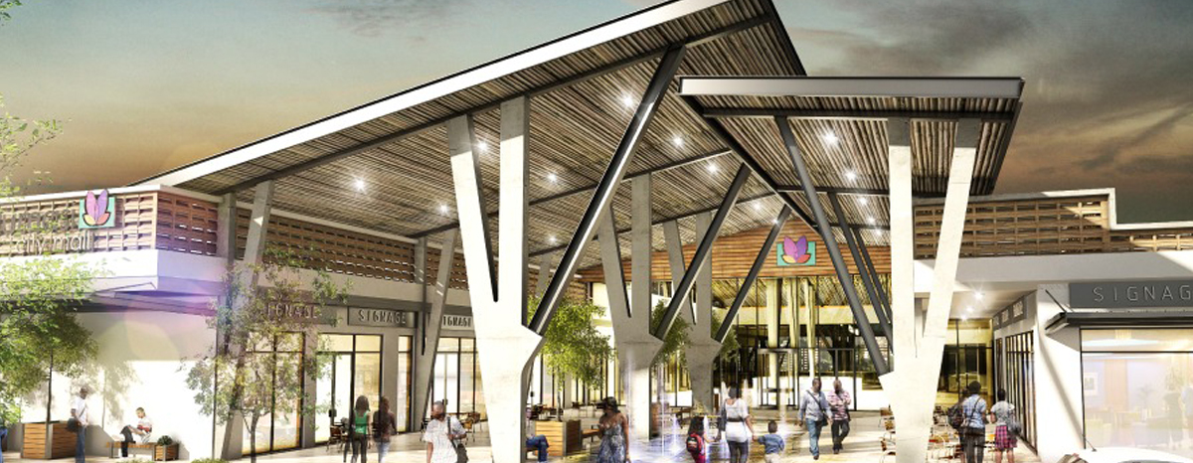
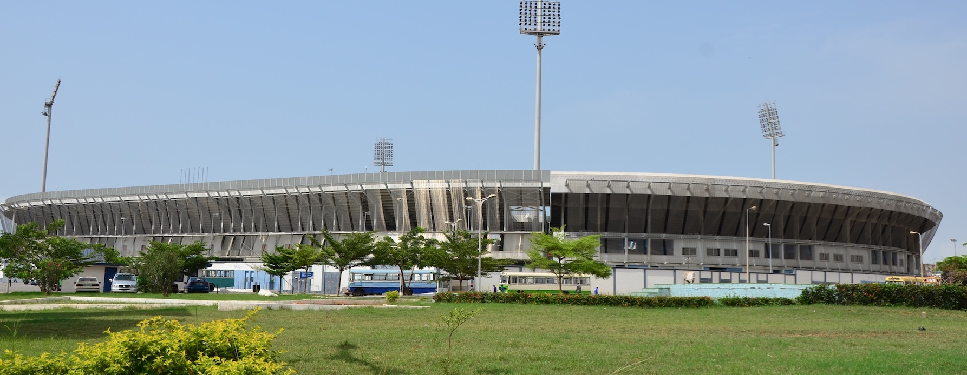
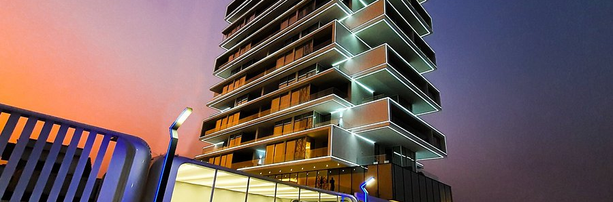
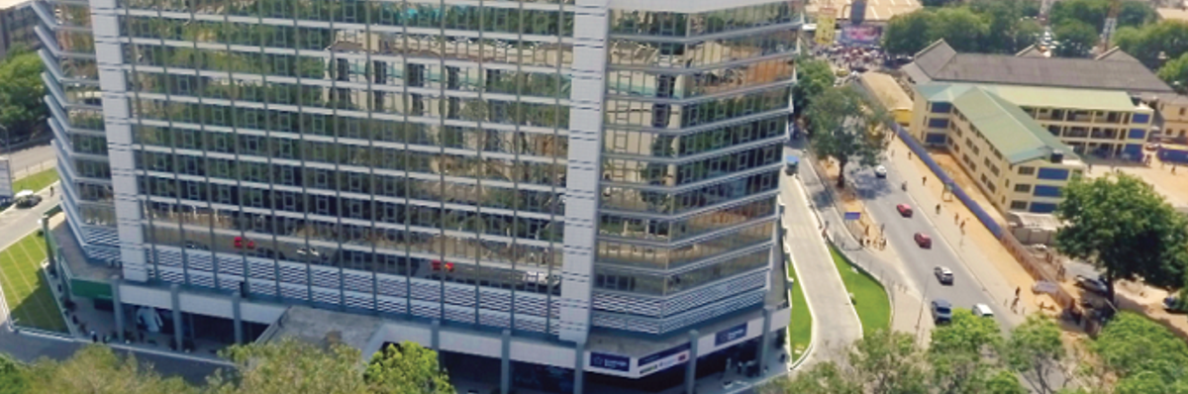
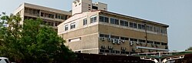
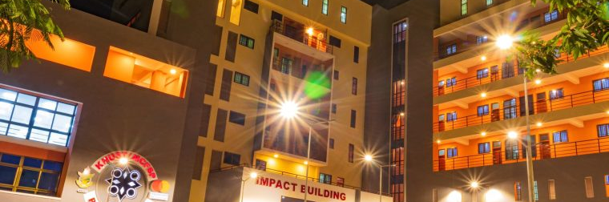
Ghana High-Value Building Insights
RECOMMENDATION MIX
*
University 4 · Hospital 8 · Stadium 2 · Airport 1
81 qualified candidates · 15 threshold recommendations · 9 scenes
Recommendations follow scene hard-metric thresholds
01
Directory leads
>
02
Location & primary metric
>
03
Proxy value model
>
04
Quality gate
01
02
03
04
05
AIRPORT
Cand. 5 · Rec. 1
TRANSPORT HUB
Cand. 1 · Rec. 0
CONVENTION
Cand. 1 · Rec. 0
MALL
Cand. 10 · Rec. 0
STADIUM
Cand. 14 · Rec. 2
Accra International Airport
Accra Central Station
Accra International Conference Centre
Kumasi City Mall
Accra Sports Stadium
3,211,751 passengers (2024)
1 operating route
1,600-seat plenary (secondary)
GLA 18,389 m²
40,000 seats
Threshold: annual passengers > 2M
Threshold: connected lines > 1
Threshold: event area > 25,000 m²
Threshold: GLA > 120,000 m²
Threshold: seats > 20,000
QUALIFIED
BELOW THRESHOLD
PRIMARY METRIC MISSING
BELOW THRESHOLD
QUALIFIED
06
07
08
09
HOTEL
Cand. 15 · Rec. 0
OFFICE
Cand. 4 · Rec. 0
HOSPITAL
Cand. 18 · Rec. 8
UNIVERSITY
Cand. 13 · Rec. 4
Number One Oxford Street Hotel and Suites
The Octagon Accra
Korle-Bu Teaching Hospital
Kwame Nkrumah University of Science and Technology
108 rooms
GIA 75,000 m² (secondary)
2,000+ beds
Student population nearing 90,000
Threshold: rooms > 150
Threshold: building height > 150 m
Threshold: beds > 450
Threshold: single-campus enrollment ≥ 20,000
BELOW THRESHOLD
PRIMARY METRIC MISSING
QUALIFIED
QUALIFIED
Each scene card combines pool size, recommendations, threshold and a representative site. Convention and office values are secondary, not substitutes for area/height. Audited 2026-07-15.

