Slide 1
Motivation
Exponentially increasing NextGen data
Bioinformatics analysis bottleneck
Need for easy and accessible tools
Bioinformatics increasingly workflow-based
Visualization of handling millions of reads
Integrate databases of genomic features

Slide 2
Target Audience
Technical Users
Bioinformaticians, software developers
Non-technical users
Scientists, clinical staff, public

Slide 3
Genome Viewers
Popular genome browsers:
UCSC Genome Browser
Ensembl Genome Browser
Generic Genome Browser (GBrowse)
Slow download of image files from the server
Lack of interactivity with underlying data set
Provide large and diverse sets of genome features

Slide 4
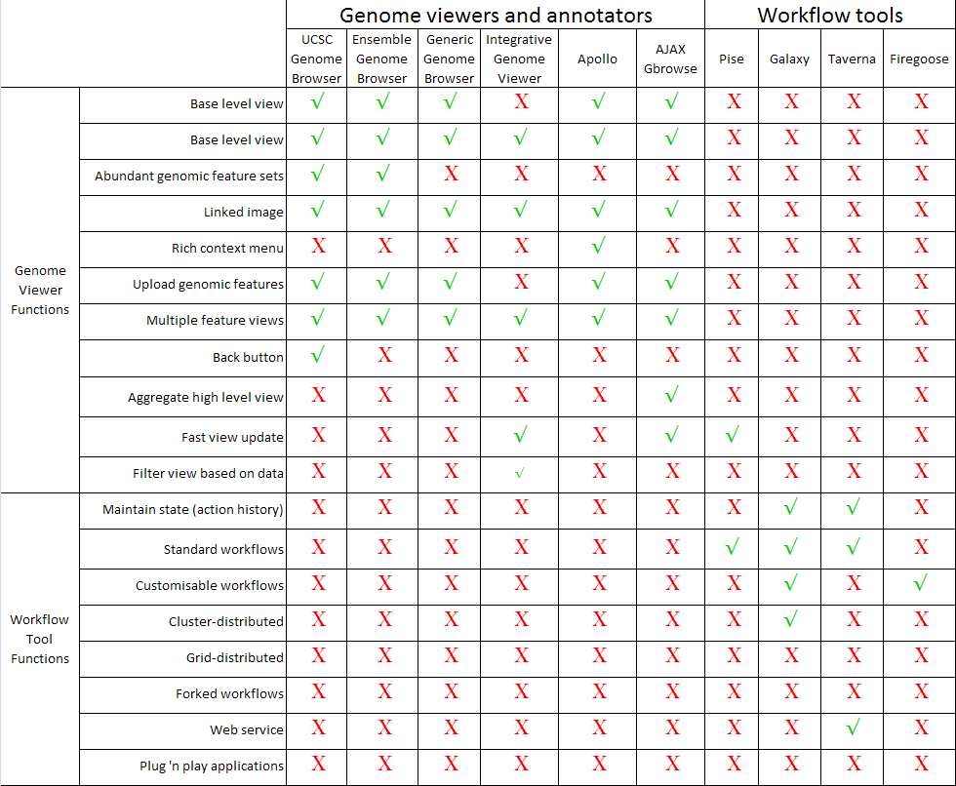
Low-level Design
Capabilities and limitations of currently available
genome viewers and bioinformatics workflow tools.

Slide 5
Functional Requirements:
Access
Low barriers to usage
Web access
Intuitive interface
Plug 'n play applications for rapid deployment
Searchable project annotations

Slide 6
Functional Requirements:
Workflows
Predefined & customizable workflows
Drag 'n drop workflows
Persistent data and workflow configurations
Loops, conditional branching
Customizable report extraction

Slide 7
Functional Requirements:
Sharing
User-defined groups with customizable permissions
Workflow, report and view sharing among groups
Data management - direct user access to input and output files
Import external biological data and genomic features into workflow

Slide 8
Functional Requirements: View
Customizable genomic views of report data
Interactive display with rich context menu
Integrated, extensible genomic features
Zoom from nucleotide level to genome view
Fast view update

Slide 9
User Experience
How technically savvy is the user and what similar systems does the user already use?
What interface look & feel styles appeal to the user?
What thoughts does the user have during the experience of completing a task with Agua?
What would make the user experience better?
What additional functions does the user want?

