Slide 1


Slide 2


Slide 3


Slide 4


Slide 5




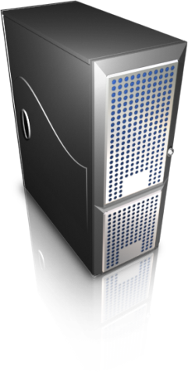

Slide 6
View
Controller
Model

